Slide 1
Overview for Cal/Val plans for the CO2M Mission
B. Bojkov, T. Marbach, R. Lang and the RSP CO2M team
TCCON/COCCON Meeting
Spa, Belgium – 12-13 June 2023
Notes:
Title slide template 1 of 2 with presentation title/information on the left. Please choose between slide 1 or 2 for the title slide and delete the other.

Slide 2
Outline
A brief introduction to EUMETSAT
CO2M mission overview and Cal/Val needs
Ongoing CO2M Cal/Val activities
Way forward and risks

Slide 3

An intergovernmental organisation with 30 Member States
AUSTRIA
BELGIUM
BULGARIA
CROATIA
CZECHIA
DENMARK
ESTONIA
FINLAND
FRANCE
GERMANY
GREECE
HUNGARY
ICELAND
IRELAND
ITALY
LATVIA
LITHUANIA
LUXEMBOURG
THE NETHERLANDS
NORWAY
POLAND
PORTUGAL
ROMANIA
SLOVAK REPUBLIC
SLOVENIA
SPAIN
SWEDEN
SWITZERLAND
TURKEY
UNITED KINGDOM

Slide 4
EUMETSAT Mission
Primary objective:
Establish, maintain and exploit European systems of meteorological satellites.
Further objective:
Contribute to the operational monitoring of the environment, and of the climate and the detection of global climatic changes.

Slide 5
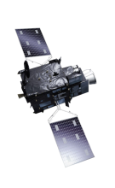
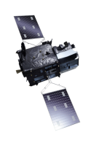

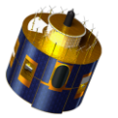

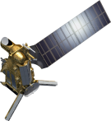
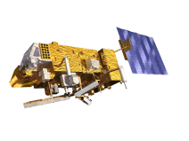
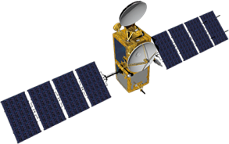
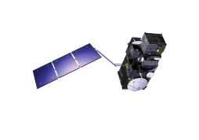
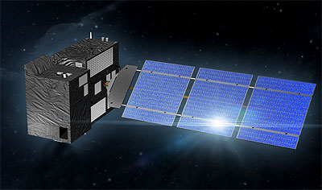

EUMETSAT missions – current and future
Geostationary
Programmes
MTG-I
Imagery Dec. 2022
MTG-S
Sounding 2024
Meteosat-10
2013
MSG-4 / Meteosat-11 In-Orbit Storage 2016
Prime Satellite 2018
Mandatory
Programmes
Meteosat-9
2006
New generation platforms: MTG and EPS-SG
Polar
Programmes
Metop-B 2013
Metop-C 2018
Metop-SG A
Sounding & Imagery 2024
Metop-SG B
Microwave Imagery 2025
JASON-2 2009
Optional and
Third Party
Programmes
(incl. Copernicus)
Sentinel-3A 2016
JASON-3 2016
Sentinel-5
on Metop-SG A 2025
Sentinel-4
on MTG-S 2025
Sentinel-3B 2018
JASON-CS/ SENTINEL-6 2021
CO2M
2025/2026

Slide 6
Remote Sensing and Products (RSP) – the science division @EUMETSAT
Matrix organisation
82 staff (5/2023)
58 on-site consultants
~12 external science support contracts
~80% with PhD in. R/S, meteorology, physics
7 RSP staff full time on CO2M + matrix support from other RSP teams

Slide 7
RSP scientific foci – scientific product development roadmaps
The scientific development of medium-term product/themed roadmaps:
To maintain (and improve) the operational dataset quality;
To provide “up-to-date” and “scientifically relevant” datasets;
To ensures the provision of fully characterised, traceable, and ultimately interoperable data;
To address changing Member State, user, and service needs and requirements, such as for the hydrology cycle, the Arctic, coastal zones, etc.;
To optimize efforts and resources within EUMETSAT, the EUMETSAT SAFs, and the Member States;
Reviewed by Member States and approved by the EUMETSAT Council.
Roadmap | Status
Aerosol (AER) | Approved in Autumn 2017, update approved in Spring 2022
Wind | Approved in Autumn 2017, update approved in Spring 2022
Image Navigation, Registration and Calibration (INRC) | Approved in Spring 2018, update to be presented in Autumn 2023
Radio Occultation (RO) | Approved in Spring 2018, update to be presented in Autumn 2022
Hyperspectral Infrared (HSIR) | Approved in Autumn 2018, update to be presented in Autumn 2023
Atmospheric Chemistry (ACh) | Approved in Spring 2019
Marine Applications (MA) | Approved in Autumn 2020
Cloud Products (CL) | Approved in Spring 2020
Passive Microwave (PMW) | Approved in Spring 2020
Fiducial Reference Measurements (FRM) | Approved in Autumn 2021
Meteorology and Marine Pathfinders (MMP) | Approved in Spring 2022
Hydrology Products | Under preparation for Spring 2024
GHG Products | Under preparation for Spring 2025

Slide 8
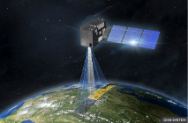
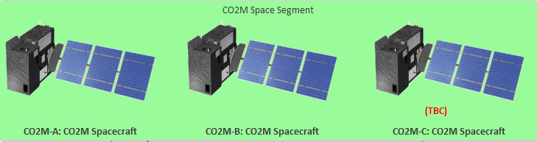
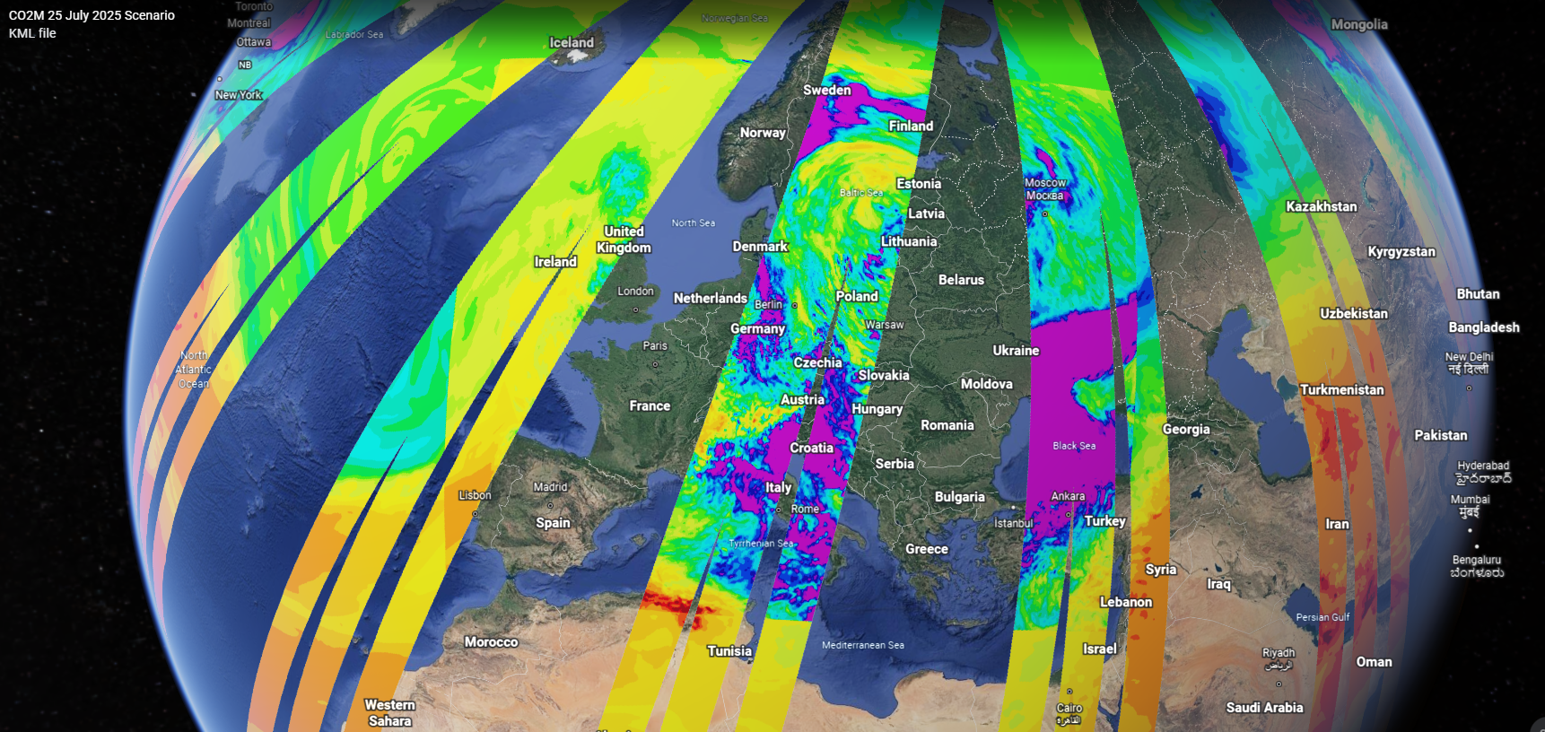


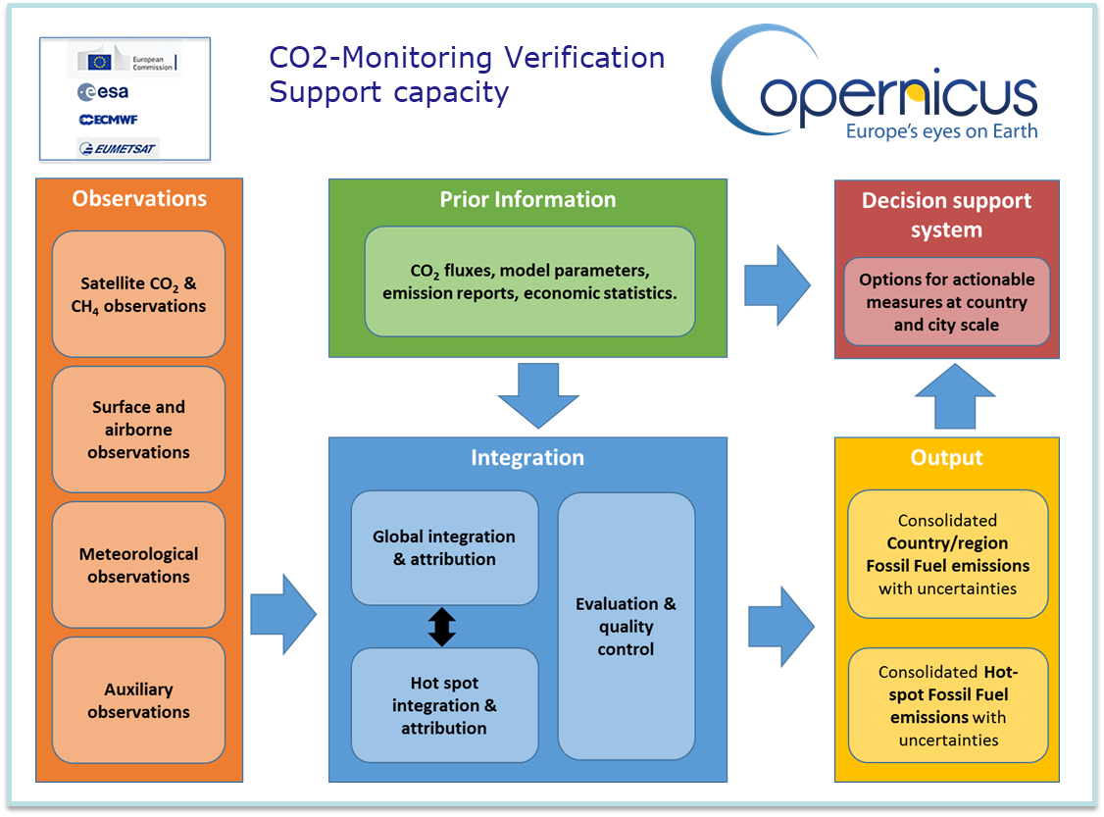
The CO2M greenhouse-gas monitoring constellation
Three (TBC) satellite missions with each >250 km swath:
FAR of Proto-flight Model (PFM) & Flight Model #2 (FM2) Q1 2026
Launch of FM3 6 months after launch of PFM
Three instruments per platform:
CO₂/NO2 push-broom grating spectrometer (CO2I/NO2I)
Multi-Angle Polarimeter (MAP)
Cloud Imager (CLIM)
Orbit:
Sun-synchronous orbit 14 5/11
159 orbits repeat cycle (~11 days)
735 km altitude
11:30 LT
Platforms in same orbital plane
CO2M test-data study
Total column CO2 concentrations [ppm]
Three platform CO2M constellation
End user products:
Product | Spatial resolution | Precision | Bias
CO2 | 4 km² | 0.7 ppm | <0.5 ppm
CH4 | 4 km² | 10 ppb | <5 ppb
NO2 | 4 km² | 1.5x10¹⁵ molec/cm² | <3.5x10¹⁵ molec/cm²
SIF* | 4 km² | 0.7 mW m⁻² sr⁻¹ nm⁻¹ | <0.2 mW m⁻² sr⁻¹ nm⁻¹
Aerosols | 16 km² | 0.05 AOD, 500 m LH | <0.05 AOD, 500 m LH
Clouds | 4 km² | <1% of FOV
*Solar Induced Fluorescence

Slide 9
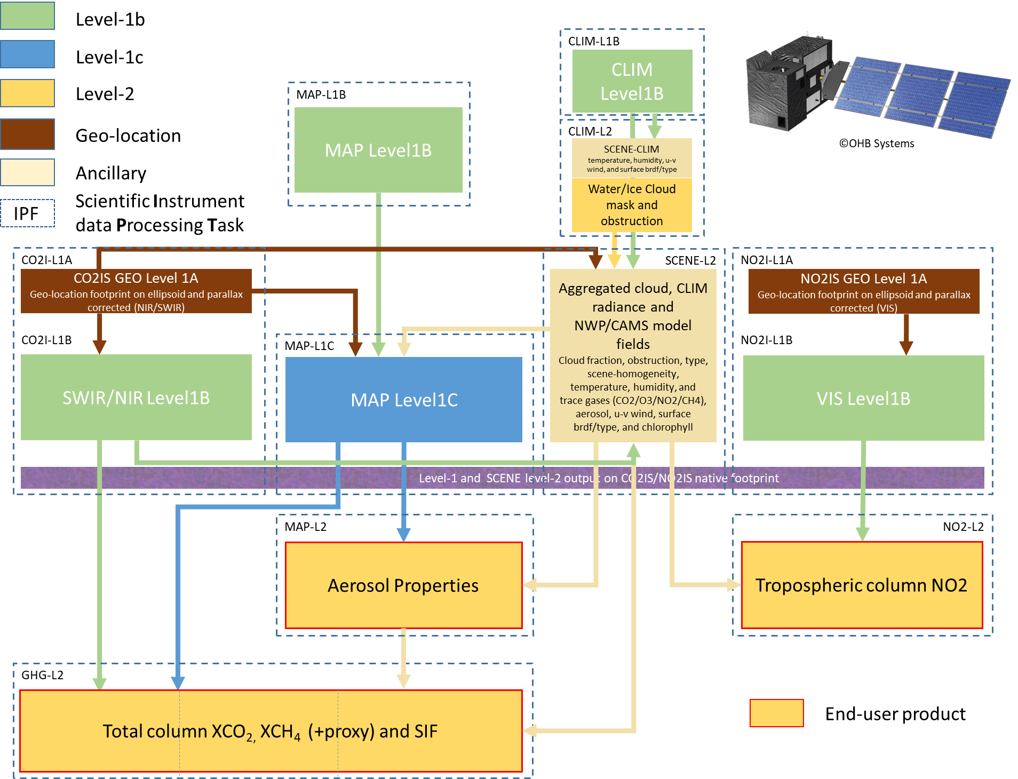
EUMETSAT CO2M MDPS scientific processing tasks
The CO2M
Mission Data Processing System (MDPS)
→ to make one
“hyper-GHG/NO2-instrument”
out of three!
Below this level: everything is co-registered or provided at the CO2I/NO2I spectrometer footprint
Need for operational XCO₂, XCH₄, NO₂ and AOD validation

Slide 10
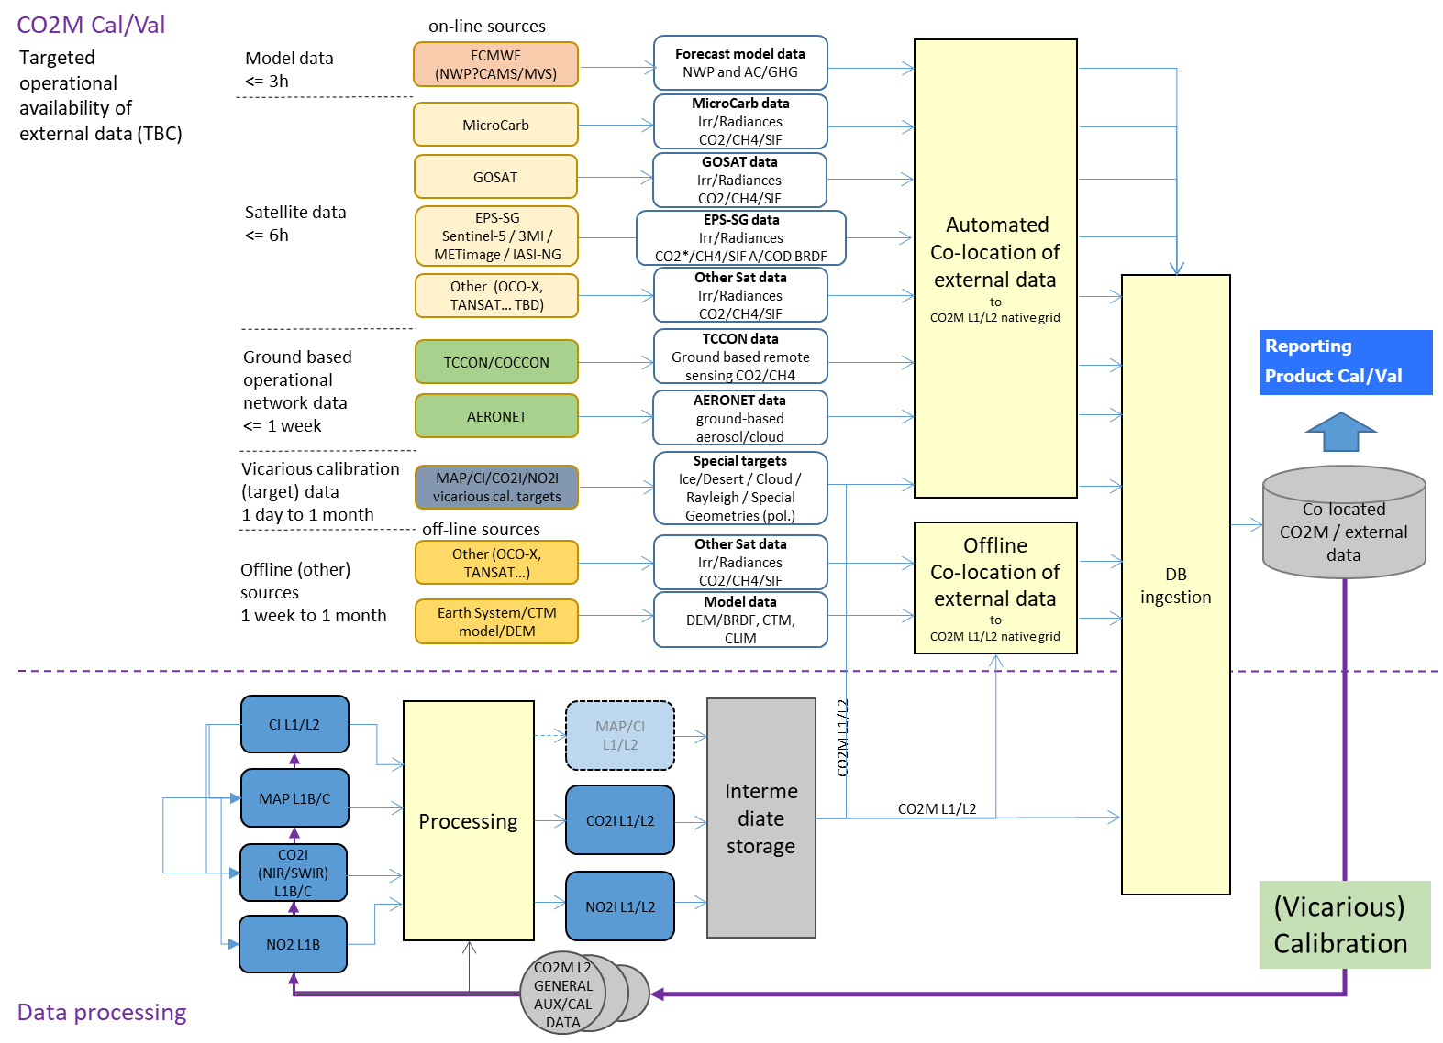
CO2M product Cal/Val system
Product Cal/Val and continuous product quality monitoring:
Level-1 calibration:
Other satellite data (Microcarb, Sentinel-4/5, GOSAT/OCO/Tansat follow-ons)
via international partner collaboration, partner agencies, GSICS, WG-Climate, CEOS.
Solar, on-board and vicarious calibration targets
Level-2 GHG/NO₂ (and ancillary) product validation and verification:
TCCON / COCCON / NDACC / PaNIR
Other ground-based (PGN, MAX-DOAS, Aeronet, etc.)
Model data (CO₂ MVS, NWP, CTM and Earth system)

Slide 11
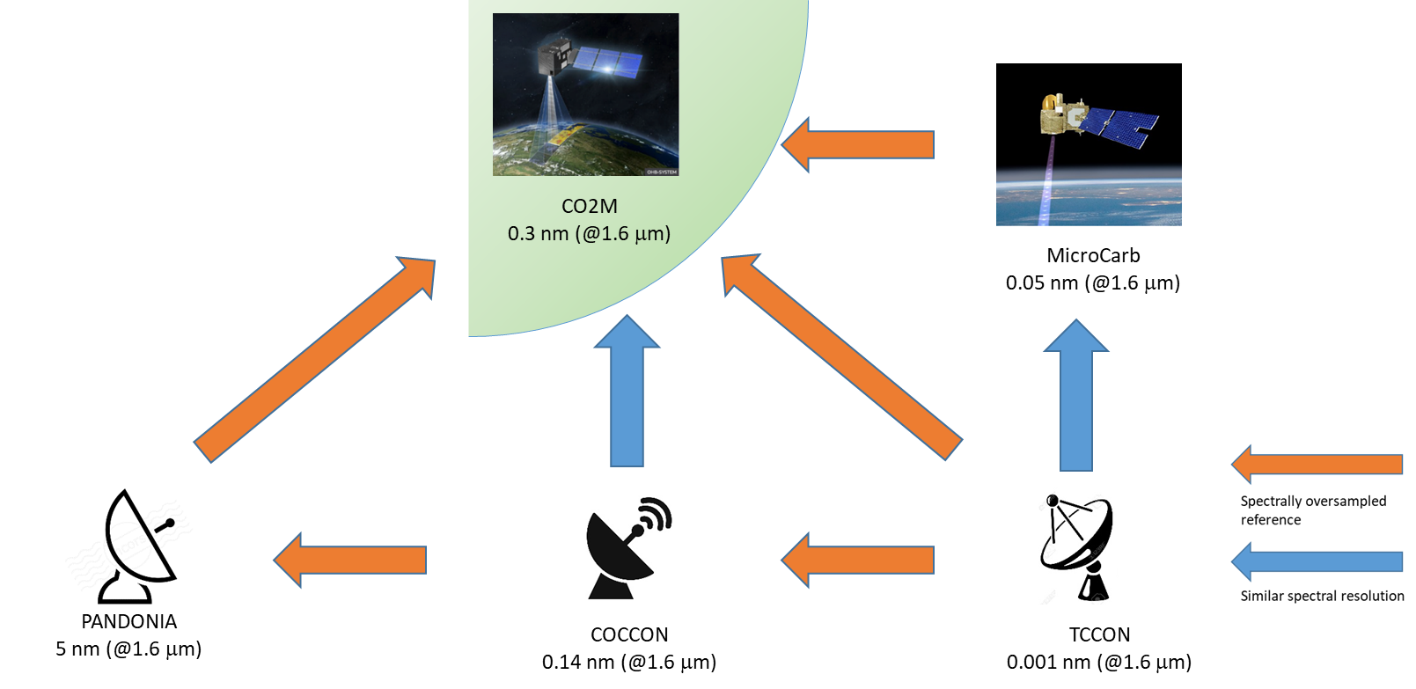
“Four+-pillar” CO2M validation
On-board Cal:
Source | CO2I | MAP | CLIM | Frequency
SUN | X | X |  | daily
Moon | X | X | X | Irreg.
WLS | X |  |  | weekly
Tuneable LED | X (ISRF)
Dark | X | X | X | orbit
SNOs
Ref. Targets
etc.
Cross-Cal
CO2M product Cal/Val plan
GSICS
GSICS
MicroCarb, OCO-x, GOSAT-x, S5, etc.
Vicarious Cal
“as needed”
~
Product VAL
Product Cal/Val
Product Cal/Val
Product Cal/Val
CO2M Ground-based network products central processing hub
Scientific support layer 2
Scientific support layer 1
Cross-Cal
Cross-Cal
Ground-based network reference product requirements
/ NDACC-FTIR
“Four-pillar” CO2M operational product validation and monitoring space-to-ground and space-to-space approach
+ NDACC/Aeronet for NO₂ and AOD

Slide 12

EUMETSAT CO2M Cal/Val study
Scientific support layer 1
EUMETSAT CO2M Cal/Val study:
Started 1st July 2021
Support definition and metric of product validation (in particular the use of ground-based network product data TCCON, COCCON, NDACC, AirCore, …) for CO2M operational monitoring of anthropogenic emissions.
Operational provision of network data (timeliness and availability!)
Overpass statistics, station environment and co-location criteria for use of ground-based total column measurements of XCO2, XCH4, NO2 and aerosol close to the sources
Contributing requirements to ground-based network products defined for CO2M

Slide 13
TCCON / COCCON station CO2M overpass statistics
Scientific support layer 1
Analysed sensitivity of XCO₂ at observational sites to flux, i.e. dXCO₂/df
Footprints indicate a spatial domain over which potential emissions could be observed
+ combining sensitivity with an estimate of actual fossil fuel emissions
Compute for each grid cell i the contribution of corresponding emission fi to the column
FFDAS station footprint simulation:
Column sensitivity
[ppm]
Emission sensitivity
[ppm/kgC/m2/day]
iLab Kaminski et al., EUM Cal/Val study

Slide 14
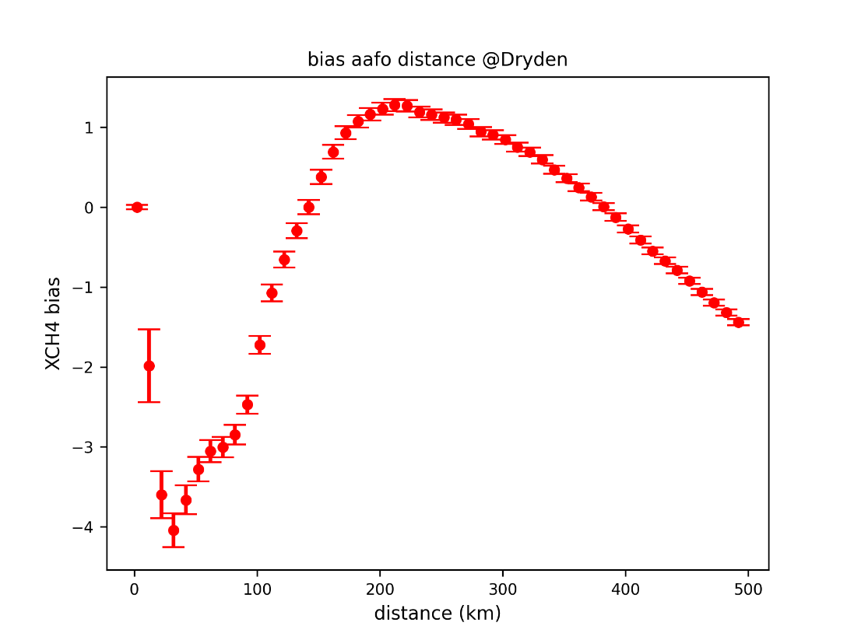
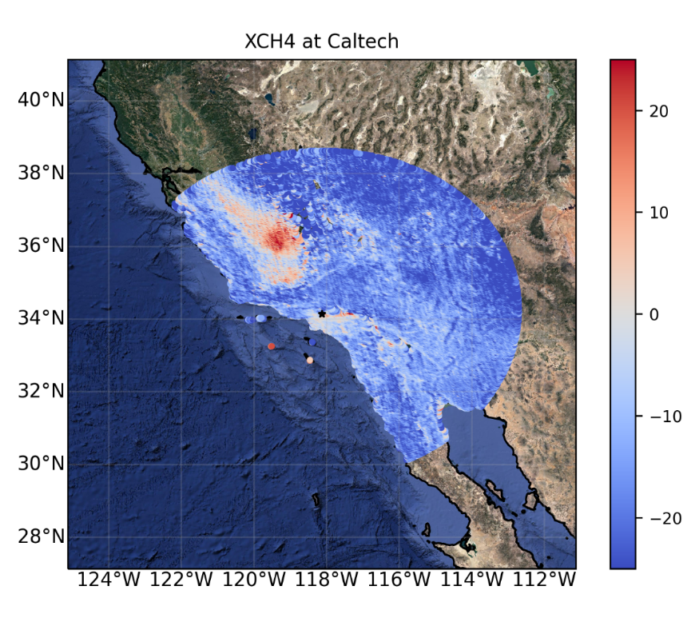
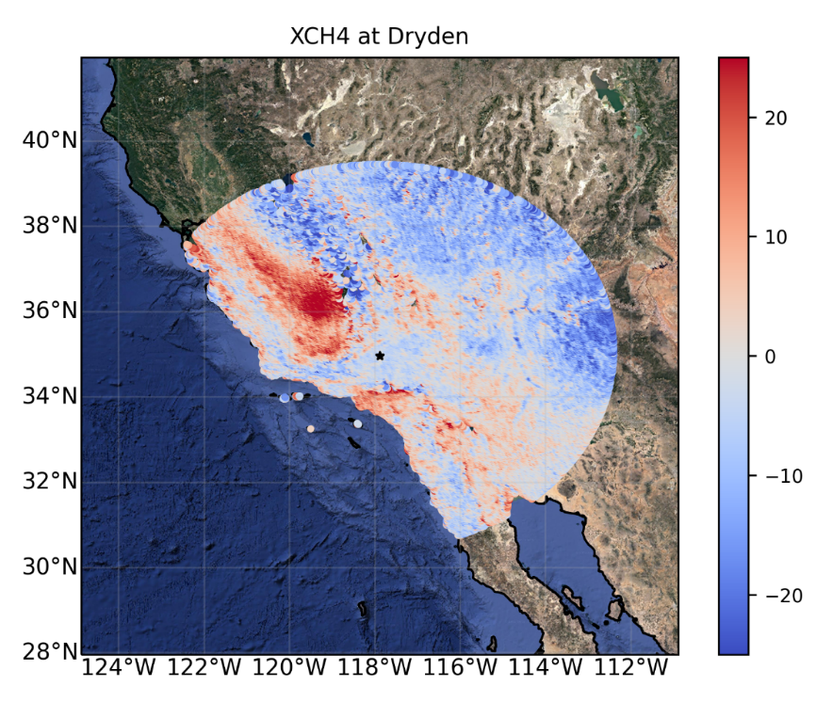
CO2M /station co-location criteria
Scientific support layer 1
Dryden/Edwards XCH4 bias w.r.t TCCON sites
San Joaquin valley (dairy farms)
Dils et al, BIRA, EUM CalVal study
Over 10 ppb bias >90 km
Evaluate best co-location criteria per stations
+ overpass and footprint statistic
Complement ground-based network product overall goal performance for XCO2/XCH4 with station specific variance expectations

Slide 15
Ground-based network product requirements for CO2M
Scientific support layer 1
EUMETSAT is working on ground-based network product requirements for future operational CO2M product validation
Document scope:
Requirements for ground-based network (COCCON, TCCON, NDACC, PaNIR, Aeronet, etc..) product performance: Co-located total column XCO₂, XCH₄, NO₂, and AOD measurements
Availability and timeliness requirements
Traceability of product performance (to WMO or FRM network standard). Inter-station and seasonal biases.
Input from CO2M Cal/Val study:
Expected overpass statistics per station for the CO2M constellation
Station footprint (based on footprint model data)
Station environmental parameters (surface albedo, terrain height, etc.)
Collocation criteria
EUM Cal/Val Study
iLab

Slide 16
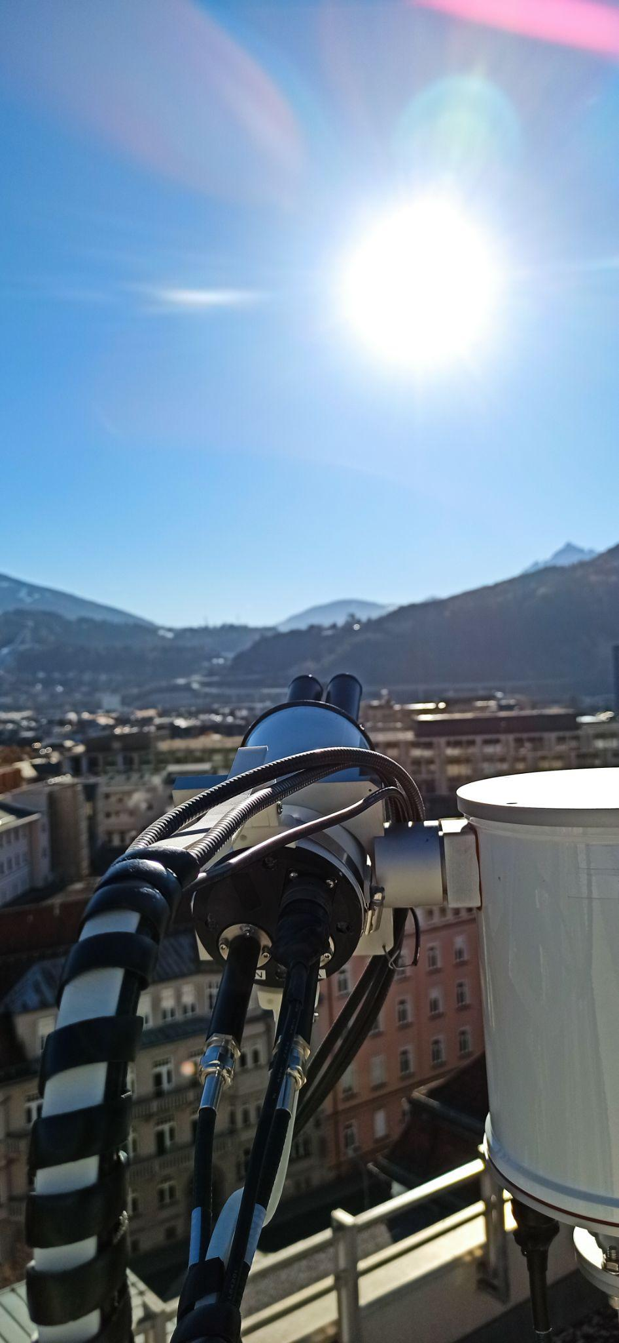
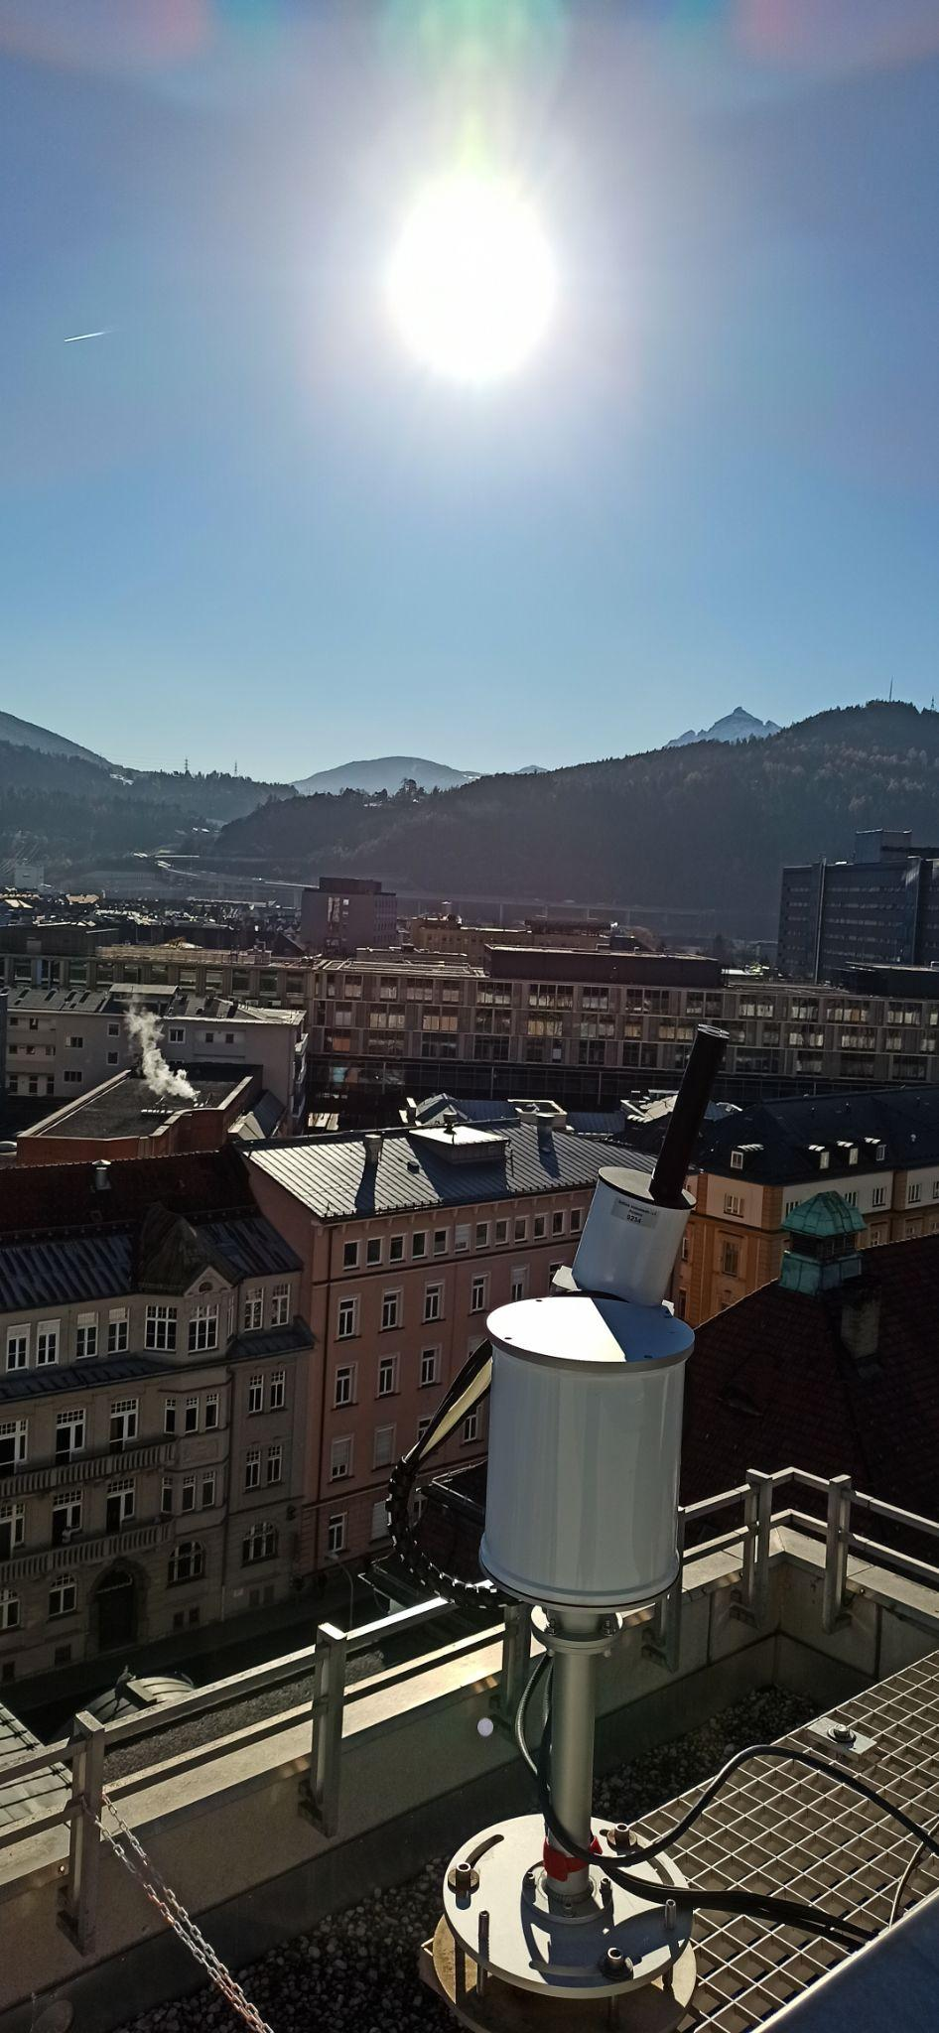
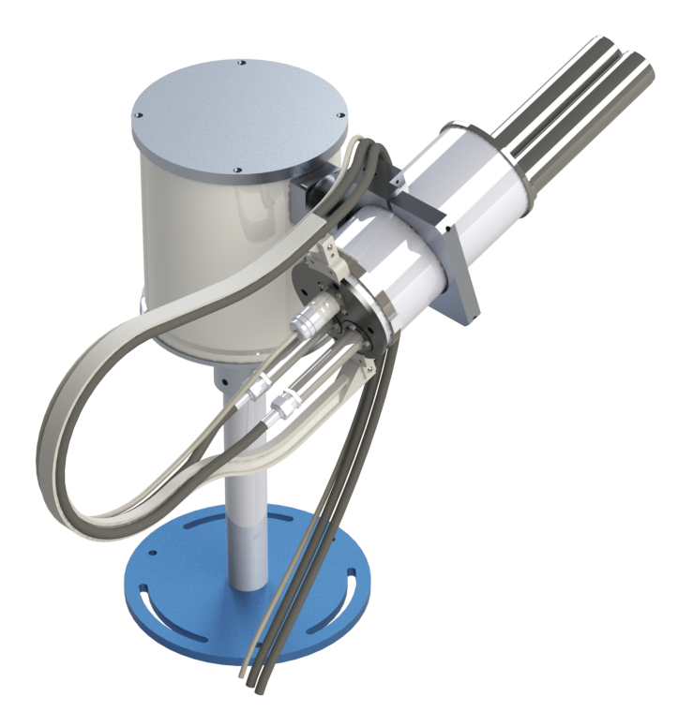

Feasibility of grating technology based system for ground-based GHG measurements
Copernicus funded PaNIR instrument development project
In support to CO2M and S4/S5, we extend the Pandora concept: Ground-based remote sensing columnar measurements of CO2, CH4 and H2O based on grating technology
Possible alternative to FTIR instruments with lower acquisition and operation costs, NRT data availability, and additional sky observation geometry to retrieve information on the spatial inhomogeneity and vertical distribution of the GHGs
Sun viewing
Sky viewing

Slide 17
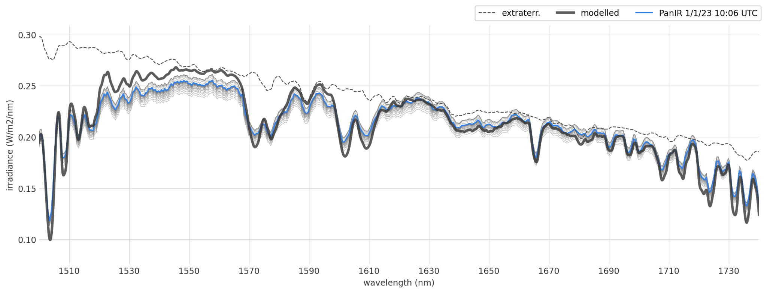
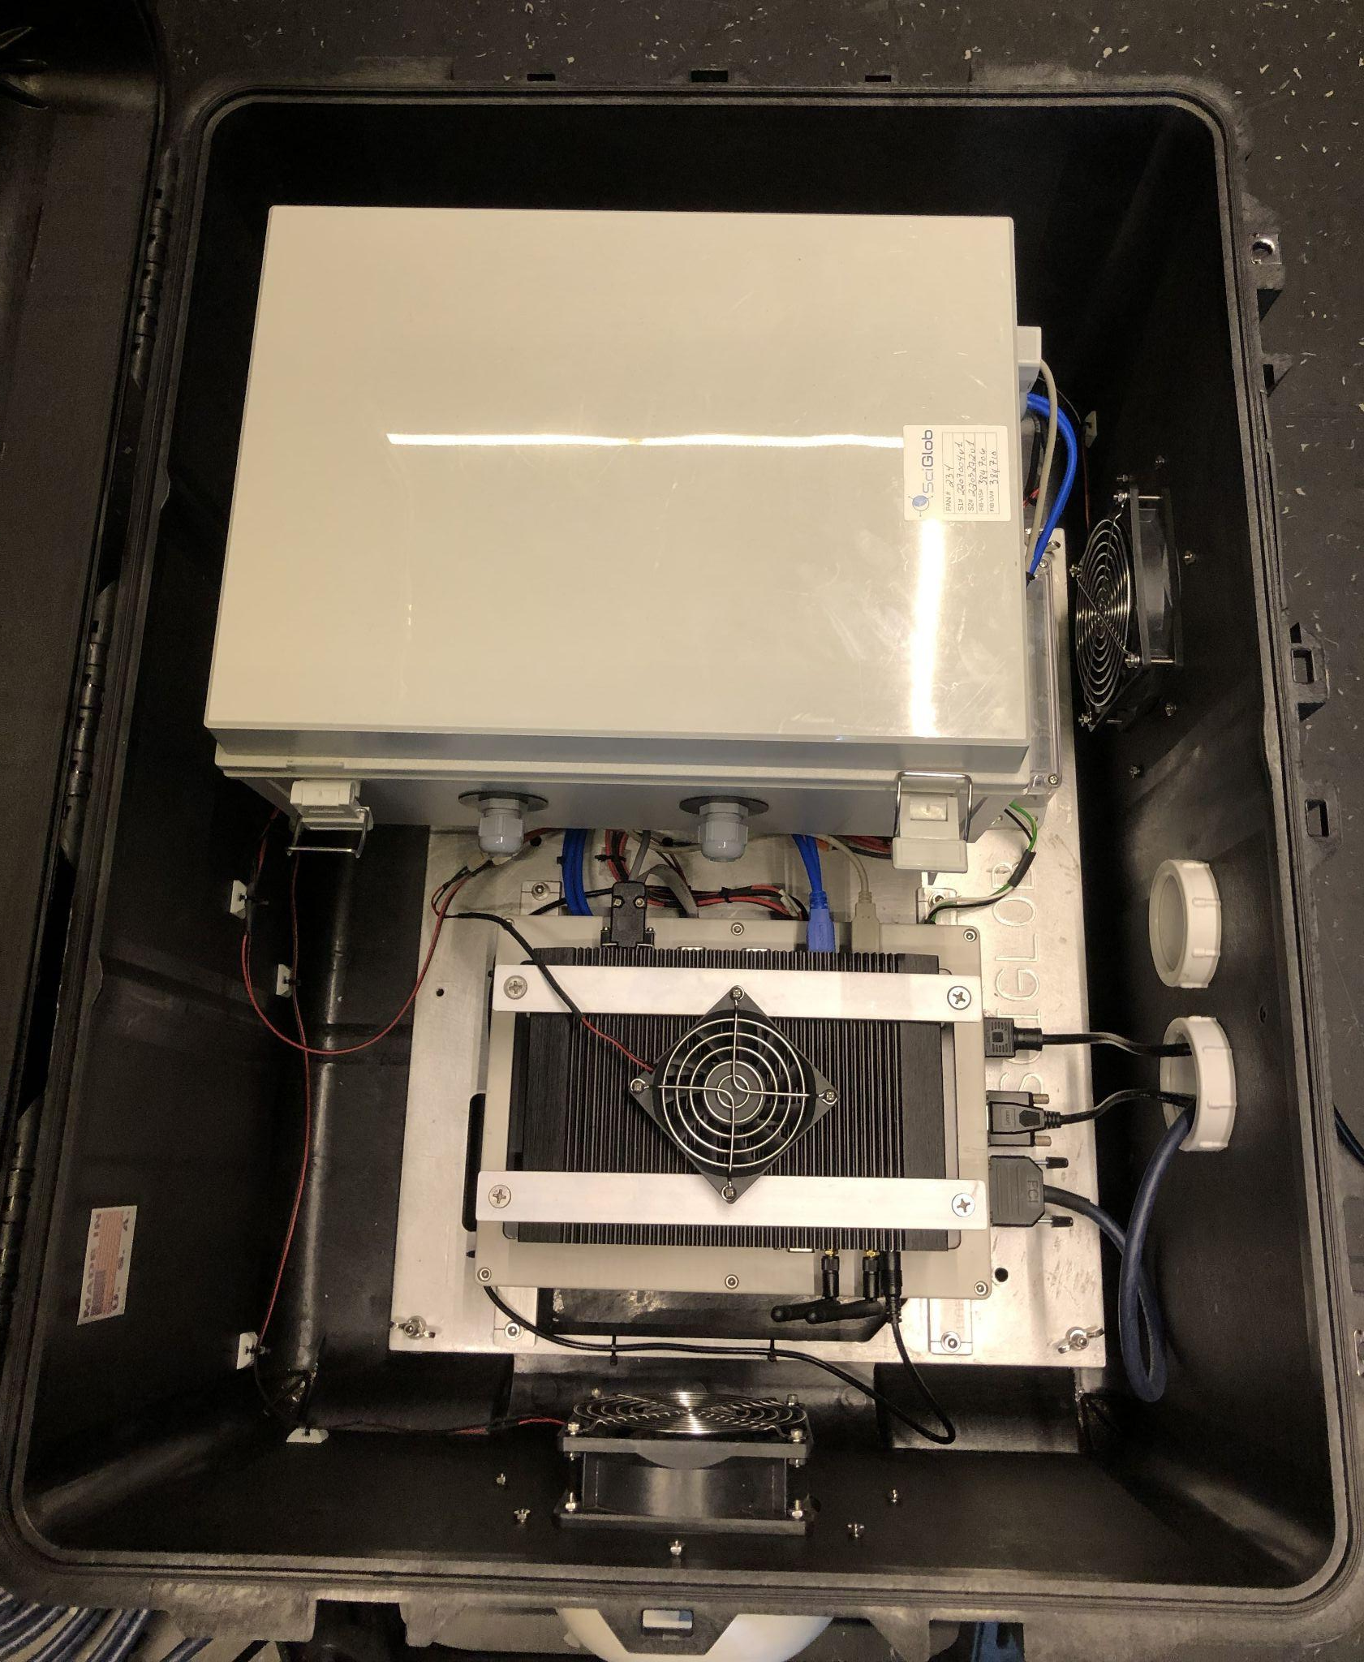
PaNIR first in the field measurement (11 December 2022)
Wider resolution system to boost throughput allowing sky observations
In field Installed at Innsbruck, Austria, since Dec. 2022
Below spectra taken around 10:00 on 1 Jan. 2023
Deployed since late March in Izaña (in parallel with TCCON)
Spec 2
Spec 1
CO₂
CH₄
H₂O
H₂O

Slide 18
EUMETSAT CO2M ground-based network product processing
Scientific support layer 2
EUMETSAT CO2M ground-based network product study:
To start in July 2023 (Karlsruhe Institute for Technology as prime)
Support definition of ground-based network data product processing dedicated to the need of operational CO2M continuous validation and monitoring
Complement existing network products (level-2) with CO2M tailored network products
Processing of CO2M moderate spectral resolution product (e.g. from TCCON)
Use of auxiliary information (a priori model data, etc.) as used by CO2M GHG processors
Evaluate/monitor/trace network to network and station to station biases
Produce co-located NO₂ and aerosol network information
Make both network provided and tailored products available to CO2M validation and continuous monitoring
Support engineering of operational ground-based network data processing system
Ground-based central processing hub

Slide 19
Way forward for CO2M Cal/Val
As part of the existing CO2M (and MicroCarb, HSIR, S5) Cal/Val activities, EUMETSAT is seeking to ensuring the timely availability of ground-based data:
Through support for the processing/reprocessing of TCCON/COCCON, AOD data (FRM4AOD), Pandora Global Network (+ Panama), etc., in close coordination with the EC, CAMS, and ESA.
By coordinating with EC RFIs (e.g. IGOS and ACTRIS), as well on a bilateral level with other space agencies such as CNES, DLR, NASA/NOAA, CMA, KMA, JAXA/NIES, and with EUM Member States and other research organisations.
and specifically
Looking into directly supporting the TCCON (and COCCON) network, but with some caveats, i.e. by not buying manpower, but rather supporting the global network processing, reprocessing, and infrastructure needs.

Slide 20
Risks for CO2M Cal/Val
Lack of timely ground-based data for the monitoring of the mission → no/delayed data puts the CO2M mission and the stocktakes at risk.
H/W issues and/or poor supporting infrastructure → poor resilience of the ground-based networks.
Duplication of activities (in other words funding at EC, space, national levels), especially in Europe → ineligible funding through Copernicus and/or EUMETSAT.

Slide 21
Take home message for CO2M (+ other missions) Cal/Val
EUMETSAT is responsible for the CO2M science implementation and operations, as well as the mission’s science, monitoring, Cal/Val, and product evolutions.
CO2M, as implemented, is a new type of (operational) mission when it comes to Cal/Val (and algorithm implementations).
CO2M Cal/Val preparations are well on the way at EUMETSAT, involving key scientific and organisational players and stakeholders.
EUMETSAT, on behalf of Copernicus, seeks to work directly with the TCCON and COCCON global networks, so as to ensure the timely availability of data for Cal/Val purposes, network reprocessing needs, and the operational resilience of the global networks.

Slide 22
Workshop on ground-based network status for CO2M/MicroCarb
Together with the ongoing CO2M Cal/Val studies and with the EUMETSAT support of CNES MicroCarb, we will organise a workshop in conjunction with the upcoming IWGGMS-19 meeting (4-6 July) in Paris:
Workshop title: “Ground-based network design workshop for validation of CO2M/MicroCarb and related missions”.
A draft web-page exists for participants to register under https://events.spacepole.be/event/167/
Location: CNES headquarters, Paris
When: 7th July 2023, 10:00 – 16:00 CEST

Slide 23
Appendix

Slide 24
CO2M product vs. ground-based network product requirements (Sec.4)
Product | Precision | Bias |  | Precision | Bias
 | CO2M |  |  | Ground-based network (T/G)
CO2 | 0.7 ppm |  | <0.5 ppm | 0.7 / 0.5 ppm *) | 0.5 / 0.2 ppm *)
CH4 | 10 ppb |  | <5 ppb | 10 / 5 ppb *) | 5 / 2 ppb *)
NO2 | 1.5x10¹⁵ molec/cm² |  | <3.5x10¹⁵ molec/cm² | 1.5 / 0.5 x10¹⁵ molec/cm² *) | 3.5 / 1.5 x10¹⁵ molec/cm² *)
Aerosols | 0.05 AOD, 500 m LH¹⁾ |  | <0.05 AOD, 500 m LH¹⁾ | <0.04 or 10% (whatever is bigger) | < 0.02
 | Angstrom Exponent (AE) defined at 440 and 865 nm³⁾ |  |  | 0.3^{*)} ^{*)}potentially bias with signs to be added (range: 0.1 – 0.2)
 | Single Scattering Albedo (SSA) ³⁾ |  |  | 0.03*) *)potentially bias with signs to be added (range: 0.01 – 0.02)
Clouds²⁾ | <1% of FOV
*) -> Values TBD (factor of 2 to 10 better) and to be complemented with station related statistics and variance information!
¹⁾ Aerosol requirements on AOD only provided as a note in MRD. No requirement in SRD.
²⁾ Currently clouds is 5% (threshold), but we aim at <1% (goal)
³⁾ AE and SSA not mentioned in MRD and SRD

Slide 25
GSICS UVNS spectrometer sub-group
Solar reference
Performance parameter: Absolute radiometric accuracy of the solar port
Performance target: Signal accuracy and stability / throughput (diffuser) and detector degradation
Resource: Solar reference spectra (high spectral resolution <0.01 nm from 250 to 2500 nm)
Needs: GSICS validation and recommendation
Research target: UV to SWIR
Target
GSICS UVNS contribution: methods, procedures, resources

Slide 26
GSICS UVNS spectrometer sub-group
Lunar reference
Performance parameter: Absolute radiometric accuracy of the earthshine port
Performance target: Signal accuracy and stability / throughput (diffuser) and detector degradation
Resource: Lunar (polarised) surface reflectance model (high spectral resolution <0.1 nm from 250 to 2500 nm)
Needs: GSICS lunar geometric (phase) and radiometric model (ROLO) / validation and recommendation
Research target: UV to SWIR / polarisation of lunar signal / lunar disk phase model / lunar high spatial resolution surface albedo
Target
GSICS UVNS contribution: methods, procedures, resources

Slide 27
GSICS UVNS spectrometer sub-group
SNOs
Performance parameter: Absolute radiometric accuracy of the earthshine port
Performance target: Signal absolute and relative accuracy and stability / mission inter-calibration / ISRF monitoring (imager vs spectrometer)
Resource: Simultaneous Nadir Overpass (SNO) database (multi-mission) LEO-LEO / LEO-GEO / GEO-GEO; cross—calibration coefficients
Needs: SNO database maintenance (long-term)
Research target: Expansion of database to provision of derived co-located spectra / images
Target
GSICS UVNS contribution: methods, procedures, resources

