Slide 1
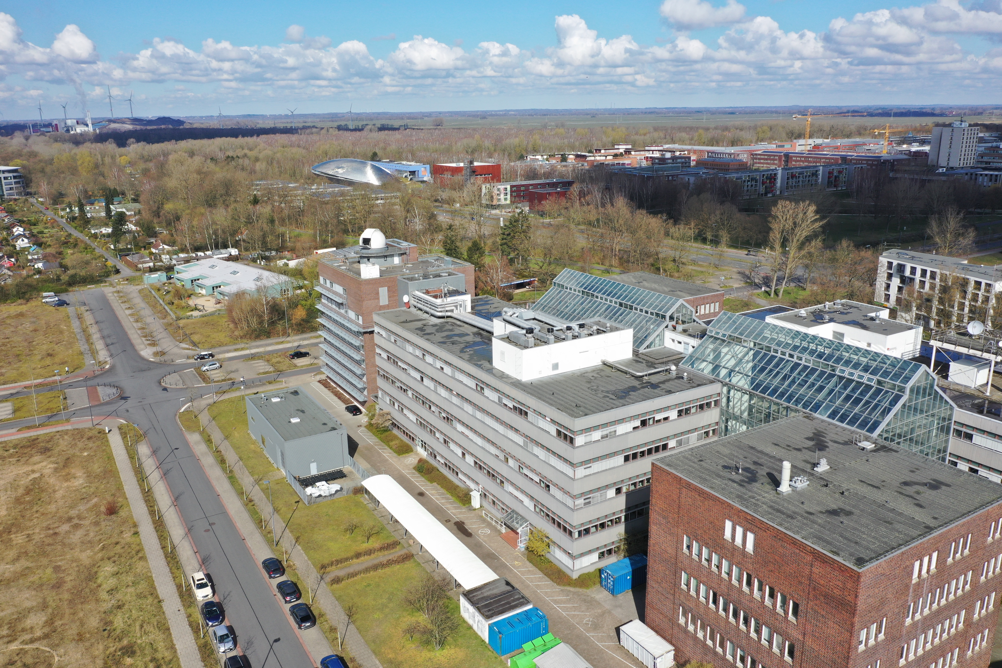
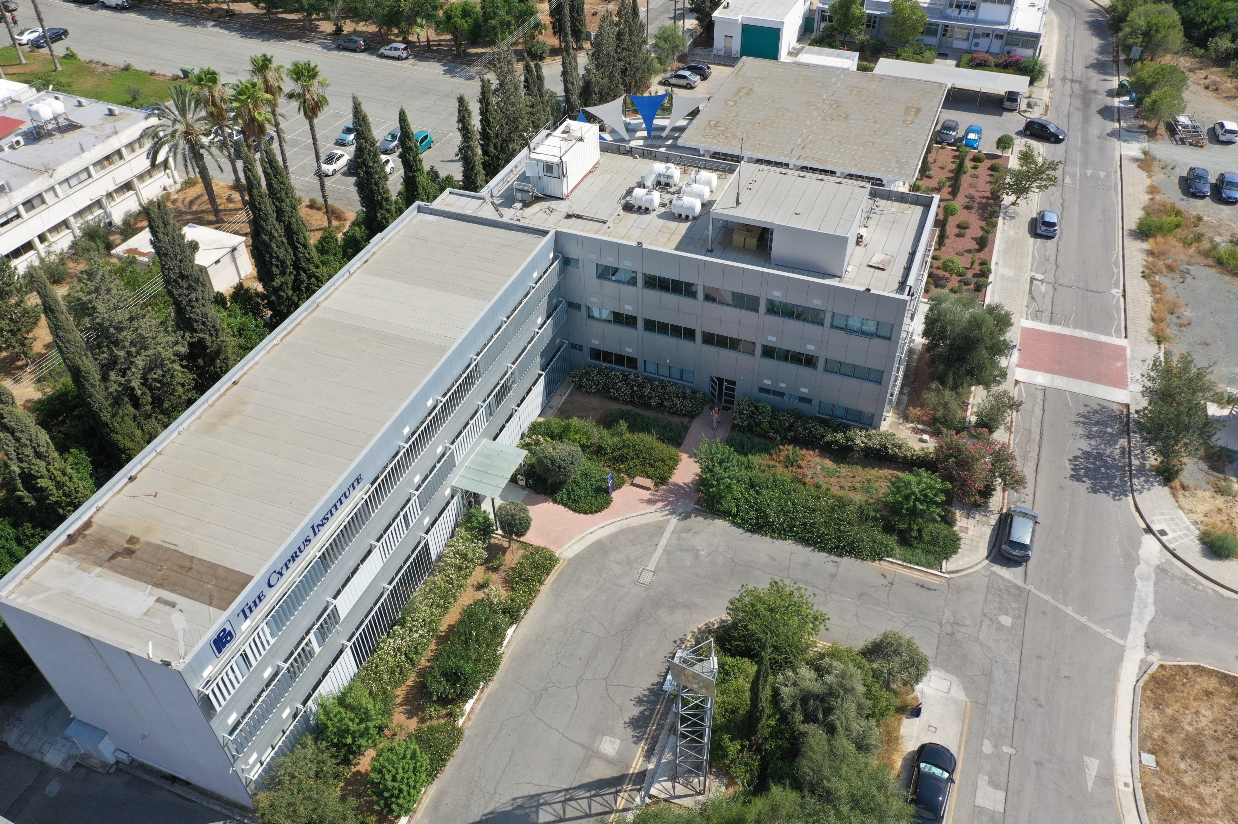
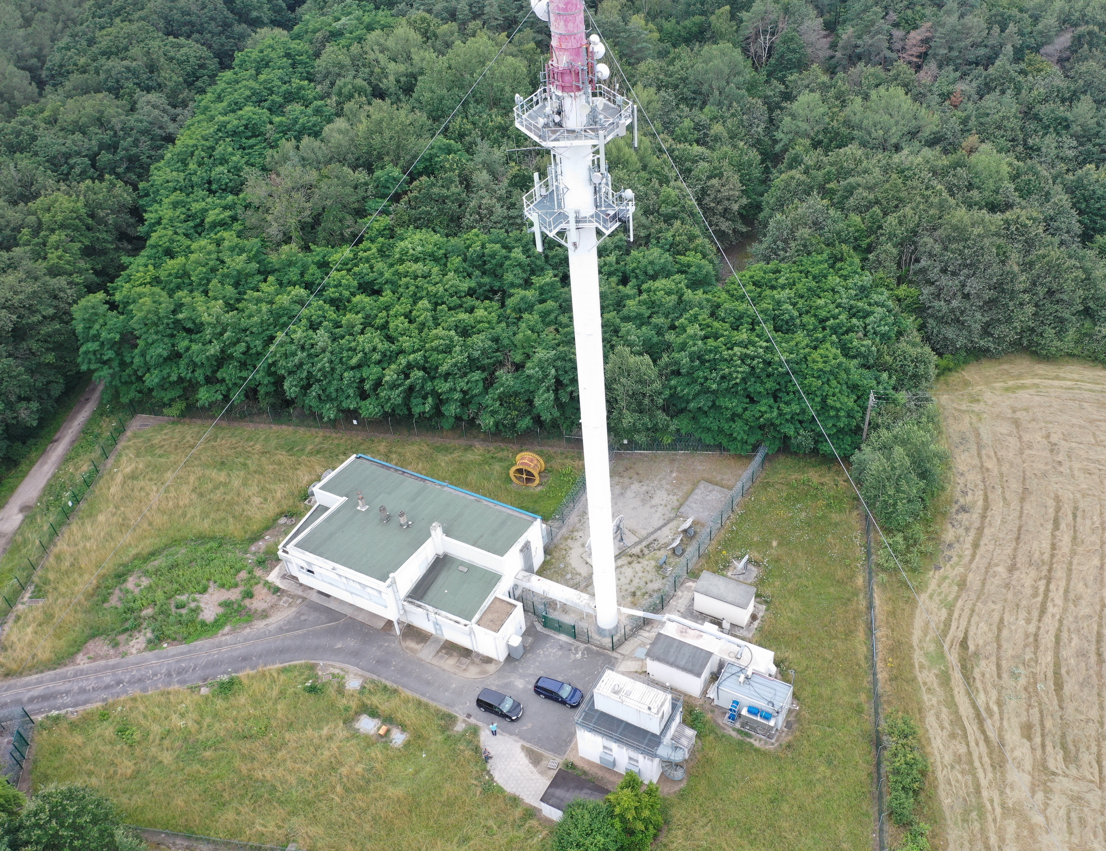
TCCON extension to lower wavenumbers - InGaAs-InSb setup and first mid-infrared retrievals from the sites Bremen, Nicosia and Orleans
Christof Petri, Constantina Rousogenous, Winfried Markert, Thorsten Warneke and Justus Notholt

Slide 2
TCCON extension to lower wavenumbers
Plan: extend the measurements at our TCCON sites to lower wavenumbers -> simultaneous InGaAs-InSb measurements
Harmonize the setup and the retrieval strategie
Bremen and Nicosia are already set up, Orleans will follow but additionally needs automated LN₂ filling.
Bremen Nicosia Orleans

Slide 3
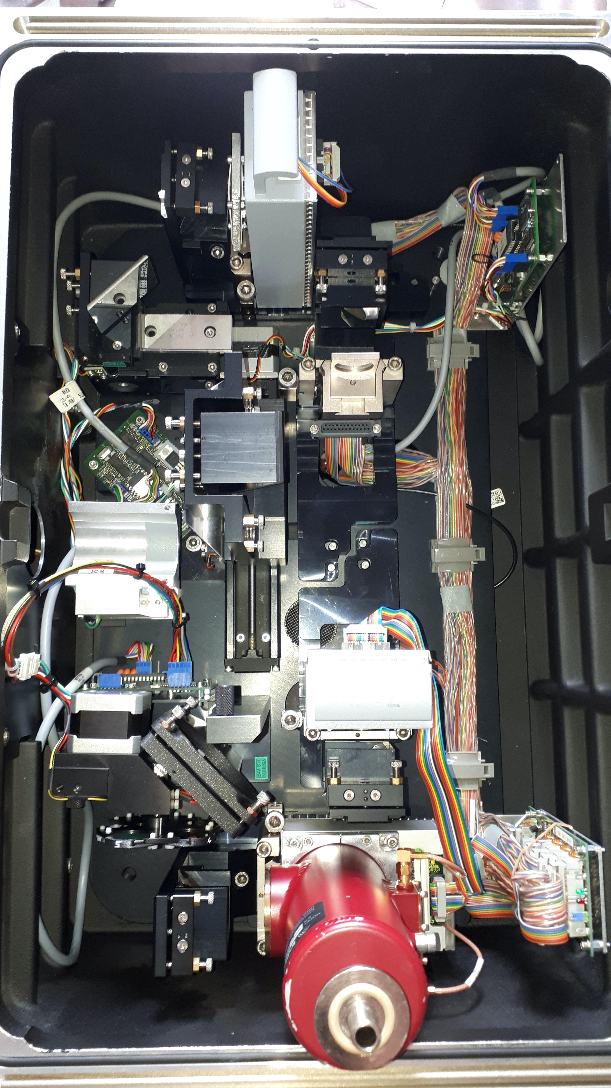
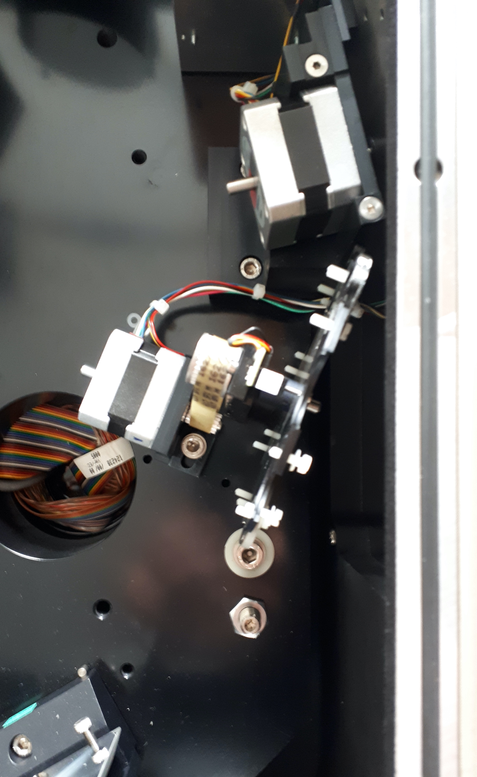
Si-detector
- not used anymore, but still ready on socket 4
8-plc. filter wheel
- placed in the interferometer chamber
Empty socket 3
Holder for HCl cell
InGaAs-detector
-on socket 2
Connection cable for dual channel recordings
on socket 1 and 2
50-50 beamsplitter
- in self constructed holder
5-plc. Filter wheel
- installed
InSb-detector
- installed on socket 1

Slide 4
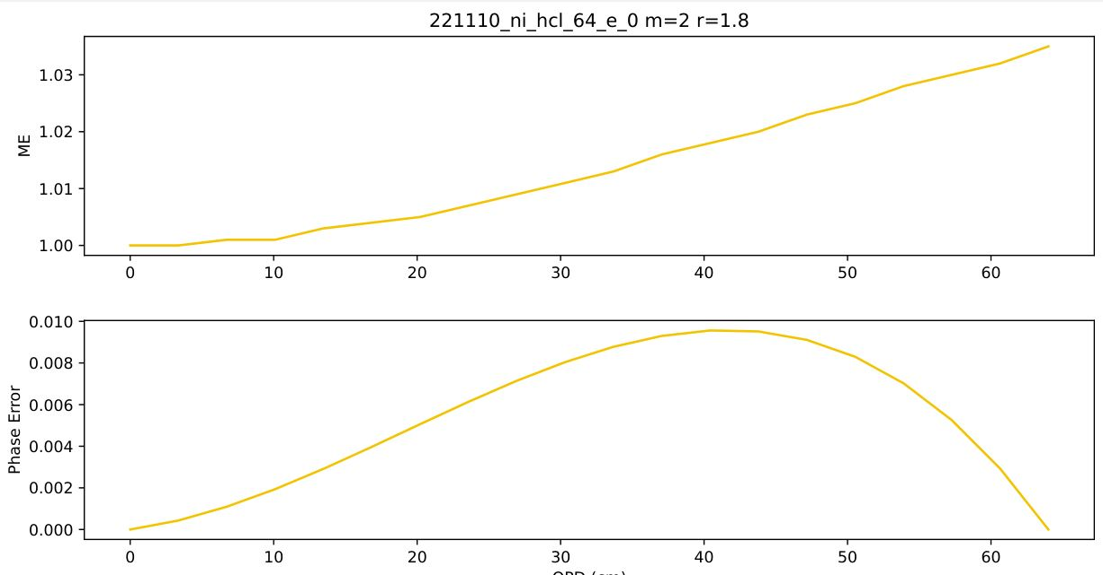
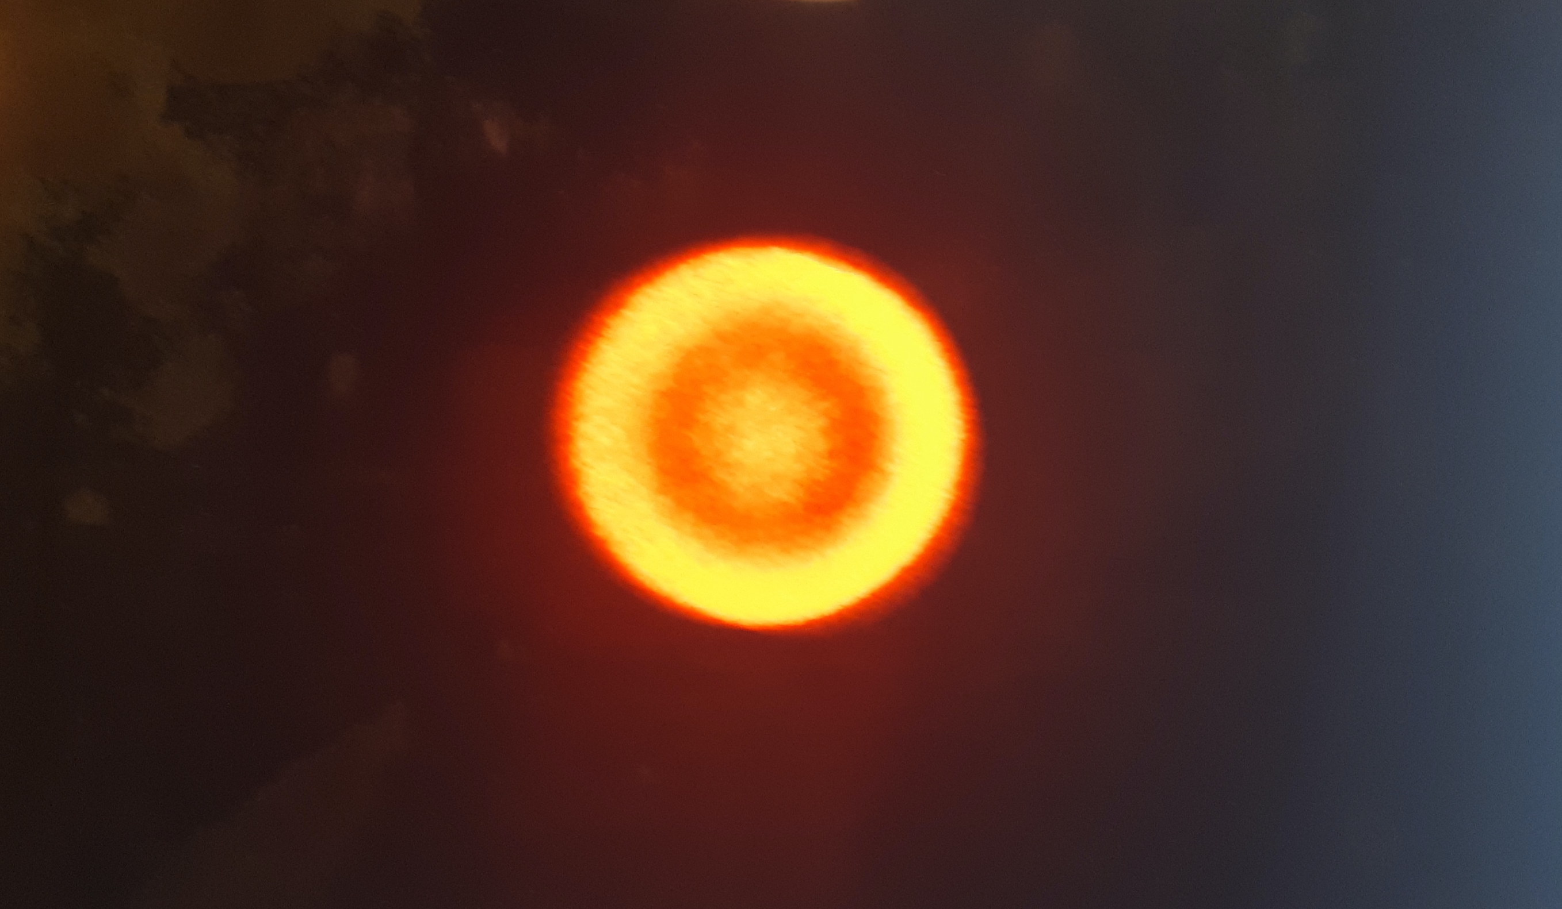
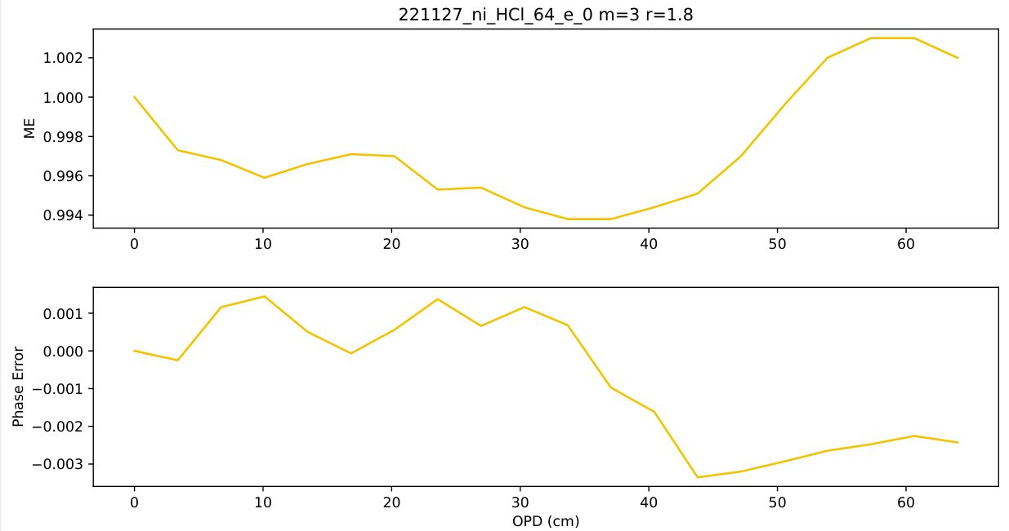
Instrument status before alignment:
- just inside TCCON requirements
Centered fringes as seen with the new alignment tools
Instrument status after alignment:
- almost perfekt

Slide 5
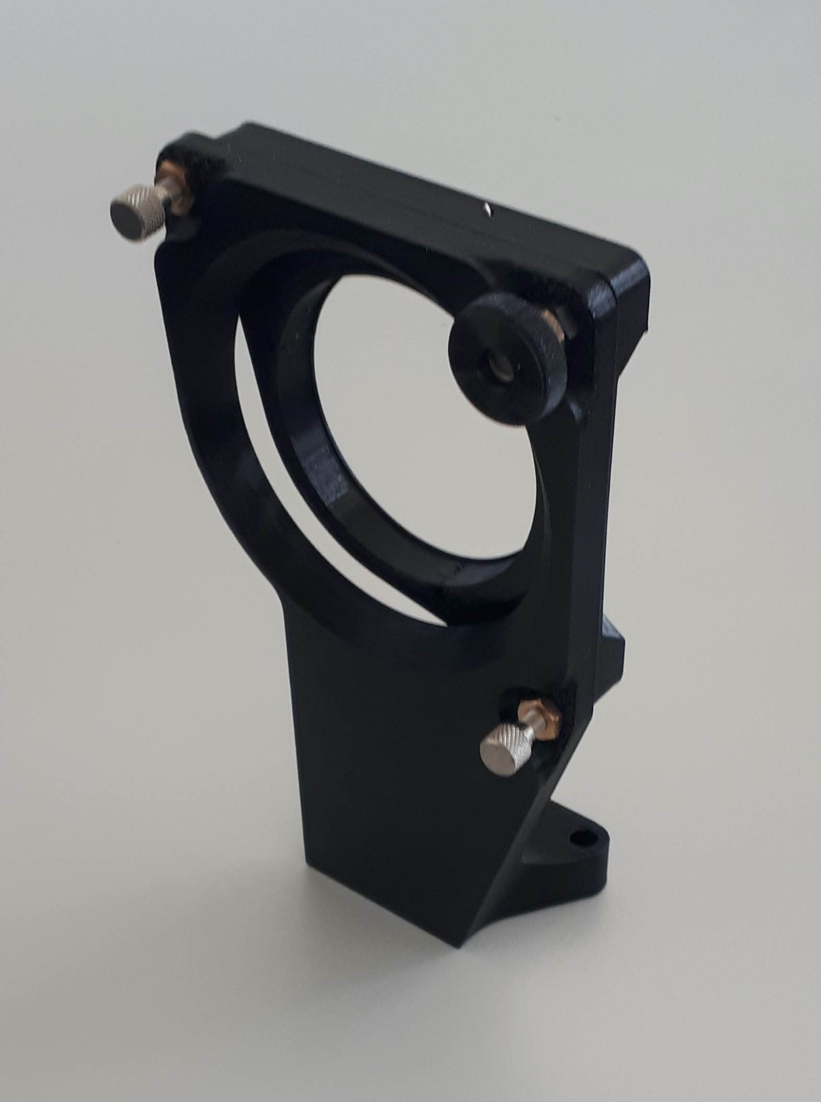
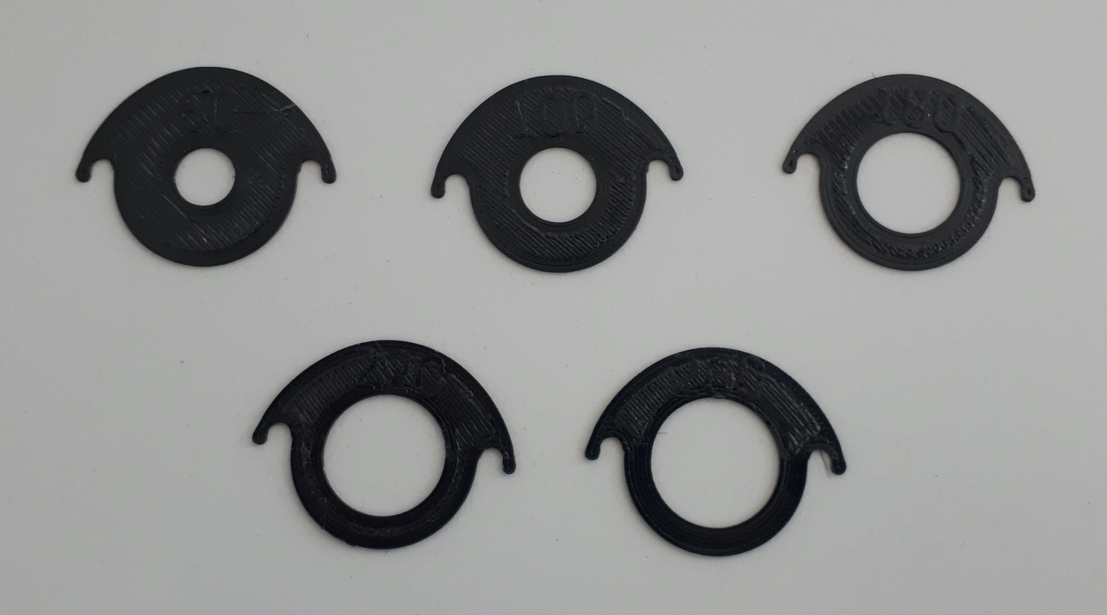
TCCON extension to lower wavenumbers
3D printed parts:
  Beamsplitter-holder for the 2“ circular 50:50 beamsplitter
    Adjustable with fine tread screws
  Filter holder
    with handle
    wings, replacing the plastic washers
    different apertures to adjust the intensity of the different filters
3D files will be provided

Slide 6
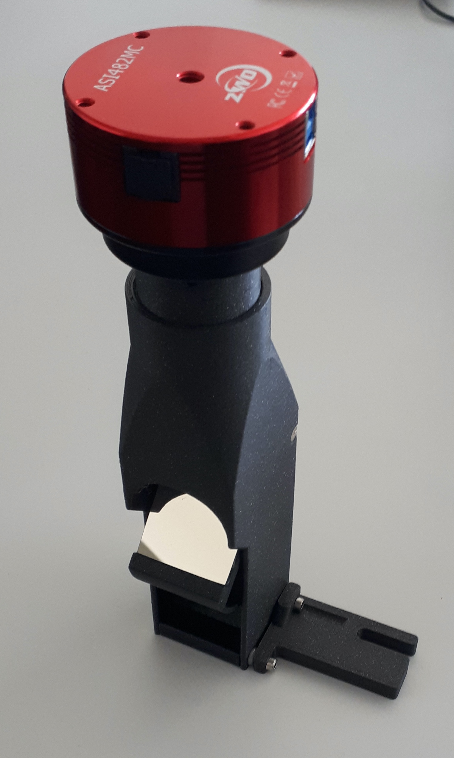
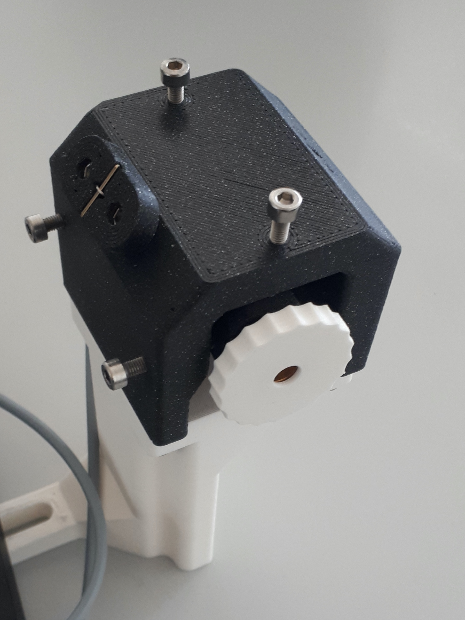
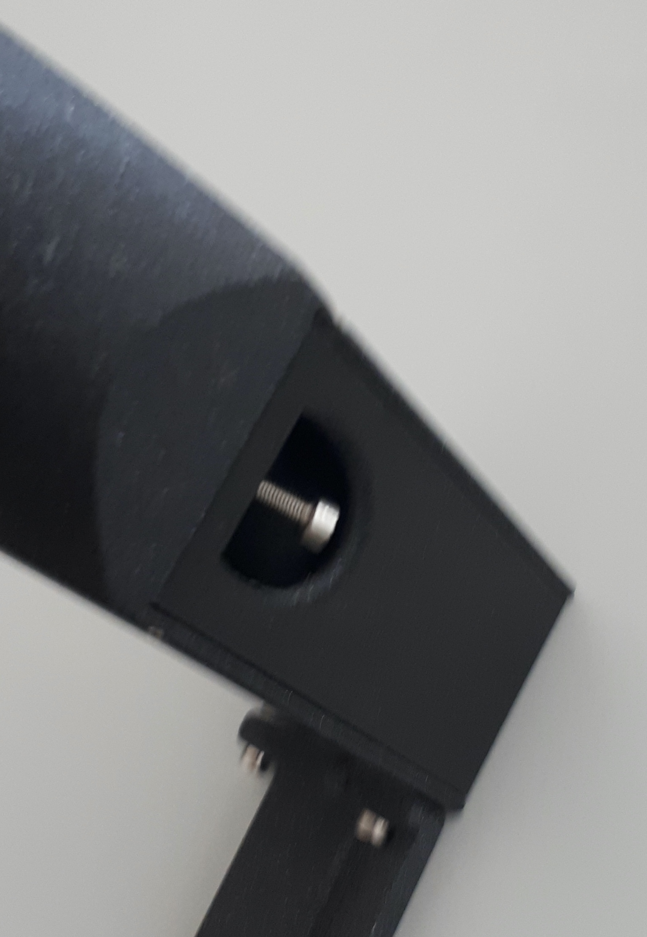
Alignment tools
3D printed alignment tools:
  Camera tower with adjustable mirror and focus
  Holder for the alignment laser, adjustable with white screen to see the back reflection

Slide 7
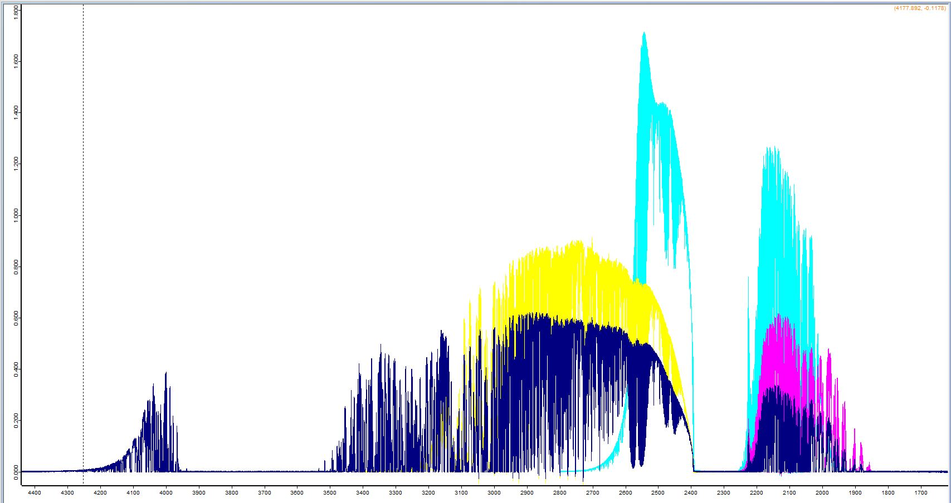
TCCON extension to lower wavenumbers
Filter ranges
filter 5
filter 6
long pass
filter 7
4150 3500 3000 2500 1900

Slide 8
TCCON extension to lower wavenumbers
Measurement schedule:
Time | Name | InGaAs | InSb filter | InSb-wavenumber | resolution
30min. | TCCON | open | Long pass | 1900 - 4150 | 0.014 cm⁻¹
30min. | scd-2 | open | NDACC 7 | 1900 - 2230 | 0.014 cm⁻¹
30min. | scd-3 | open | NDACC 6 | 1950 - 2650 | 0.014 cm⁻¹
30min. | scd-4 | open | NDACC 5 | 2400 - 3200 | 0.014 cm⁻¹
30min. | TCCON-LR | open | Long pass | 1900 - 4150 | 0.2 cm⁻¹
3 x weekly | NDACC-set | ------ | 2, 3, 5, 6, 7 | 1900 - 4150 | 0.005 cm⁻¹

Slide 9
TCCON extension to lower wavenumbers
Retrieval schedule:
Name | spectra | InGaAs wn | InSb-wn | gases
TCCON | InGaAs only | 4000-11000 | ------- | TCCON
Long-pass | InSb + InGaAs | O₂ only | 1900 - 4150 | C2H6, C2H2, CO, CO2, CH4, H2CO, HCN, N2O, NO
scd-2 | InSb + InGaAs | O₂ only | 1900 - 2230 | CO, NO, O3
scd-3 | InSb + InGaAs | O₂ only | 1950 - 2650 | CH4, N2O, OCS
scd-4 | InSb + InGaAs | O₂ only | 2400 - 3200 | C2H6, C2H2, CO2, CH4, H2CO, HCN
TCCON-LR | InSb + InGaAs | tbd | tbd
NDACC-set | InSb only | ------- | 1900 - 4150 | NDACC

Slide 10
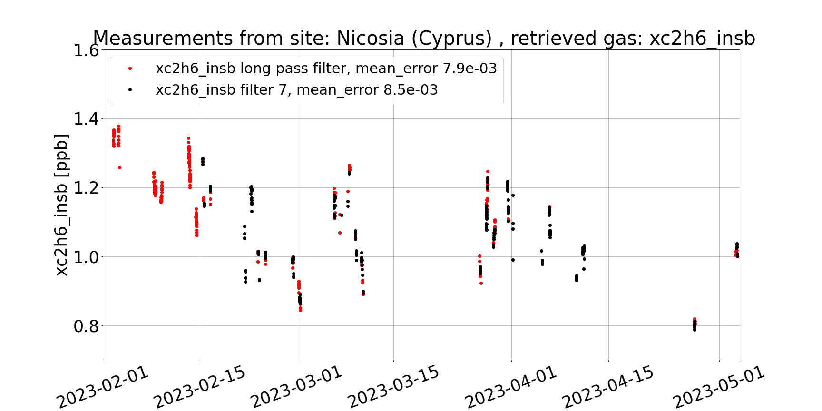
TCCON extension to lower wavenumbers
First results: XC₂H₆ (2976-3305)
5

Slide 11
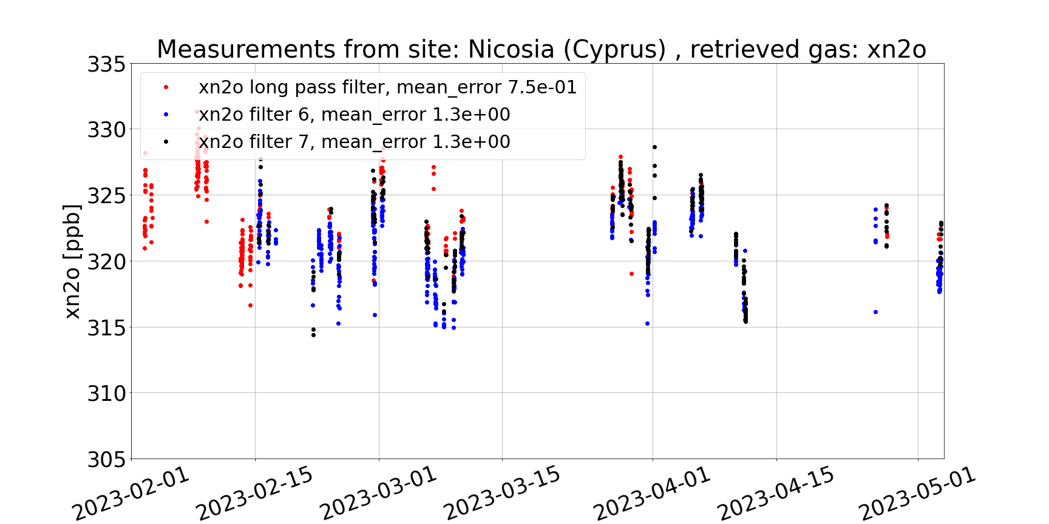
TCCON extension to lower wavenumbers
First results: XN₂O (2443-2813)
5

Slide 12
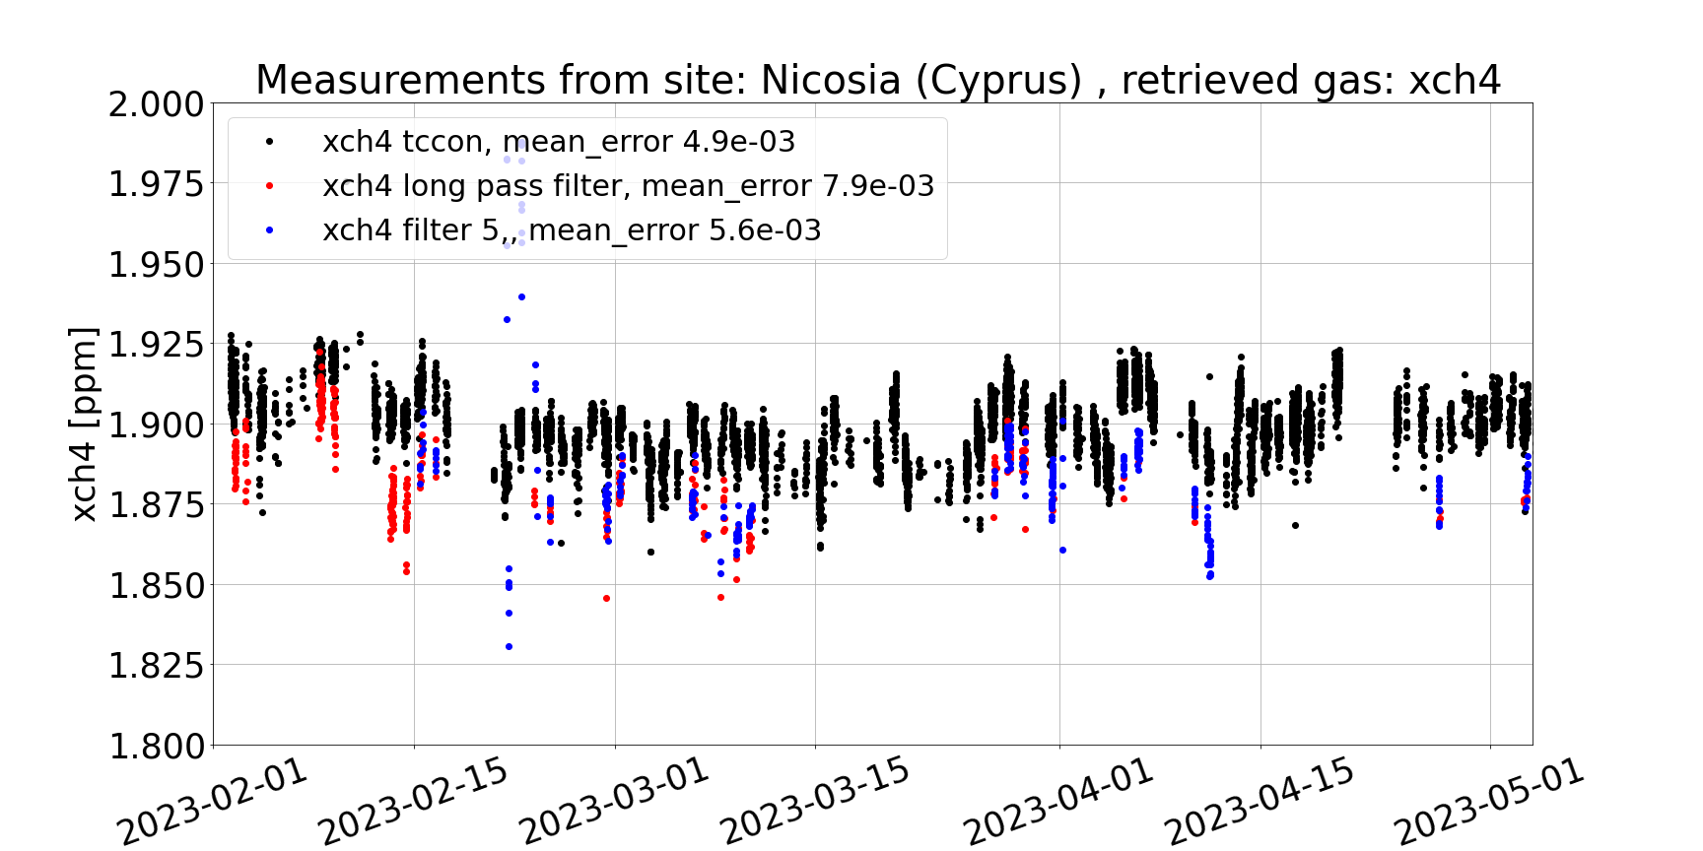
TCCON extension to lower wavenumbers
First results: XCH₄ (5938-6076 vs. 2599-2921)

Slide 13
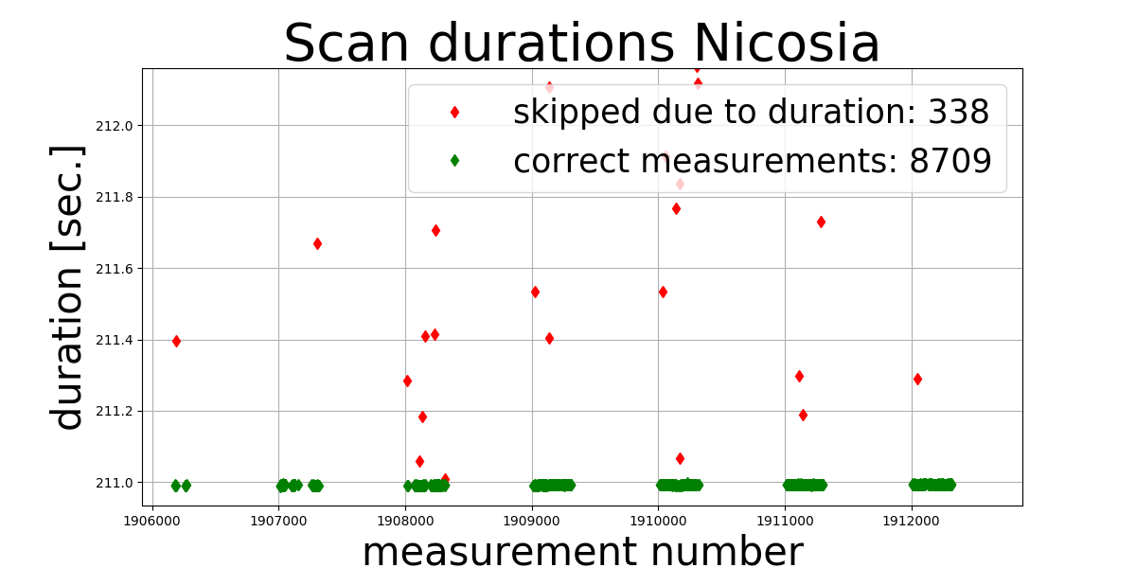
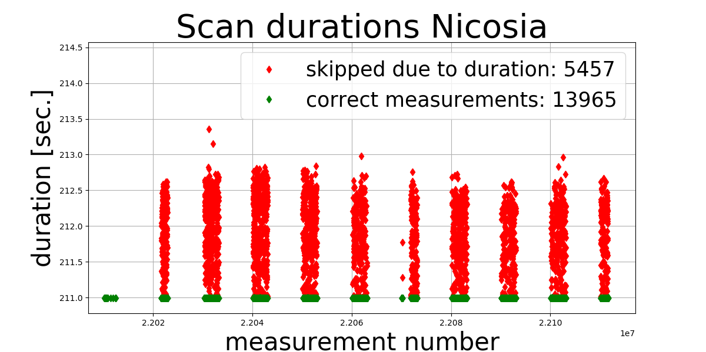
FTIR issues Nicosia
We found ‚longer than usual‘ scan durations ‚DUR‘ at Nicosia
At Orleans all ! measurements have precisely the same durations
This started already in 2019: 3% of measurements
In 2022: 27% !
-> filter out longer scan durations
2019: 3%
212
211.5
211
2022: 27%
212
211.5
211

Slide 14
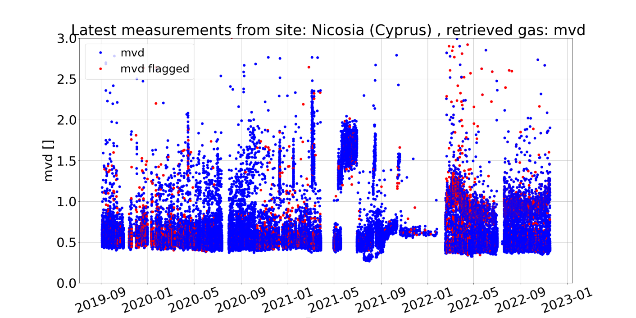
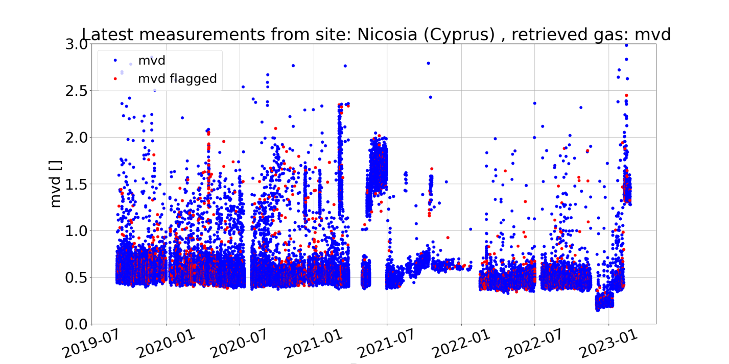
FTIR issues Nicosia
Scatter of MVD parameter increases in 2022
Filtering for the ‚too long‘ measurements: mvd looks much better in 2022.
-> additionally filter mvd > 0.75
Tests to measure with 20kHz, 10kHz, 5kHz

Slide 15
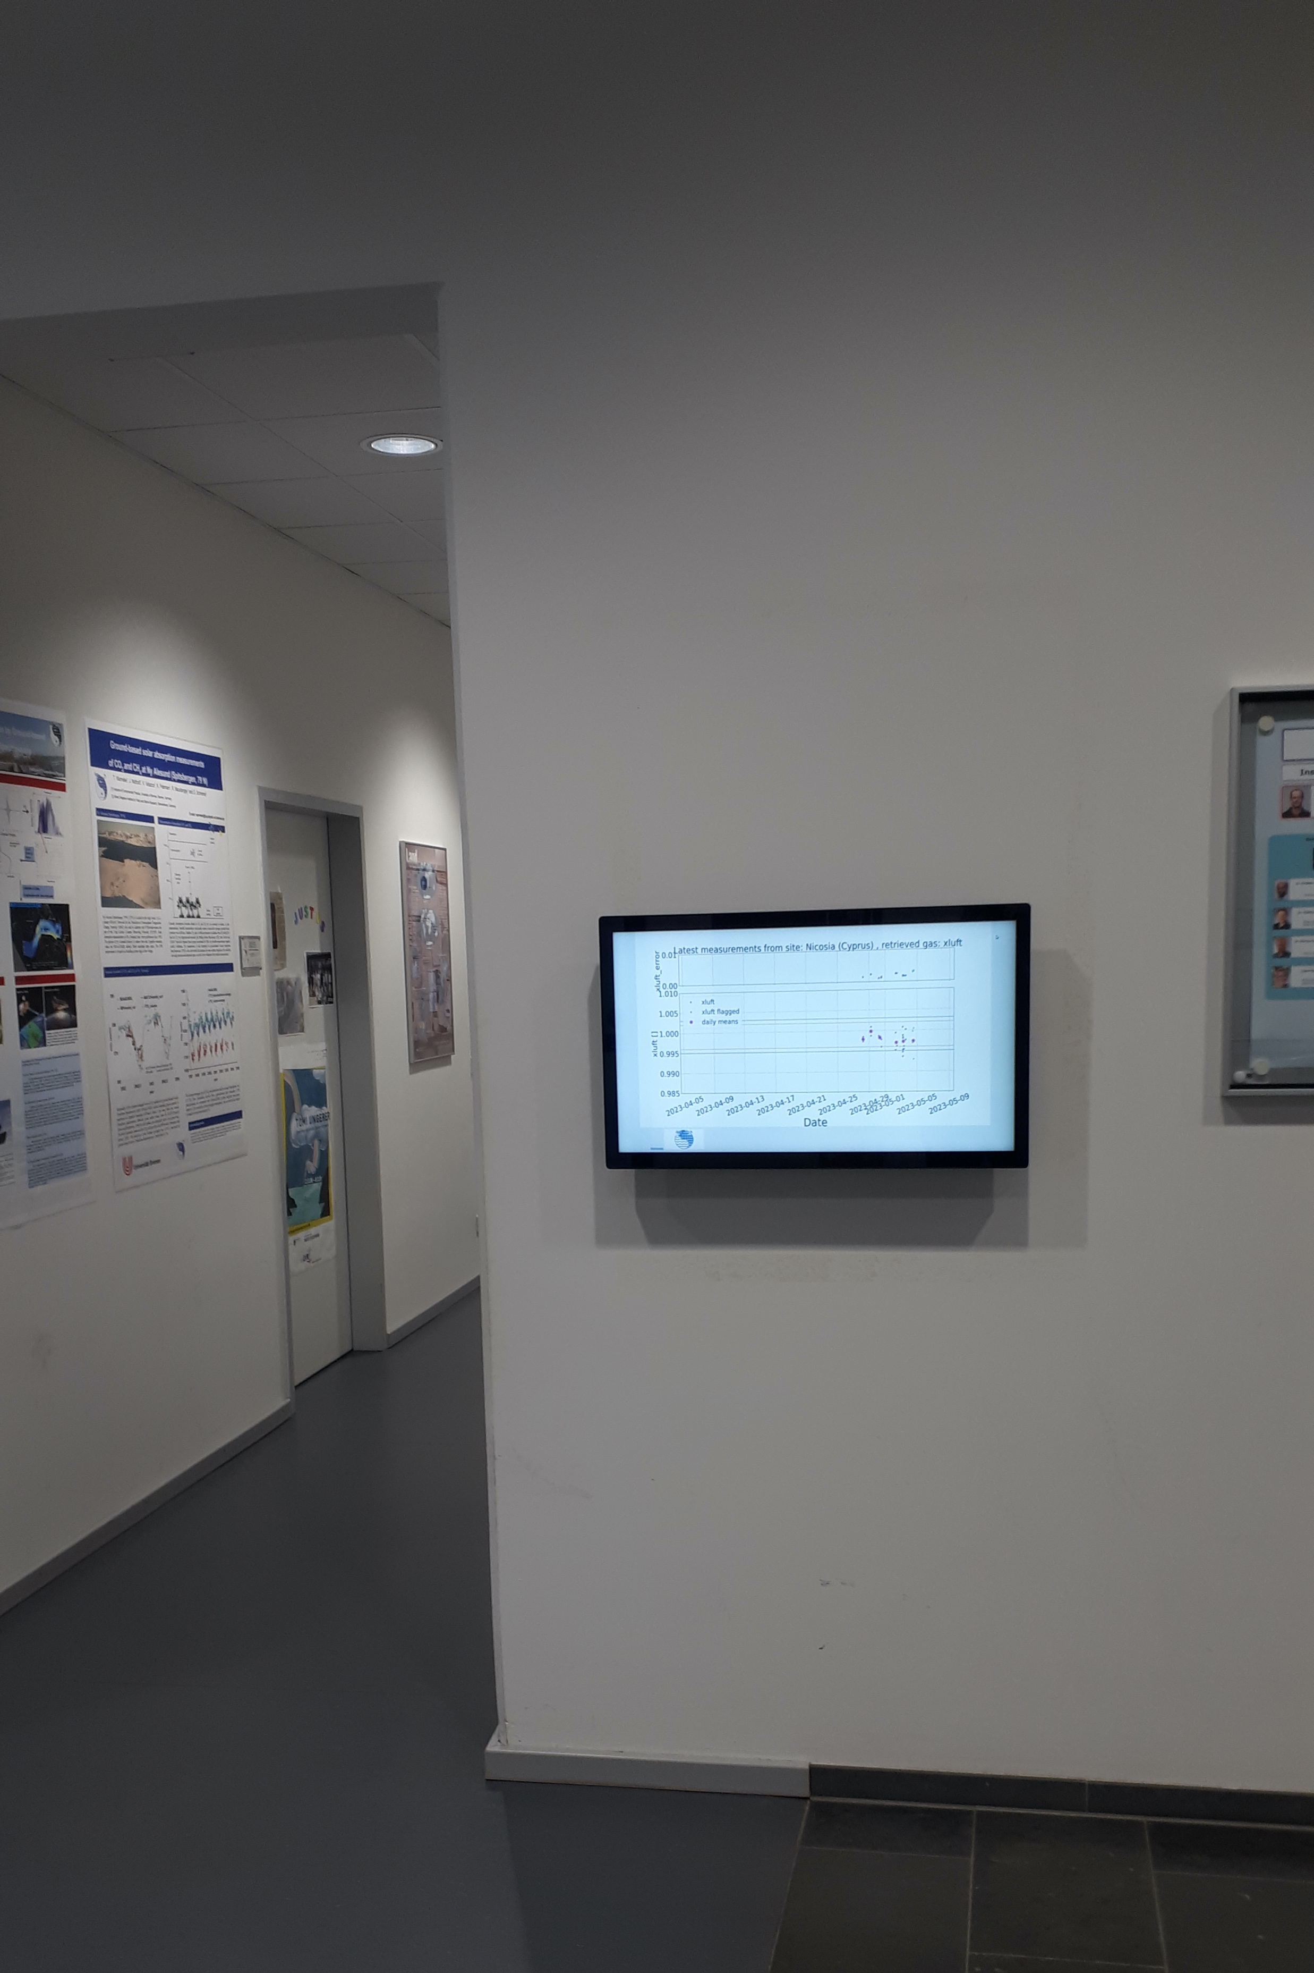
QC-monitor
QC-monitor at our stairway
  automatically updated
  using the touchscreen you can check the fast retrieval results from different sites.

Slide 16
Summery and outlook
Extended TCCON measurements are performed at our sites Bremen and Nicosia, Orleans will follow
First results are shown
MIR measurements:
  Fits have to be checked for tilt and curvature
  Correction factors for have to be found
Persistent instrumental issues at Nicosia

Slide 17
Thank you
for
your attention!

