Slide 1

How well does OCO-2 capture the Seasonal Cycle of Carbon Dioxide?
NDACC-IRWG-TCCON-COCCON Annual Meeting 2023 | June 12, 2023 – Spa, Belgium
Matthäus Kiel¹⁾, J. Laughner¹⁾, S. Das¹⁾, D. Roten¹⁾, G. Osterman¹⁾, A. Chatterjee¹⁾, V. Payne¹⁾ Contact: matthaeus.kiel@jpl.nasa.gov
Affiliation: ¹⁾Jet Propulsion Laboratory, California Institute of Technology, Pasadena, CA, USA
© 2023 California Institute of Technology. US Government sponsorship acknowledged.

Slide 2
Introduction
Introduction
Seasonal cycle is an indicator of the dynamics of CO₂ uptake and release in terrestrial ecosystems.
Understanding seasonal changes of CO₂ is essential for gaining insights into complex dynamics of the terrestrial carbon cycle.
Seasonal cycle is important quantity for testing the accuracy of CO₂ measurements from space.

Slide 3
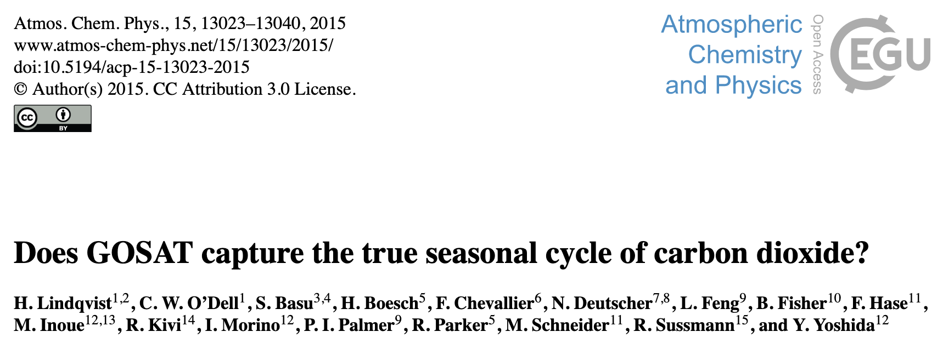
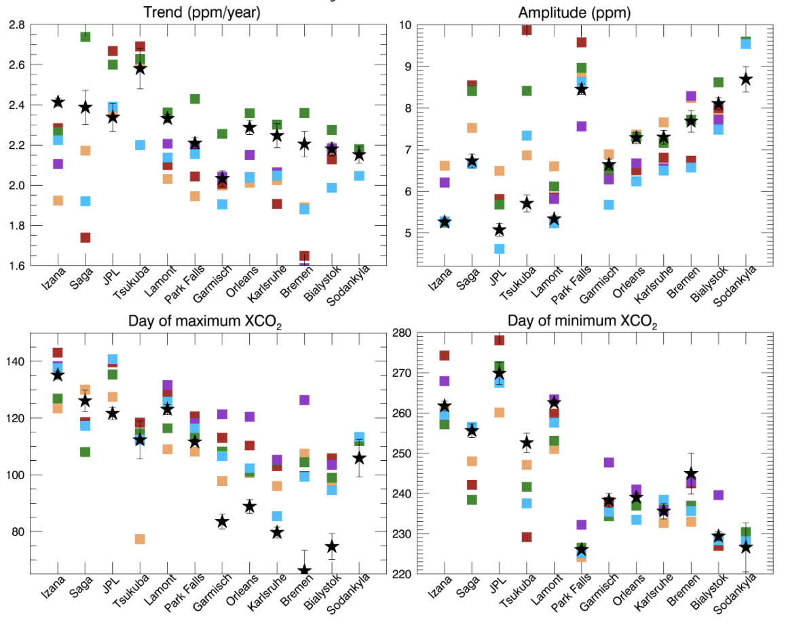
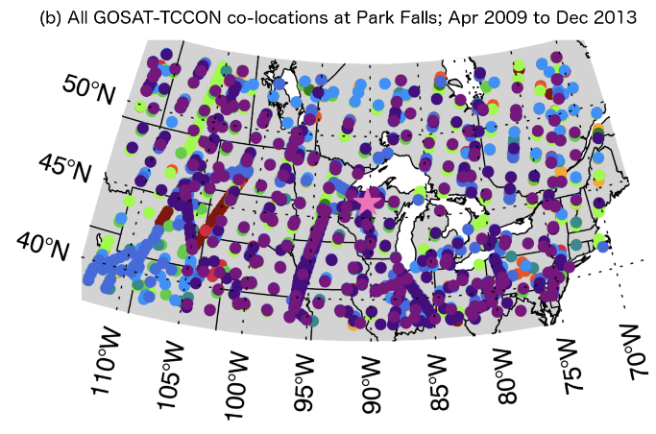
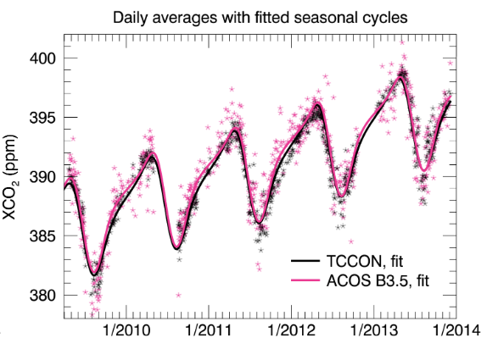
Figures: Lindqvist, H, et. al.: Does GOSAT capture the true seasonal cycle of carbon dioxide?, Atmos. Chem. Phys., 15, 13023–13040, https://doi.org/10.5194/acp-15-13023-2015, 2015.
2022 Update: Taylor, T. E., et al.: An 11-year record of XCO₂ estimates derived from GOSAT measurements using the NASA ACOS version 9 retrieval algorithm, Earth Syst. Sci. Data, 14, 325–360, https://doi.org/10.5194/essd-14-325-2022, 2022.

Slide 4
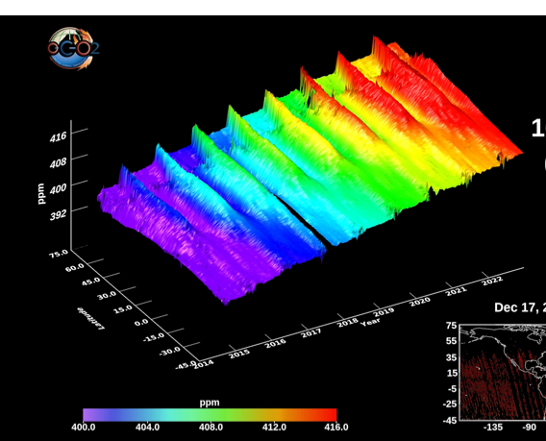
Introduction
Remotely Sensed Data
OCO-2 XCO₂
OCO-2
ACOS V11.1 XCO₂ (x2007)
Sept. 2014 – Dec. 2022
TCCON (Truth Proxy)
GGG2020 XCO₂ (x2007)
Northern Hemisphere Sites
Collocation Criteria
±2.5° Latitude, ±5 Longitude for nadir and glint observations (modified for city sites)
Target mode observations
Average TCCON XCO₂ within ±1h of OCO-2 overpass time
16-Day Average
Land and Ocean
16-day average Land + Ocean

Slide 5
Skewed Sine Wave Approach
The seasonal cycle of XCO₂ can be parameterized as a skewed sine wave with an upward trend (Lindqvist et al., 2015)
Lamont TCCON
Mean Seasonal Cycle Lamont TCCON
This method cannot be used to quantify interannual variability but it gives an average SCA pretty conveniently.

Slide 6
Skewed Sine Wave Approach
The seasonal cycle of XCO₂ can be parameterized as a skewed sine wave with an upward trend (Lindqvist et al., 2015)
Linear trend
Seasonal Cycle Amplitude: 2*|a₂|
Lamont TCCON
Mean Seasonal Cycle Lamont TCCON
SCA
This method cannot be used to quantify interannual variability but it gives an average SCA pretty conveniently

Slide 7
Skewed Sine Wave Approach
The seasonal cycle of XCO₂ can be parameterized as a skewed sine wave with an upward trend (Lindqvist et al., 2015)
Linear trend
Seasonal Cycle Amplitude: 2*|a₂|
Lamont OCO-2 Overpasses
Mean Seasonal Cycle Lamont
SCA
This method cannot be used to quantify interannual variability but it gives an average SCA pretty conveniently

Slide 8
Skewed Sine Wave Approach
The seasonal cycle of XCO₂ can be parameterized as a skewed sine wave with an upward trend (Lindqvist et al., 2015)
Linear trend
Seasonal Cycle Amplitude: 2*|a₂|
Lamont OCO-2 Overpasses
Mean Seasonal Cycle Lamont
SCA
SCA
Shift
This method cannot be used to quantify interannual variability but it gives an average SCA pretty conveniently

Slide 9
Detrended Mean Seasonal Cycle
OCO-2 Requirements Minimum of three observations within ±45 days of three local minima and maxima.

Slide 10
Seasonal Cycle Amplitude
Amplitude captured within ± 0.5 ppm for 13 sites and ± 0.25 ppm for 9 out of 15 sites.
Largest differences for Xianghe (-1.18 ppm), Rikubetsu (-0.82 ppm), and Bremen (+1.01 ppm).

Slide 11
Seasonal Cycle Phase Shift
Day of Maximum
Day of Minimum
Day of maximum to minimum XCO₂
Maximum: mean △d = -2 ± 6 days ranging from [-10, 11] days.
Minimum: mean △d = +2 ± 6 days ranging from [-5, 17 ] days.
Largest differences for Bremen and Karlsruhe.

Slide 12
Sampling Effect – Seasonal Cycle Amplitude/Phase
All TCCON Data
TCCON data collocated with OCO-2
All
Collocated

Slide 13
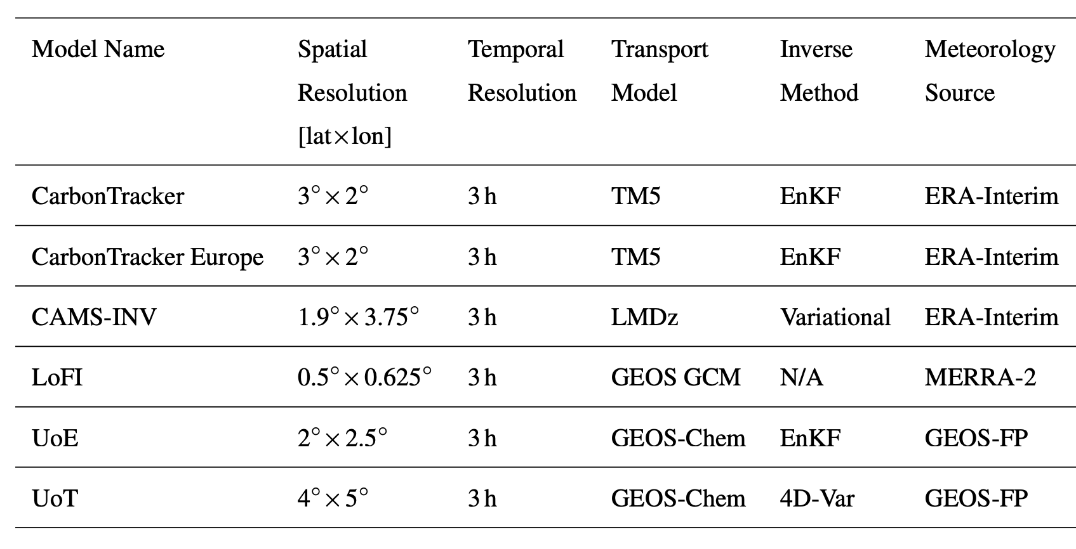
Global Scale - Seasonal Cycle Amplitude
Comparisons against TCCON are spatially limited.
Multi-model median (MMM) XCO₂ is derived from CO₂ fields of six models resampled at OCO-2 sounding location.
For consistency, only model XCO₂ that deviated by less than ±1.0 ppm from the initial median value are included.
Soundings are excluded if standard deviation amongst the models is >0.7 ppm.
Averaging kernel correction is applied to model XCO₂ values to account for differences in vertical sensitivities and prior profiles.

Slide 14
Latitudinal Dependence - Seasonal Cycle Amplitude
OCO-2 soundings within 5° latitude bins are combined into single time series.
Seasonal cycle is fitted using daily averages of OCO-2 XCO₂ and resampled model data.
MACC and Toronto are biased low between equator and mid-latitudes compared to other models.
OCO-2 SCA is shallower (~1ppm) over high northern latitudes compared to MMM.

Slide 15
Longitudinal Dependence - Seasonal Cycle Amplitude
In the mid-latitudes (45-50°N), seasonal cycle amplitude increases from west to east.
OCO-2 seasonal cycle amplitude increases from 7.4 ppm to 11.1 ppm from 180–120W to 120–180◦ E.
OCO-2 seasonal cycle amplitude shallower over Northern America and Eurasia but elevated by ~1ppm over Eastern Asia.
LoFi and CT biased high over Northern America and Eurasia compared to other models.

Slide 16
Summary
Two independent approaches were used to evaluate the OCO-2 XCO₂ seasonal cycle: comparisons against TCCON and a Multi-Model Median truth proxy
OCO-2 captures the seasonal cycle amplitude of TCCON within ± 0.5 ppm for 13 sites and ± 0.25 ppm for 9 out of 15 sites in the Northern Hemisphere.
OCO-2 captures the seasonal cycle phase within ± 2 days on average, with differences of up to two weeks over Bremen and Karlsruhe.
Model and satellite observations qualitatively agree for latitudes 0-65°N; From the 0-40°N model SCA is shallower than OCO-2 (driven by two models); From 40°N upward, OCO-2 SCA is ~1ppm shallower than MMM.
Longitudinal changes in SCA at mid-latitudes qualitatively agree Increases in SCA by ~4ppm west to east with OCO-2 SCA slightly shallower than MMM by few tens of a ppm.

