Slide 1

WELCOME
A very warm welcome to the attendees of the NDACC-IRWG / TCCON / COCCON annual meeting 2023 from the entire BIRA-IASB team

Slide 2
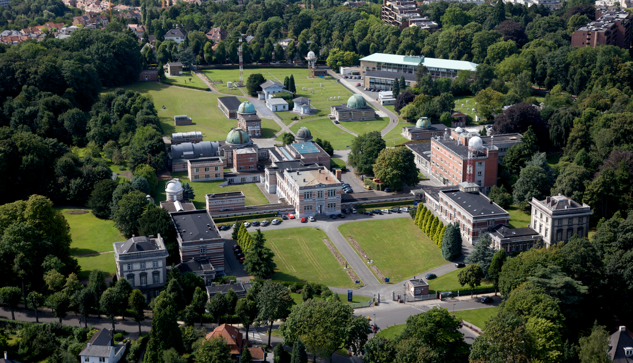
BIRA-IASB

Slide 3
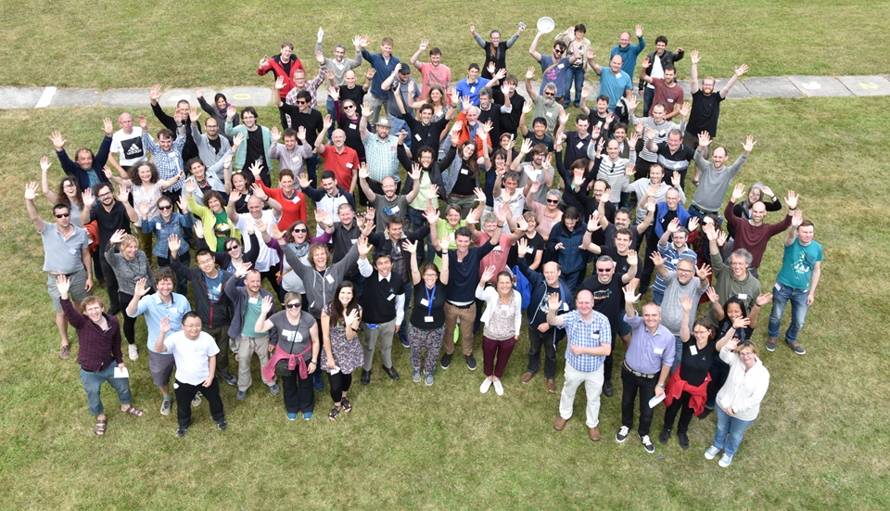
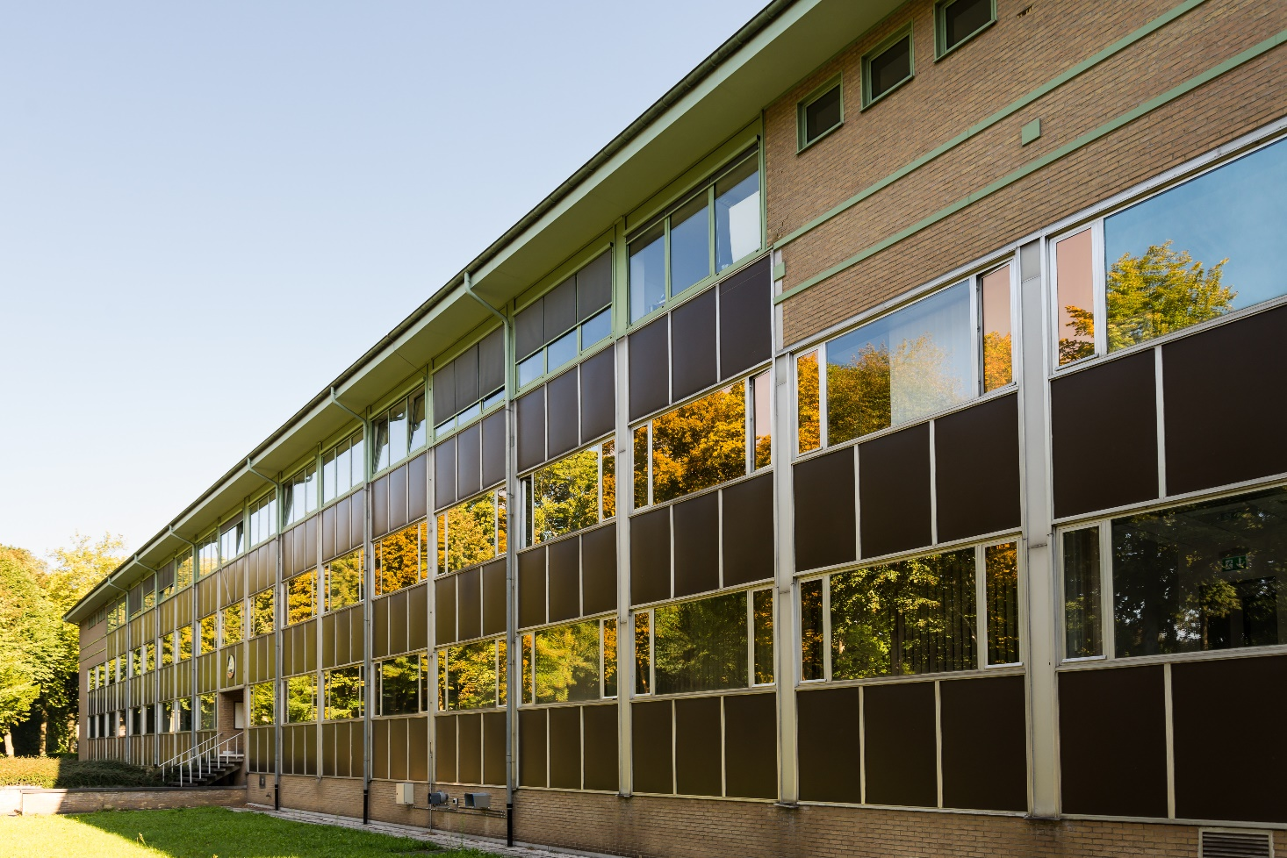

Royal Belgian Institute for Space Aeronomy
(BIRA-IASB)
Aeronomy studies:
- the atmospheres of the Earth, planets, comets, …
- their interactions with the solar radiation and the environment,
- as well as the interplanetary space
SCIENCE BETWEEN HEAVEN AND EARTH BIRA-IASB websites
https://www.youtube.com/watch?v=UqDs2T2jEGo http://www.aeronomie.be
http://50.aeronomie.be

Slide 4
Participants
We have a total of 106 registrations – 93 registrations for physical participation and 13 online participants.
We have prepared special badge holders made of seeded paper. You can take them home and just throw it in earth to grow flowers. Please return the orange lanyards for reusing them at our next event.

Slide 5
Breaks
Two booths for Coffee / Tea – one next to the meeting room and a second one downstairs close to the poster rooms.
Light lunch is organized at the terrace.
Special request on dietary requirement are taken into account.
Two poster rooms, one adjacent to the meeting room here and a second one downstairs next to the bar – a room with the glass doors. Bruker will present one instrument in the downstairs room as well. The posters are spread to give enough space for the presenters and the high number of visitors.

Slide 6
Social event on Monday
We invite all participants to a hosted walking dinner and ice breaker (open bar for two hours) starting from 18:00.
We will take a group photo at the start of the break at 15:30.

Slide 7
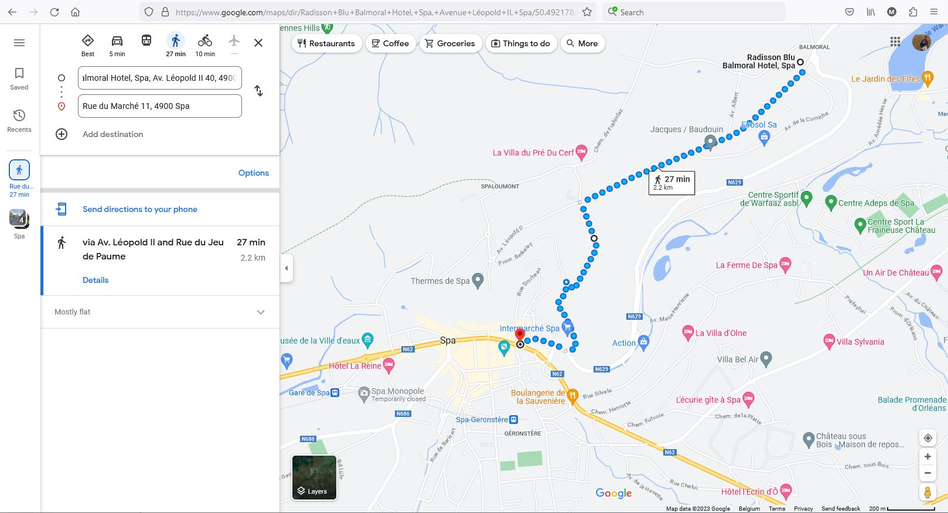
Walking to Spa

Slide 8
Conference dinner on Wednesday
All participants who have pre-registered for the conference dinner are welcome to join here on Wednesday starting at 19:00.

Slide 9
Extra activities
Enjoy the swimming pool and sauna
Lot of nice hiking routes are around this region
Spa is also known for the world famous Circuit of SPA-Francorchamps
While you are in Belgium enjoy the Belgian fries and beer

Slide 10
Questions or comments?
Please contact or anyone from the local organizing committee and we will address it.

Slide 11
Have a great meeting and enjoy your stay in Belgium

