Slide 1

Using High Arctic TCCON Stations to Validate Modelled Carbon Monoxide and Methane
E. McGee¹, K. Strong¹, K.A. Walker¹, C. Whaley², R. Kivi³, J. Notholt⁴,
G. Cassidy⁵ and the AMAP SLCF Modelling Team
NDACC-IRWG-TCCON-COCCON Annual Meeting 2023
June 12th 2023
¹ University of Toronto
² Canadian Centre for Climate Modelling and Analysis, ECCC
³ Finnish Meteorological Institute
⁴ Institute of Environmental Physics, University of Bremen
⁵ McMaster University

Slide 2
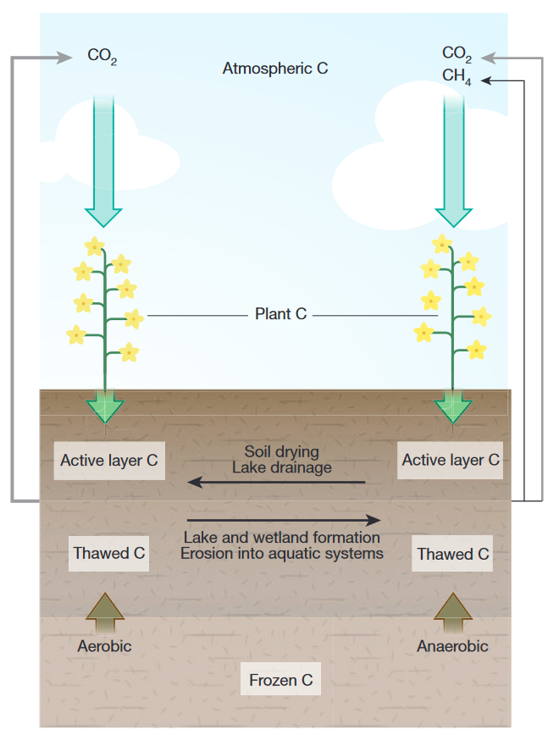
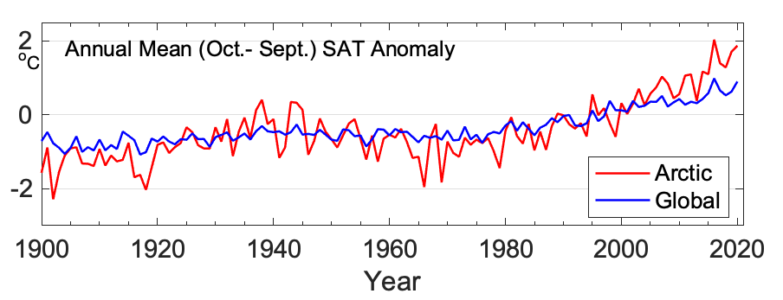
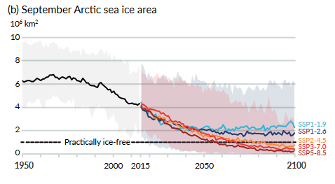
The Warming Arctic
Melting Permafrost
Ballinger et al., 2020 (NOAA), Fig. 1
Schurr et al., 2015, Box 1 Figure
IPCC., 2021, Fig. SPM.8b
Notes:
The Arctic is a highly sensitive ecosystem that is being disproportionately affected by anthropogenic climate change, warming at approximately three times the rate of the global average according to the most recent IPCC report.
Between the loss of sea ice and melting permafrost, multiple changes to the ecosystem are feeding positive feedback loops.
Being able to model the effects of these various feedback loops on the Arctic atmosphere is essential for being able to predict future changes to the environment, and in order to have confidence in our models, we need to validate them.

Slide 3
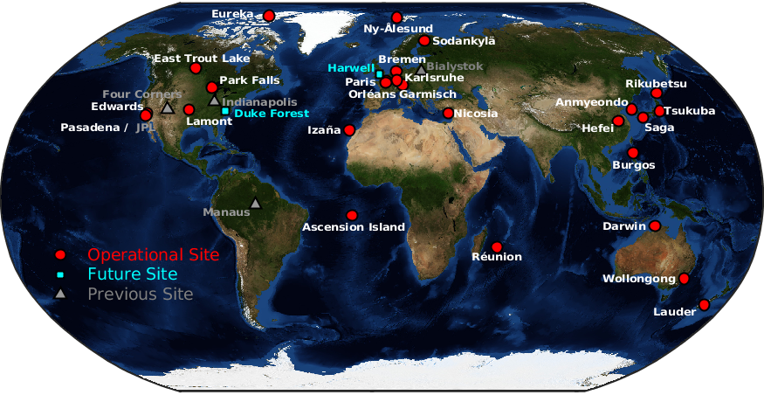
TCCON
TCCON
Used to validate many satellite datasets and models
GGG2020 release data has been used for this project
GGG from the three Arctic sites will be used for this work
Notes:
We all know what TCCON is, it’s why we’re here, so I won’t spend much time on it here – just note that the three Arctic sites: Eureka, Ny Alesund, and Sodankyla (which I very well may be mispronouncing) are the ones used in this project.

Slide 4
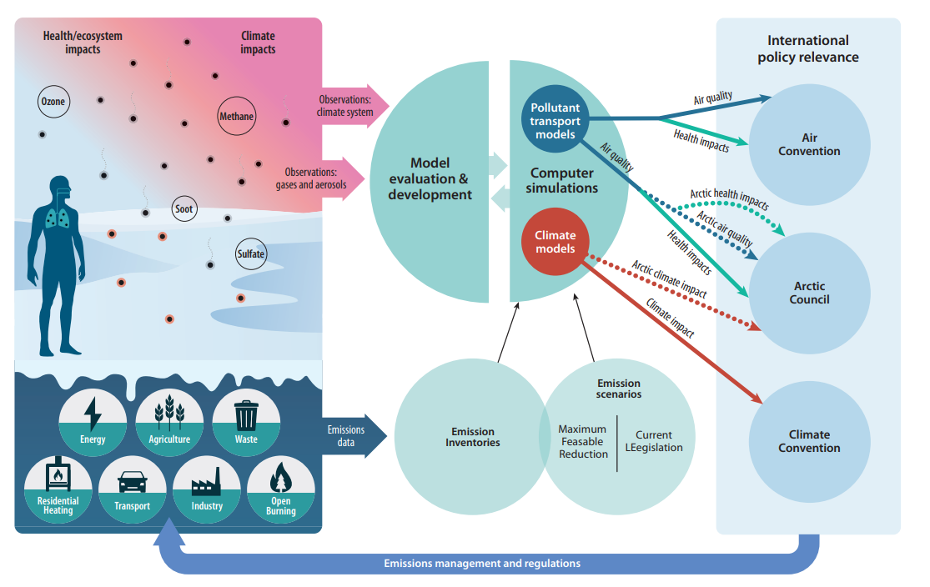
Arctic Monitoring and Assessment Programme
Short-Lived Climate Forcers (SLCFs):
Species that have climate impacts
and a lifetime shorter than that of
CO₂
Shorter lifetimes = changes in policy may see effects sooner
AMAP, 2021
Notes:
The Arctic Monitoring and Assessment Programme, or AMAP, is a working group of the Arctic Council that consolidates evidence on various factors impacting the Arctic environment in order to inform policy.
AMAP was until very recently focused on short-lived climate forcers, or SLCFs, which are species that have climate impacts and a lifetime shorter than that of CO2. While CO2 is still the main driver of anthropogenic climate change, the effects of necessary reductions in emissions are delayed due to its long atmospheric lifetime. SLCFs have the advantage that we may be able to see climate impacts from policy much quicker – hopefully fast enough that current changes in policy could act to protect the sensitive Arctic ecosystem.

Slide 5
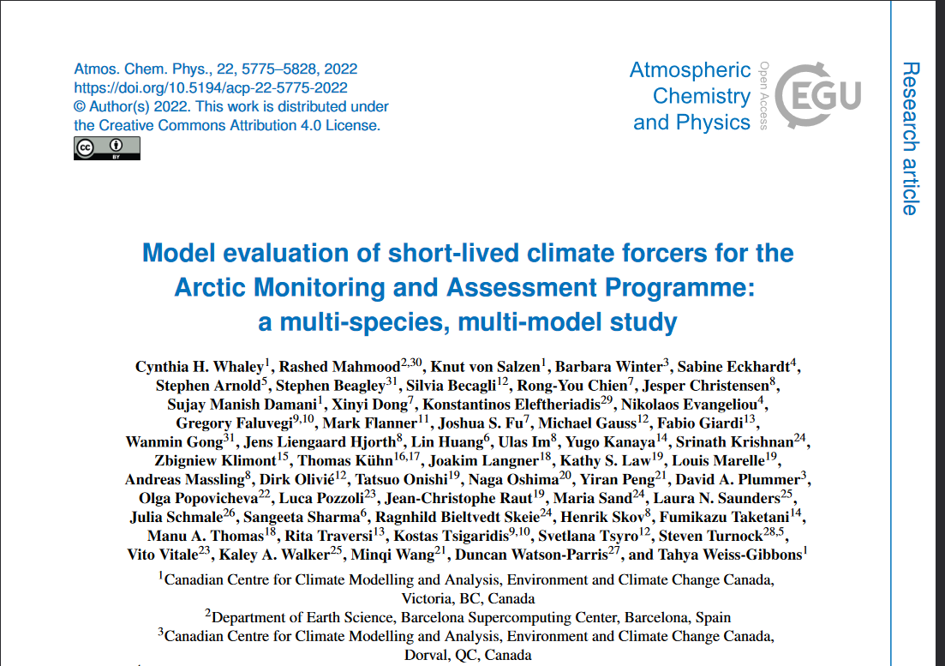
AMAP SLCF Comparisons
In-depth comparisons with surface in-situ measurements and satellite measurements have been done (Whaley et al., 2022)
AMAP is generally focused on many different SLCFs
  For this project we focus on CO and CH₄ due to availability of TCCON data
  CO is a precursor to ozone in the troposphere, and has health impacts on a variety of species
  CH₄ is a strong greenhouse gas
Whaley et al. study found that models were generally biased low compared to observations for methane and carbon monoxide, especially in the Arctic
CO₂
O₃
H₂O
NO
N₂O
CO
NO₂
HDO
CH₄
HF
Sulfate aerosols
Measured by TCCON
AMAP species of interest
Notes:
In order to validate AMAP models, a few comparisons with surface in-situ and satellite measurements have already been done by my collaborators, and these found that models were generally biased low compared to observations in the Arctic for methane and carbon monoxide.
While AMAP generally has focused on many different SLCFs, for the comparisons I have done with TCCON we focus on carbon monoxide and methane due to those species being the overlap of SLCFs of interest to AMAP and species that TCCON measures

Slide 6
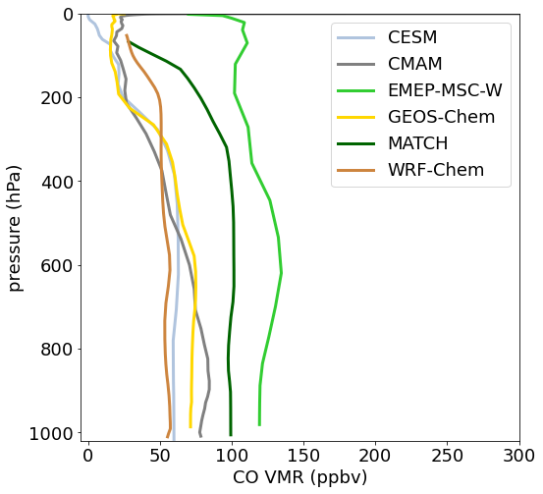
Data Product Comparison
Example Profiles: Eureka, Nunavut
June 3rd 2015 18:00 UTC
Model outputs from AMAP are 3-hourly vertical profiles for 2014 and 2015 (except for GEM-MACH, which is only provided for 2015)
Column-averaged dry air mole fractions (Xgas) for the model profiles were calculated in the same step as smoothing the model profiles with TCCON priors and averaging kernels
Notes:
The model outputs are 3-hourly vertical profiles, while TCCON data products are column-averaged dry-air mole fractions. In order to compare these two different products, we smooth the model profiles with TCCON priors and averaging kernels, and calculate Xgas from that.

Slide 7
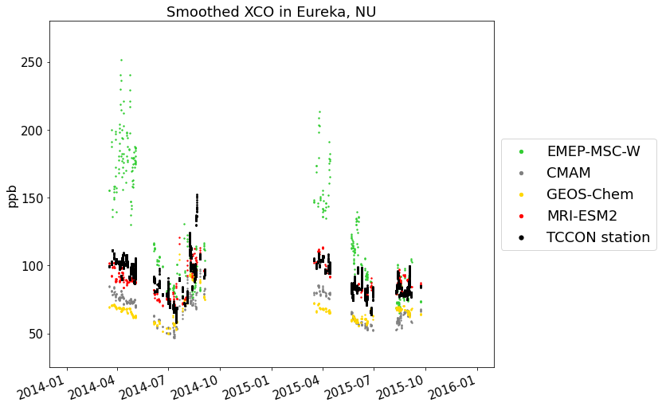
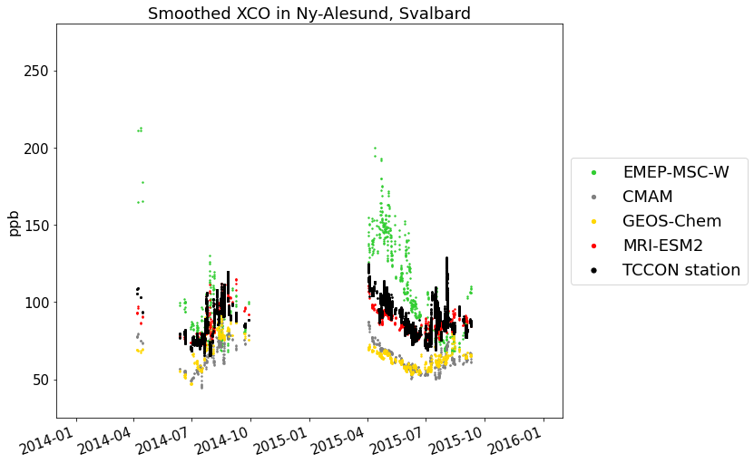
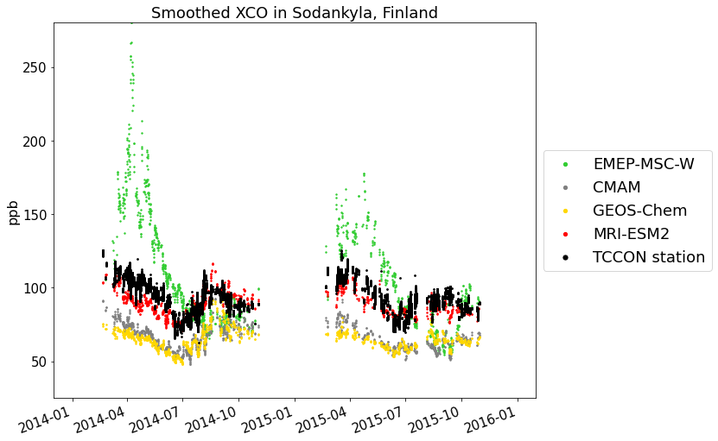
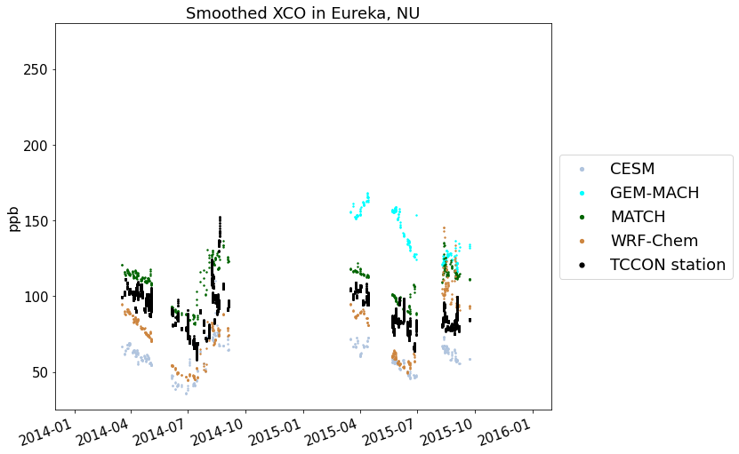
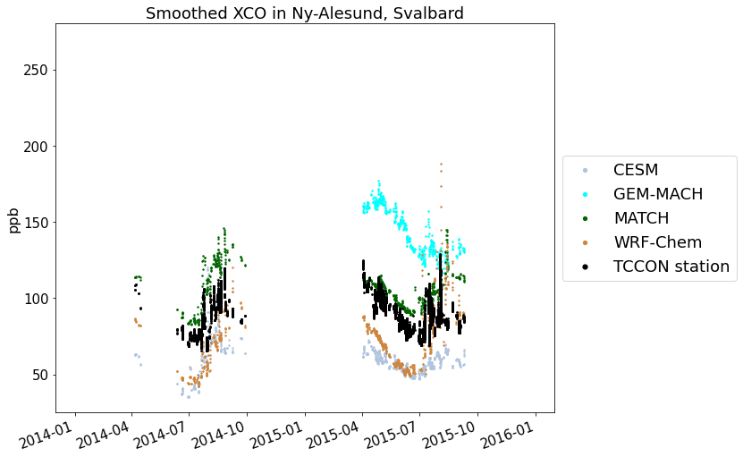
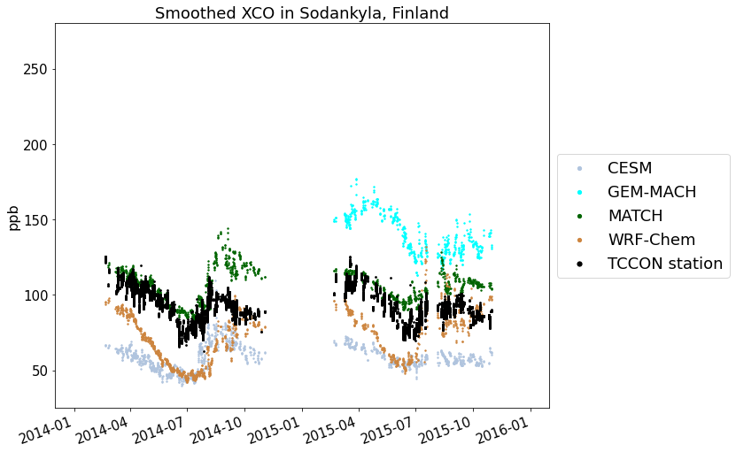
Time series – XCO, smoothed
Eureka, NU
Ny-Ålesund, Svalbard
Sodankylä, Finland
Notes:
I have separated the many models that model CO into two different plots for improved legibility – here plots that are on top of one another are for the same site
-Seasonal biases in some models (EMEP, MATCH)

Slide 8
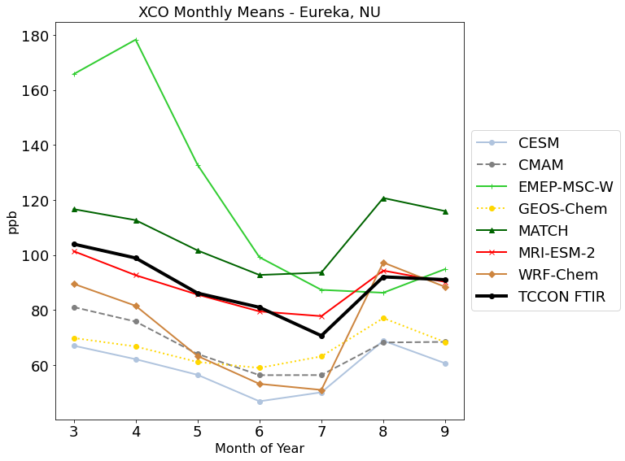
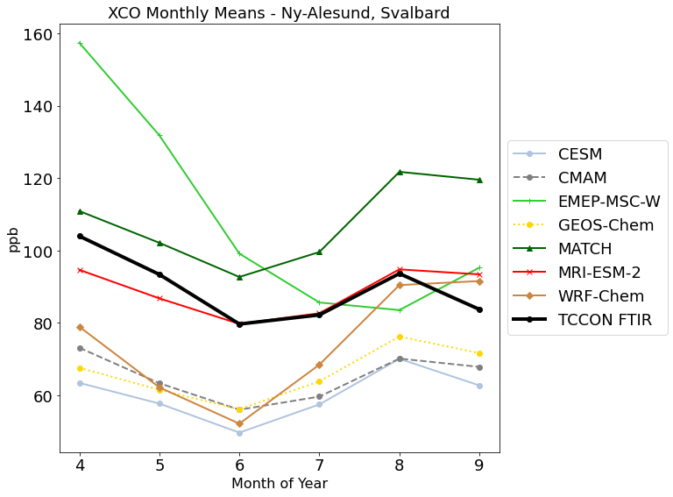
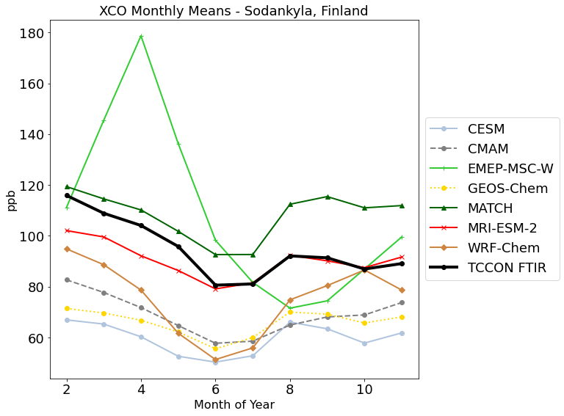
Monthly Means – XCO, smoothed, 2014-2015
Eureka, NU
Ny-Ålesund, Svalbard
Sodankylä, Finland
Notes:
Monthly means show very well the seasonal bias of EMEP, as well as some other models especially at specific sites
WRF-Chem tends to be biased low except in the late summer and fall months, where it doesn’t seem biased one way or the other, and MATCH appears to become biased high to a greater degree later in the year.
Some models exhibit more consistent bias – CESM, and CMAM, for example, and MRI-ESM-2 doesn’t appear particularly biased at all

Slide 9
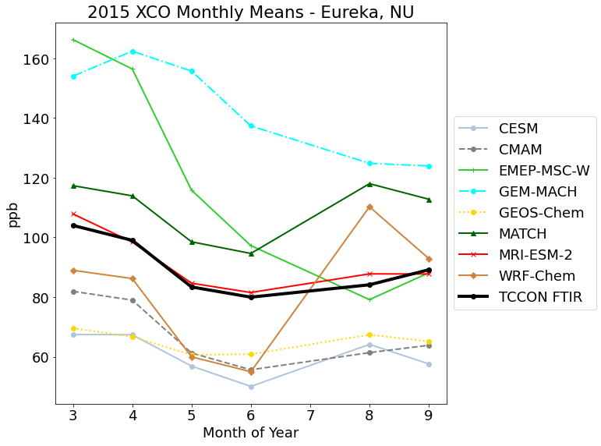
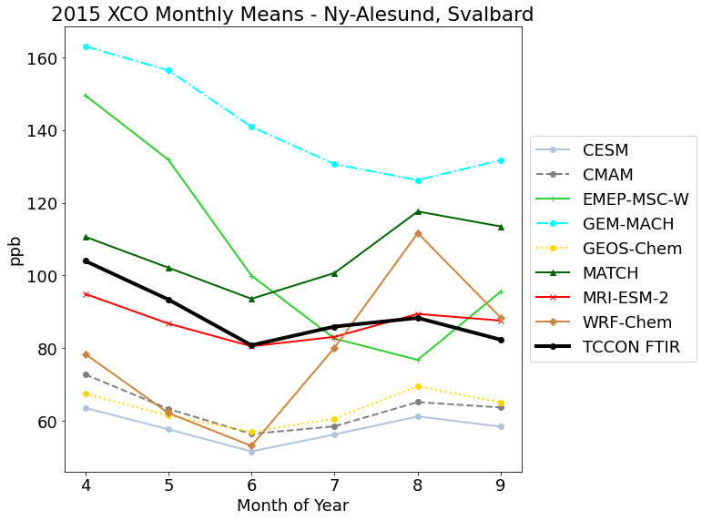
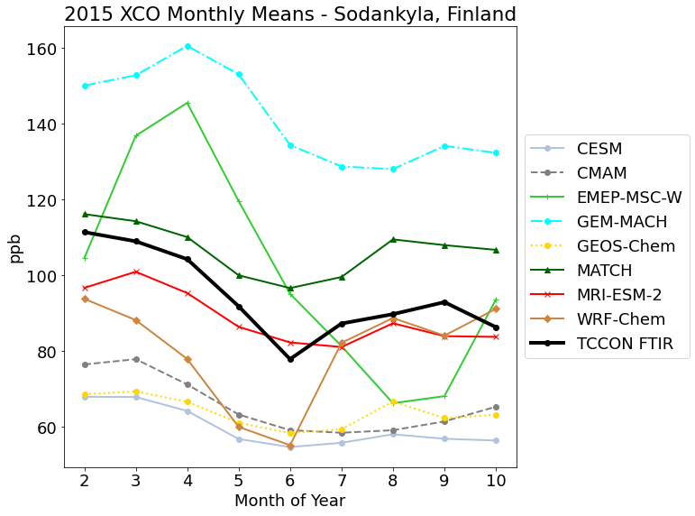
Monthly Means – XCO, smoothed, 2015 only
Eureka, NU
Ny-Ålesund, Svalbard
Sodankylä, Finland
Notes:
In order to compare GEM-MACH monthly means to both TCCON FTIR results and other models, I took only model predictions and TCCON data from 2015 (as GEM-MACH was only provided for 2015).

Slide 10
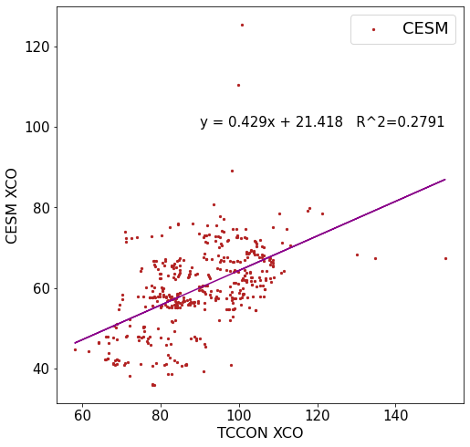
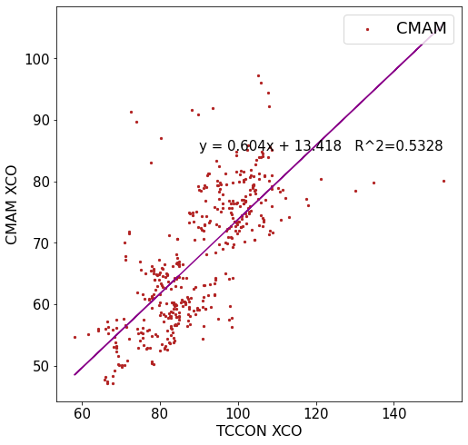
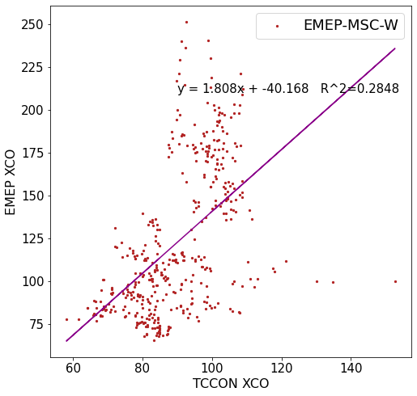
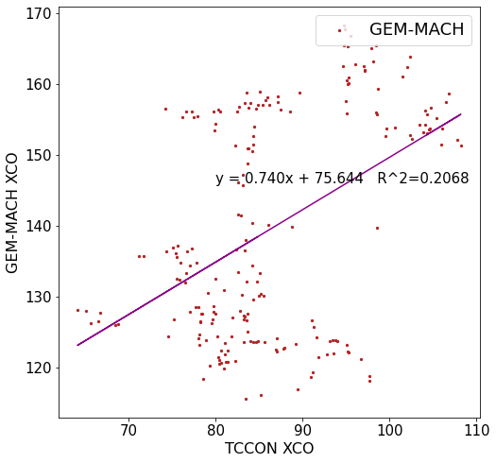
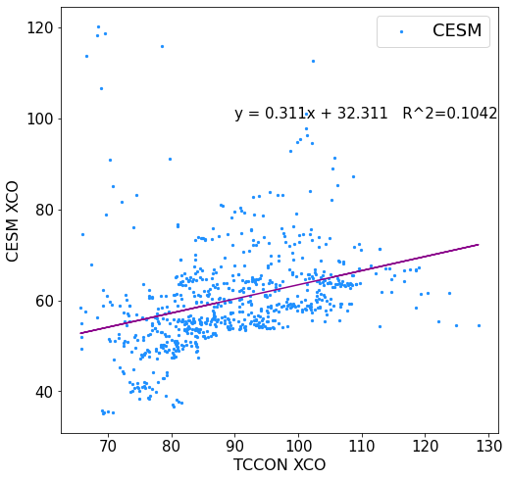
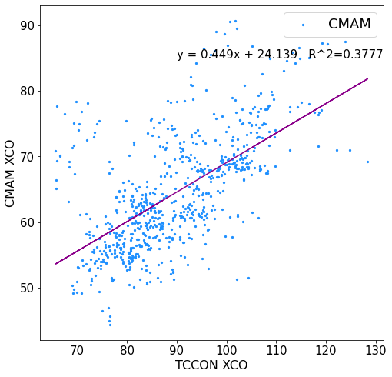
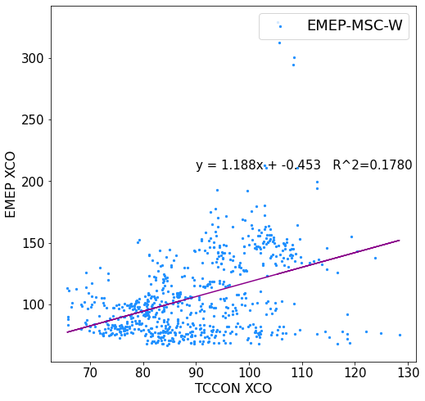
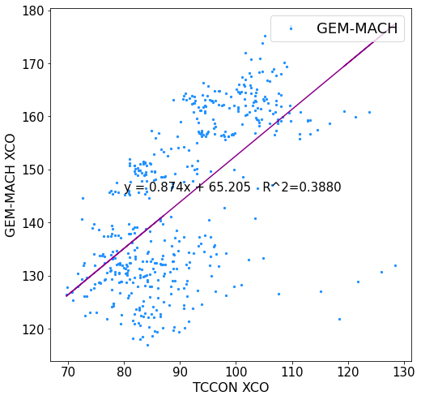
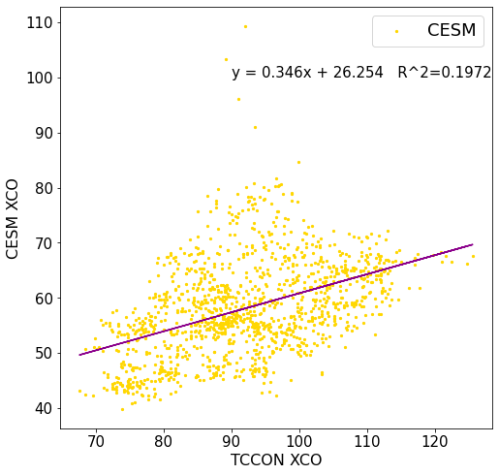
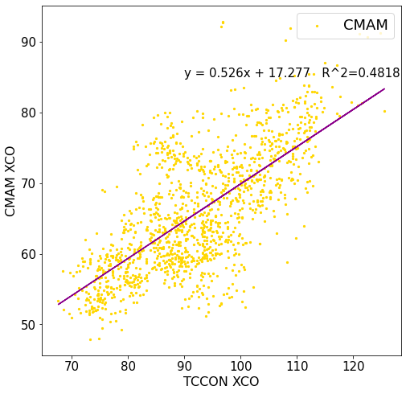
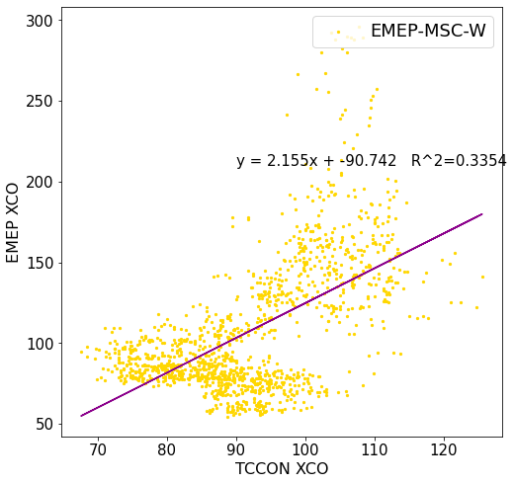
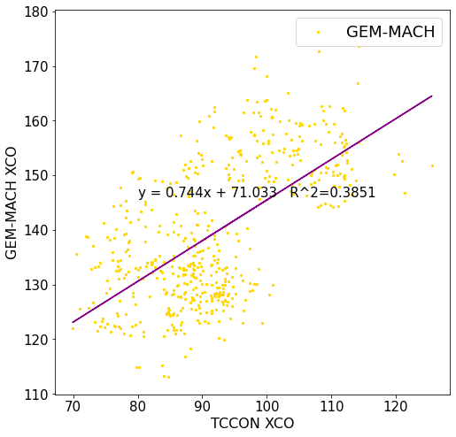
Eureka
Ny Ålesund
Sodankylä
Notes:
Correlation plots show the model XCO on the y axis and the TCCON XCO on the x axis – I apologize for the very small text on these plots. Here we have CESM, CMAM, EMEP-MSC-W, and GEM-MACH

Slide 11
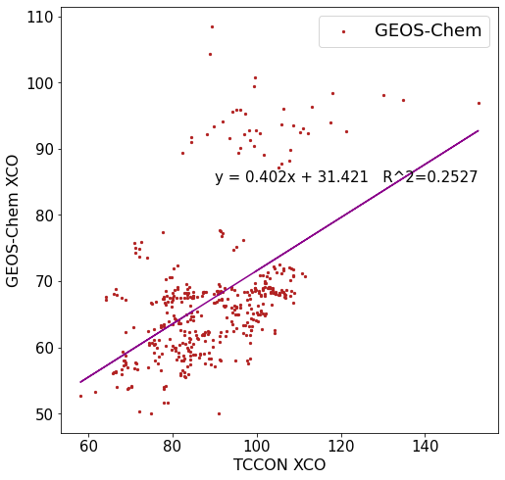
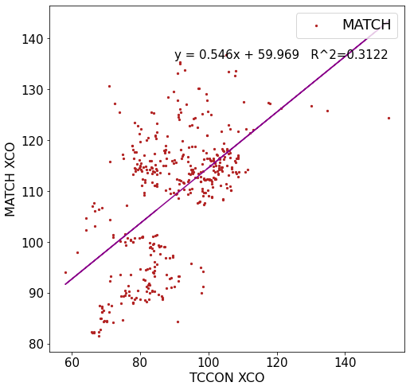
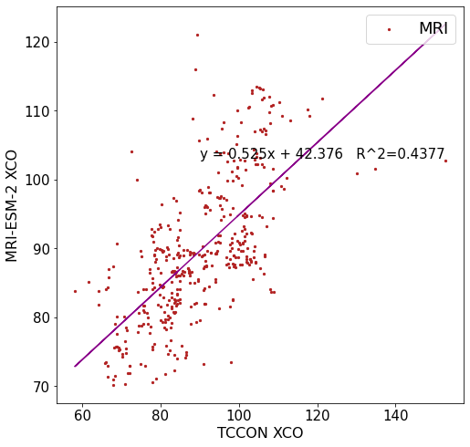
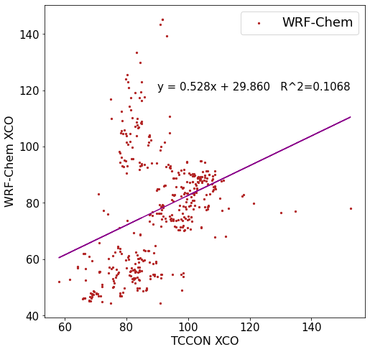
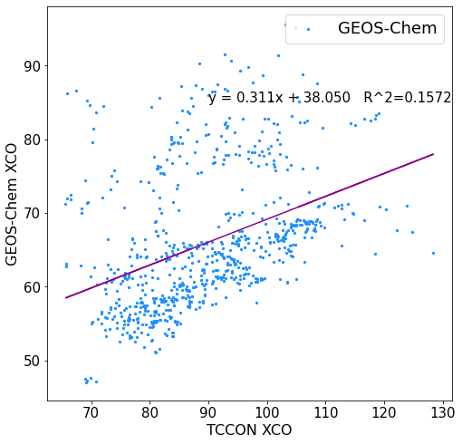
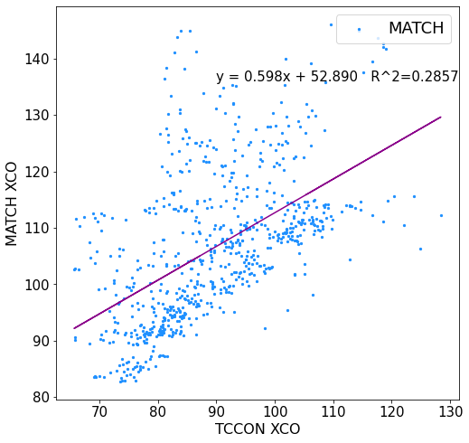
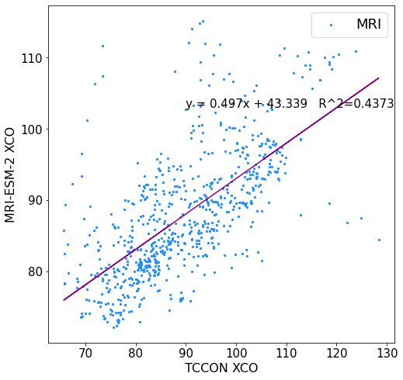
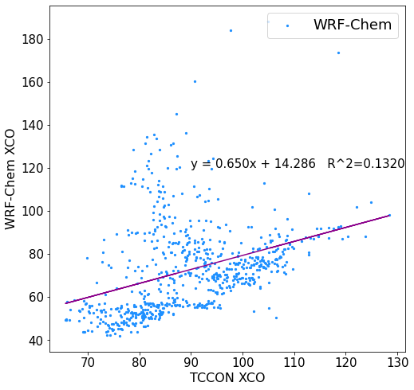
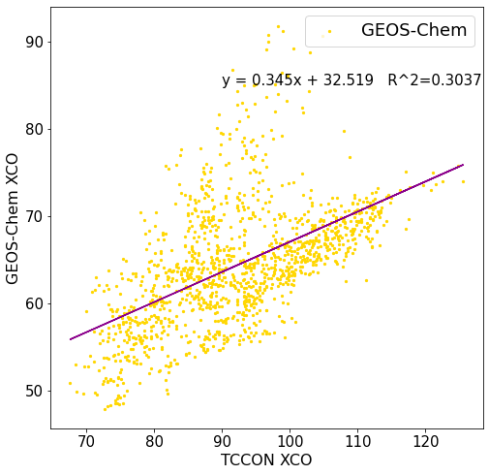
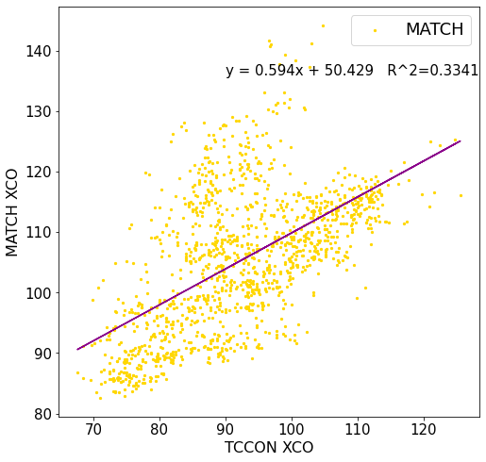
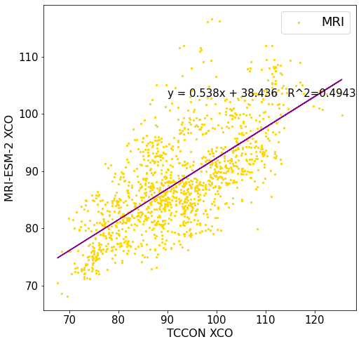
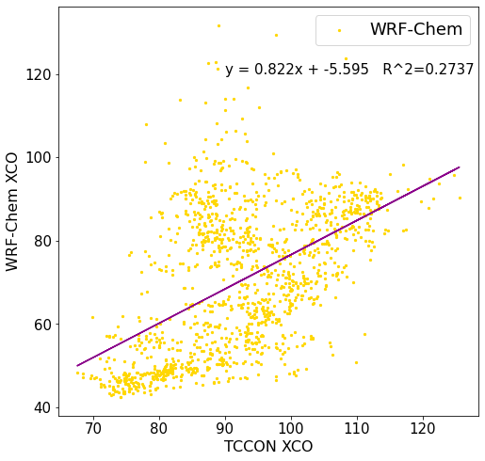
Eureka
Ny Ålesund
Sodankylä
Notes:
Here we have GEOS-Chem, MATCH, MRI-ESM2, and WRF-Chem

Slide 12
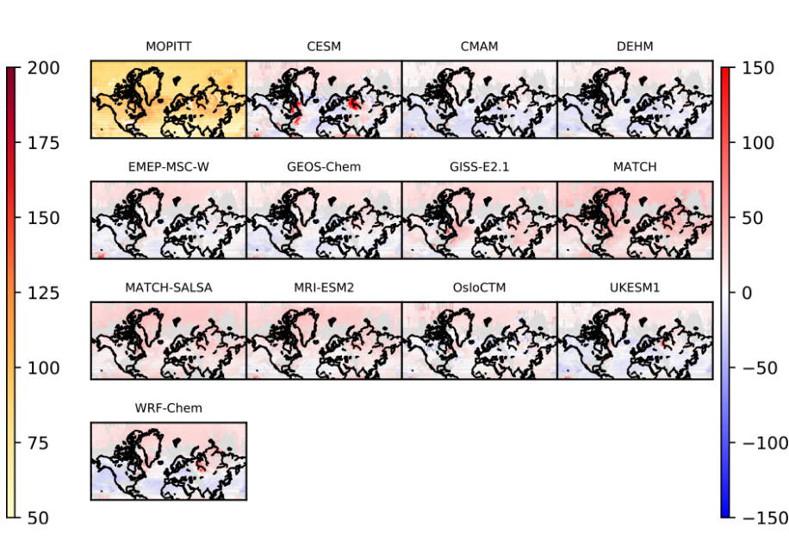
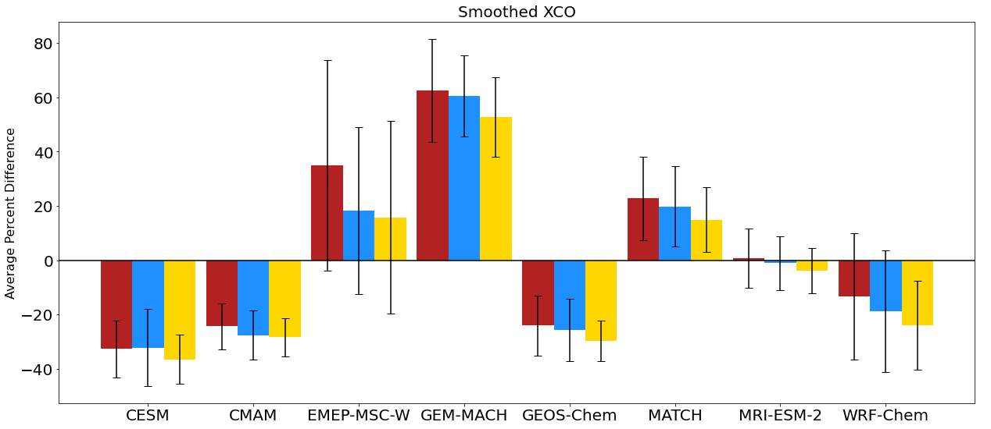
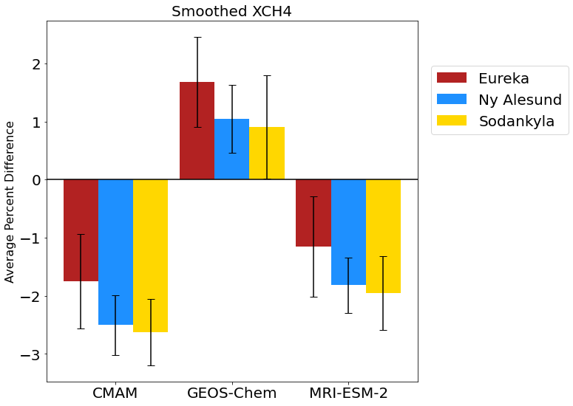
Consistency with Other Analyses
Figure 12 from Whaley et al. 2022: Summertime (JJA) (top left) mean MOPPIT CO at 600 hPa (ppbv, left color bar) and (remaining panels) model biases (model minus measurement, ppbv, right color bar) for 2014-2015
Notes:
Ignoring some models that we were not provided, and noting that GEM-MACH is not included in the figure on the right, we can see some plausibly similar trends, though it is sometimes hard to tell in Eureka due to the density of coastline outlines. We can certainly see that CMAM is biased low and MATCH is biased high (with the possible exception of Sodankyla), but my analysis of other models may not necessarily agree at all sites. So, some differences do emerge, but this comparison is not one-to-one – this shows only summertime months and we have included some spring and fall months where possible, and as we saw before many models performed better or worse seasonally. Additionally, the quantity on the right is MOPITT CO at 600 hPa, not the column-averaged dry air mole fraction, and therefore model biases in other parts of the atmosphere could affect our results.
Considering that the paper on the right found that CO was in general biased low in the Arctic when taking a multi-model mean, and considering that they did not include GEM-MACH, which is by far the highest-biased model in our investigation, we can broadly say that our overall conclusions about model bias in the Arctic wouldn’t be dissimilar

Slide 13
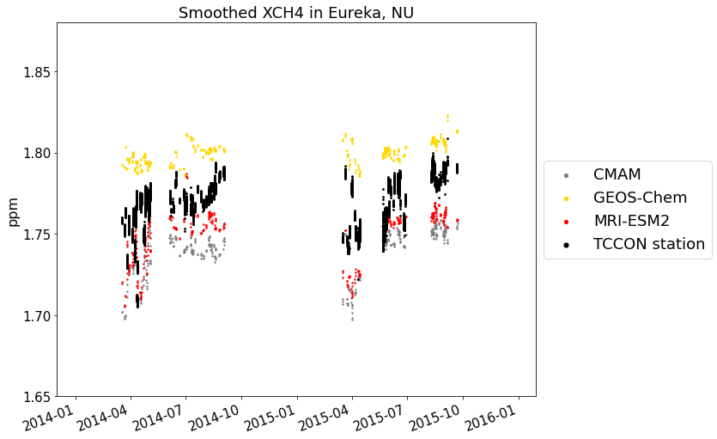
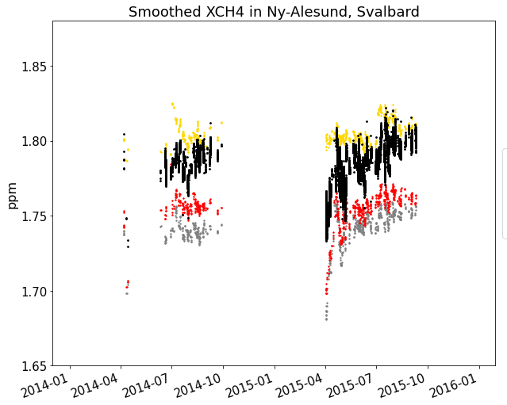
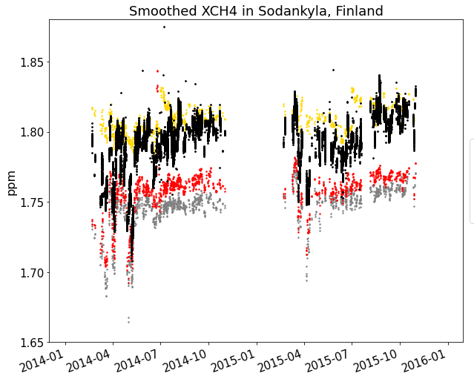
Time series – XCH₄, smoothed
Eureka, NU
Ny-Ålesund, Svalbard
Sodankylä, Finland
Notes:
Models all do fairly similarly for methane, with GEOS-Chem appearing to have on average good agreement at all sites, but other modes may better capture time series features – amounts of variability, etc.

Slide 14
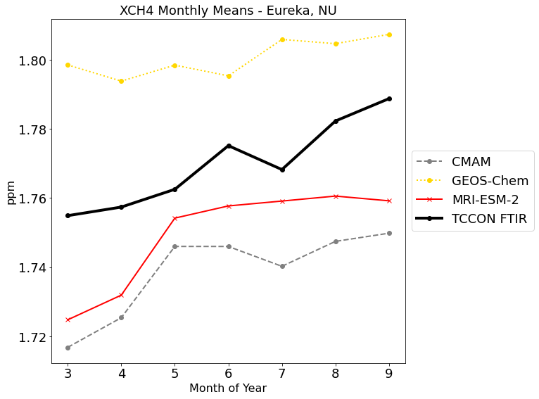


Monthly Means – XCH_{4,} smoothed, 2014-2015
Eureka, NU
Ny-Ålesund, Svalbard
Sodankylä, Finland
Notes:
Similarly to the time series, we can see GEOS-Chem on average reproduces the seasonal cycle well, but this is not the full story

Slide 15









Eureka
Ny Ålesund
Sodankylä
Notes:
CMAM & MRI vs GEOS-Chem for correlations

Slide 16

Consistency with Other Analyses
Figure 5 from Whaley et al. 2022: Measured surface-level methane (top left) (ppbv, left color bar) and (remaining panels) model biases (model minus measurement, also ppbv, right color bar) for 2014-2015
Notes:
We were not provided with methane outputs for GISS, OsloCTM, or UKESM1, and since methane is prescribed rather than modelled by EMEP-MSC-W it has been neglected from my analysis at the behest of the EMEP modelling team. However, for the three models we do have in common with this figure from Cyndi’s paper, we see that CMAM and MRI-ESM-2 are indeed biased low in the high Arctic, while GEOS-Chem is biased high.

Slide 17
Conclusions
First comparison of AMAP models with column-averaged dry air mole fractions from TCCON
Most models show internally consistent results across the three TCCON sites
MRI-ESM-2 and CMAM appear to outperform other models for predicting Arctic XCO and XCH₄ when it comes to fitting correlations
These results appear to be broadly consistent with other validations of AMAP models using surface in-situ and satellite data, especially for methane
Future work
  Extending to TCCON sites at lower latitudes

Slide 18









Thank you for listening!
Special thanks to my collaborators: S. Roche, V. Flood, and the entire TCCON collaboration as well as the AMAP SLCF Modelling Team
AMAP, 2021. Impacts of Short-lived Climate Forcers on Arctic Climate, Air Quality, and Human Health. Summary for Policy-makers. Arctic Monitoring and Assessment Programme (AMAP), Tromsø, Norway.
Ballinger, T.J.,et al., 2020: Surface Air Temperature. Arctic Report Card 2020, R.L. Thoman, J. Richer-Menge, and M.L. Druckenmiller, Eds., doi:10.25923/gcw8-2z06
CANDAC, Bruker Information. https://www.candac.ca/candac/Instruments/Docs/BRUKER_info_en.pdf Retrieved May 21st, 2021
Ganesan, A. L., et al. (2019). Advancing Scientific Understanding of the Global Methane Budget in Support of the Paris Agreement. Global Biogeochemical Cycles, 33(12), 1475–1512. https://doi.org/10.1029/2018gb006065
IPCC, 2019: Summary for Policymakers. In: IPCC Special Report on the Ocean and Cryosphere in a Changing Climate [H.-O. Pörtner, D.C.Roberts, V. Masson-Delmotte, P. Zhai, M. Tignor, E. Poloczanska, K. Mintenbeck, M. Nicolai, A. Okem, J. Petzold, B. Rama, N. Weyer (eds.)]. In press.
PEARL-CANDAC, PEARL FTS. https://www.pearl-candac.ca/website/index.php/instrumentation/pearl-fts/ Retrieved June 2nd 2022
Schuur, E. A et al. (2015). Climate change and the permafrost carbon feedback. Nature, 520(7546), 171–179. https://doi.org/10.1038/nature14338 TCCON, 2021. TCCON Sites. https://tccon-wiki.caltech.edu/Main/TCCONSites Retrieved May 21st, 2021
Whaley, C. H. et al. (2022). Model evaluation of short-lived climate forcers for the Arctic Monitoring and Assessment Programme: a multi-species, multi-model study. Atmos. Chem. Phys., 22, 5775–5828. doi:10.5194/acp-22-5775-2022
Zhang, L. L., et al. (2017). A comparison of satellite observations with the XCO2 surface obtained by fusing TCCON measurements and GEOS-Chem model outputs. Science of the Total Environment, 601–602, 1575–1590. https://doi.org/10.1016/j.scitotenv.2017.06.018

Slide 19



Smoothing and Dry Air Corrections and Calculation of Xgas
$$Xgas=h^{T}x_{prior}+{\left(d\right)}^{T}(x_{model}−x_{prior})$$
$$a_{j}≡TCCON averaging kernel at level j$$
$$d_{j}≡h_{j}a_{j}, elementwise product of the pressure$$
$$weighting function and the averaging kernel$$
Notes:
Priors and averaging kernels are 3-hourly as well and on the same time markers, so we take the temporally nearest prior & averaging kernel and use it to smooth the model profile, as well as convert it to Xgas in the process

