Slide 1
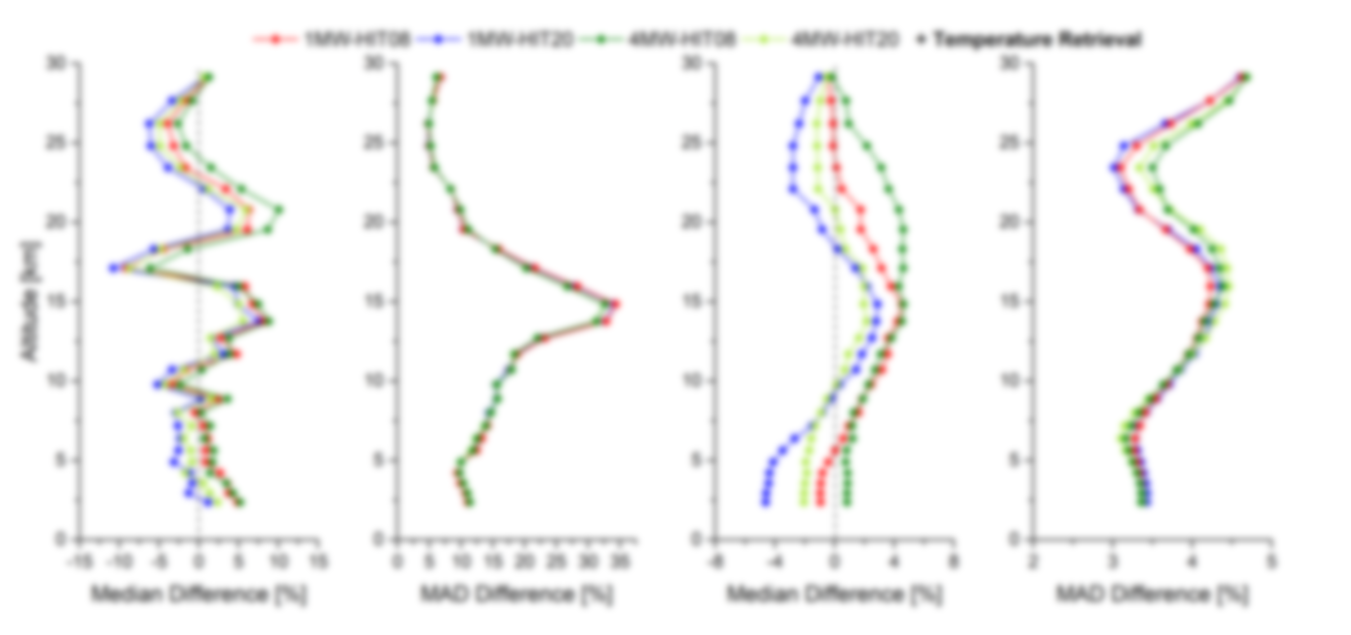
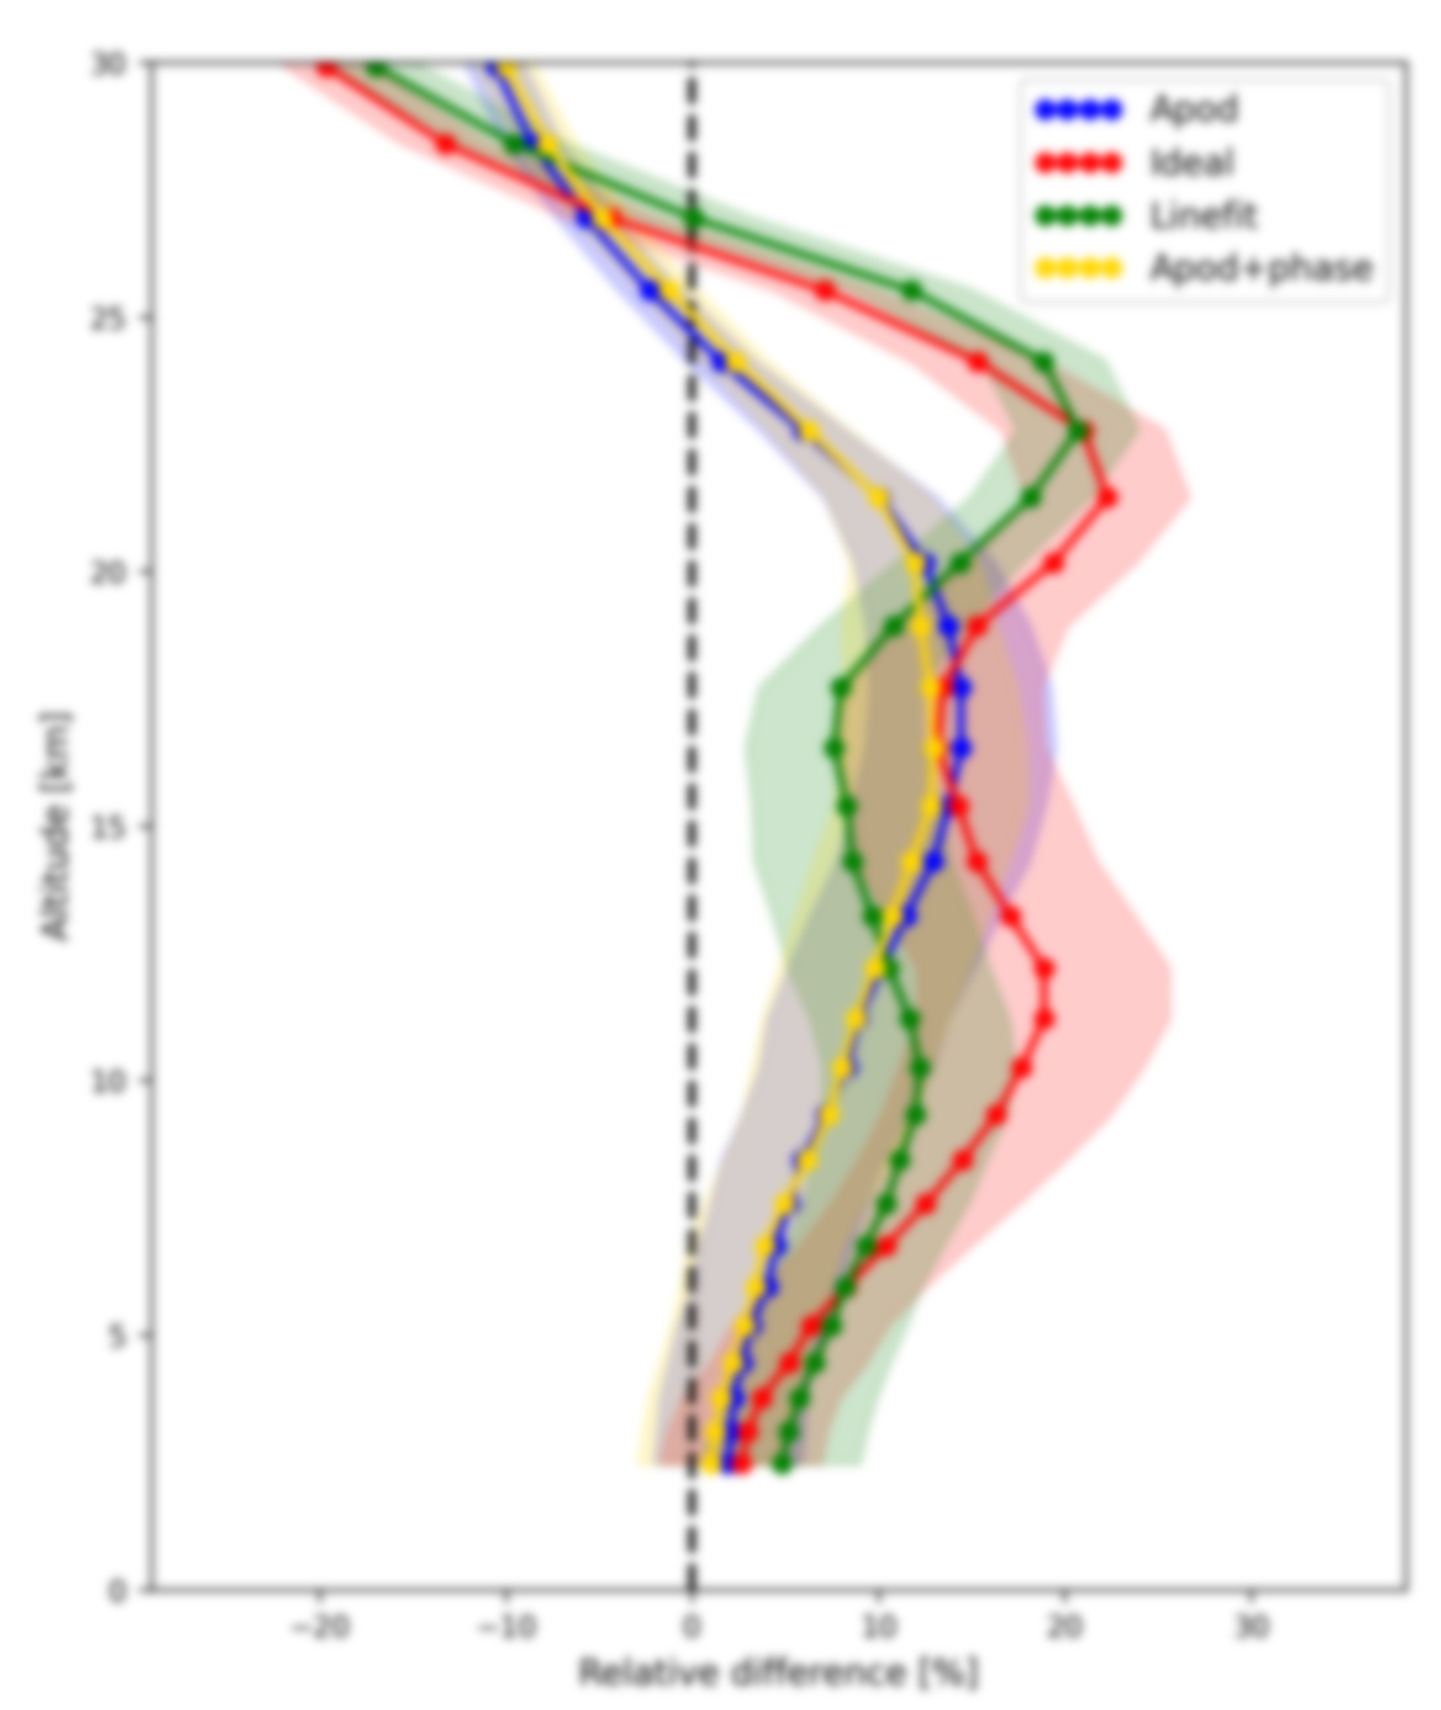
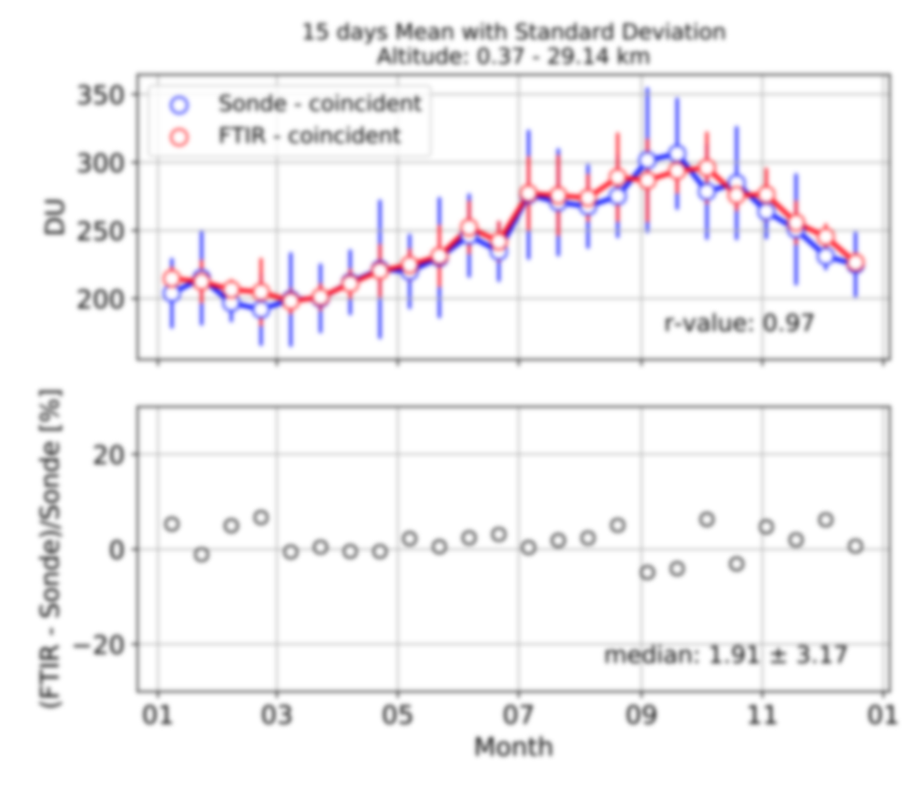
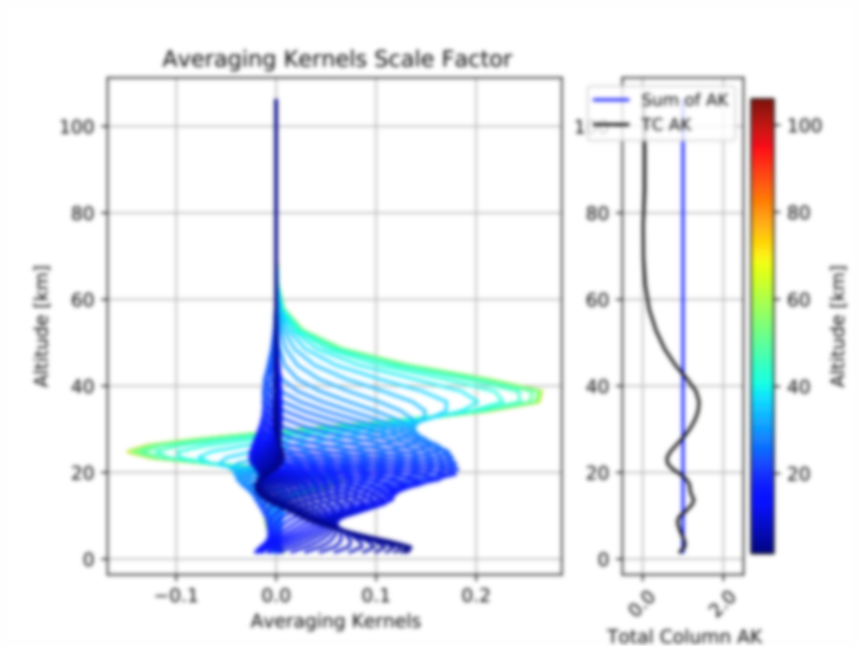
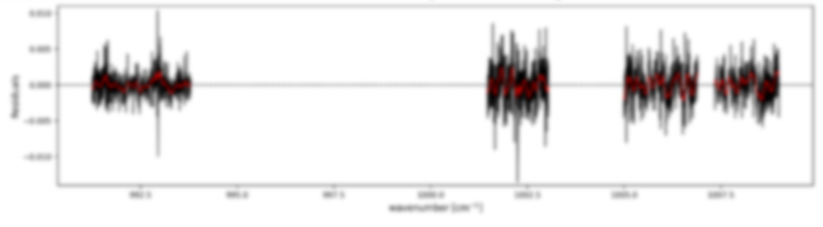
Updates on the ozone retrieval strategy
IRWG meeting – Spa – 2023
Robin Björklund, Ivan Ortega, Corinne Vigouroux, Omaira García, Dan Smale, James Hannigan, Nicholas Jones, Emmanuel Mahieu

Slide 2
Overview
Start from current NDACC ozone retrieval strategy (Vigouroux, ACP 2015)
Change retrieval method one aspect at a time:
Spectroscopy
Spectral range
A priori
Regularization
ILS
Temperature retrieval
Analyze effect on RMS, DOFS, uncertainties, total column and profile
Validate against Brewer/Dobson (columns) and sondes (profiles and columns)
Use datasets mainly from Lauder, Maido, Boulder, and Izaña

Slide 3
Spectroscopy
Current spectroscopic line list HITRAN2008
Compare with new lists HITRAN2020 (Gordon et al. 2022), and ATM2020 (Geoff Toon)

Slide 4
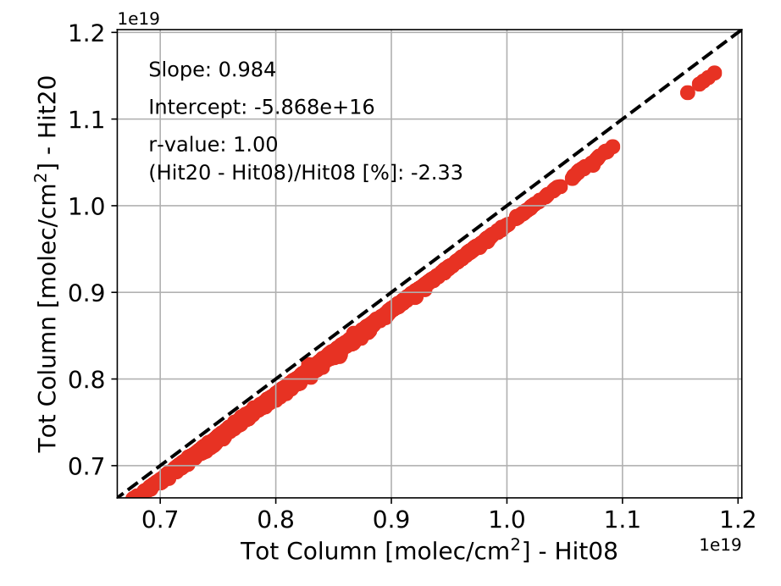
Spectroscopy
Current spectroscopic line list HITRAN2008
Compare with new lists HITRAN2020 (Gordon et al. 2022), and ATM2020 (Geoff Toon)
Results:
HIT20 improves the quality of retrievals (residuals, RMS, DOFS) in comparison with HIT08
Water vapor lines from ATM20 further improves the retrieval (especially for humid sites)
Combination of HIT20 with H₂O from ATM20 seems most ideal
All sites show decrease in total ozone column when changing from HIT08 to HIT20 by about 2-3%

Slide 5
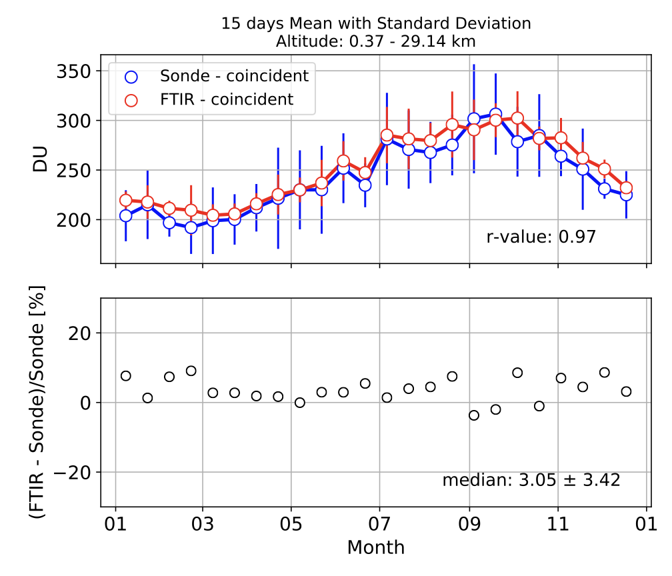
Spectroscopy
Decreased column from changing to HIT20 improves comparison to Dobson and Brewer as well as collocated ozonesondes
Example: Lauder ozonesonde comparison (0.37-29.14km)
HIT08
HIT20

Slide 6
Spectral range
Choice of microwindow (MW) to perform retrieval on is important: we need strong O₃ lines without too much interference from other molecules
We compare the current 1 MW approach (1000-1005 cm⁻¹) to 4 more narrow MWs which avoid strong water vapor lines (García et al., 2022; Schneider and Hase, 2008)

Slide 7
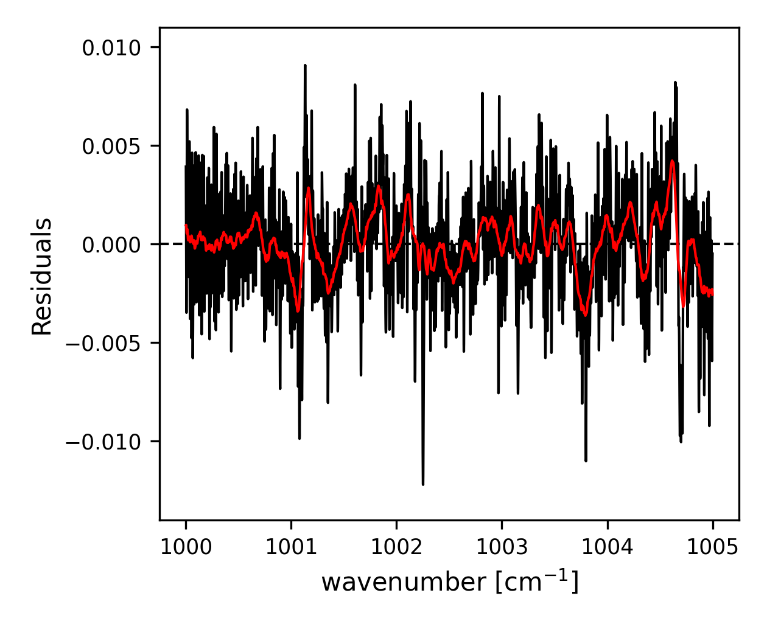
Spectral range
Choice of microwindow (MW) to perform retrieval on is important: we need strong O₃ lines without too much interference from other molecules
We compare the current 1 MW approach (1000-1005 cm⁻¹) to 4 more narrow MWs which avoid strong water vapor lines (García et al., 2022; Schneider and Hase, 2008)
Results:
Clear improvement for all sites with better RMS and higher vertical sensitivity
Similar or improved uncertainties
Columns are very similar for both spectral ranges

Slide 8
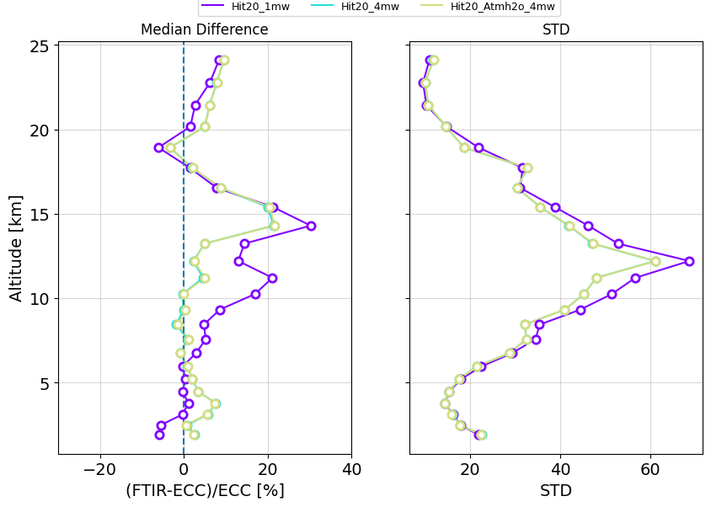
Spectral range
Results from ozonesonde comparison slightly more ambiguous:
4MW retrievals show improvement in the comparisons with ozonesonde in the upper troposphere/ lower stratosphere and 1MW shows slightly better results in the stratosphere (Boulder)
4MW approach is still most consistent and has least spread (also at Lauder, Maido)

Slide 9
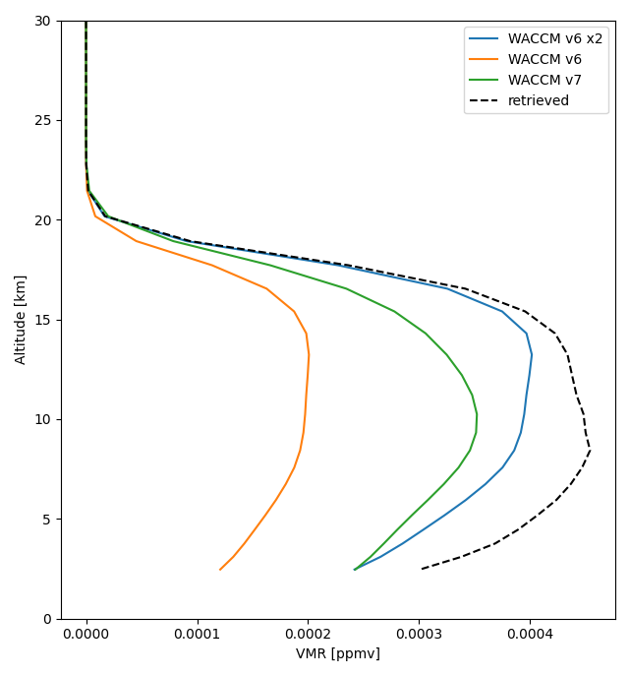
A priori
Compare retrievals with currently used WACCM version 6 and newer version 7
(WACCM, Marsh et al.2013)
Statistics (RMS, DOFS,…) are very similar both for WACCM v6 and WACCM v7
Total columns are unchanged for all sites
Comparison with sonde profile: slight preference for v7 at Lauder, but v6 at Boulder
Only additional arguments to choose v7 is for consistency with this choice with other target molecules
For example: WACCM v7 improves a priori estimate for C₂H₆ at Maido

Slide 10
Regularization
We tested the choice of regularization of the a priori covariance matrix S_{a}, comparing the currently used Optimal Estimation (OE, Rodgers 2000) against Tikhonov regularization (Tikhonov 1963) with higher constraint

Slide 11
Regularization
We tested the choice of regularization of the a priori covariance matrix S_{a}, comparing the currently used Optimal Estimation (OE, Rodgers 2000) against Tikhonov regularization (Tikhonov 1963) with higher constraint
Results:
No effect on total column
New regularization provides better agreement with sondes in the troposphere, but worse than OEM (10%) in lower and middle stratosphere, so no clear preference
Setup for Tikhonov only requires optimizing regularization strength parameter in function of RMS and DOFS (aiming for DOFS = 3 – 5)
Improvement with long-term trends when comparing to ozonesondes at Lauder
Drift with sonde | Troposphere 0.5 – 11 km | Low stratosphere 14 – 22 km | Mid stratosphere 22 – 29 km
OE | -3.1 ± 2.1 | -0.5 ± 1.5 | 0.6 ± 1.4
Tikhonov | -0.2 ± 2.3 | -1.0 ± 1.4 | 0.1 ± 1.2

Slide 12
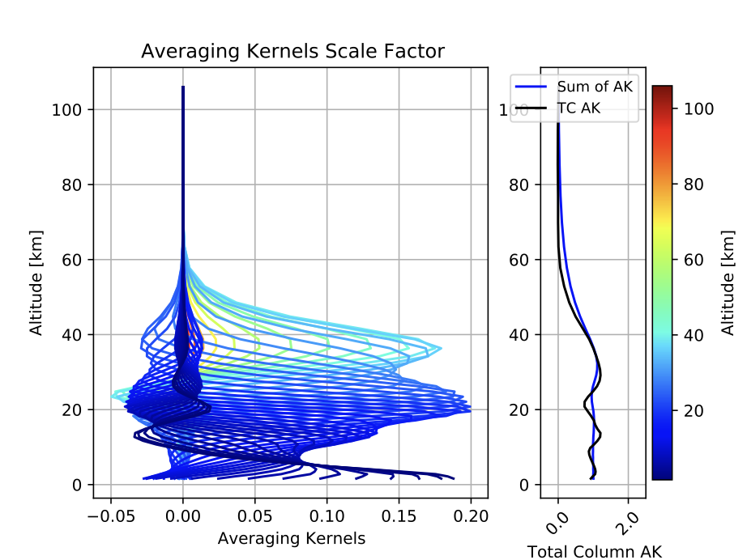
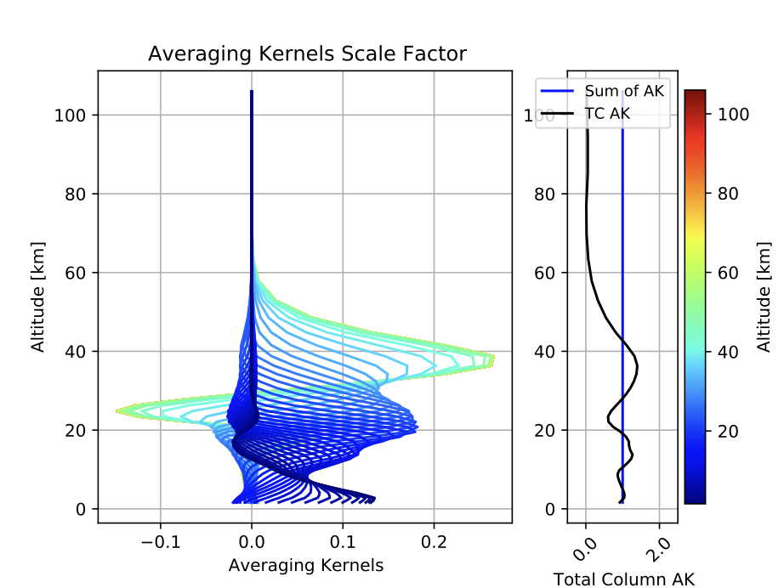
Regularization
Small concern for Tikhonov: AVKs show additional negative values for dependence of highest altitudes on ~25km

Slide 13
ILS retrieval
We tested the approach of handling the Instrument Line Shape (ILS) split into three main options:
Ideal ILS
ILS from LINEFIT
Retrieved ILS

Slide 14
ILS retrieval
We tested the approach of handling the Instrument Line Shape (ILS) split into three main options:
Ideal ILS
ILS from LINEFIT
Retrieved ILS
Results:
Izaña: ILS retrieved with 2nd order polynomial offers best performance in retrieval strategy
Maido: retrieving ILS improves RMS and precision. Better O3 sonde comparison except in lower stratosphere
Lauder: ILS tests shows instrument line shape close to ideal, so ideal ILS can be used in retrieval
No clear overlapping results from different sites
Situation might vary strongly depending on site concerning availability of cell measurements or typical instrumental changes. Choice is left to the groups

Slide 15
ILS retrieval
Sonde comparison for different ILS strategies at Maido
We see better results when retrieving ILS but worry of retrieving ILS is that you force your lines to be fitted
Information from lamps using LINEFIT help with determining instrument effects but not all site have consistent lamp measurements…

Slide 16
Temperature retrieval
Simultaneous retrieval of temperature using extra 4 CO₂ microwindows instead of relying on NCEP temperature profiles
For instruments properly characterized and stable over time:
Clear improvements in retrieval of ozone and its precision (for example at Izaña)
but
Unstable instruments are negatively affected
Cross-interference between T-retrieval and instrument performance
Stable instruments can benefit from temperature retrieval (at the cost of computation time), but currently we do not include this change in the strategy

Slide 17
Summary of decisions
Spectroscopy
Microwindows
A priori
Regularization
ILS retrieval
T retrieval
HITRAN2020 + ATM20 for H₂O
4 microwindows
WACCM version 7
Tikhonov
Depends on site
No. But more study needed
Improves columns
Avoids water interference
Consistent with other molecules
Improves long-term trends
Cell measurement available?
Good for stable instruments
Strategy also tested by Yana Virolainen for St. Petersburg (Thanks!)
Full retrievals with new strategy for other sites will soon be needed

