Slide 1
IRWG spectral line list evaluation project
O3+Temperature Retrieval
Izaña

Slide 2
Temperature Retrieval Settings
Based on “Schneider, M. and Hase, F.: Technical Note: Recipe for monitoring of total ozone with a precision of around 1 DU applying mid-infrared solar absorption spectra, Atmos. Chem. Phys., 8, 63–71, doi:10.5194/acp-8-63-2008, 2008”
Four temperature microwindows with isolated CO2 signatures are added to the O3 microwindows: 962.80–963.80, 964.25–965.25, 967.20–968.20, 968.60–969.60 cm-1.
CO2 is retrieved using a scaling retrieval, whereas temperature profile is retrieved using an optimal estimation on a linear scale simultaneously to the O3 profile.
The a priori temperature profiles are taken from the daily NCEP PT profiles, and the a-priori temperature covariance is constructed assuming an uncertainty correlation length of 10 km (excluding the boundary layer, ie, the first level at IZO) and uncertainty values of 2 K in the boundary layer, 1 K throughout the rest of the troposphere, and 5 K above the tropopause.
Results shown in the following slides (years 2018-2020) with/without a simultaneous temperature retrieval:
Performance for 1MW/4MW using different spectroscopic databases (HIT2008, ATM2020, HIT2020) and WACCM versions (V6, V7)
Comparisons to coincident ECC sondes (partial columns and profiles)
Comparisons to coincident Brewer total columns

Slide 3
Spectroscopy: HIT08/Atm20/HIT20
LINEFIT ILS | 1 MW-HIT08 | 4MW-HIT08 | 1 MW-Atm20 | 4 MW-Atm20 | 1 MW-HIT20 | 4 MW-HIT20
O3 total column [10¹⁸ molec/cm²] | 7.89 | 7.90 | 7.89 | 7.89 | 7.71 | 7.72
O3 apriori [10¹⁸ molec/cm²]
H2O total column [10²¹ molec/cm²] | 1.49 | Na | 1.65 | NA | 1.69 | NA
H2O apriori [10²¹ molec/cm²]
RMS [10⁴ a.u.r.] | 0.99 | 0.85 | 0.89 | 0.86 | 0.86 | 0.81
DOF | 3.85 | 4.15 | 3.93 | 4.14 | 3.96 | 4.18
Random [%] | 1.84 | 1.79 | 1.84 | 1.79 | 1.85 | 1.78
Systematic [%] | 3.09 | 3.09 | 3.10 | 3.09 | 3.10 | 3.09
Diff60 [10¹⁶ molec/cm²]//[%] | 8.56//1.09 | 8.68//1.10 | 8.57//1.09 | 8.73//1.11 | 8.38//1.09 | 8.39//1.09
σ_{daily mean} [10¹⁶ molec/cm²] | 3.37 | 3.39 | 3.40 | 3.41 | 3.33 | 3.27
Mean SNR(Mean NSR 1001.47-1003.04 cm⁻¹) | 0.003358 | 0.003286 | 0.003333 | 0.003275 | 0.003173 | 0.003164
Number of spectra | 1203 | 1185 | 1205 | 1181 | 1206 | 1195
Conclusions | 4MWs gives the best results (highest DOFS, lowest residues) independently spectroscopy database. The LINEFIT ILS retrieved with a clamped PE offers better performance

Slide 4
Spectroscopy: HIT08/Atm20/HIT20
LINEFIT ILS + Temperature Retrieval | 1 MW-HIT08 | 4MW-HIT08 | 1 MW-Atm20 | 4 MW-Atm20 | 1 MW-HIT20 | 4 MW-HIT20
O3 total column [10¹⁸ molec/cm²] | 7.85 | 7.88 | 7.91 | 7.91 | 7.72 | 7.72
O3 apriori [10¹⁸ molec/cm²]
H2O total column [10²¹ molec/cm²] | 1.42 | NA | 1.67 | NA | 1.68 | NA
H2O apriori [10²¹ molec/cm²]
RMS [10⁴ a.u.r.] | 0.97 | 0.84 | 0.88 | 0.85 | 0.85 | 0.81
DOF | 3.75 | 3.98 | 3.81 | 3.97 | 3.84 | 4.01
Random [%] | 0.51 | 0.43 | 0.51 | 0.43 | 0.51 | 0.43
Systematic [%] | 2.97 | 2.95 | 2.98 | 2.95 | 2.97 | 2.95
Diff60 [10¹⁶ molec/cm²]//[%] | 9.60//1.23 | 9.53 | 9.68//1.23 | 9.64//1.22 | 9.43//1.23 | 9.35//1.22
σ_{daily mean} [10¹⁶ molec/cm²] | 4.42 | 4.33 | 4.56 | 4.37 | 4.52 | 4.23
Mean SNR(Mean NSR 1001.47-1003.04 cm⁻¹) | 0.003319 | 0.003269 | 0.003310 | 0.003257 | 0.003140 | 0.003137
Number of spectra | 1198 | 1183 | 1192 | 1173 | 1204 | 1189

Slide 5
WACCM
1MW, HIT08, LINEFIT ILS | WACCM v6 Without temperature | WACCM v7 Without temperature | WACCM v6 With temperature | WACCM v7 With temperature
O3 total column [10¹⁸ molec/cm²] | 7.89 | 7.89 | 7.85 | 7.85
O3 apriori [10¹⁸ molec/cm²]
H2O total column [10²¹ molec/cm²] | 1.50 | 1.51 | 1.43 | 1.44
H2O apriori [10²¹ molec/cm²]
RMS [10⁴ a.u.r.] | 1.04 | 1.03 | 1.01 | 1.01
DOF | 3.82 | 3.83 | 3.72 | 3.72
Random [%] | 1.84 | 1.84 | 0.52 | 0.52
Systematic [%] | 3.09 | 3.09 | 2.96 | 2.96
Diff60 [10¹⁶ molec/cm²]//[%] | 8.39//1.06 | 8.23//1.06 | 9.48//1.21 | 9.42//1.20
σ_{daily mean} [10¹⁶ molec/cm²] | 3.22 | 3.23 | 4.31 | 4.33
Mean SNR (Mean NSR 1001.47-1003.04 cm⁻¹) | 0.0035 | 0.0035 | 0.0035 | 0.0035
Number of spectra | 1197 | 1170 | 1183 | 1156
Conclusions | Switching to WACCM v7 is similar to WACCM v6

Slide 6
Sonde comparison: altitudes of 1 DOF Surf-13 km
N=43, Surf-13 km | 1MW-HIT08 |  | 4MW-HIT08 |  | 1MW-HIT08 +Temperature Retrieval |  | 4MW-HIT08 +Temperature Retrieval
 | (O3SONDE-FTIR)/FTIR | Same but smoothed O3SONDE | (O3SONDE-FTIR)/FTIR | Same but smoothed O3SONDE | (O3SONDE-FTIR)/FTIR | Same but smoothed O3SONDE | (O3SONDE-FTIR)/FTIR | Same but smoothed O3SONDE
Median [%] | 1.74 | 2.29 | 1.70 | 1.91 | 0.12 | 0.96 | 1.67 | 1.66
MAD [%] | 5.88 | 3.32 | 5.50 | 3.26 | 5.29 | 3.34 | 5.34 | 3.26
STD [%] | 7.62 | 4.69 | 7.06 | 4.61 | 7.12 | 4.76 | 6.90 | 4.58
N=43, surf-13 km | 1MW-HIT20 |  | 4MW-HIT20 |  | 1MW-HIT20 +Temperature Retrieval |  | 4MW-HIT20 +Temperature Retrieval
 | (O3SONDE-FTIR)/FTIR | Same but smoothed O3SONDE | (O3SONDE-FTIR)/FTIR | Same but smoothed O3SONDE | (O3SONDE-FTIR)/FTIR | Same but smoothed O3SONDE | (O3SONDE-FTIR)/FTIR | Same but smoothed O3SONDE
Median [%] | -1.11 | -0.79 | -0.47 | -0.47 | -2.00 | -1.86 | -0.72 | -0.96
MAD [%] | 5.53 | 3.29 | 5.35 | 3.21 | 5.01 | 3.29 | 5.23 | 3.17
STD [%] | 7.20 | 4.63 | 6.91 | 4.58 | 6.77 | 4.66 | 6.80 | 4.53
MAD: Mean Absolute Deviation; STD: Standard Deviation

Slide 7
Sonde comparison: altitudes of 1 DOF 11.5-23.5 km
N=43, 11.5-23.5 km | 1MW-HIT08 |  | 4MW-HIT08 |  | 1MW-HIT08 +Temperature Retrieval |  | 4MW-HIT08 +Temperature Retrieval
 | (O3SONDE-FTIR)/FTIR | Same but smoothed O3SONDE | (O3SONDE-FTIR)/FTIR | Same but smoothed O3SONDE | (O3SONDE-FTIR)/FTIR | Same but smoothed O3SONDE | (O3SONDE-FTIR)/FTIR | Same but smoothed O3SONDE
Median [%] | 3.17 | 5.25 | 2.89 | 5.38 | 1.98 | 3.74 | 3.30 | 5.17
MAD [%] | 4.80 | 3.16 | 4.36 | 3.41 | 4.74 | 3.41 | 4.61 | 3.62
STD [%] | 5.94 | 4.10 | 5.54 | 4.37 | 5.83 | 4.31 | 5.88 | 4.73
N=43, 11.5-23.5 km | 1MW-HIT20 |  | 4MW-HIT20 |  | 1MW-HIT20 +Temperature Retrieval |  | 4MW-HIT20 +Temperature Retrieval
 | (O3SONDE-FTIR)/FTIR | Same but smoothed O3SONDE | (O3SONDE-FTIR)/FTIR | Same but smoothed O3SONDE | (O3SONDE-FTIR)/FTIR | Same but smoothed O3SONDE | (O3SONDE-FTIR)/FTIR | Same but smoothed O3SONDE
Median [%] | 0.61 | 2.47 | -0.25 | 2.16 | -0.24 | 0.92 | -0.32 | 1.51
MAD [%] | 4.58 | 3.19 | 4.33 | 3.44 | 4.76 | 3.40 | 4.61 | 3.70
STD [%] | 5.75 | 4.15 | 5.51 | 4.39 | 5.87 | 4.27 | 5.86 | 4.79
MAD: Mean Absolute Deviation; STD: Standard Deviation

Slide 8
Sonde comparison: altitudes of 1 DOF 22-29.5 km
N=43, 22-29.5 km | 1MW-HIT08 |  | 4MW-HIT08 |  | 1MW-HIT08 +Temperature Retrieval |  | 4MW-HIT08 +Temperature Retrieval
 | (O3SONDE-FTIR)/FTIR | Same but smoothed O3SONDE | (O3SONDE-FTIR)/FTIR | Same but smoothed O3SONDE | (O3SONDE-FTIR)/FTIR | Same but smoothed O3SONDE | (O3SONDE-FTIR)/FTIR | Same but smoothed O3SONDE
Median [%] | 1.79 | 3.27 | 1.87 | 3.55 | 1.71 | 2.95 | 1.99 | 3.45
MAD [%] | 3.45 | 3.21 | 3.45 | 3.31 | 3.64 | 2.89 | 3.67 | 3.18
STD [%] | 4.54 | 4.36 | 4.78 | 4.54 | 4.79 | 4.38 | 5.07 | 4.92
N=43, 22-29.5 km | 1MW-HIT20 |  | 4MW-HIT20 |  | 1MW-HIT20 +Temperature Retrieval |  | 4MW-HIT20 +Temperature Retrieval
 | (O3SONDE-FTIR)/FTIR | Same but smoothed O3SONDE | (O3SONDE-FTIR)/FTIR | Same but smoothed O3SONDE | (O3SONDE-FTIR)/FTIR | Same but smoothed O3SONDE | (O3SONDE-FTIR)/FTIR | Same but smoothed O3SONDE
Median [%] | 0.14 | 1.28 | 0.04 | 1.49 | -0.55 | 0.51 | -0.82 | 1.40
MAD [%] | 3.39 | 3.19 | 3.47 | 3.27 | 3.51 | 3.81 | 3.55 | 3.08
STD [%] | 4.55 | 4.35 | 4.75 | 4.47 | 4.64 | 4.27 | 4.93 | 4.73
MAD: Mean Absolute Deviation; STD: Standard Deviation

Slide 9
Sonde comparison: surface-29.5 km
N=43, surf-29.5 km | 1MW-HIT08 |  | 4MW-HIT08 |  | 1MW-HIT08 +Temperature Retrieval |  | 4MW-HIT08 +Temperature Retrieval
 | (O3SONDE-FTIR)/FTIR | Same but smoothed O3SONDE | (O3SONDE-FTIR)/FTIR | Same but smoothed O3SONDE | (O3SONDE-FTIR)/FTIR | Same but smoothed O3SONDE | (O3SONDE-FTIR)/FTIR | Same but smoothed O3SONDE
Median [%] | 1.68 | 4.08 | 1.90 | 4.11 | 0.96 | 3.16 | 1.70 | 4.04
MAD [%] | 2.54 | 2.56 | 2.57 | 2.56 | 2.54 | 2.56 | 2.62 | 2.57
STD [%] | 3.22 | 3.40 | 3.31 | 3.45 | 3.37 | 3.61 | 3.59 | 3.86
N=43, surf-29.5 km | 1MW-HIT20 |  | 4MW-HIT20 |  | 1MW-HIT20 +Temperature Retrieval |  | 4MW-HIT20 +Temperature Retrieval
 | (O3SONDE-FTIR)/FTIR | Same but smoothed O3SONDE | (O3SONDE-FTIR)/FTIR | Same but smoothed O3SONDE | (O3SONDE-FTIR)/FTIR | Same but smoothed O3SONDE | (O3SONDE-FTIR)/FTIR | Same but smoothed O3SONDE
Median [%] | -0.74 | 1.61 | -0.44 | 1.84 | -1.71 | 0.52 | -1.03 | 1.06
MAD [%] | 2.54 | 2.55 | 2.56 | 2.56 | 2.51 | 2.49 | 2.59 | 2.61
STD [%] | 3.21 | 3.37 | 3.29 | 3.42 | 3.33 | 3.53 | 3.53 | 3.83
MAD: Mean Absolute Deviation; STD: Standard Deviation

Slide 10
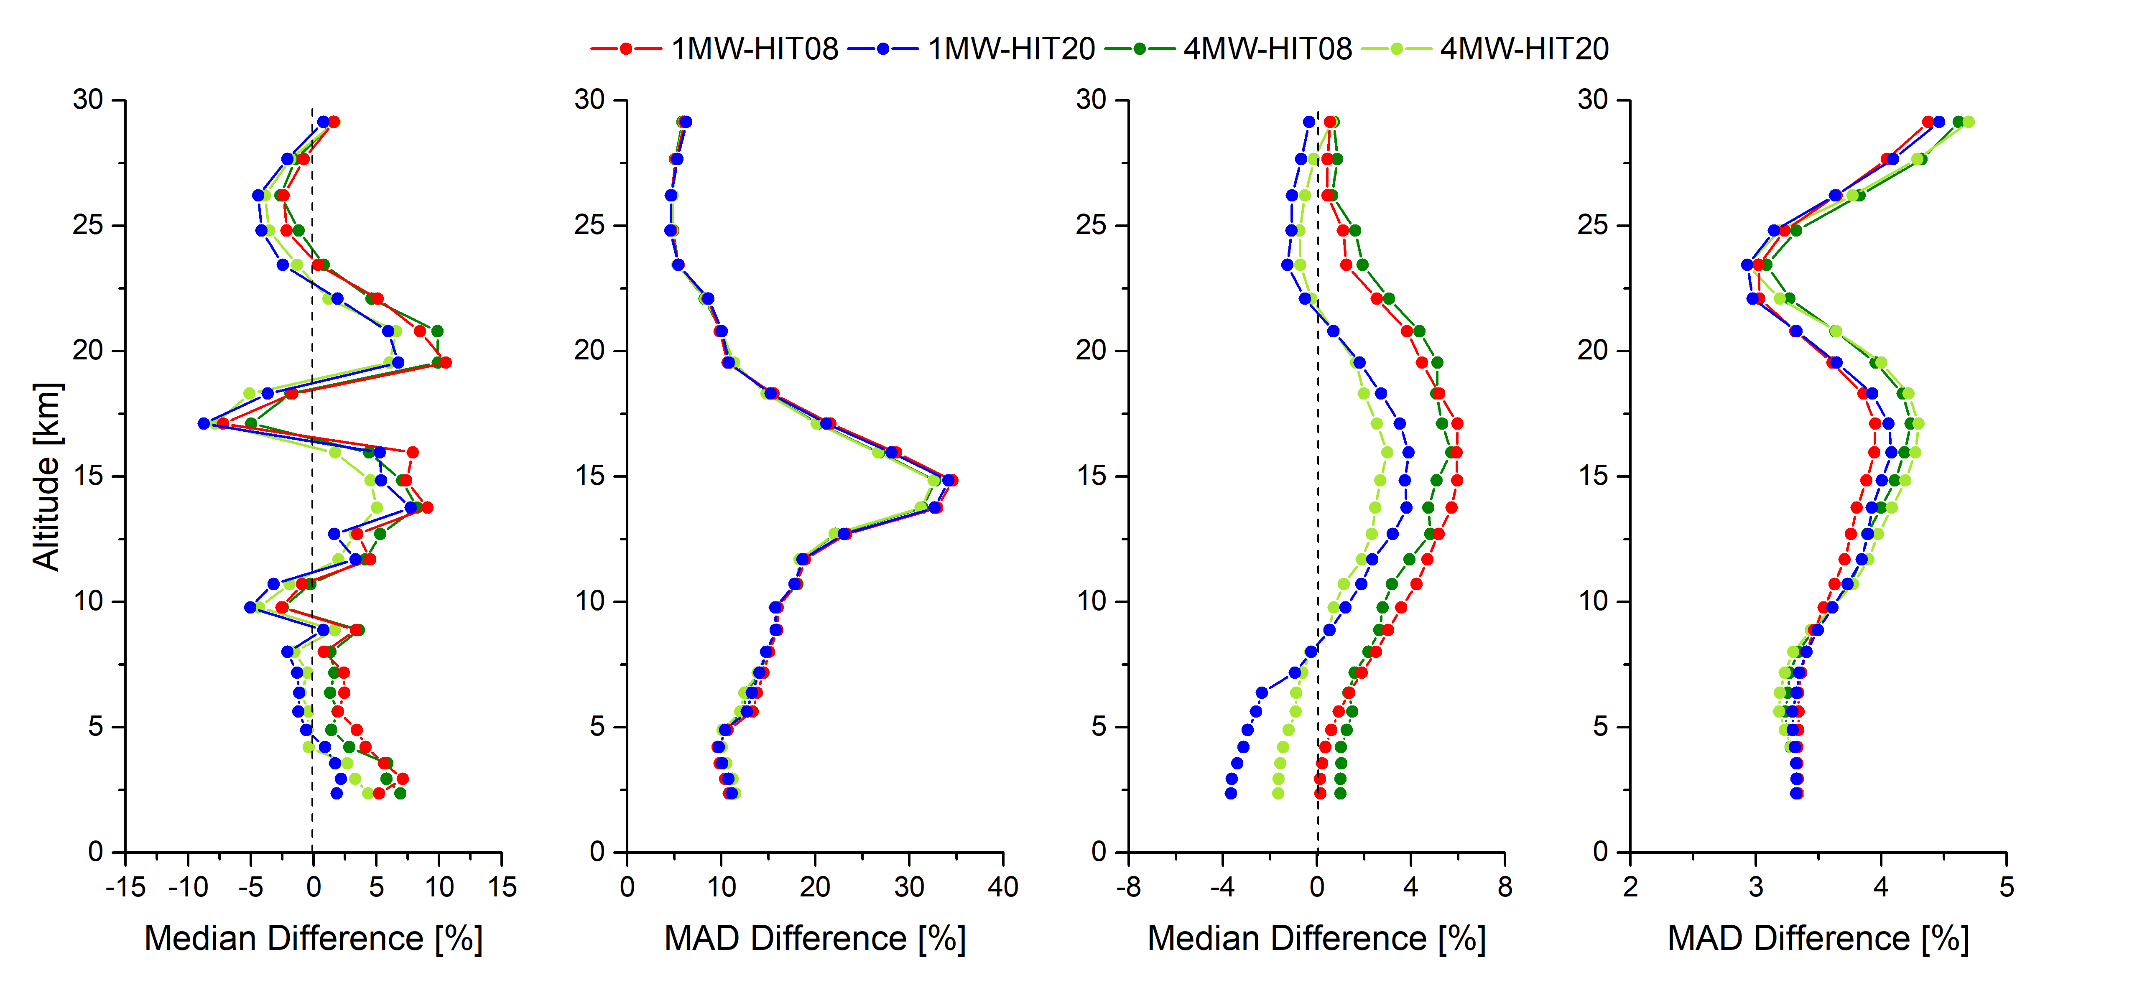
Sonde comparison of VMR profile: median for strategies
Without temperature retrieval
(O3SONDE-FTIR)/FTIR
Sonde smoothed with FTIR AVK
(O3SONDE-FTIR)/FTIR

Slide 11
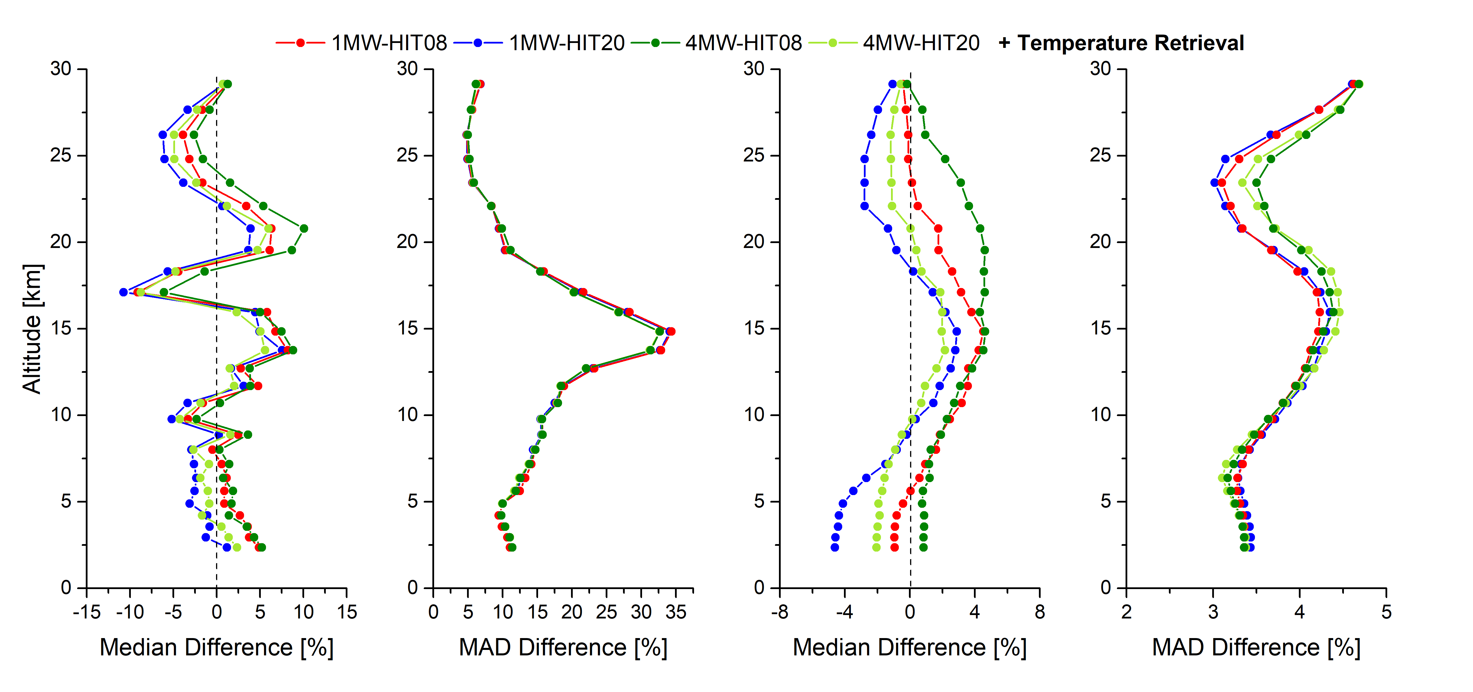
Sonde comparison of VMR profile: median for strategies
With temperature retrieval
(O3SONDE-FTIR)/FTIR
Sonde smoothed with FTIR AVK
(O3SONDE-FTIR)/FTIR

Slide 12
Sonde comparison: altitudes of 1 DOF 22-29.5 km
N=43, 22-29.5 km | 1MW-HIT08 |  | 4MW-HIT08 |  | 1MW-HIT08 +Temperature Retrieval |  | 4MW-HIT08 +Temperature Retrieval
 | (O3SONDE-FTIR)/FTIR | Same but smoothed O3SONDE | (O3SONDE-FTIR)/FTIR | Same but smoothed O3SONDE | (O3SONDE-FTIR)/FTIR | Same but smoothed O3SONDE | (O3SONDE-FTIR)/FTIR | Same but smoothed O3SONDE
Median [%] | 1.79 | 3.27 | 1.87 | 3.55 | 1.71 | 2.95 | 1.99 | 3.45
MAD [%] | 3.45 | 3.21 | 3.45 | 3.31 | 3.64 | 2.89 | 3.67 | 3.18
STD [%] | 4.54 | 4.36 | 4.78 | 4.54 | 4.79 | 4.38 | 5.07 | 4.92
N=43, 22-29.5 km | 1MW-HIT20 |  | 4MW-HIT20 |  | 1MW-HIT20 +Temperature Retrieval |  | 4MW-HIT20 +Temperature Retrieval
 | (O3SONDE-FTIR)/FTIR | Same but smoothed O3SONDE | (O3SONDE-FTIR)/FTIR | Same but smoothed O3SONDE | (O3SONDE-FTIR)/FTIR | Same but smoothed O3SONDE | (O3SONDE-FTIR)/FTIR | Same but smoothed O3SONDE
Median [%] | 0.14 | 1.28 | 0.04 | 1.49 | -0.55 | 0.51 | -0.82 | 1.40
MAD [%] | 3.39 | 3.19 | 3.47 | 3.27 | 3.51 | 3.81 | 3.55 | 3.08
STD [%] | 4.55 | 4.35 | 4.75 | 4.47 | 4.64 | 4.27 | 4.93 | 4.73
MAD: Mean Absolute Deviation; STD: Standard Deviation

Slide 13
FTIR&Brewer comparison
 | 1 MW-HIT08 | 4MW-HIT08 | 1 MW-Atm20 | 4 MW-Atm20 | 1 MW-HIT20 | 4 MW-HIT20
Median [%] | 3.129 | 3.170 | 3.130 | 3.160 | 0.748 | 0.880
MAD [%] | 0.734 | 0.720 | 0.734 | 0.724 | 0.717 | 0.700
STD [%] | 1.035 | 1.022 | 1.035 | 1.026 | 1.011 | 0.995
Number of spectra | 863 | 848 | 865 | 847 | 866 | 860
Conclusions | 4MWs-HIT20 gives the best results
+Temperature Retrieval | 1 MW-HIT08 | 4MW-HIT08 | 1 MW-Atm20 | 4 MW-Atm20 | 1 MW-HIT20 | 4 MW-HIT20
Median [%] | 2.679 | 3.022 | 3.384 | 3.446 | 0.902 | 0.905
MAD [%] | 0.614 | 0.594 | 0.606 | 0.607 | 0.600 | 0.581
STD [%] | 1.172 | 1.191 | 1.195 | 1.206 | 1.180 | 1.167
Number of spectra | 861 | 847 | 860 | 842 | 865 | 853
Conclusions | 4MWs-HIT20 gives the best results. Temperature retrieval improves the Brewer-FTIR agreement!
MAD: Mean Absolute Deviation; STD: Standard Deviation

Slide 14
FTIR&Brewer comparison
+Temperature Retrieval | 1 MW-HIT08 | 4MW-HIT08 | 1 MW-Atm20 | 4 MW-Atm20 | 1 MW-HIT20 | 4 MW-HIT20
Median [%] | 2.679 | 3.022 | 3.384 | 3.446 | 0.902 | 0.905
MAD [%] | 0.614 | 0.594 | 0.606 | 0.607 | 0.600 | 0.581
STD [%] | 1.172 | 1.191 | 1.195 | 1.206 | 1.180 | 1.167
Number of spectra | 861 | 847 | 860 | 842 | 865 | 853
Conclusions | 4MWs-HIT20 gives the best results
Temperature from CO2 lines | 1 MW-HIT08 | 4MW-HIT08 | 1 MW-Atm20 | 4 MW-Atm20 | 1 MW-HIT20 | 4 MW-HIT20
Median [%] | 3.813 | 3.760 |  |  | 1.321 | 1.445
MAD [%] | 0.834 | 0.811 |  |  | 0.816 | 0.800
STD [%] | 1.132 | 1.110 |  |  | 1.104 | 1.088
Number of spectra | 843 | 828 |  |  | 846 | 838
Conclusions | 4MWs-HIT20 gives the best results
Note that the “temperatura from CO2 lines” is an intermediate test, which uses a two-step strategy for O3 inversions: (1) the temperature profiles are retrieved from the 4 CO2 lines using the NCEP PT profiles as a priori, and then (2) these updated Temp profiles are used to retrieve O3 profiles using the standard strategy (without a simultaneous temperature retrieval).

