Slide 1
NDACC Data Host Facility
J. D. Wild ESSIC/UMD; NOAA/NESDIS
G. Chen: NASA/LaRC, A. Aknan: SSAI; NASA/LaRC
R. Lin now retired!
• Data Archiving
Data Retrieval
NDACC Partners and Downstream Databases
DOI, Data License, Data Versions
Transition to LaRC
Resource Information
June 2022– IRWG meeting

Slide 2
NDACC Data Archiving
File counts
Instrument Working Group Details
COVID Impact Summary
Remaining and Proposed Action Items
Campaign Datasets
RD Datasets
June 2022– IRWG meeting

Slide 3
NDACC Data Archiving
Number of files
2017 | 2018 | 2019 | 2020 | 2021
128212 | 140834 | 158018 | 180041 | 233850
165 Active Long Term Measurements as defined by the M&A Directory
June 2022– IRWG meeting

Slide 4
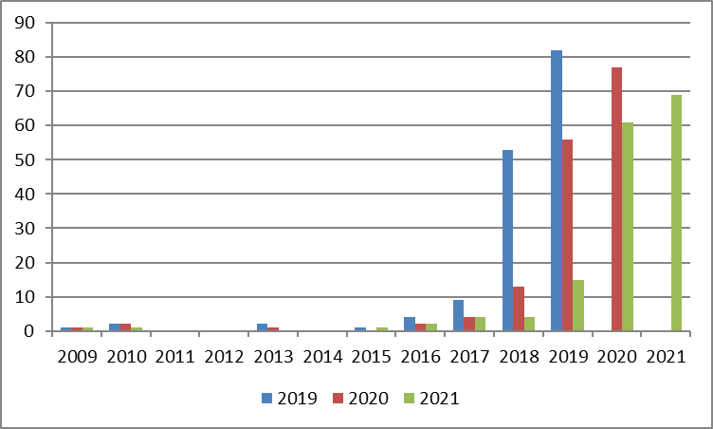
Data End Dates – As of 10/1/2020
Number of Files
June 2022– IRWG meeting

Slide 5
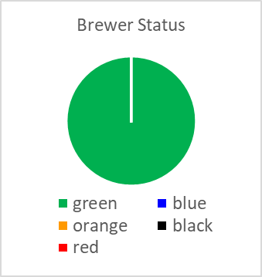
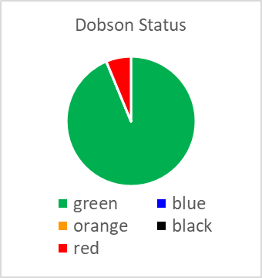
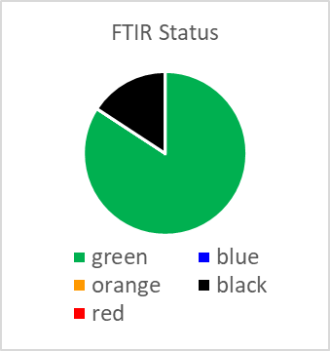
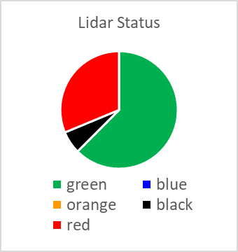
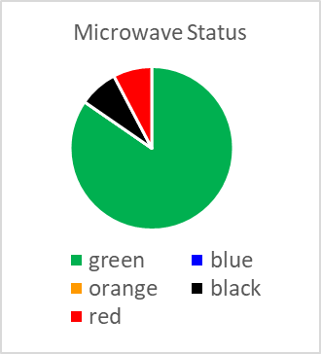
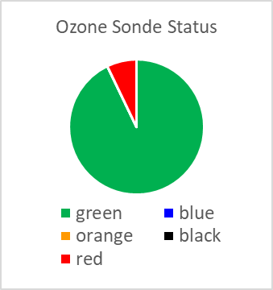
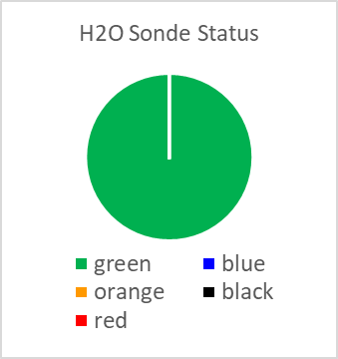
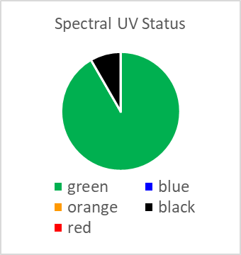
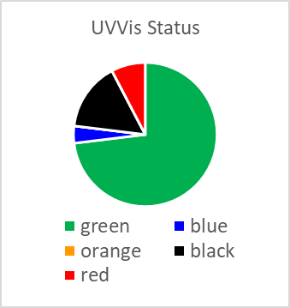
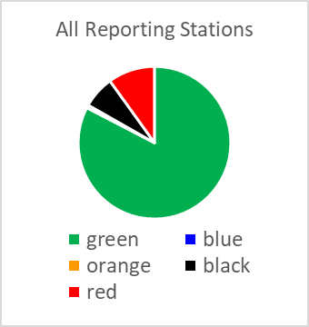
Instrument Group Data Compliance - 2020
8
16
19
32
13
28
7
12
26
8
Up to date through at least 2019
161
Last submission within 1 year, but not up to date
Data with extenuating circumstances
Data submitted in last 2 years, not in past year, not up to date (Black)
No submissions since more than 2 years
June 2022– IRWG meeting

Slide 6
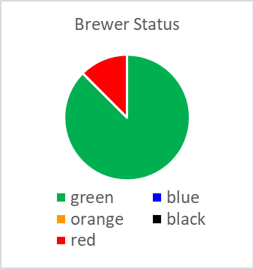
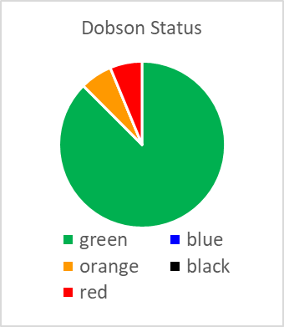
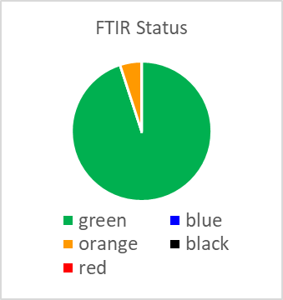
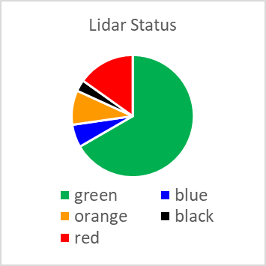
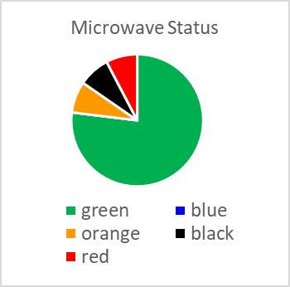
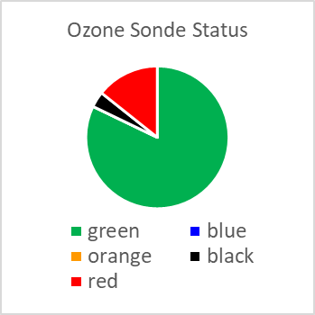
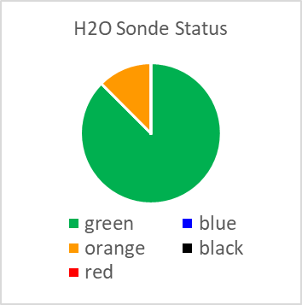
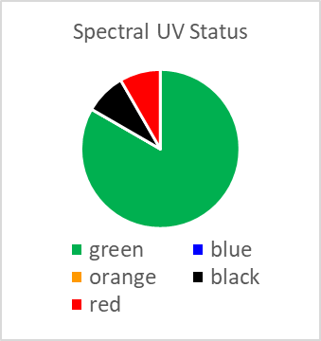
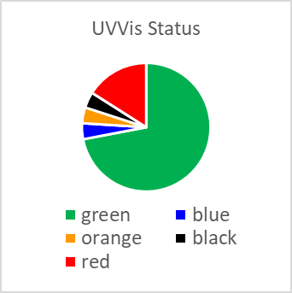
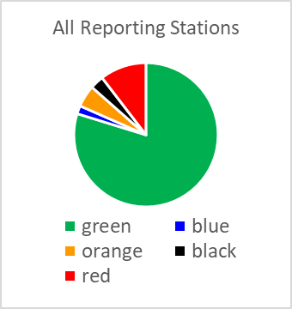
Instrument Group Data Compliance - 2021
8
16
20
35
13
28
8
12
25
8
Up to date through at least 2019
165
Last submission within 1 year, but not up to date
Data with extenuating circumstances
Data submitted in last 2 years, not in past year, not up to date (Black)
No submissions since more than 2 years
June 2022– IRWG meeting

Slide 7
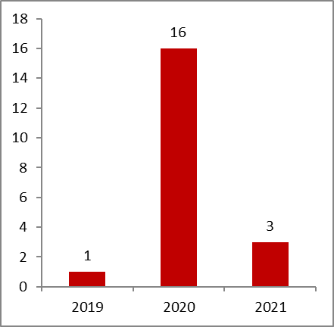
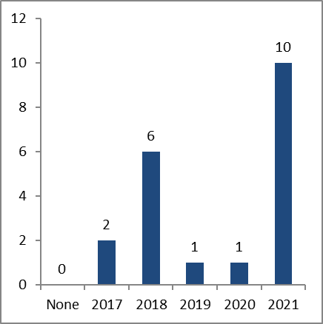
FTIR Data Submission Status Continuing Measurements – Highlights
Data End Dates
Metadata File Dates
Data Submission - 2021
All stations now submitting in HDF.
Boulder, newly affiliated this year with data submitted 2010 – 2020.
All but one station Green this year (Bremen, Paramaribo, were black last year)
Maido down since Jan 2020 due to failed Solar Tracker, and COVID impact on repair.
Metadata Files - 2021
All sites are submitted and reasonably up to date.
Boulder (newly affiliated) submitted metadata file.
Site Reports
Missing reports from Zugspitze, Toon/Mt Barcroft
June 2022– IRWG meeting

Slide 8
COVID Impact on Data Submission (from Site Reports)
FTIR
Arrival Hgts: COVID delayed laser replacement losing one month of data Aug-Sept 2021.
Eureka: No operators on site since March 2020, remote operations from Toronto until laser failure in July 2020 ended measurements. Hope to repair Fall 2021.
Jungfraujoch: Failure of device for remote operation, chip shortage, lack of travel/customs issues resulted in data loss Dec 2020 to June 2021.
Maido: Solar tracker broken, no travel prevents repair. No measurements since Jan 1, 2020.
June 2022– IRWG meeting

Slide 9
RD Submissions
NDACC Affiliated Instruments also submitting to RD Directories
FTIR: Arrival Heights, Boulder, Bremen, Eureka, Harestua, Jungfraujoch, Maido, Lauder, Mauna Loa, Ny Alesund, Paramaribo, St Petersburg, Thule, Toronto
RD Submissions from Non-NDACC Instruments
FTIR: Porto Velho, Garmisch, Sodankyla
June 2022– IRWG meeting

Slide 10
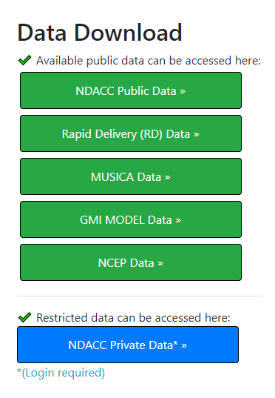
** RD Submissions **
Use of RD Directories
RD directories are a service to NDACC partners.
RD Data submitted to these directories is NOT NDACC data, and does not satisfy data submissions requirements as per Data Protocol for Data Providers.
PI stated reasons for using RD
I have a CAMS obligation to submit RD.
CAMS is a timeline requirement, not a data type requirement.
Sole reasons to submit data to RD directories
Data is not final NDACC verified product – not up to NDACC standards, has not been validated, is preliminary, etc.
Data is not from an NDACC affiliated instrument, or is not and NDACC affiliated data product (offaxis for UVVis).
Data is not of standard granularity (ie submitting fast delivery daily files to be later consolidated to monthly or yearly files and resubmitted to Consolidated Directories).
NDACC Affiliated Data
NDACC Service Directories
June 2022– IRWG meeting

Slide 11
Data Retrieval File Counts
June 2022– IRWG meeting

Slide 12
Top 2021 Data Users:
NDACC DHF at CPC |  |  | NDACC DHF at LaRC
Rank | Count | Institution | Rank | Count | Institution
1 | 108910 | NASA, GSFC | 1 | 6667581 | BIRA, Belgium
2 | 52178 | OMA, Belgium | 2 | 599203 | NASA, GSFC
3 | 50042 | Univ. of Science and Tech, China | 3 | 69697 | Cox Communications, Virginia
4 | 39538 | Telecom, Norway | 4 | 65730 | NASA, Redstone Arsenal, Alabama
5 | 32687 | OMA, Belgium | 5 | 16518 | University Bremen
6 | 30759 | Univ. Pierre&Madame Currie, France | 6 | 14848 | NASA, California
7 | 21583 | Univ. Leeds, Great Britain | 7 | 8080 | DWD, Germany
8 | 16599 | Telecom, Belgium | 8 | 5885 | Leibniz-Institut, Germany
9 | 15690 | DWD, Germany | 9 | 5751 | NASA, Redstone Arsenal, Alabama, Washington State
10 | 14528 | OHP, France | 10 | 5630 | Microsoft Corp
Top 2020 Data Users: Univ. Science/Tech, China (206037), University of Toronto (134922)
Top 2019 Data Users: Chinese Acad of Science(249590), Rutherford Appleton (152526)
Top 2018 Data Users: BIRA, Belgium (263667), NASA GSFC (257647)
Top 2017 Data Users: Telecom, Netherlands (403659); Obs Midi-Pyrenees (35447)
Top 2016 Data Users: Univ. Leeds (120528); US EPA (111587)
June 2022– IRWG meeting

Slide 13
NDACC Data Retrieval
September 2021 – Virtual meeting

Slide 14
NDACC Data Retrieval
# files in database |  |  | # file transfers
Instr. | # files |  | CPC Web (Private) |  | CPC Anon ftp |  | LaRC (est)
 | 2020 | 2021 | 2020 | 2021 | 2020 | 2021 | 2021
Bksnde | 426 | 426 |  |  | 2365 | 281 | 355
Brewer | 2610 | 2702 | 9 | 1 | 17823 | 9661 | 1540
Dobson | 8459 | 9425 | 1 |  | 45444 | 10634 | 7525
Dustsonde | 375 | 375 |  |  | 1342 | 350 | 293
FTIR | 6844 | 7620 | 208 | 215 | 54302 | 32542 | 5565
Lidar | 20026 | 33858 | 10068 | 5168 | 116472 | 93698 | 71682
Mwave | 34866 | 36965 | 22 | 1182 | 135488 | 22579 | 119290
O3sonde | 45053 | 48607 | 3143 | 10 | 299949 | 101633 | 98859
Spt UV | 3692 | 3791 | 15 | 7 | 17204 | 5983 | 2847
UV Vis | 56444 | 88786 | 1208 | 7 | 212064 | 167758 | 210324
WVsonde | 1246 | 1315 |  | 1 | 6113 | 2097 | 1127
Total | 180041 | 233850 | 14674 | 6591 | 908566 | 447216 | 519407
June 2022– IRWG meeting

Slide 15
DHF Partners and Downstream Databases
June 2022– IRWG meeting

Slide 16
DHF Partners and Downstream Databases
CEDA – (was BADC) Has mirrored NDACC DHF since 1991. Is retaining all data mirrored so far, but not reorganizing codes to mirror DHF at LaRC, https://www.ceda.ac.uk/
NILU/EVDC – Full mirror NDACC DHF
CAMS-27 – Financially supports specific PIs for RD data with increased data format standards
https://cams27.aeronomie.be/, https://atmosphere.copernicus.eu/
NORS/GEOMON – Predecessors to ACTRIS, https://nors.aeronomie.be/index.php/nors-validation-server
ACTRIS – Copies NDACC metadata, NDACC data for ACTRIS PIs, https://actris.nilu.no
ECMWF/C3S – Copy (with PI explicit consent) of data for use at C3S – MOU signed July 2021
WOUDC – Copy of file metadata for search engines. Has copied data in past, https://www.woudc.org
GAWSIS – Copy/Coordination of metadata for search engine, https://gawsis.meteoswiss.ch/GAWSIS – MOU in process
DCIO – Copy of file metadata for search engines
AVDC – Copy of file metadata for search engines
BIRA mirror – data for internal use at BIRA
June 2022– IRWG meeting

Slide 17
DOI Data License Data Versions
June 2022– IRWG meeting

Slide 18
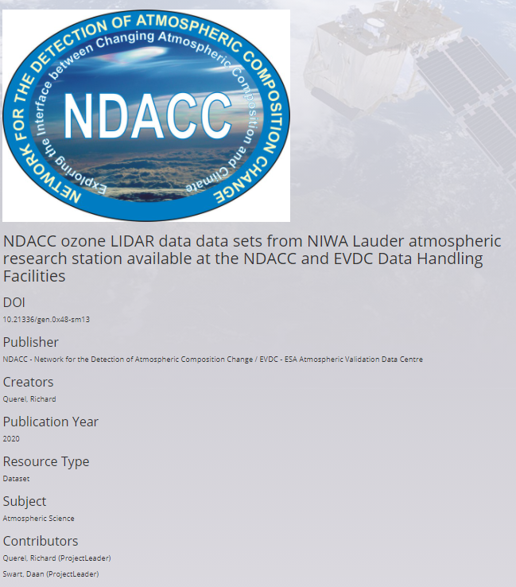
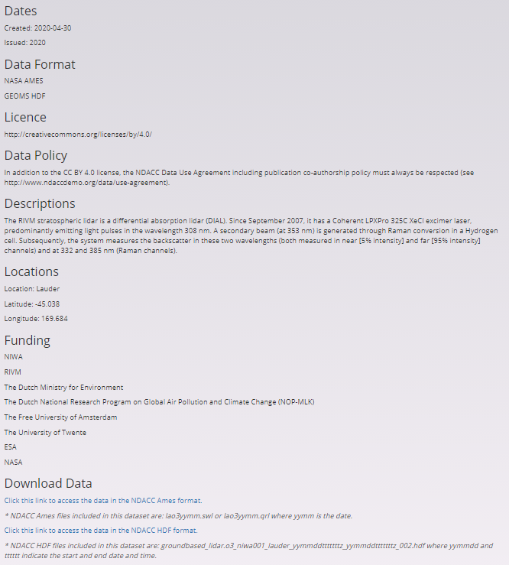
DOIs for NDACC data providers are being published by EVDC
Landing page is at EVDC
Supply information in headers below including: Data Title, Format, License, Description, etc
Will link to dataset at the NDACC DHF
Contact Jeannette Wild for more info
When created, DOI and license information should be added to data files and metadata files
June 2022– IRWG meeting

Slide 19
Data License and Data Versions
Data License: Choose between 3 suggested licenses for NDACC (PIs must decide for their data):
CC0 (most open – credits not even (legally) required ) - in part. for US gov’t data
CC-By-SA (4.0) license (open – but credits required)
CC-BY-NC-SA license (not open for commercial use)
When chosen, Data License information should be added to data files and metadata files
Choose carefully. Know restrictions by a journal if you are creating DOI for a journal. ESSD for example requires CC-BY (4.0) or less restrictive. Contact your funding organization for guidance.
Once published, there cannot be a change from less restrictive to more restrictive.
Data Versions:
Optional ability to augment DATA_SOURCE to include simple version number
Optional ability to augment DATA_SOURCE with text descriptor/keyword (WEEKLY, CENTRAL)
Document at www.ndaccdemo.org/sites/default/files/docs/NDACC_Data_Versioning_2_3_Main.pdf
Each WG proposes Keywords which will be centrally managed at GEOMS/DHF level.
Some approved Keyword examples:
HIRES (Hi-Res)
Monthly
GLASS (algorithm name)
Can include an algorithm or reprocessing version number.
groundbased_lidar.aerosol_nasa.jpl002_glass.1.1_mauna.loa.hi_20040602t063747z_20040602t083820z_001.hdf
Traditional Data Source
Reprocessing version number (after . )
Algorithm name (After _ )
June 2022– IRWG meeting

Slide 20
** Transition to LaRC **
June 2022– IRWG meeting

Slide 21
NDACC DHF Transition – NOAA/CPC to NASA LaRC
NDACC Entities at NOAA/NCEP/CPC
NDACC DHF
Database server (wwwdb) not accessible outside of CPC DHF managers
- houses the relational database RDB
Data ingest area
ftp site for public data
Tools area www.ndsc.ncep.noaa.gov/PI (interface to wwwdb RDB)
NDACC Website
www.ndacc.org (and development instances)
- links to NDACC DHF, but does not contain data
Secure (password access) for Steering Committee www.ndsc.ncep.noaa.gov/sc_space
NDACC DHF transition phases
Phase 1 – duplicate DHF functionality at LaRC - COMPLETE
Format check & Mirror of data
Data ingest
Data download
External mirrors and downstream databases, metadata sharing
Phase 2 – Establish full relational database at LaRC - COMPLETE
Enable search engines
Enable NDACC data tools
Phase 3 – Relocate NDACC website – DUE SUMMER 2022
June 2022– IRWG meeting

Slide 22
NDACC DHF Transition – NOAA/CPC to NASA LaRC
Phase 1 – duplicate DHF functionality at LaRC
Format check testing of ingest – took sometime to fully test and develop
Mirror of data & metadata - https://www-air.larc.nasa.gov/missions/ndacc/
NDACC Station Data has been mirrored at LaRC since summer 2020.
Long-term mirror period tested that format checking codes accepted equivalent files
MUSICA, RD, NCEP, GMI, and metadata files are all now at LaRC
Data ingest - https://www-air.larc.nasa.gov/cgi-bin/NDscan
CAMS 27 additional checks enabled for files submitted at LaRC
All data submission accounts transferred to LaRC as of 5/1/2021; no ingest at CPC.
IP identification only used for data submission by script
Account / password web interface can be used from any location
Single or multiple file upload
Test format only or check and archive
June 2022– IRWG meeting

Slide 23
NDACC DHF Transition – NOAA/CPC to NASA LaRC
Phase 1 – duplicate DHF functionality at LaRC (continued)
User Manuals emailed to all data providers at account set up
Data download - https://www-air.larc.nasa.gov/missions/ndacc/
Web interface or script enabled for public and private
Completed 5/1/2021
External mirrors and downstream databases, metadata sharing
CEDA, NILU/EVDC mirrors, partnerships with BIRA, WOUDC, C3S, ACTRIS
Completion goal - Fall 2021 (all but one now complete)
June 2022– IRWG meeting

Slide 24
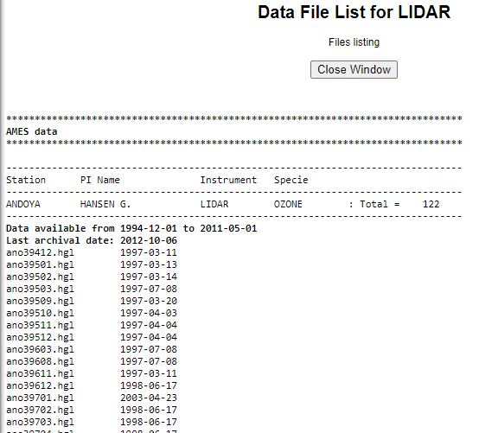
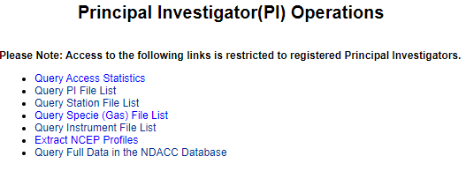
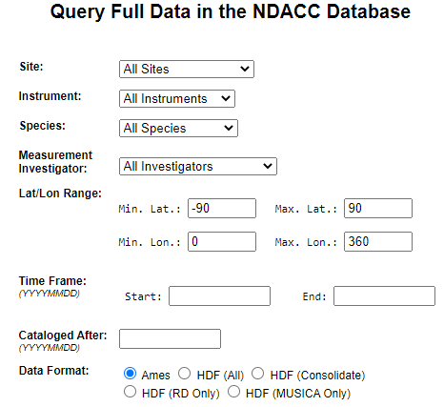
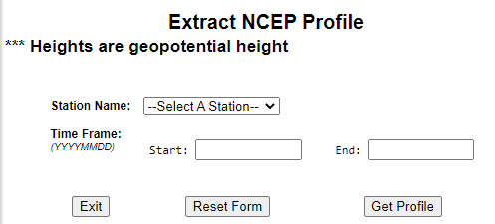
NDACC DHF Transition – NOAA/CPC to NASA LaRC
Phase 2 – Establish full RDB at LaRC
Enable search engines (www.ndsc.ncep.noaa.gov/PI)
COMPLETE
Enable NDACC data tools (Complete 7/1/2021)
Phase 3 – Relocate NDACC website including password protected SC Space
www.ndacc.org
All NDACC documents, news, M&A, Station tables, etc.
Goal – SUMMER 2022
June 2022– IRWG meeting

Slide 25
NDACC DHF Transition – Common mistakes in Data Transfer
Trying to submit to CPC DHF
Files are auto copied to CPC every night. No need to double submit
Public vs. Private
LaRC DHF allows PI to choose public/private per submission.
Default is private ( once public, not reversible).
Where’s my data – it’s not on the public directory listing?
Choose carefully.
Account not linked to dataset submitted
Data set exists in the DHF, but an account owner did not add dataset to list it will submit.
Update account profile to add dataset.
September 2021 – Virtual meeting

Slide 26
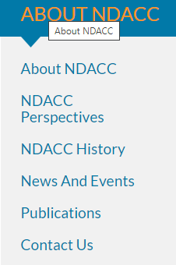
NDACC Web Pages
New Item (under development):
Create full searchable database for Publication lists
Search on Keywords, Year, Author, Journal name
OR combinations
Year
Author
Journal
Keyword
June 2022– IRWG meeting

