Slide 1
NO2 harmonized FTIR data set for the validation of TROPOMI Stratospheric NO2
Corinne Vigouroux, Bavo Langerock, Carlos Aquino Bauer, Thomas Blumenstock, Martine De Mazière, Michel Grutter, James Hannigan, Frank Hase, Nicholas Jones, Rigel Kivi, Eric Lutsch, Emmanuel Mahieu, Maria Makarova, Isamu Morino, Isao Murata, Tomoo Nagahama, Justus Notholt, Ivan Ortega, Mathias Palm, Markus Rettinger, Amelie Röhling, Dan Smale, Wolfgang Stremme, Kim Strong, Youwen Sun, Ralf Sussmann, Yao Té, Pucai Wang, Tyler Wizenberg
Poster presented at the LPS2022; put in Gather at the TCCON/NDACC 2022;
Abstract for the S5P 5th Anniversary (October 2022), including HCHO
ESA public reports: https://mpc-vdaf.tropomi.eu/

Slide 2
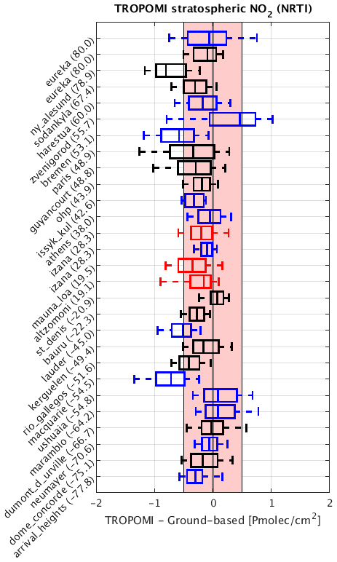
Motivation
TROPOMI stratospheric NO2 has been already validated (Verhoelst et al., AMT, 2021) using Zenith-Scattered Light (ZSL) DOAS.
ZSL are sunrise/sunset measurements: so chemical box model needed to interpolate to S5P overpass time (13:30), leading to estimated 6% uncertainty (in addition to the estimated uncertainty of measurements themselves 10-14%).
FTIR: can provide data collocated in time, with a precision of about 6-10%.
FTIR can provide diurnal cycles.
New harmonized FTIR species !

Slide 3
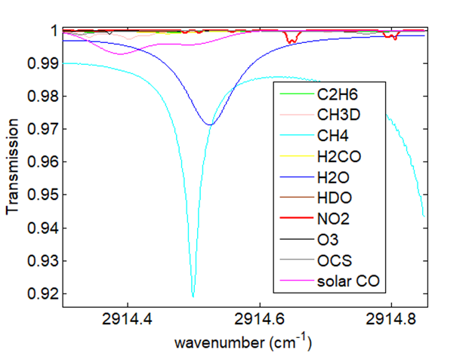
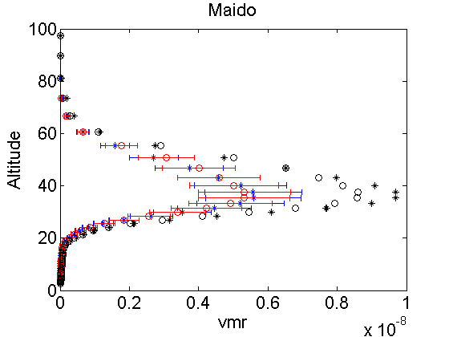
Harmonized retrieval settings
Preliminary work with settings tested by Tyler, Dan, and Ivan; then Sent to IRWG (Feb 2021);
Same spectral window: 2914.3-2914.85 cm⁻¹
Same regularization: Tikhonov L1.
Same spectroscopic parameters for NO₂ and interfering gases: atm20 from G. Toon (https://mark4sun.jpl.nasa.gov/toon/linelist/linelist.html). For NO₂, it corresponds to HITRAN 2008.
A priori profiles are from WACCM v6.
A priori
O: waccmv6
* : waccmv7
Both WACCM v7 and WACCM v6 strongly overestimate NO2 at Maido !
What about the other sites ?
Retrieved waccmv6
Retrieved waccmv7

Slide 4
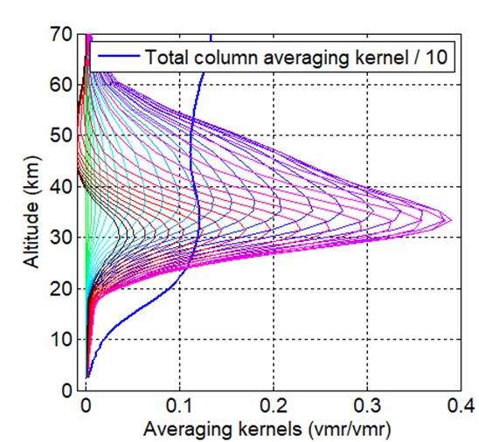
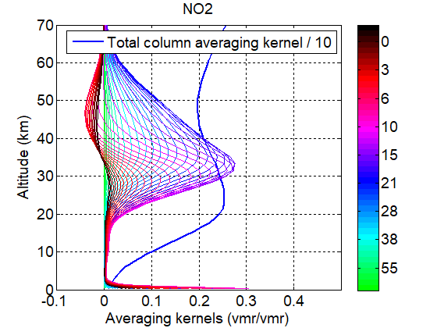
Sensitivity mainly in the stratosphere
Maido
Xianghe
All sites:
Mean DOFS Tot. Column= 1.0-1.4 Mean DOFS 12-100km=1.0-1.3
Maido
Mean DOFS Tot. Column= 1.10
Mean DOFS 12-100km=1.08
Xianghe
Mean DOFS Tot. Column= 1.25
Mean DOFS 12-100km=1.09

Slide 5
TROPOMI Stratospheric NO2
TROPOMI NO2 products: Total, stratospheric, and tropospheric columns
The tropospheric columns are obtained by subtracting the stratospheric columns to the measured total columns
The stratospheric columns are obtained from a chemistry-transport model TM5 coupled with a data assimilation of observations, ensuring that at clean areas (e.g. oceans,..) where tropo NO2 is negligible, the stratospheric columns coming for the model/assimilation system match the measured TROPOMI total columns.
From this model, the tropopause height is available and is used to separate tropo and strato NO2 columns: the users can apply TROPOMI AK associated to the required product, to their profiles. For strato NO2: the TROPOMI AK below the tropopause are set to zero.
We follow same Equation as Vigouroux et al. 2020 for HCHO (Rodgers and Connor 2003). Different a priori taken into account and smoothing with the TROPOMI AK for stratospheric NO2:
Our smoothed profiles are then set to zero below the tropopause = we can compare the same stratospheric columns as defined by TROPOMI.

Slide 6
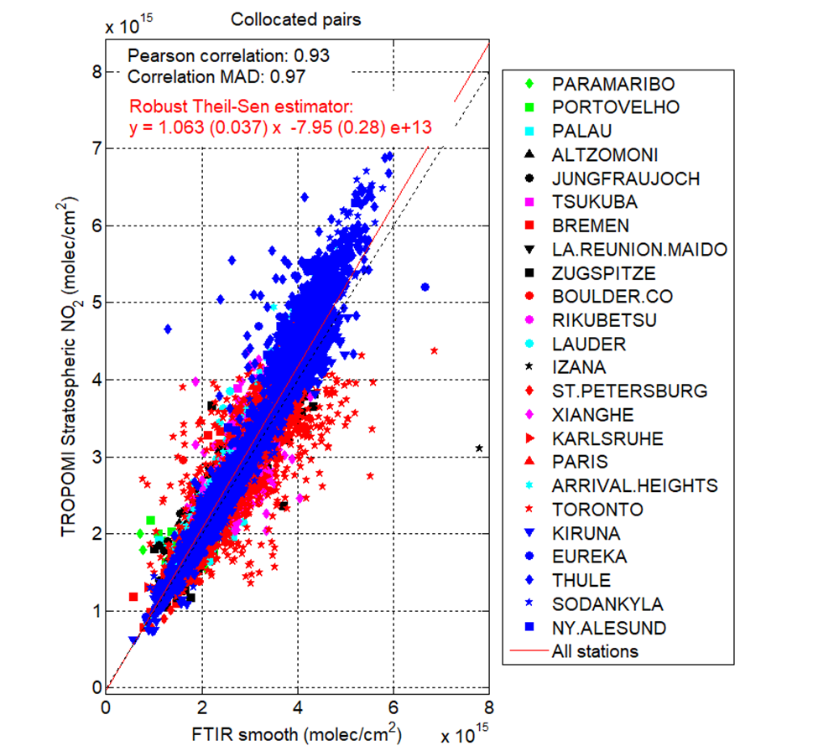
TROPOMI Validation: all stations together
Collocated pairs: Average of TROPOMI pixels within 50km of the collocation point (defined according to the line of sight of the FTIR measurement, at the maximum of FTIR sensitivity in the stratosphere). Average FTIR measurements taken within +/-1h of the TROPOMI overpass time.
Correlation is very good= 0.97.
Very small offset : -0.8x10¹⁴ molec/cm² (~1%)
BIAS= +3.4% for all collocated pairs. This is within the S5P mission requirements of 10% maximum bias. However this is not always true for individual sites.
Dispersion MAD=2.9 x10¹⁴ molec/cm². This is within the S5P requirements of 5.0 x10¹⁴ molec/cm². And similar to S5P comparison with ZSL (Verhoelst et al., 2021).

Slide 7
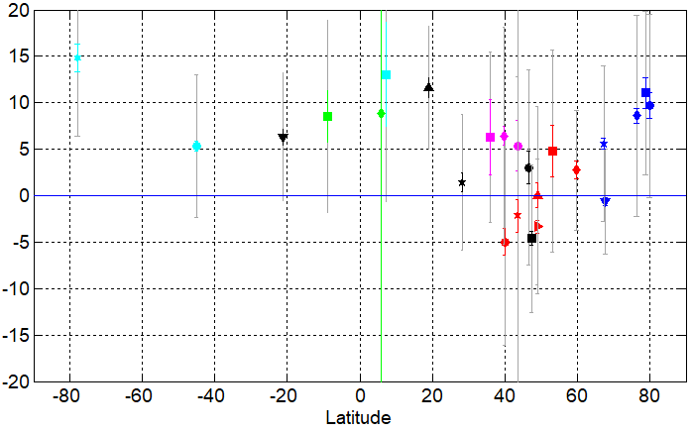
TROPOMI Validation: BIAS at individual stations
Median TROPOMI-FTIR/FTIR
The individual BIAS are within 7% (< S5P requirements of 10%) except for high latitude and tropical sites= +9-14%.
The median of the individual biases is +5.5%.
The median bias using the ZSL-DOAS network is negative (-6.1%).
A possible reason for the different biases is that Verhoelst et al. (2021) use DOAS total columns, assuming a negligible contribution of the tropospheric NO2. On-going work to quantify.
The station-to-station 1σ scatter of the individual biases is 5.5%. = homogeneity of the network
This is similar to the one obtained from the ZSL-DOAS network.
Can we do better as a harmonized network ? Our negative individual biases are only for polluted sites (+ Zugspitze): is it due to a “bad influence” of tropo NO2 in our FTIR data or to TROPOMI worse stratospheric NO2 above polluted sites?

Slide 8
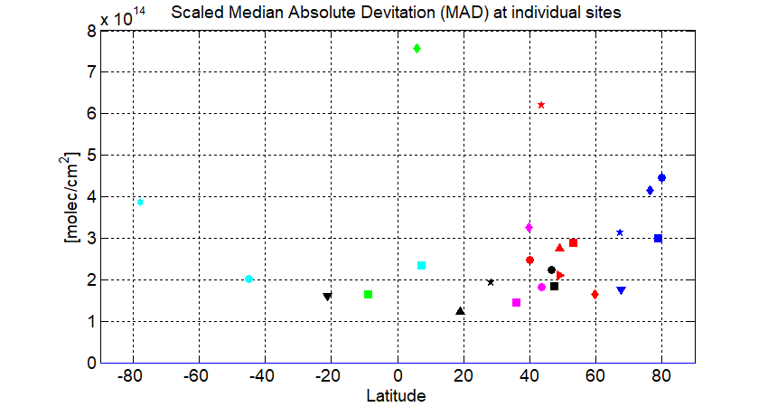
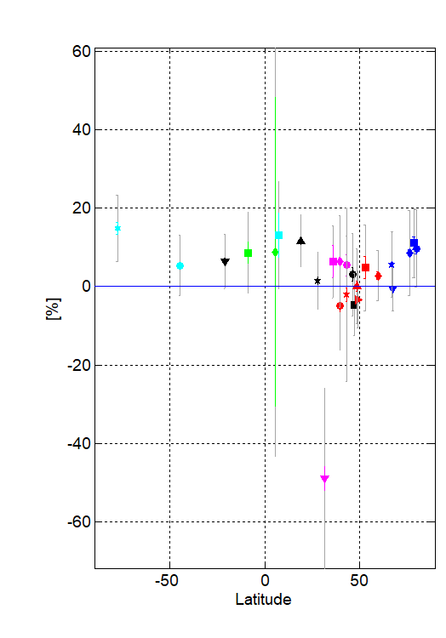
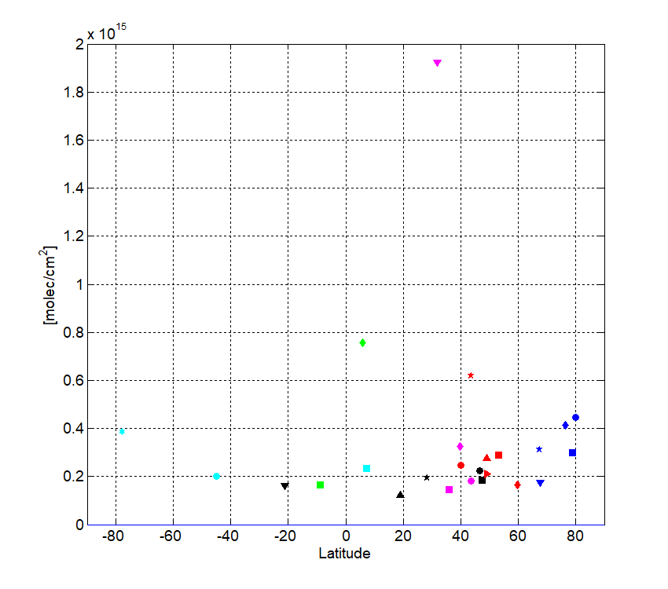
TROPOMI Validation: MAD at individual stations
The individual MAD are within 3x10¹⁴ molec/cm² except for highest latitude sites (4x10¹⁴ still < S5P requirements of 5x10¹⁴ molec/cm²) and for 2 “worse” sites: Toronto (the only site using a different spectrometer Bomem giving larger random FTIR uncertainty 7.5x10¹⁴), and Paramaribo (a site with only 7 coincidences).
BIAS
MAD
Note: Hefei has been removed from the comparisons

Slide 9
Conclusions
FTIR harmonized NO2: as good as ZSL-DOAS (station-to-station scatter; MAD/bias TROPOMI)
Diurnal cycle: see the poster (or extra slides)
Do we try improve the data set while I start writing ? (waccm v7 ? Uncertainties harmonization ? Bias at polluted sites ? Hefei: new data set ?)
On-going:
Making our own ZSL DOAS / TROPOMI comparisons to understand the different bias.
Ivan & Minqiang are working on improving tropospheric NO2 at polluted sites.

Slide 10
Thank you ☺

Slide 11
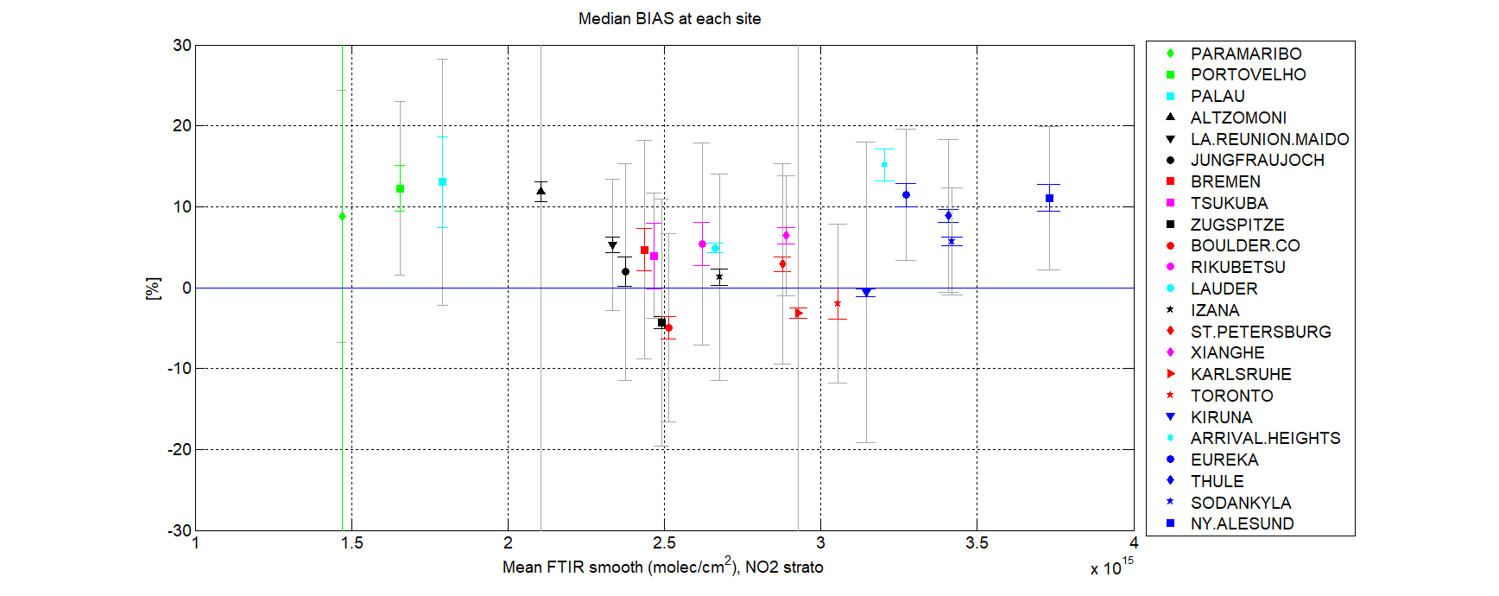
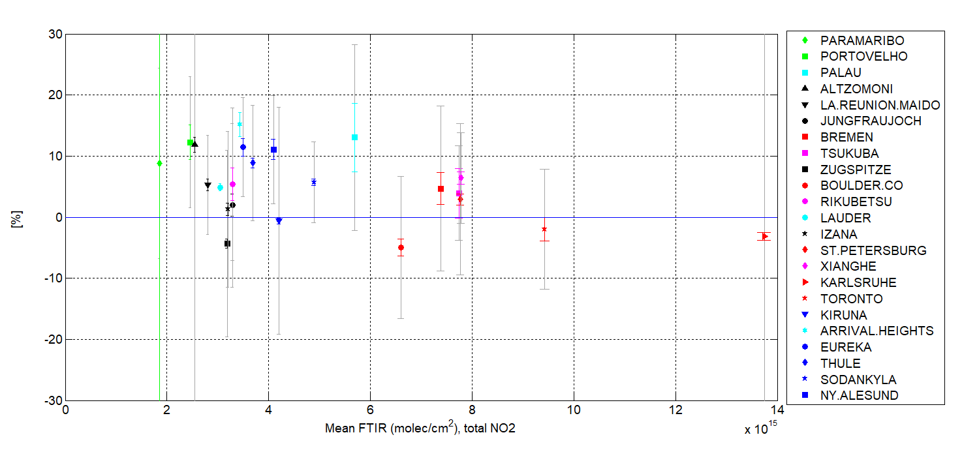
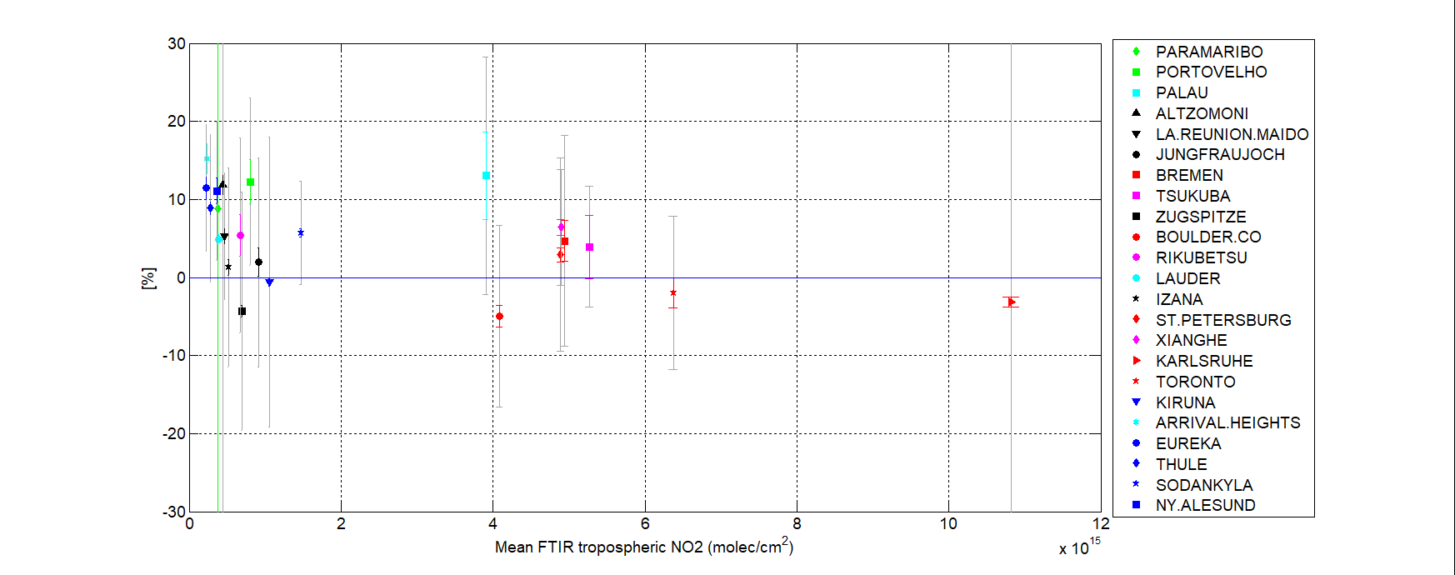
No clear dependence on the NO2 levels.

Slide 12
Diurnal cycles
The TROPOMI and FTIR diurnal cycles look in good agreement at all sites.
They can differ from one site to another similar one (e.g. Thule vs Eureka; Paris vs Karlsruhe): to explore when more years of data will be available.

Slide 13
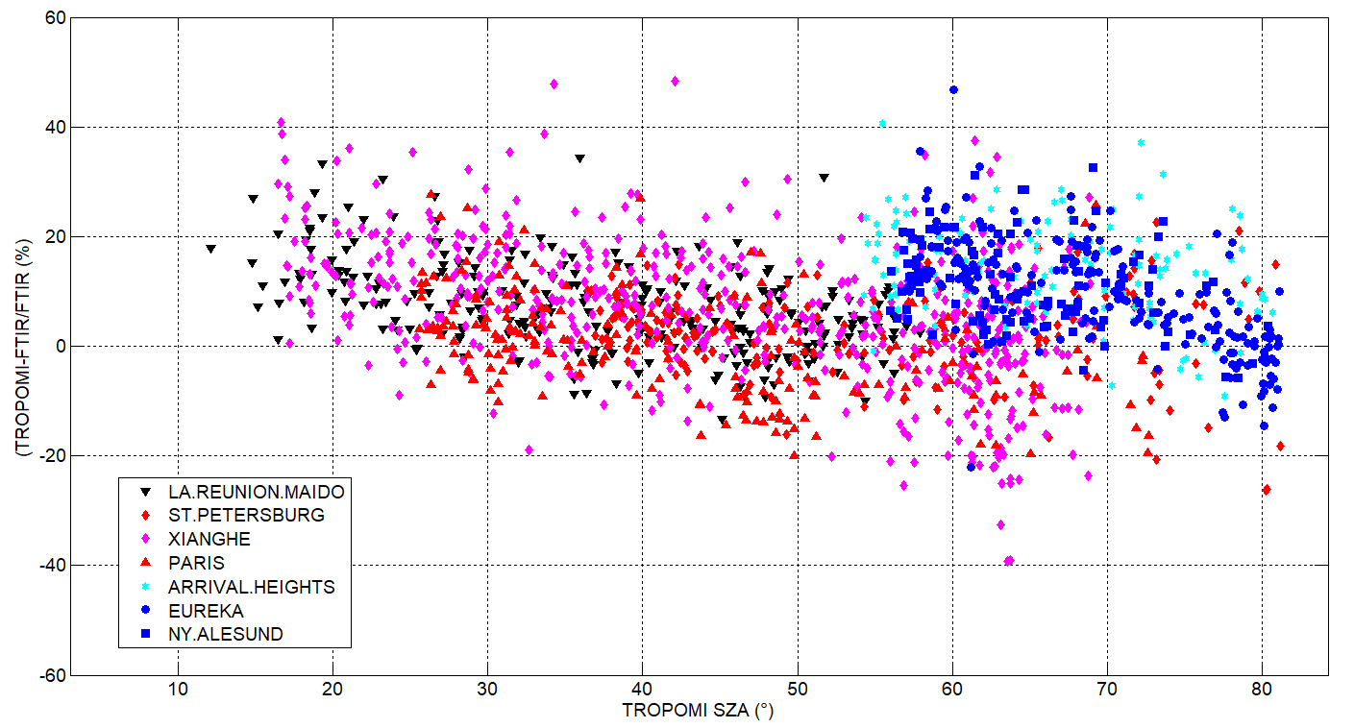
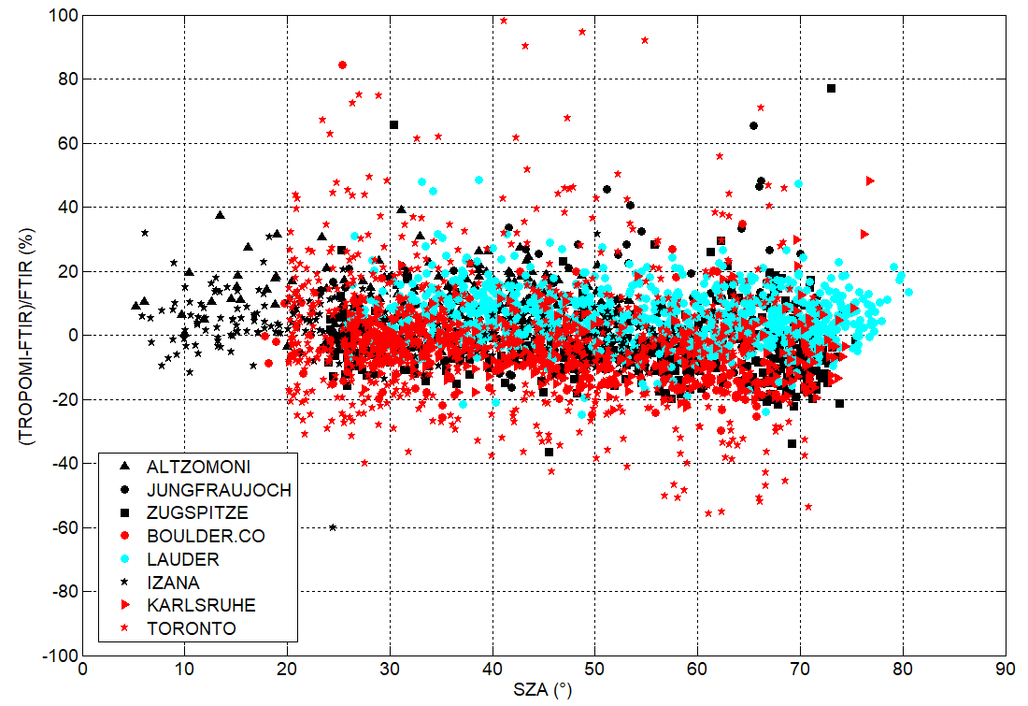
Seasonal cycle in the bias ? SZA dependence ?
At some sites, the differences do show a seasonal cycle, also seen if we plot the differences versus the S5P solar zenith angle (SZA). Some sites does not show this – or as strong - behavior.
The reason for this still need to be investigated.

Slide 14
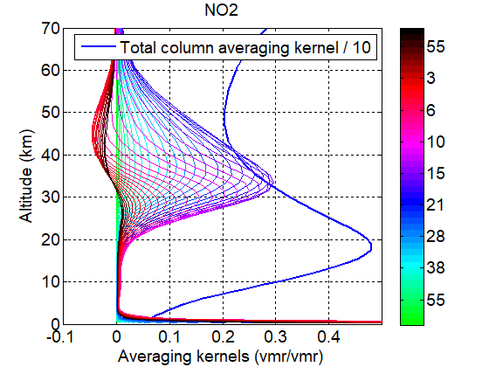
Sensitivity in the stratosphere
mean_dof =
1.6418 0.1980
1.2457 0.1332
mean_tc =1.0e+16 *
1.6582 0.8078
0.7474 0.2000
median_TC_diff30 =1.0e+15 *
4.1862 4.7106
0.9394 0.9208
median_TC_diff30_perc2
25.2453 28.4073
12.5689 12.3190
median_PC_diff30 =1.0e+14 *
1.6292 1.2054
1.3954 1.1149
median_PC_diff30_perc2 =
6.0730 4.4935
5.0088 4.0019
Xianghe (enhanced NO2 surface)
Xianghe (waccmv6)
Increasing DOFS in the troposphere (from 0.15 to 0.45): sensibility increased; agreement of seasonal cycle with MAX-DOAS (Minqiang)
But at the cost of decreasing the stratospheric NO2 precision significantly.
Compromise / choice needed.

