Slide 1
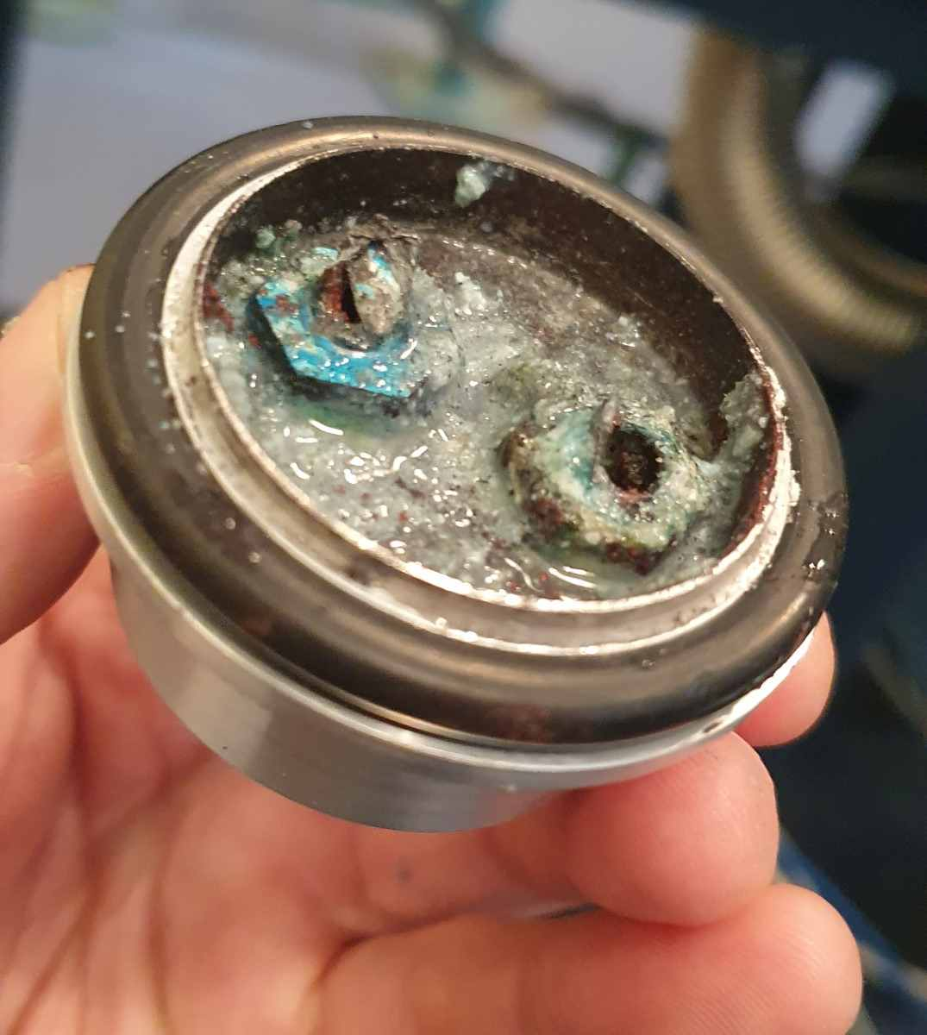
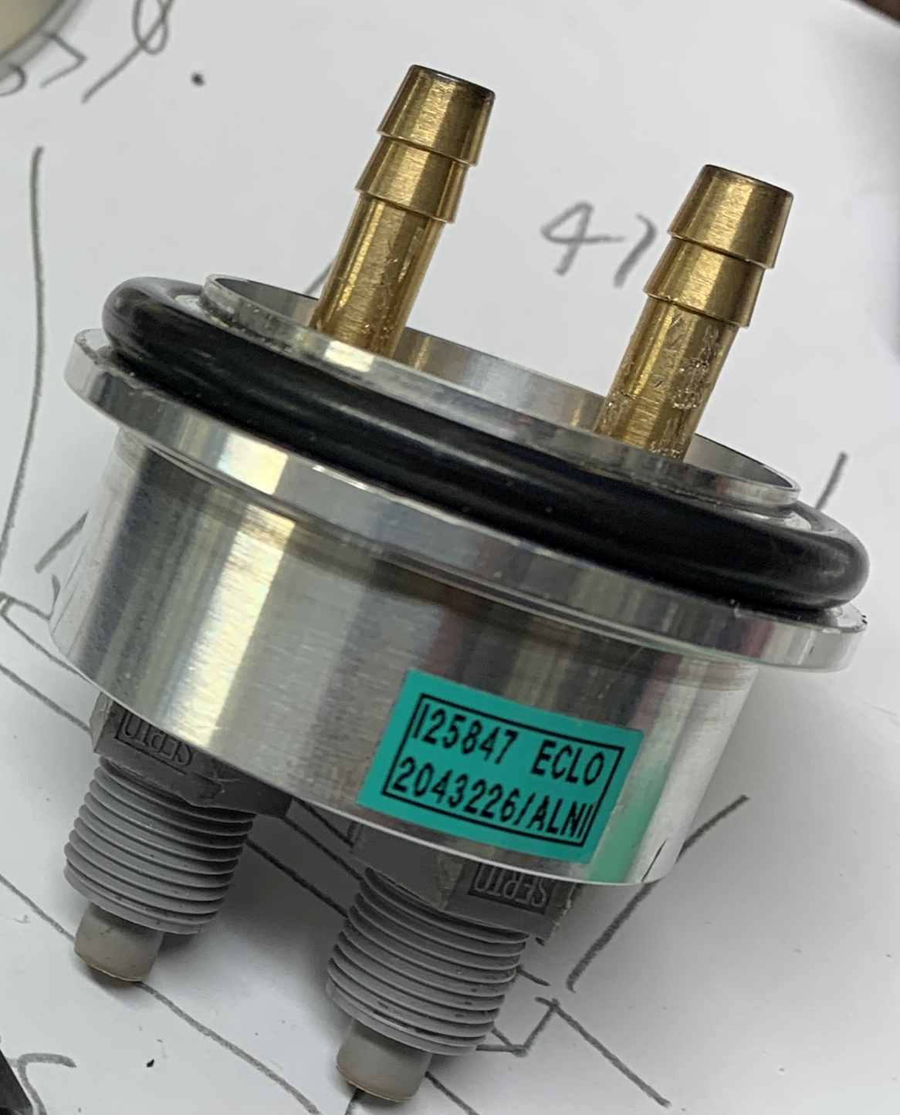
Don’t use ultra-pure or deionised water! Corroded cooler pipes in Arrival Heights Bruker 125HR after just 8 years.
What it should look like!

Slide 2
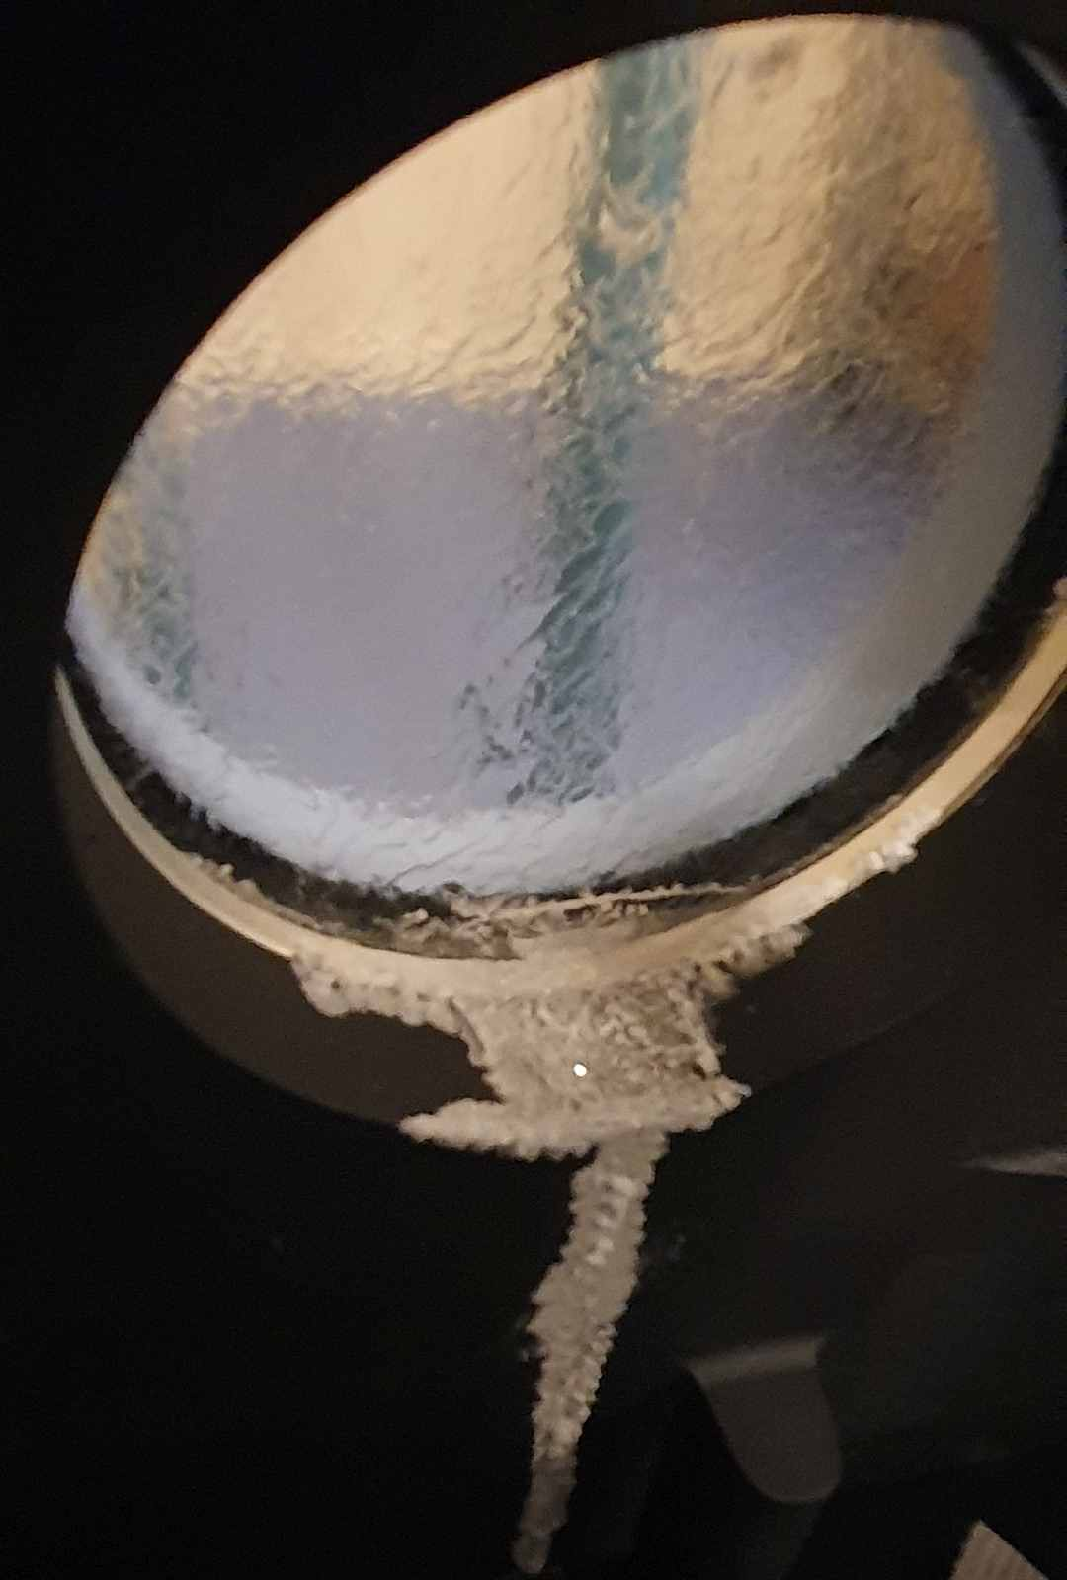
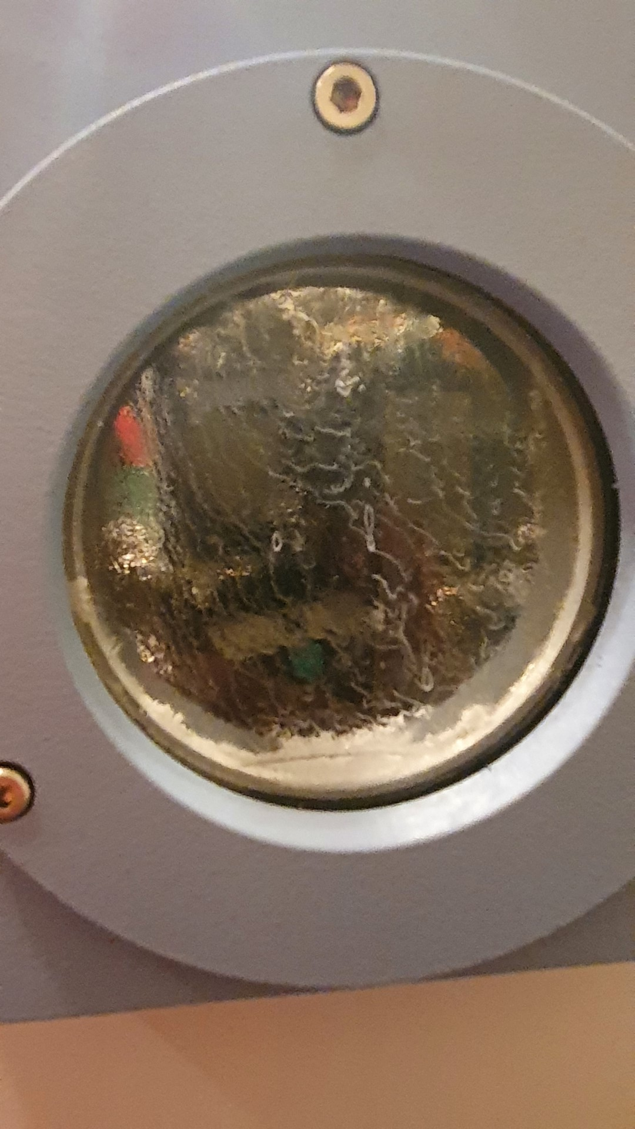
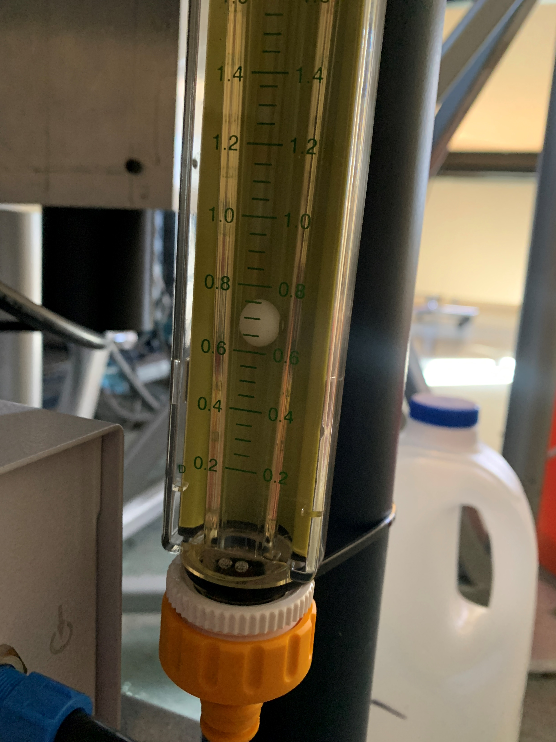
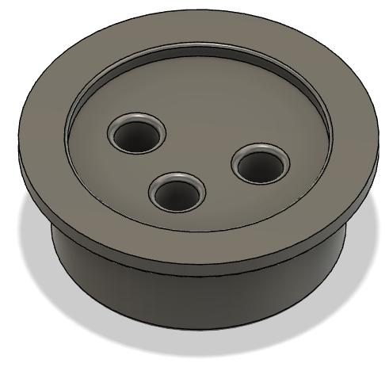
KBr window destroyed by high humidity,
Spectra looking ok but more noisy.
LASA & LASB down by 60% (~2V).
Planning to replace BS and window in Oct 2022
Contact: john.robinson@niwa.co.nz
FIX: use drinking/tap water
Keep an eye on MIRS cooler flow and MIRS temperature (via web interface)
Interim flange, 3D printed
Extra hole for drainage!
(operate at atmos pressure)

