Slide 1
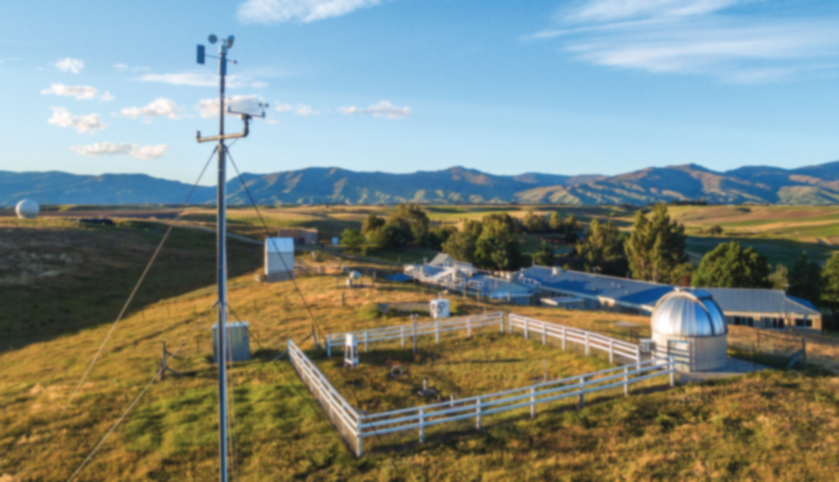
Intercomparison of long-term ozone measurements from ground-based techniques
FTIR + Umkehr + LIDAR + O₃ sondes + MWR at Lauder
Robin Björklund
NDACC IRWG meeting
1/07/2022
In collaboration with: Corinne Vigouroux, Bavo Langerock, Dan Smale, Peter Effertz, Irina Petropavlovskikh, James Hannigan, Richard Querel, Ivan Ortega, Miyagawa Koji, John Robinson, Penny Smale, Mike Kotkamp, Gerald Nedoluha

Slide 2
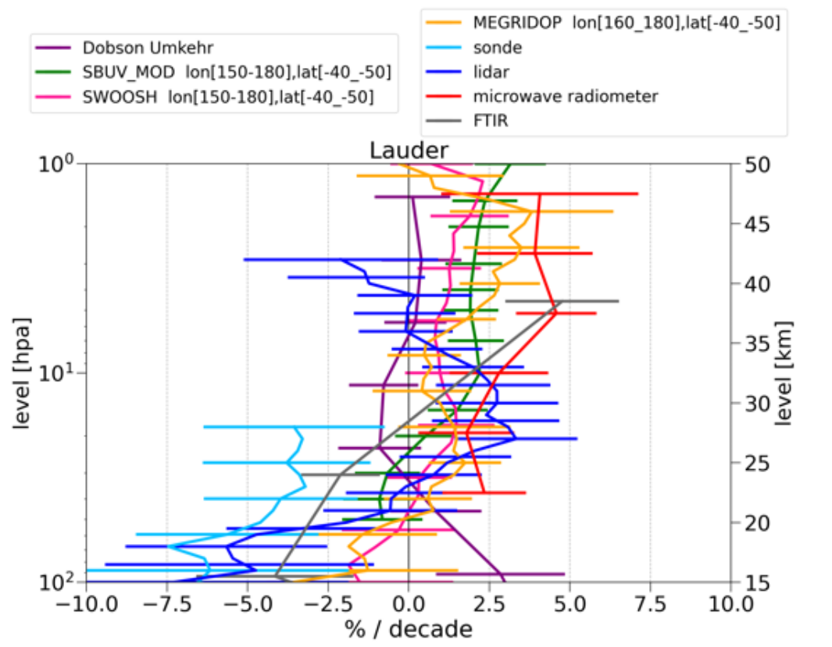
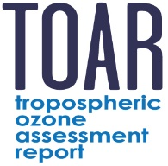
Motivation and context
Need for a comprehensive intercomparison and evaluation of various ozone measurements
Analyse long term trends and potential drift between techniques
→ aim to study data at supersites: Lauder / Mauna Loa / Boulder for 20+ years
Contain information for many observations: FTIR / O₃ sonde / LIDAR / Umkehr / MWR /…
/ HEGIFTOM
troposphere
LOTUS
stratosphere
Figure from Godin-Beekmann et al. 2022, ACPD

Slide 3
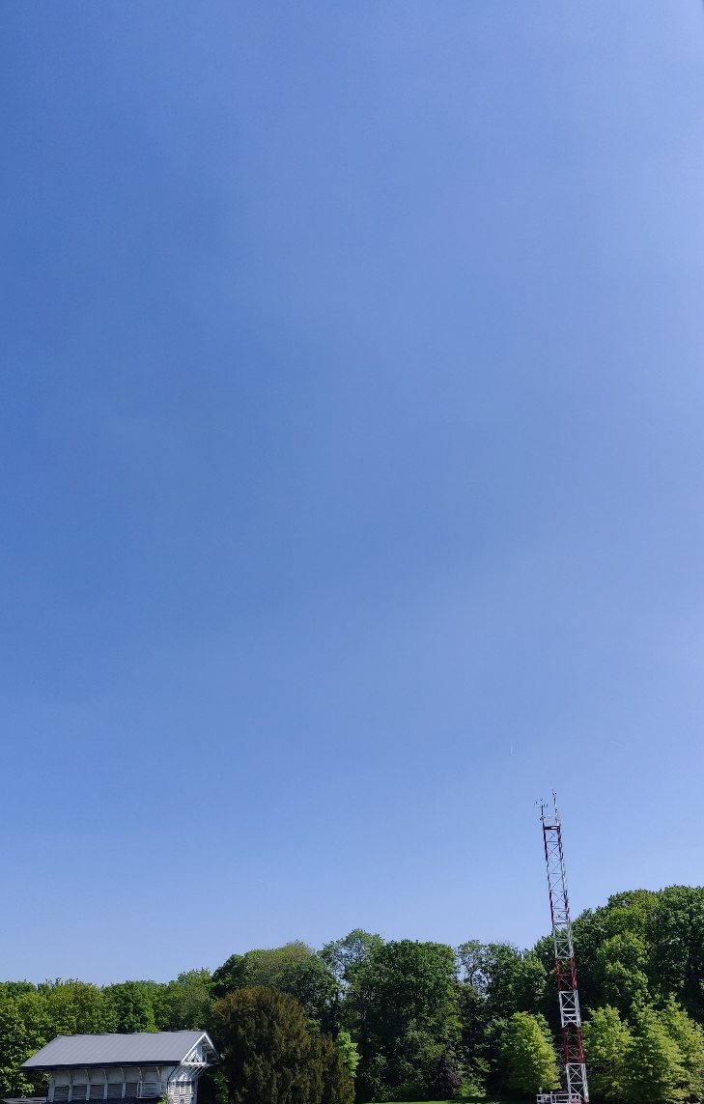
Validation: partial columns
Choose partial columns based on overlap of measurements with ~1 DOFS of FTIR
LIDAR
MWR
42
1.1
2.2
‘High’ stratosphere
DOFS
29
0.7
1.1
‘Mid’ stratosphere
DOFS
21.7
0.7
‘Low’ stratosphere
14
10.9
0.5
Troposphere
FTIR
Umkehr
Sonde

Slide 4
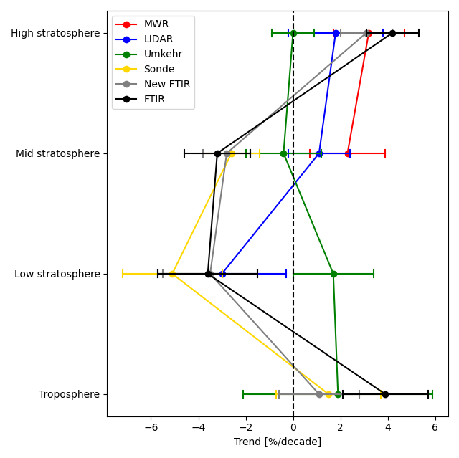
Conclusions of intercomparison
Trend per technique
29-42 km
22-29 km
14-22 km
Trends in agreement with LOTUS
But we see the effect of partial columns vs profile
0-11 km

Slide 5
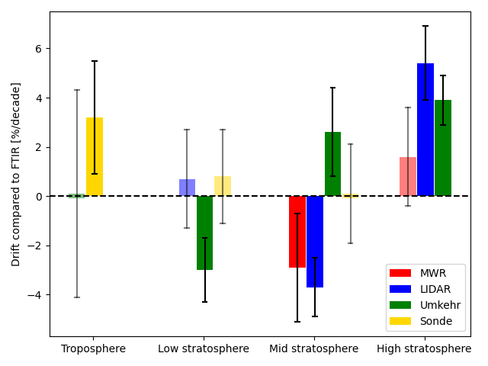
Conclusions of intercomparison
Trends mostly in agreement with drift
→ Trends found in LOTUS are usually from real observed trends
Sometimes effect of sampling? → LIDAR
0-11 km
14-22 km
22-29 km
29-42 km

