Slide 1
Benchmarking climate model top-of-atmosphere radiance in the 9.6μm ozone band compared to TES and IASI observations
Helen Worden, Andrew Conley,
Jean-François Lamarque, Steve Massie (NCAR),
Kevin Bowman (JPL),
Drew Shindell, (Duke Univ.)
Cathy Clerbaux, (LATMOS),
Pierre-François, Stamatia Doniki (ULB),
William Collins (UCB), Andrew Lacis (GISS)
Notes:
Kevin talked about using TES radiative kernels to constrain climate models by looking at the radiative effects of differences in ozone. Here I will describe a more fundamental test of climate model predictions for ozone.

Slide 2
Benchmarking O₃ band TOA flux
The proposal addresses two primary questions:
What is the bias in IPCC climate model predictions of present day top-of-atmosphere (TOA) flux in the 9.6μm ozone band?
What is the impact of an ozone band TOA flux bias on present day tropospheric ozone flux sensitivity and pre-industrial to present day ozone radiative forcing estimates?
These will be tested with CAM-chem, RRTMG and GISS RT models using TES and IASI TOA flux and IRKs (Instantaneous Radiative Kernels)

Slide 3
IPCC AR5 Radiative Forcing Definitions
Direct Ozone RF
Preindustrial-to-present day: 0.35 W/m²
through 21st century: 0.89 W/m²
Indirect Ozone RF
Suppression of carbon uptake due to
plant damage: 0.6 to 1.1 W/m²
(Sitch et al., Nature, 2007)
IPCC AR5 Fig. 8.1
Used in <= AR4
+ AR5 (hatched)
Used in
AR5 (solid)
Notes:
ERF more realistic since tropopause can change as well (fixed SST) Calculation of ERF requires longer simulations with more complex models than calculation of RF, but the inclusion of the additional rapid adjustments makes ERF a better indicator of the eventual global mean temperature response, especially for aerosols.

Slide 4
Trade-offs for air-quality controls and climate benefits
IPCC AR5
Need accurate measurements and model assessments
for informed policy decisions
Notes:
Reductions in Nox and VOCs can add to warming through aerosol reductions and increasing methane lifetime

Slide 5
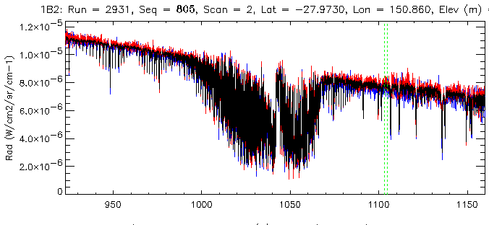
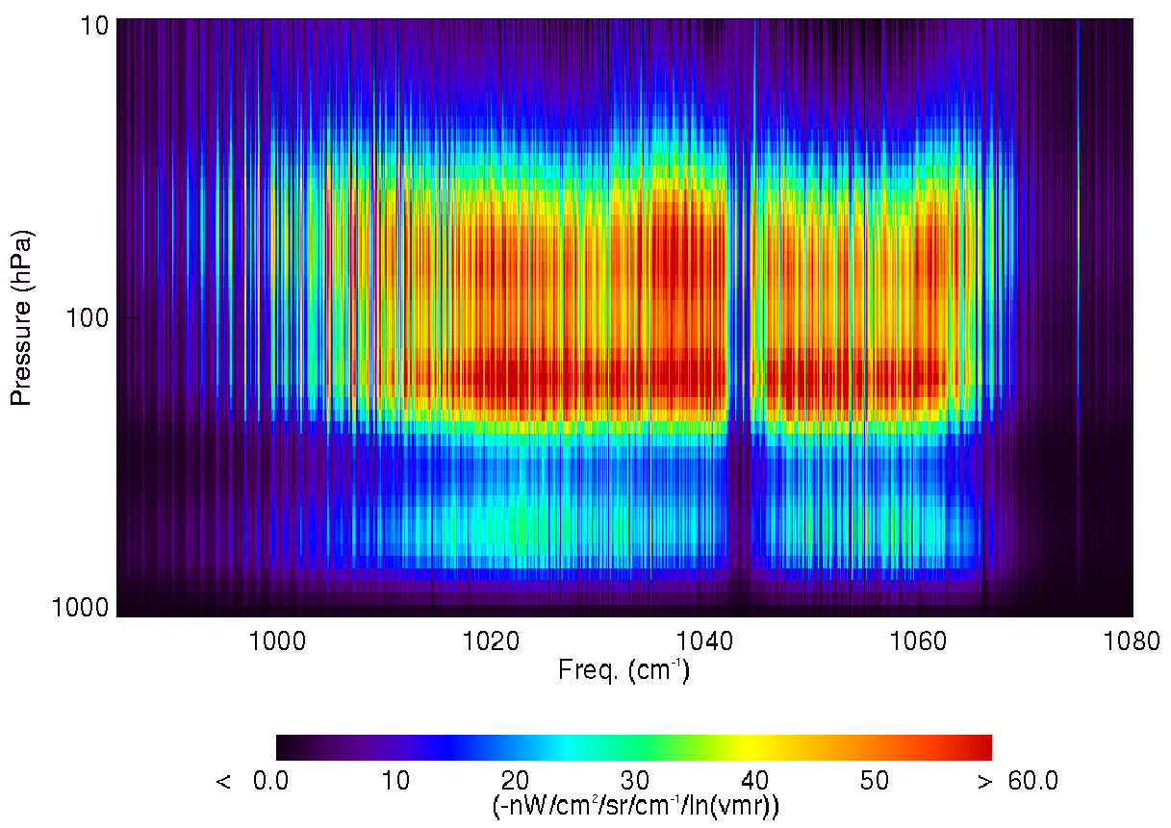
Satellite IR O₃ observations
L(θ,φ,ν) = TOA Radiance (W/cm²/sr/cm⁻¹)
TOA flux (W/m²)
L(θ,φ)
θ
CO₂
φ
O₃
H₂O, N₂O
O₃ (lnVMR) Jacobians
R = anisotropy
Pressure (hPa)
LWRE (W/m²)
(long-wave radiative effect)
Frequency (cm⁻¹)
-nW/cm²/sr/cm⁻¹/ln(VMR)

Slide 6
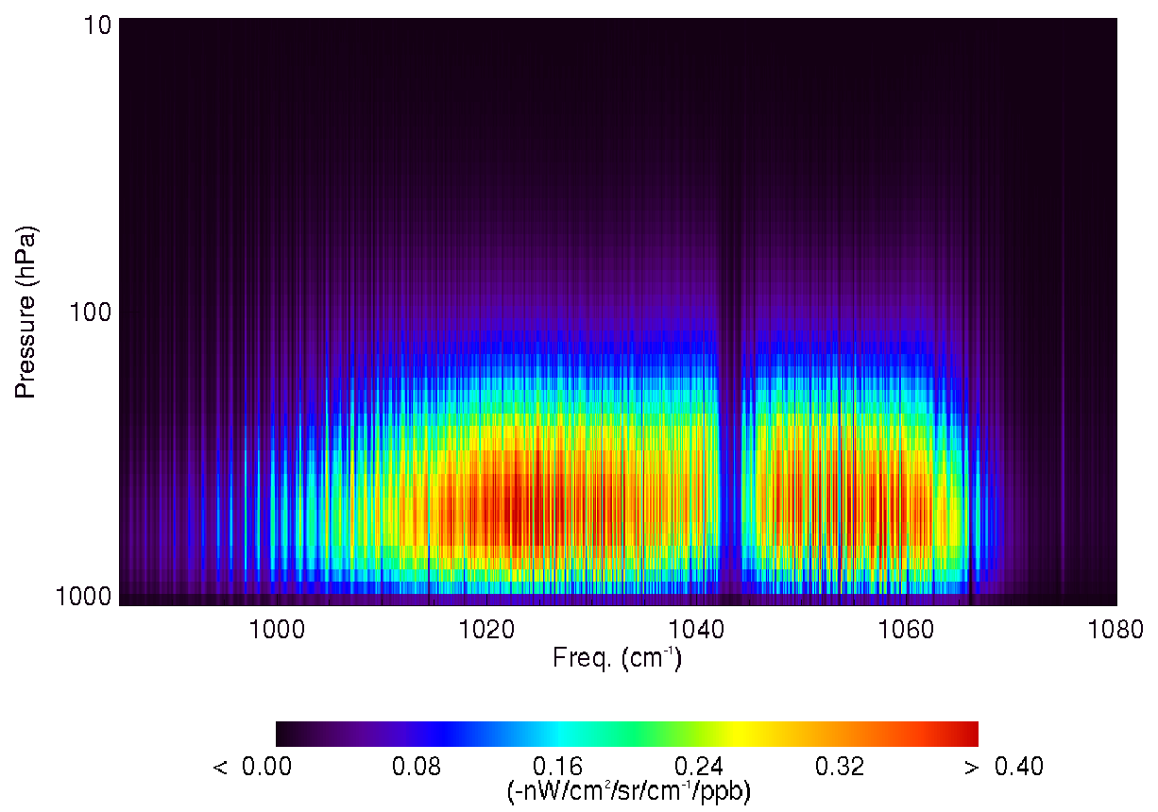
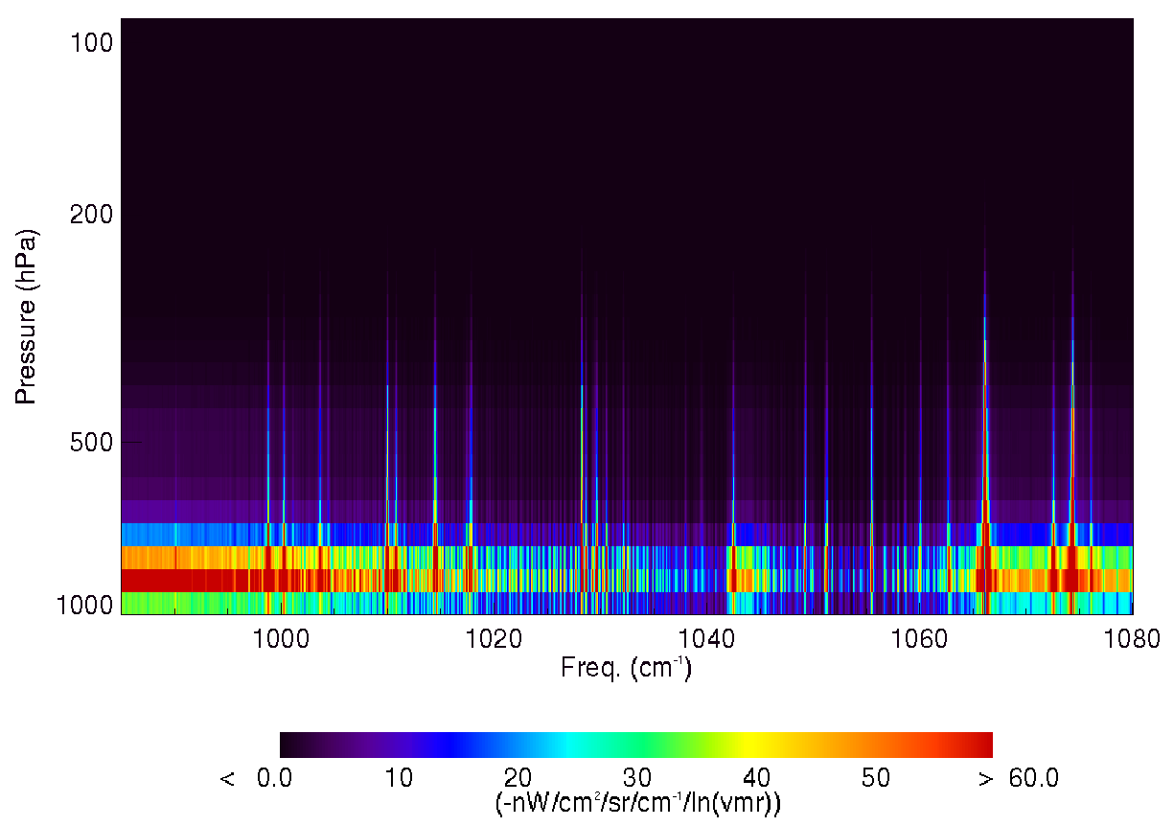
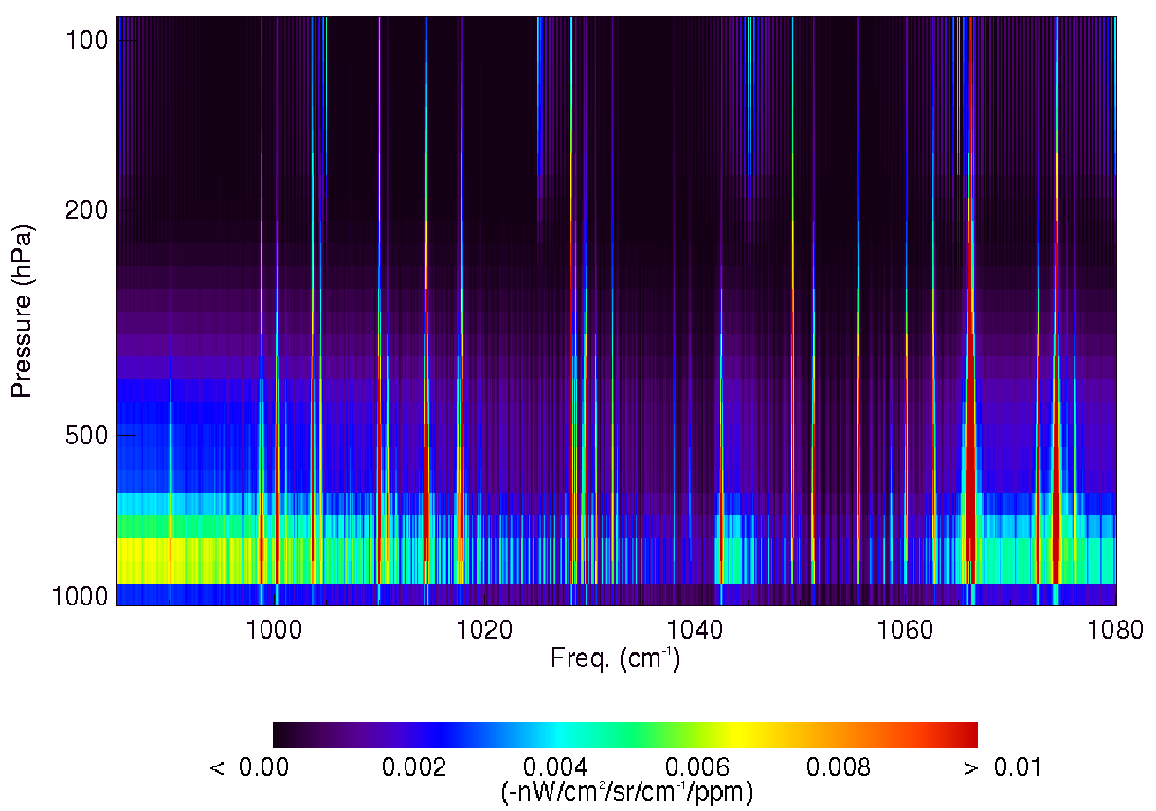
Spectral sensitivity of TOA flux to ozone and water vapor
O₃ (lnVMR) Jacobians
O₃ (ppb) Jacobians
Pressure (hPa)
TES obs. at 65°N, Aug. 2006
Frequency (cm⁻¹)
Frequency (cm⁻¹)
-nW/cm²/sr/cm⁻¹/ln(VMR)
-nW/cm²/sr/cm⁻¹/ppb
H₂O (lnVMR) Jacobians
H₂O (ppm) Jacobians
High spectral resolution is critical for separating O3 and H2O flux variability
Worden et al., JGR, 2011
Pressure (hPa)
Frequency (cm⁻¹)
Frequency (cm⁻¹)
-nW/cm²/sr/cm⁻¹/ln(VMR)
-nW/cm²/sr/cm⁻¹/ppm
Notes:
With spectral resolution, we explicitly account for the effect of water vapor when we integrate over the O3 band Jacobians since the O3 Jacobians are zeroed out when there is a strong H2O line.

Slide 7
H₂O and O₃ are radiatively coupled
O₃ (lnVMR) Jacobians
Pressure (hPa)
Pressure (hPa)
Frequency (cm⁻¹)
-nW/cm²/sr/cm⁻¹/ln(VMR)
-nW/cm²/sr/cm⁻¹/ln(VMR)
H₂O (lnVMR) Jacobians
65°N
6.2°N
Pressure (hPa)
Pressure (hPa)
Frequency (cm⁻¹)
-nW/cm²/sr/cm⁻¹/ln(VMR)
-nW/cm²/sr/cm⁻¹/ln(VMR)

Slide 8
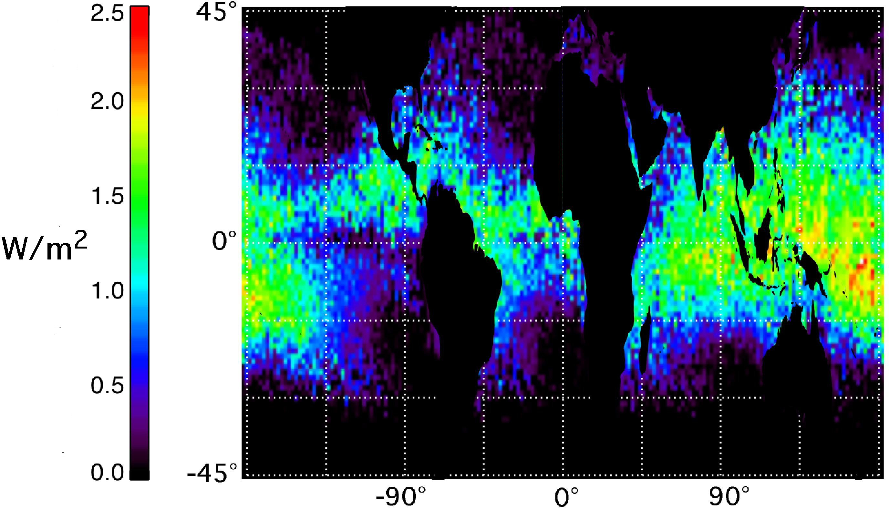
Potential Feedbacks to O₃ RF from H₂O
Water vapor LWRE in the IR ozone band
IPCC AR5 FAQ 8.1 Fig. 1: Water cycle
with water vapour feedback ~7%/°C
Worden et al., Nature GEO, 2008
Understanding the feedback of water vapor on ozone RF (more water = less O₃ RF) due to changes in the hydrological cycle from climate change will require the long-term measurements of IASI (A,B,C-2016) and IASI-NG (2021,2028,2035)

Slide 9
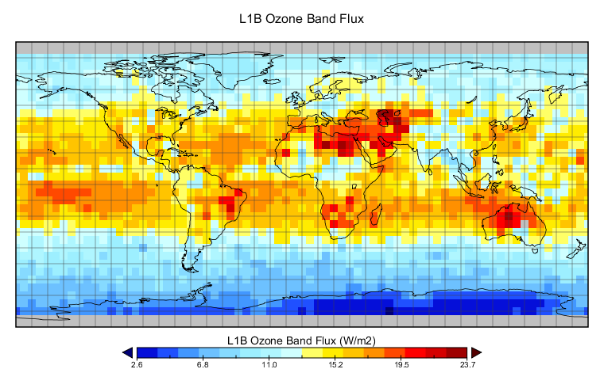
Initial Results: O₃ band TOA Flux
All-sky August 2006 Average
Similar to OLR but only for the IR ozone band
This is a fundamental quantity, predicted by climate models, but never tested against observations.

Slide 10
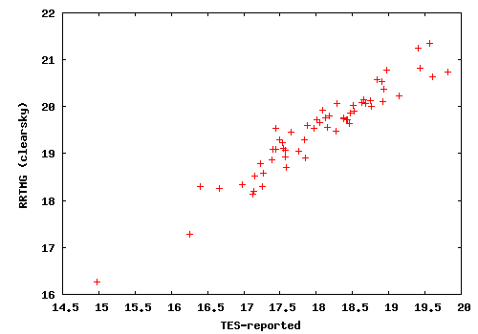
Initial Results: O₃ band TOA Flux
O₃ band flux
comparison for
atmospheres
specified from
TES retrievals
Thanks to A. Conley (NCAR)
RRTMG clear-sky (W/m²)
TES clear-sky (W/m²)
Known issues:
RRTMG band is 980-1080; TES band is 985-1080
(~1.1 to 1.7 W/m²)
different estimate of anisotropy (~5% difference w/ RRTMG higher)

Slide 11
Initial Results: Tropos. O₃ LWRE
IASI Tropospheric LWRE for 15 July, 2009
0
W/m²
-2
Thanks to S. Doniki, ULB, Brussels

Slide 12
Initial Results: Tropos. O₃ LWRE
Model-TES ΔLWRE comparison
Δ_{LWRE}
Bowman et al., ACPD, 2013
Latitude (deg)
Zonal averages: GISS RTM TOA flux sensitivity
and TES IRKs applied to same model differences
Notes:
Since the GISS model has a known dry bias in the upper troposphere at mid-latitudes, this could contribute to a higher sensitivity to changes in ozone as compared to TES.

Slide 13
Initial Results: Tropos. O₃ LWRE
From A. Conley, NCAR
Same atmosphere and surface conditions
Large differences for both clear and all-sky cases
Notes:
RRTMG is the Rapid Radiative Transfer Model for GCMs from AER

Slide 14
Conclusions
TOA flux from the IR Ozone band is a fundamental quantity in climate models that has not been compared to measurements.
Continuing the TES record with IASI data is critical for understanding present day to future changes in O₃ radiative forcing, such as cloud coverage and water vapor feedback.
Initial results show differences for both flux and flux sensitivity between models and data that need to be reconciled.

Slide 15
Backup

Slide 16
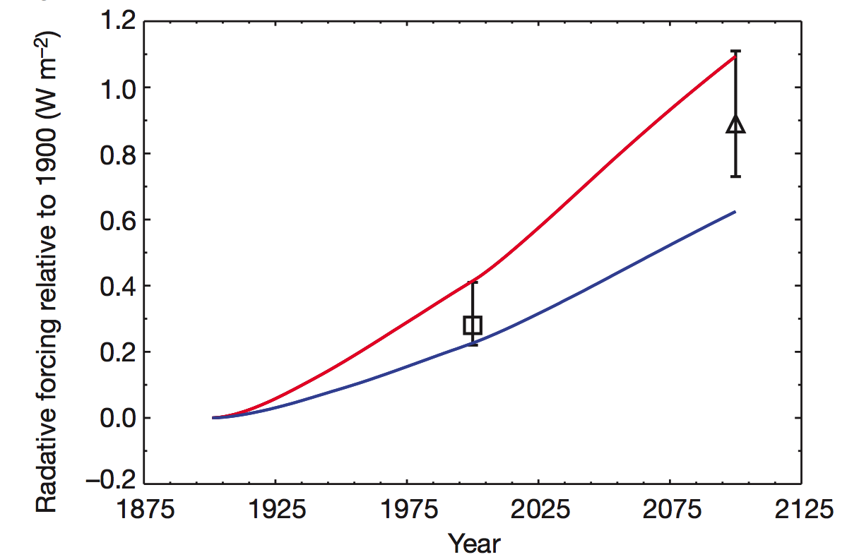
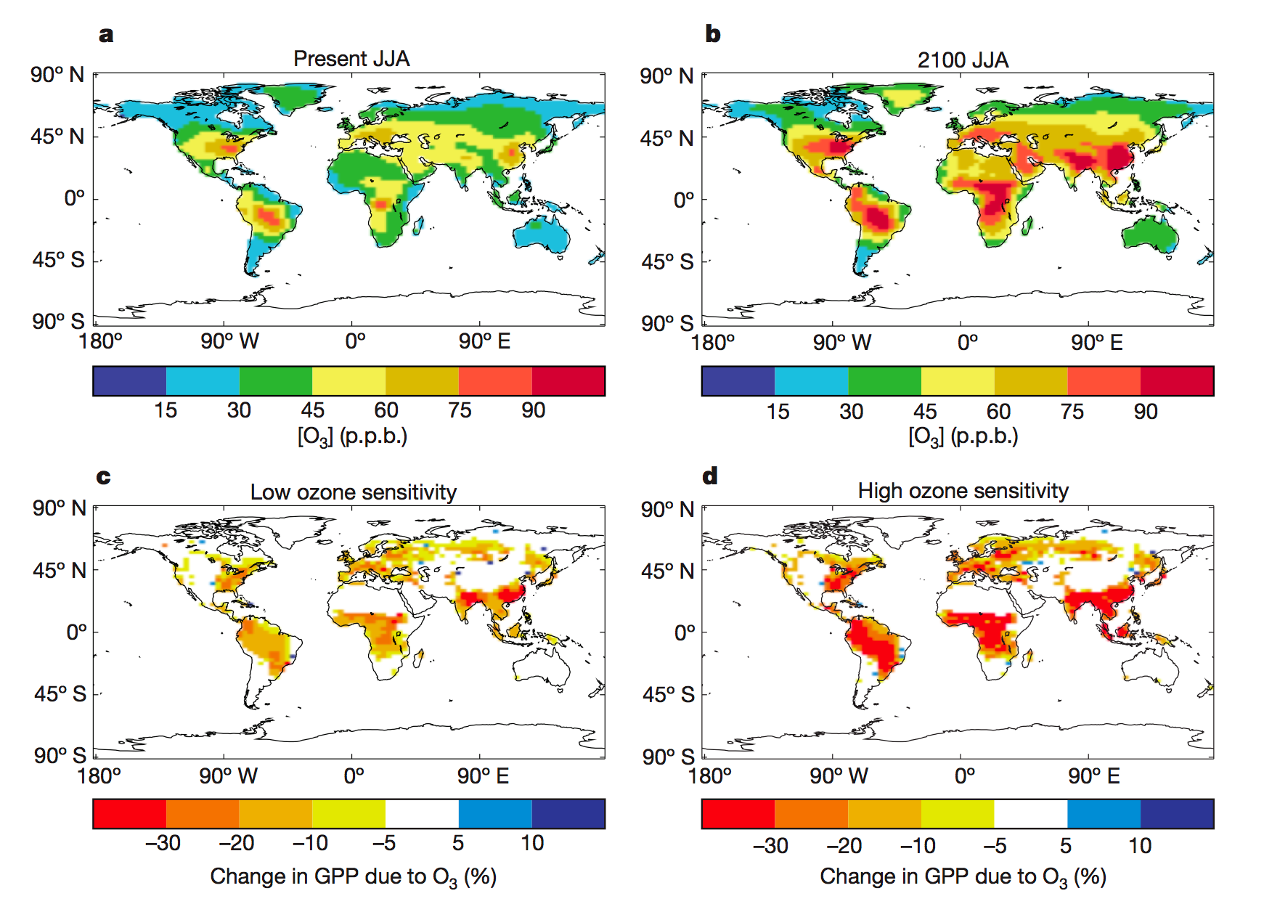
Role of ozone in chemistry-carbon-climate coupling
Direct effect:
Preindustrial-to-present day:
.35 [.25, .65] W/m²
Preindustrial through 21st century:
.89 W/m²
But O₃ RF is also coupled to changes in H₂O
.89 W/m²
Indirect effects:
Suppression of carbon
uptake by ozone damage to
plants could lead to additional
0.62 to 1.09 W/m² CO₂
radiative forcing
Sitch et al,(2007), Nature

Slide 17
H₂O and O₃ are radiatively coupled
Worden et al., JGR, 2011
Tropospheric ozone LWRE has a strong dependence on water vapor in the tropics.
Notes:
different amounts of precipitable water vapor can change the tropical clear-sky LWRE of tropospheric ozone by up to a factor of 5. Regions of high humidity lead to a relatively optically thick atmosphere where ozone variability has little impact on TOA flux variability, i.e., ozone and water vapor are radiatively coupled in the TOA flux. Changes in the spatial distribution of ozone precursor emissions, e.g., increases in Asia, coupled with changes in the hydrological cycle from climate change will lead to different patterns of ozone forcing.

Slide 18
Flux Estimate and Anisotropy
Flux:
L(θ,φ)
θ
φ
Anisotropy:

Slide 19
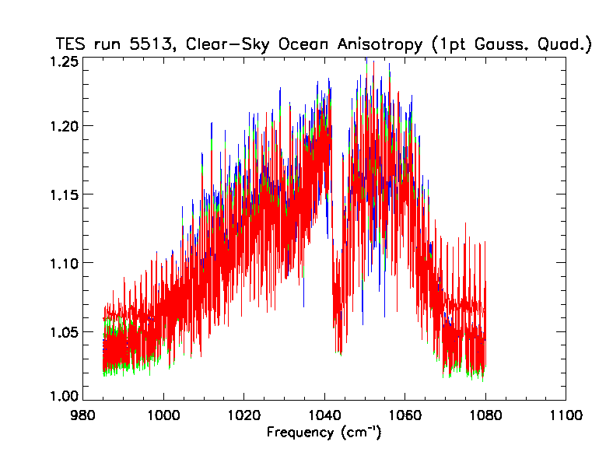
Anisotropy Results
Red = -5°-15°N
Green = 15°-30°N
Blue = 30°-45°N
TES anisotropy spectra
for clear-sky ocean scenes
AIRS clear-sky anisotropy
models: 14 sub-scenes for
prec. wv, T_lapse, T_sur
X. Huang et al., JGR, 2008

Slide 20
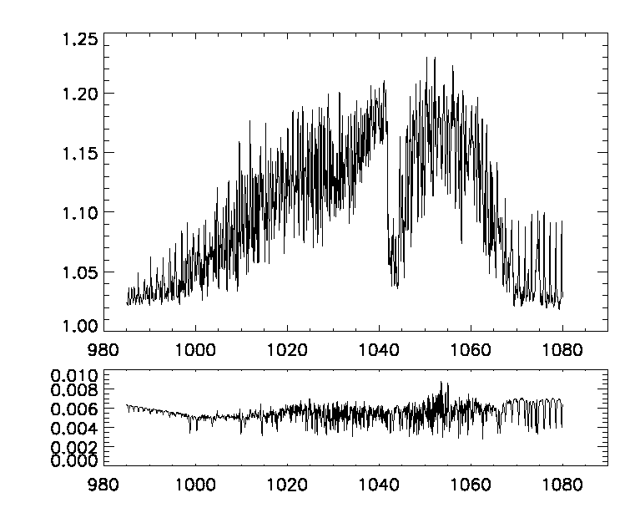
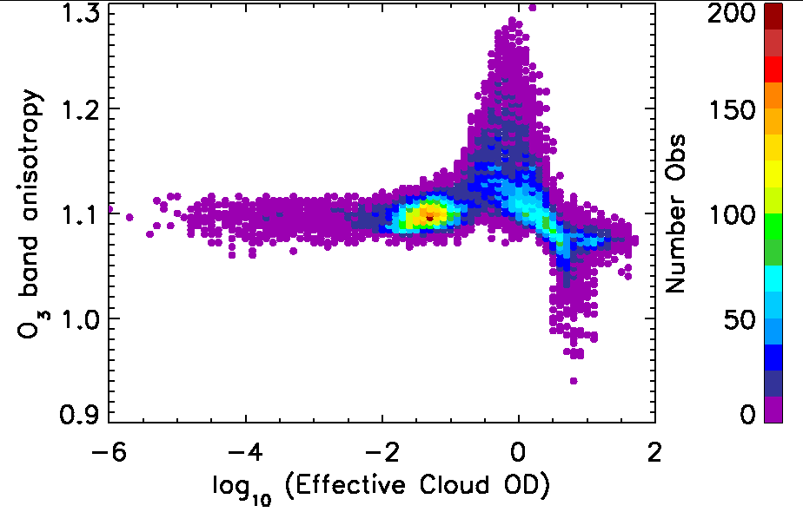
ANISOTROPY ESTIMATE
R spectral dependence
R cloud OD dependence
TES Anisotropy
Worden et al., JGR, 2011

Slide 21
Spectral Anisotropy Estimate
R = anisotropy, F = flux, L = radiance, θ=nadir angle, ν=frequency
(assumes azimuthal symmetry)
Let x = sinθ, then dx = cosθdθ
using Gaussian integration of moments. From Abramowitz & Stegun
for n=1, k=1: x_{i} = 0.666667 and w_{i} = 0.50

