Slide 1
Satellite Data Tutorial
Helen Worden (NCAR), Kevin Bowman (JPL)

Slide 2
Objectives
Learn how to find and download satellite data.
Learn differences between in situ data and remotely sensed data.
Learn how to apply a satellite instrument operator to data with finer vertical resolution.
Learn error characterization for remotely sensed data.
Examine comparison of satellite data with in situ measurements.

Slide 3
Exercise
Given data from an ozone sonde launch, (single day) perform the following:
Download the appropriate TES data (e.g. TES Lite data in netCDF format)
Find the nearest cloud-free, good quality observation in the TES data
Add model or apriori to fill in at top where sonde data cuts off
Initial mapping of sonde data to the TES pressure grid
Check the TES O3 averaging kernel (AK)
Apply the TES O3 instrument operator (AK and a priori profile) to the sonde data
Compare transformed sonde profile to TES O3 observation using the TES observation error covariance.
Diagnose coincidence of observations using back trajectories (if there is time)

Slide 4
Websites to help
http://tes.jpl.nasa.gov/data/
http://tes.jpl.nasa.gov/uploadedfiles/TESQuickStartGuide.htm
TES Data Visualization:
http://tes.jpl.nasa.gov/visualization/SCIENCE_PLOTS/R12/browse_run3277.html
http://tes.jpl.nasa.gov/visualization/SCIENCE_PLOTS/TES_L3_Daily.htm
Other Tools:
http://ready.arl.noaa.gov/HYSPLIT.php (back trajectories)
Other Data:
http://www.pole-ether.fr/etherTypo/index.php?id=1585&L=1 (IASI CO data & daily plots)
https://www2.acom.ucar.edu/mopitt (MOPITT CO data & visualization options)

Slide 5
Ascension Island O3 sonde & sonde mapped to TES pressure levels

Slide 6
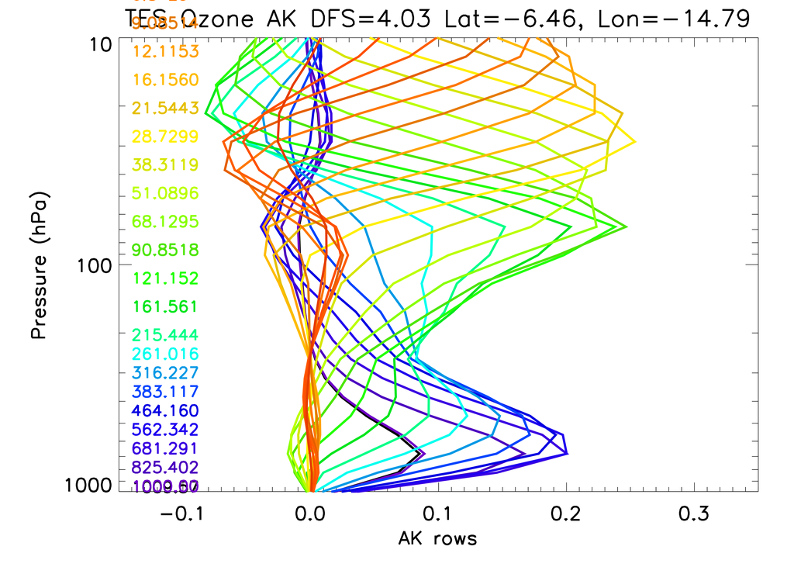
TES Averaging Kernel (AK) for closest clear observation

Slide 7
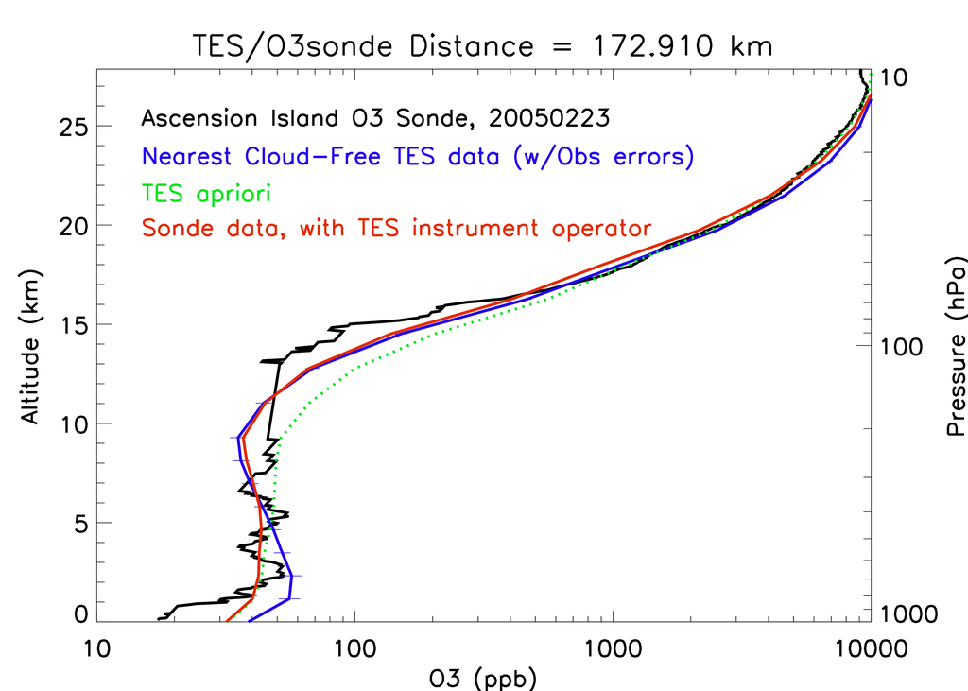
TES/Sonde Comparison
Low TES sensitivity,
sonde with TES op
moves to a priori

Slide 8
Optimal Estimation Retrieval Errors
Observation error
used for comparisons
after applying the TES AK and apriori
S_{x} = (Total error covariance)
(A_{xx} −I)S_{a}(A_{xx} −I)^{Τ} + (Smoothing error)
(A_{XXcs})S_{a}^{XcsXcs}(A_{XXcs})^{Τ} + (Cross-state error, includes T,H₂O )
MG_{z} S_{n} G_{z}^{T}M^{Τ} + (Measurement error)
∑MG_{z}K_{b}^{i}S_{b}^{i} (MG_{z}K_{b}^{i} )^{T} (Systematic errors)
x = estimated state parameters (e.g. ozone)
M = linear mapping matrix on pressure levels from retrieval parameters (z) to state parameters (x).
Gain matrix: ${\text{G}}_{z}={\left({\text{K}}_{z}^{T}{{{\text{S}}_{n}^{−1}\text{K}}_{z}+ Λ}_{z}\right)}^{−1}{{\text{K}}_{z}^{T}\text{S}}_{n}^{−1}$
F = forward model radiance; K_{z} = Jacobian matrix: $\frac{∂F}{∂z};$S_{n} = measurement covariance; Λ_{z} = constraint matrix.
Averaging kernel A_{xx} = MG_{z}K_{z}M⁻¹, which is the sensitivity of the retrieval to the true state.
S_{a} = a priori covariance
S_{a}^{XcsXcs} = covariance of cross state parameters that are retrieved concurrently, i.e., atmospheric temperature and water vapor.
S_{b}^{i} = covariance for the ith forward model systematic error, such as spectroscopic uncertainties, with Jacobian K_{b}^{i} giving the sensitivity of the forward model radiance to these non-retrieved forward model parameters.

Slide 9
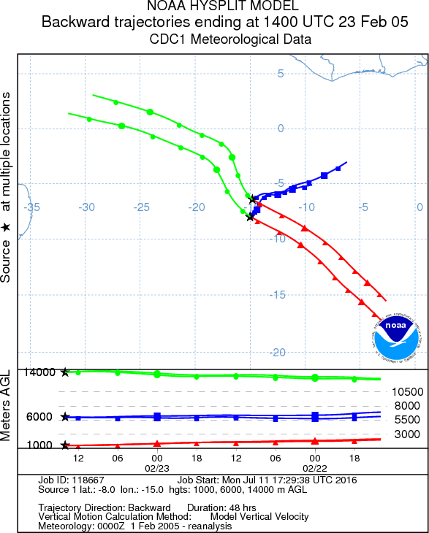
Back Trajectories (diagnostic)
TES
Sonde
Back trajectories can only indicate if air is coming from
similar or different places. If air is coming from the same place, measurements should be similar. But if back trajectories are different, the diagnostic is less conclusive (ozone could be similar even if back trajectories are different)

Slide 10
Perform comparison for TES and ozonesonde from San Cristobal (Galapagos)
Use IDL, Matlab, etc. – your preference. Modify for different date and location.
Sonde file and reader (IDL) provided.
Find file on TES data website but use TES data file provided (too much bandwidth needed for everyone to download TES files).
Produce plots showing TES AK and TES/Sonde comparison.
Run back trajectories (if time).

