Slide 1
Hydrometeors Comparison: WRF vs. DLA
Kristin Cummings
31 January 2016

Slide 2
Methodology
Compared hydrometeor horizontal cross sections from the DLA, which appear in DiGangi (2014), with WRF output (using the 21Z restart file from Megan’s wetscav_1 run, which I’ve been using from the beginning of my analyses – exp306?)
Graupel
Cloud ice/snow
Compared hydrometeors at three time periods
DLA plots were at 23:21 Z
WRF tended to be 40 min before observations (00:00 Z)
WRF results at 23:40 Z appeared to contain the highest cloud ice/snow concentrations

Slide 3
DLA Hydrometeors at 23:21Z
Graupel Mixing Ratio
Cloud Ice & Snow Mixing Ratio
DiGangi, 2014

Slide 4
DLA Hydrometeors at 00:00Z
Graupel Mixing Ratio
Cloud Ice & Snow Mixing Ratio
DiGangi, 2014

Slide 5
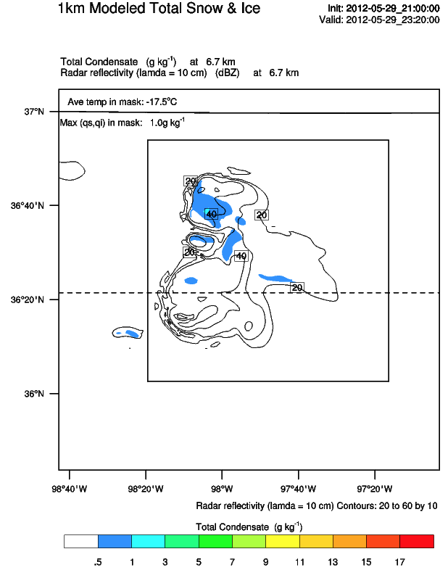
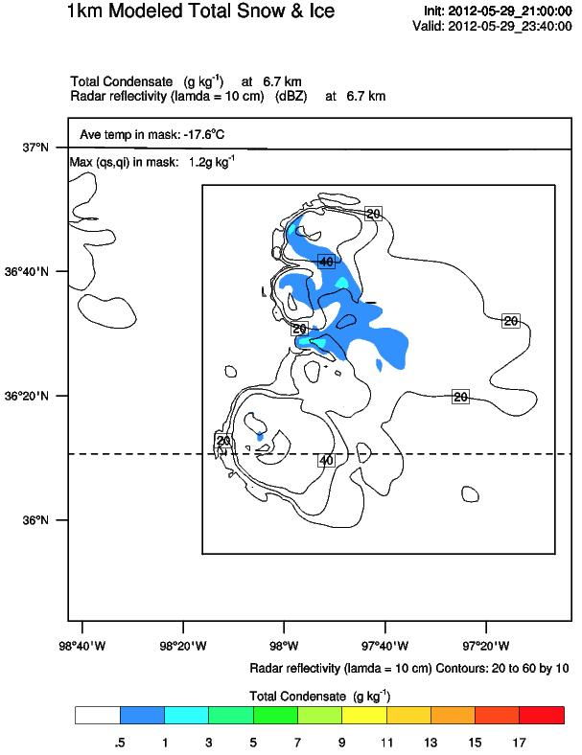
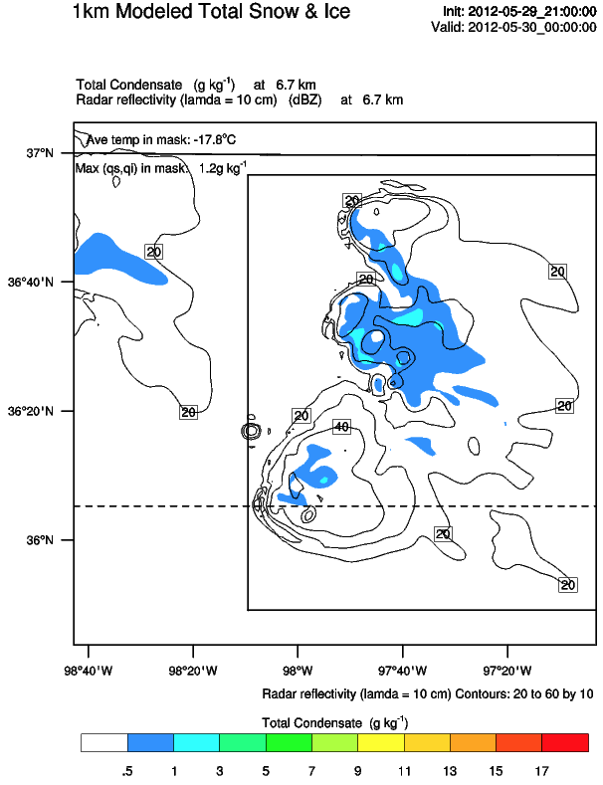
In DLA (slide 2) at 23:21Z, cloud ice/snow first appears at 6.7 km in eastern anvil of the Kingfisher storm in a small area of less than 1.0 g kg⁻¹
In WRF (above) at 23:20-00:00Z, cloud ice/snow appears in storm core with maximum values less than 1.2 g kg⁻¹ at 6.7 km
Dashed line represents the vertical cross section shown on slide 7
Reflectivity shown as thin, black lines contoured every 10 dBZ from 20-60 dBZ

Slide 6
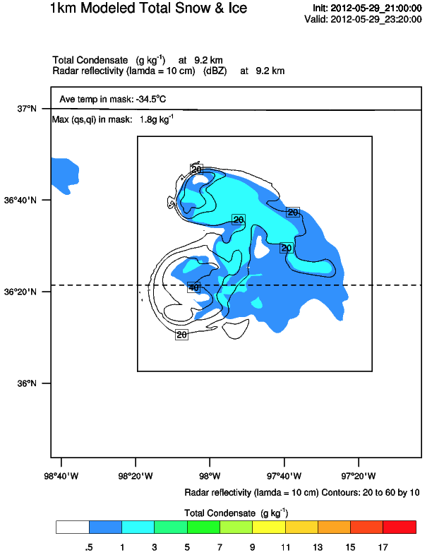
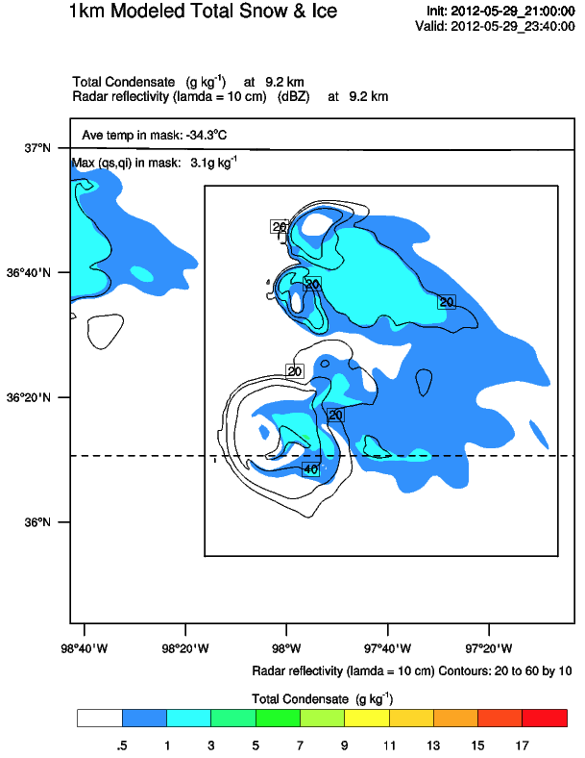
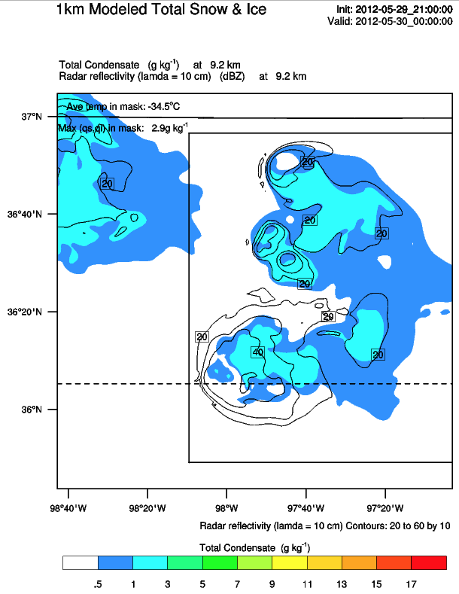
In WRF (above) at 23:20-00:00Z, cloud ice/snow appears in storm core with maximum values less than 3.1 g kg⁻¹ at 9.2 km

Slide 7
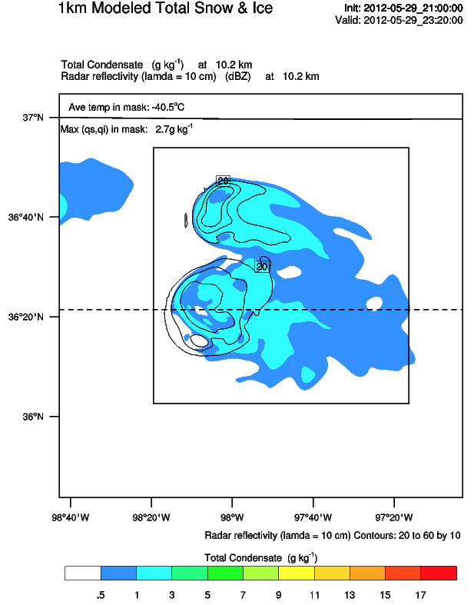
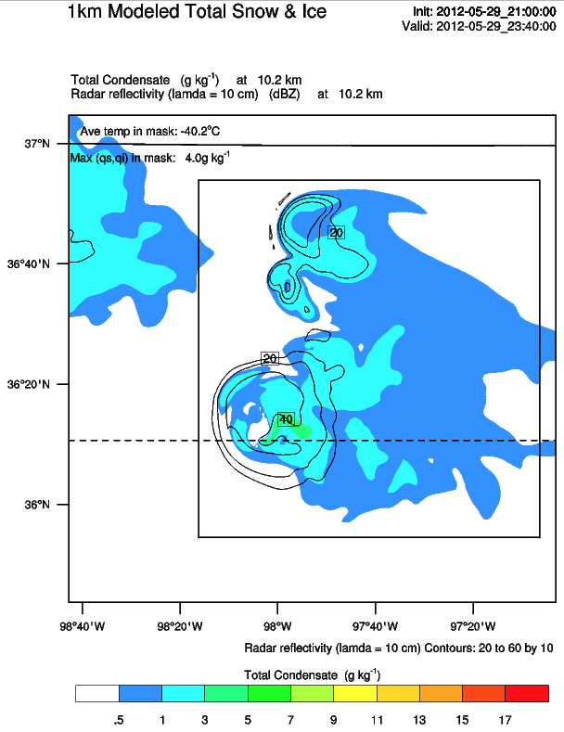
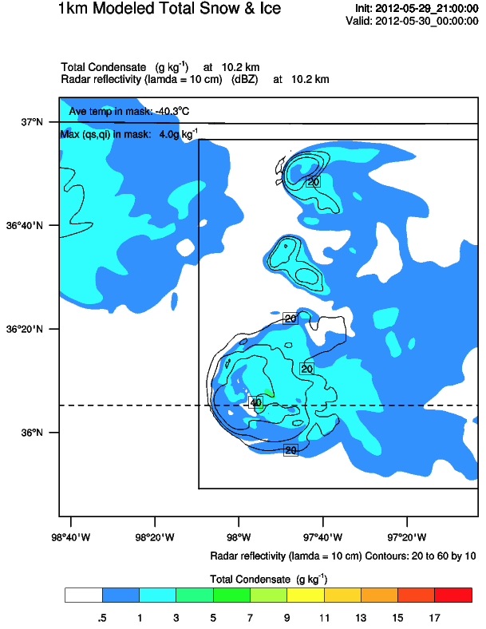
In DLA (slide 2) at 23:21Z, cloud ice/snow is concentrated in and around the high flash densities northeast of the bounded weak lightning region, but also extends into eastern anvil and storm core.
Max values at 10.2 km are 6.0-7.0 g kg⁻¹.
In WRF (above) at 23:20-00:00Z, cloud ice/snow appears in storm core with maximum values less than 4.0 g kg⁻¹ at 10.2 km
Higher values appear on the east/southeast side of storm core

Slide 8
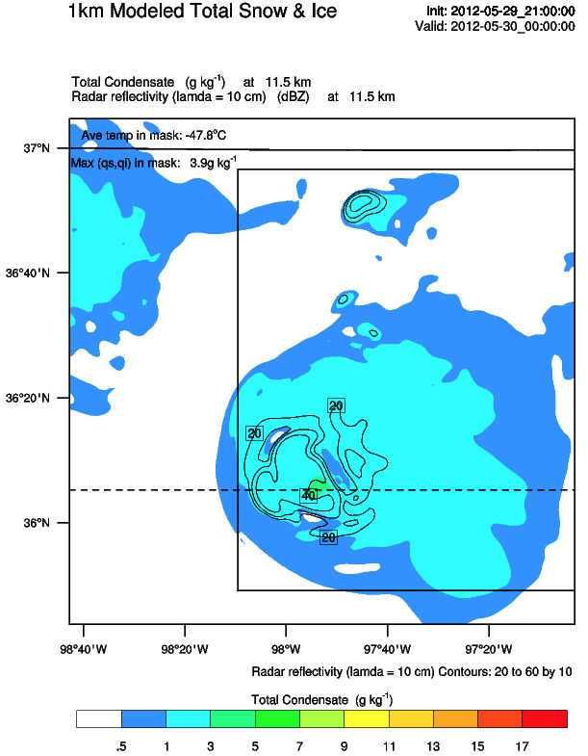
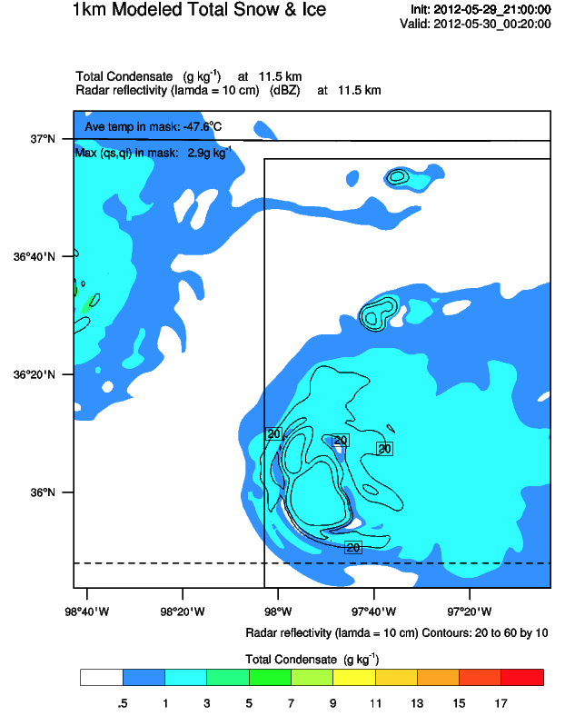
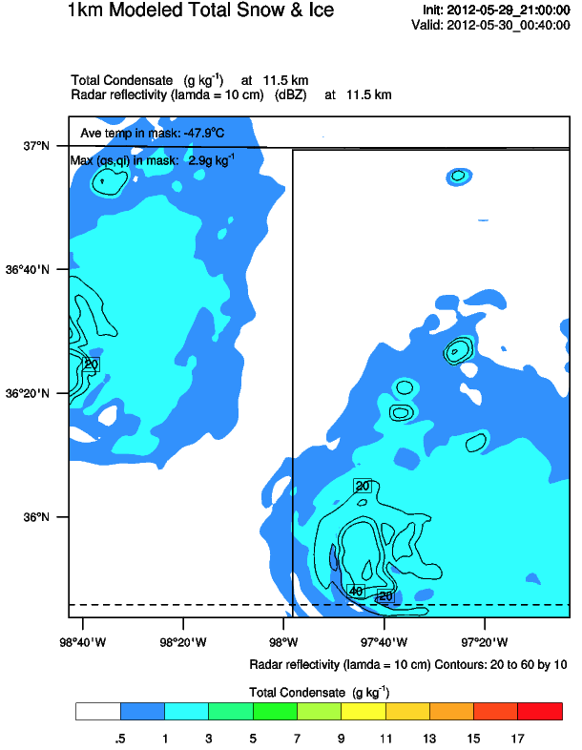
In DLA (slide 3) at 00:00Z, cloud ice/snow concentrations between 11.2-11.7 km are 6.0-7.0 g kg⁻¹.
In WRF (above) at 00:00Z-00:40Z, cloud ice/snow appears in storm core with maximum values less than 3.9 g kg⁻¹ at 11.5 km

Slide 9
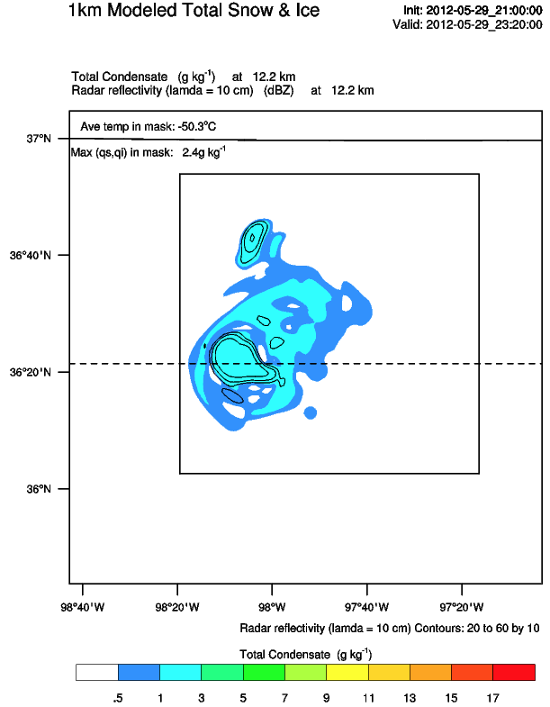
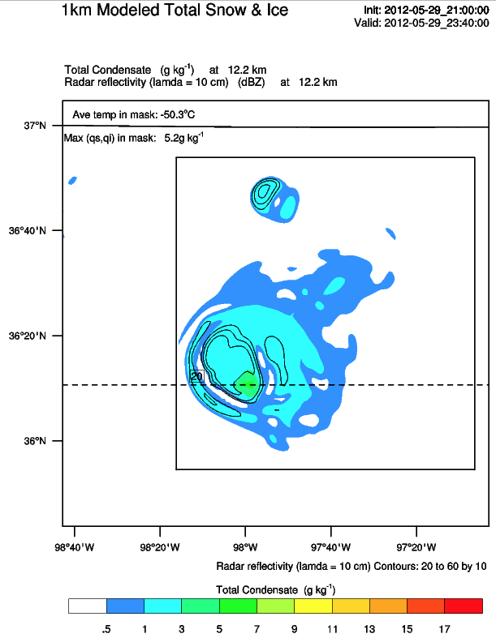
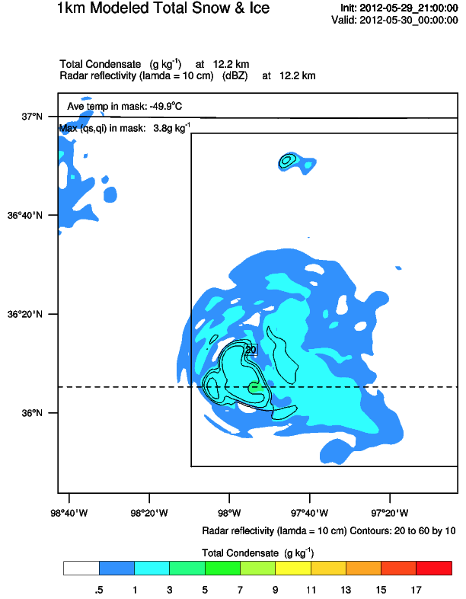
Max from 11.2-12.2km: 2.8 g kg⁻¹
Max from 11.2-12.2km: 5.2 g kg⁻¹
Max from 11.2-12.2km: 4.0 g kg⁻¹
Max from 11.7-13.7km: 2.7 g kg⁻¹
Max from 11.7-13.7km: 5.2 g kg⁻¹
Max from 11.7-13.7km: 3.9 g kg⁻¹
In DLA (slide 2) at 23:21Z, cloud ice/snow concentrations increased with altitude on the eastern edge of the bounded weak lightning region.
Between 11.2 to 12.2 km the snow/ice increased to 10.0 g kg⁻¹.
Between 11.7 to 13.7 km the snow/ice were greater than or equal to 7.0 g kg⁻¹.
In WRF (above) at 23:20-00:00Z, cloud ice/snow appears in storm core with maximum values less than 5.2 g kg⁻¹ at 12.2 km

Slide 10
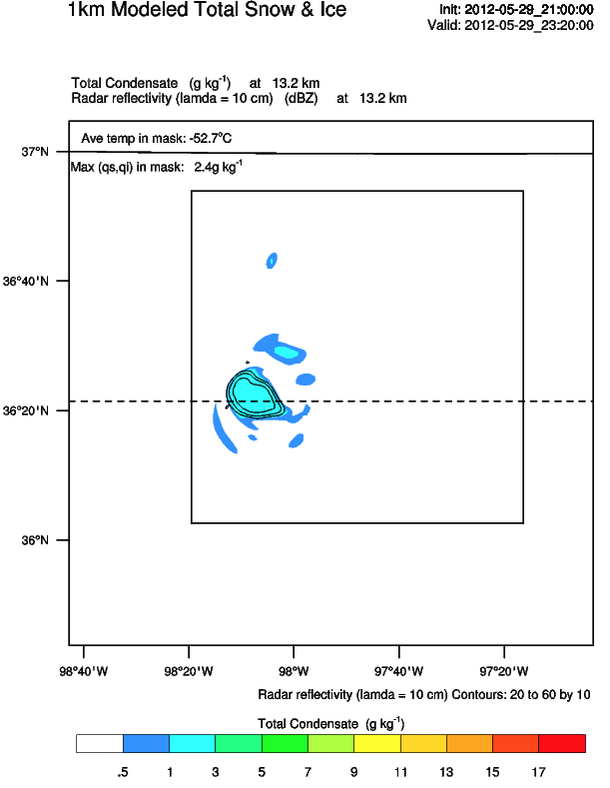
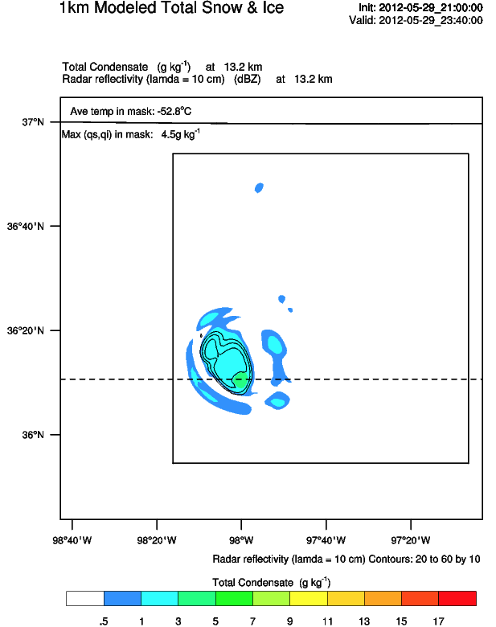
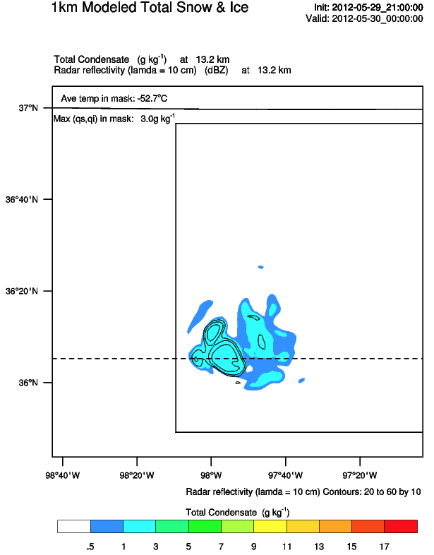
Max from 11.2-12.2km: 2.8 g kg⁻¹
Max from 11.2-12.2km: 5.2 g kg⁻¹
Max from 11.2-12.2km: 4.0 g kg⁻¹
Max from 11.7-13.7km: 2.7 g kg⁻¹
Max from 11.7-13.7km: 5.2 g kg⁻¹
Max from 11.7-13.7km: 3.9 g kg⁻¹
In DLA (slide 2) at 23:21Z, cloud ice/snow concentrations increased with altitude on the eastern edge of the bounded weak lightning region.
Between 11.7 to 13.7 km the snow/ice were greater than or equal to 7.0 g kg⁻¹.
Maximum snow/ice concentrations were between 8.0-9.0 g kg⁻¹.
In WRF (above) at 23:20-00:00Z, cloud ice/snow appears in storm core with maximum values less than 4.5 g kg⁻¹ at 13.2 km

Slide 11
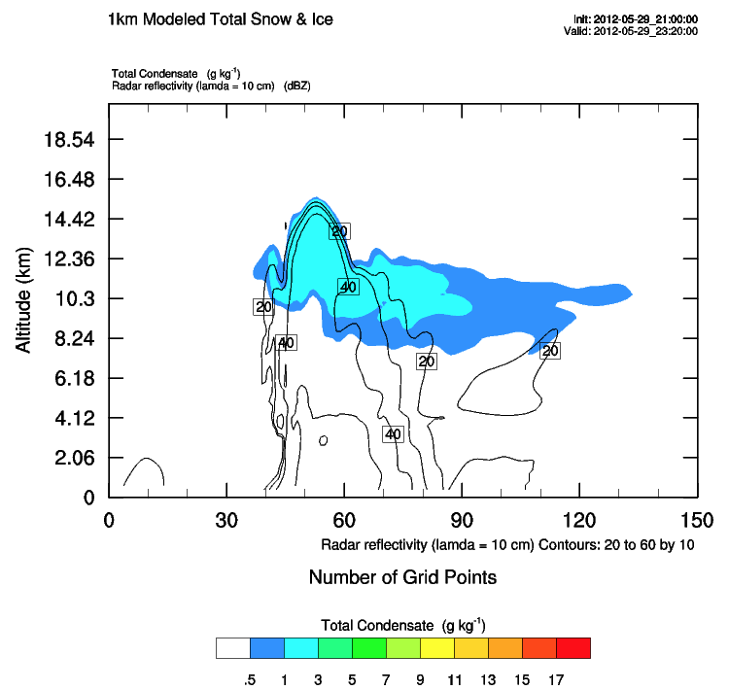
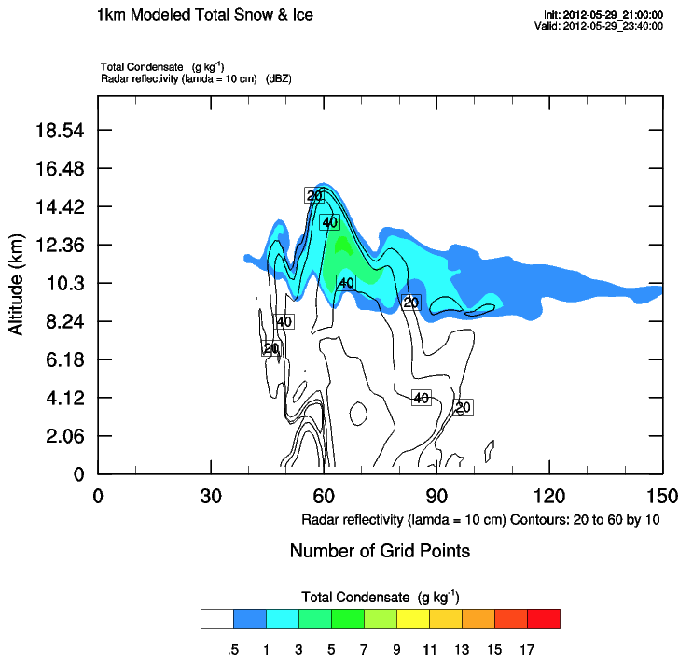
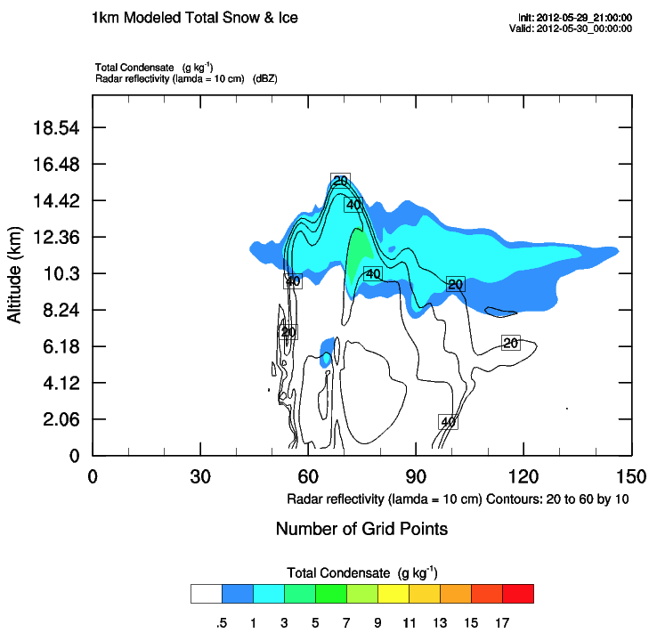
In DLA at 23:21Z, cloud ice/snow concentrations
First appear at 6.7 km
Disappear above 15.7 km
In WRF (above) at 23:20-00:00Z, cloud ice/snow concentrations
First appear ~8.2 km, with a pocket around 6.0 km
Disappear above ~15.4 km

Slide 12
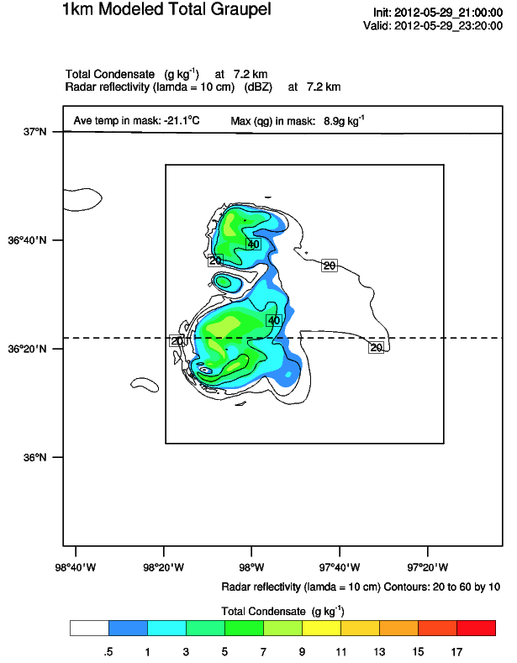
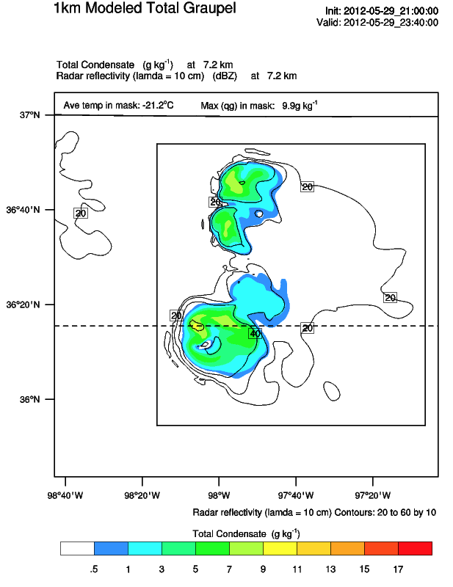
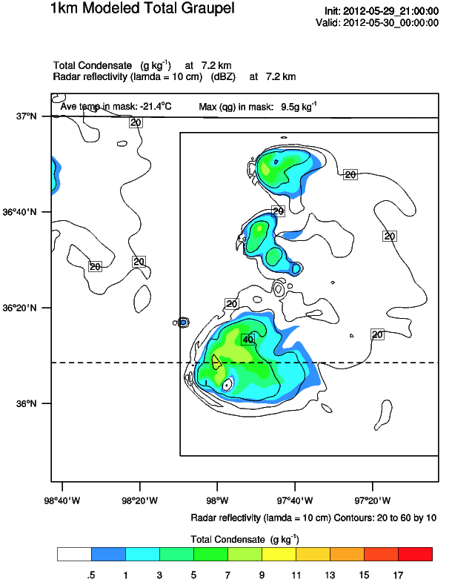
In DLA (slide 2) at 23:21Z, higher values of graupel concentrations were noticeable with the high flash density on the southwest side of the bounded weak lightning region
Contours appear to show concentrations up to 5.0 g kg⁻¹
In WRF (above) at 23:20-00:00Z, graupel appears in storm core with maximum values less than 9.9 g kg⁻¹ at 7.2 km

Slide 13
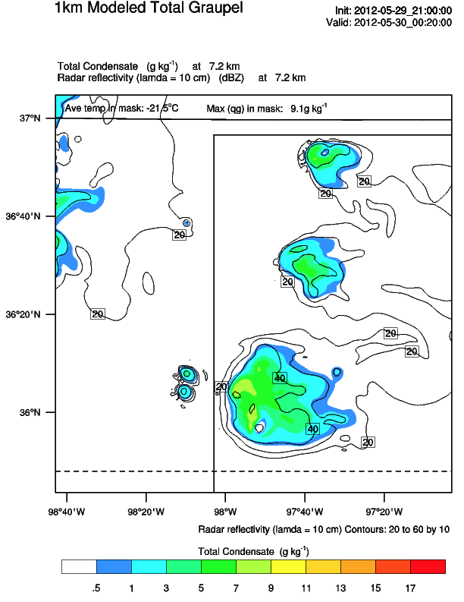
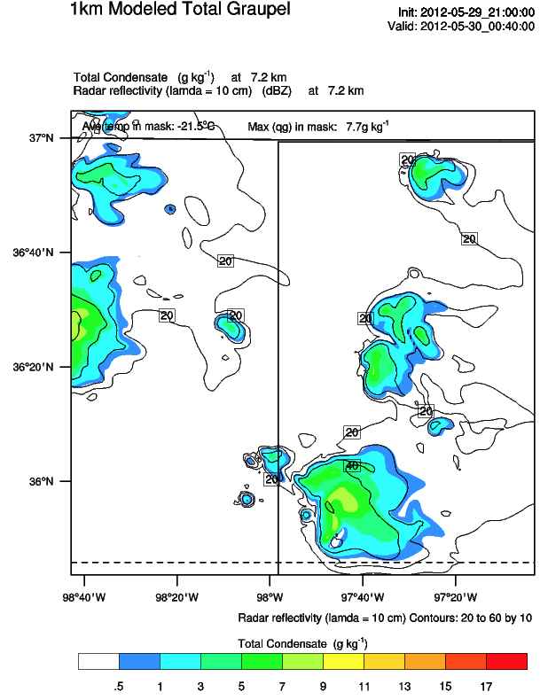
In DLA (slide 3) at 00:00Z, higher values of graupel concentrations were noticeable within, west and northwest of the bounded weak lightning region
Maximum concentrations at 7.2 km are 11.0-12.0 g kg⁻¹
In WRF (above) at 00:00-00:40Z, graupel appears in storm core with maximum values less than 9.5 g kg⁻¹ at 7.2 km

Slide 14
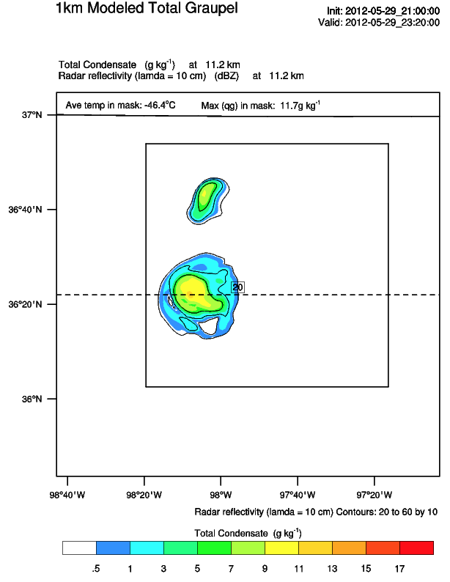
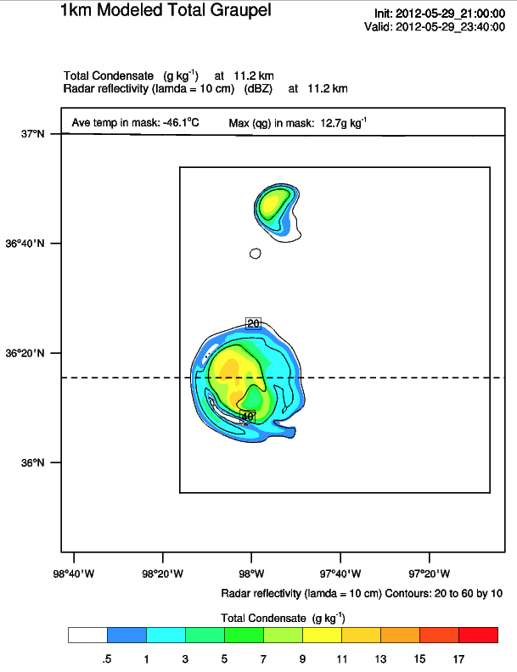
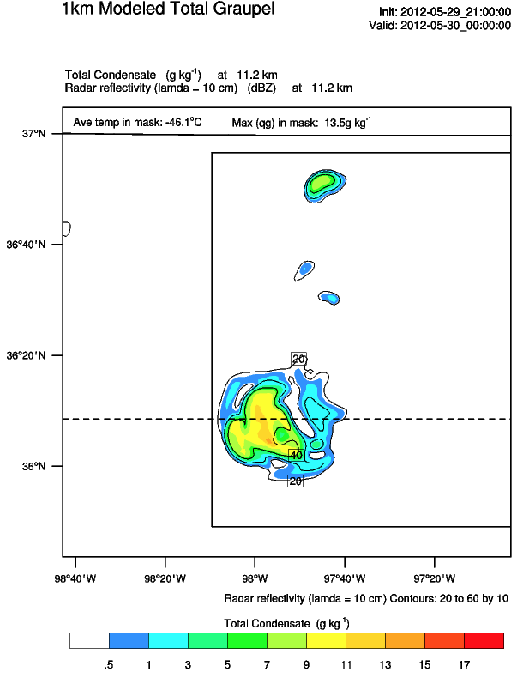
Max from 11.2-12.2km: 11.8 g kg⁻¹
Max from 11.2-12.2km: 12.8 g kg⁻¹
Max from 11.2-12.2km: 13.6 g kg⁻¹
Max from 11.7-13.7km: 11.8 g kg⁻¹
Max from 11.7-13.7km: 12.9 g kg⁻¹
Max from 11.7-13.7km: 13.5 g kg⁻¹
In DLA (slide 2) at 23:21Z, graupel concentrations are mainly ≥ 1.0 g kg⁻¹
Contours appear to show concentrations up to 7.0 g kg⁻¹
In WRF (above) at 23:20-00:00Z, graupel appears in storm core with maximum values less than 13.5 g kg⁻¹ at 11.2 km
Graupel values approach 15 g kg⁻¹ near 02:00Z model time between 11.7-13.7km

Slide 15
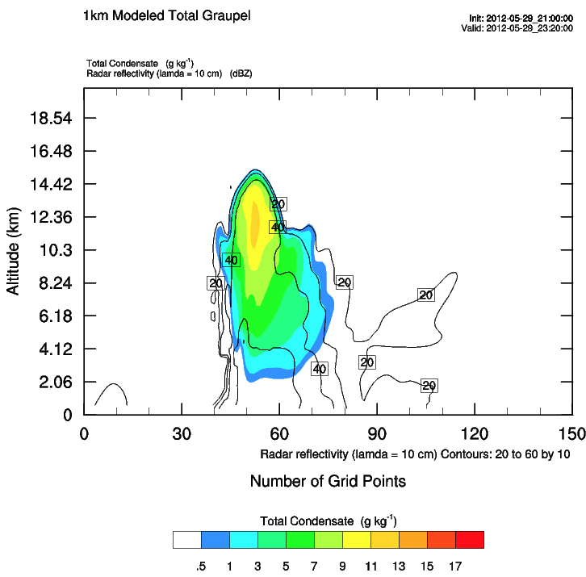
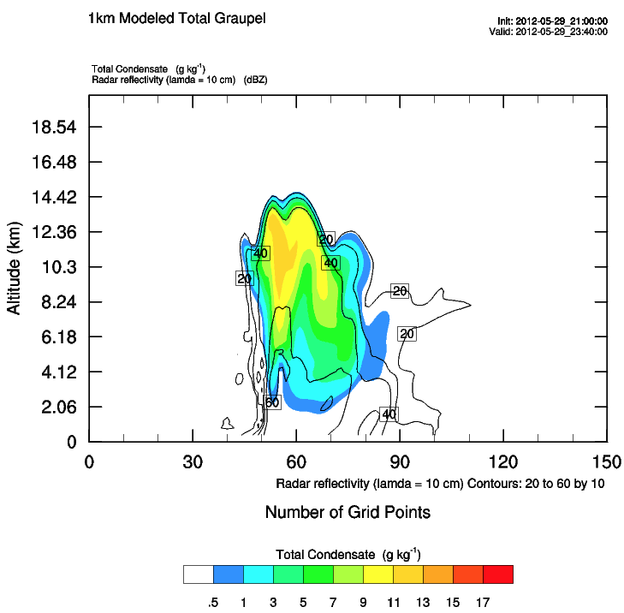
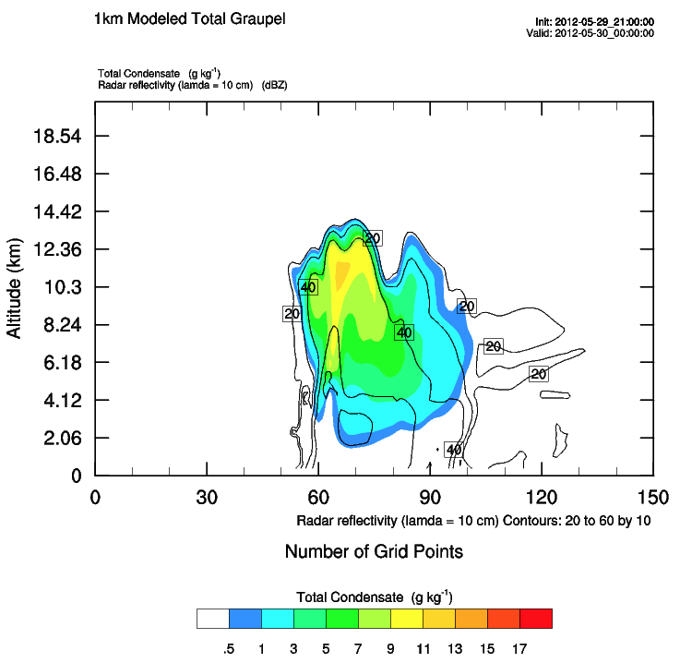
In DLA at 23:21Z, graupel concentrations
Existed from 0.2 to 15.2 km
High values near at or near surface are likely hail
Hail core eastern side of bounded weak lightning region from 0.7 to 2.2 km with maximum concentrations from 8.0-9.0 g kg⁻¹ at 1.2 km
High concentrations just above ~4.4 km (freezing level)
In WRF (above) at 23:20-00:00Z, graupel concentrations
Location of these vertical cross sections are not the same as those for cloud ice/snow
First appear ~2.0 km
Disappear above ~15.4 km

Slide 16
Conclusions
WRF cloud ice/snow
Appears to be in the same location as the DLA
Similar values at 6.7 km
WRF concentrations are roughly half that of the DLA at altitudes above 10.2 km
This is opposite of what the Precip Ice Mass plots showed, where the WRF PIM was triple the DLA PIM estimate (~800x10⁶ kg vs. ~275x10⁶ kg, respectively).
Maybe the difference here is simply the application of the Deierling et al. (2008) PIM scheme in the output of the two models? Or differences in the two models and the non-hydrometeor variables/criteria that are being used in the PIM flash rate calculation?
WRF graupel
Does not extend as low in altitude as the DLA
At DLA time 23:21Z, the WRF concentrations from 23:20-00:00Z appear to be roughly twice that of the DLA (hard to count the contours in DLA plot)
At DLA time 00:00Z, the WRF concentrations from 00:00-00:40Z appear to be 1.5 times that of the DLA concentrations
This is similar to the Graupel Echo Volume plots, where the WRF GEV mass was similar to the DLA estimate of GEV mass (~220 km³ vs. ~200 km³, respectively)

Slide 17
Adjusting WRF Hydrometeors
If WRF graupel concentrations are roughly twice the DLA mixing ratios, then decrease WRF graupel by half
If WRF snow/ice concentrations are roughly half the DLA mixing ratios, then double the snow concentrations
Tested different combinations of the above
Discovered that if decrease the WRF graupel concentrations by half and don’t modify the snow concentrations, then the precipitation ice mass is only two times that of the DLA
I think the graupel echo volume is similar between the WRF and the DLA because you simply count up the number of grid cells that meet the criteria, while with the precipitation ice mass you are actually using the mixing ratios of the graupel and snow
It appears based on the comparison between the WRF and DLA hydrometeors and the comparisons with the visible satellite images, that the WRF is getting the size of the anvil correct, but there are differences in the hydrometeor concentrations
It doesn’t appear that the differences can simply be fixed by decreasing the WRF graupel by half and increasing the snow by two because the adjustments cancel each other out

Slide 18
Description of Hydrometeor Variables used for Computing FRPSs
PRECIPITATION ICE MASS (kg; Deierling et al., 2008)
Compute precipitation snow mass (qs_p_mass, kg) where T < 268.15 K) and qs > 1E-12 and w < vts_morr:
qs_p_mass = qs_p_mass + qs * rho * dx * dy *dz
Compute graupel mass (qg_mass, kg) where T < 268.15 K and qg > 1E-12:
qs_mass = qg_mass + qg * rho * dx * dy * dz
Compute precipitation ice mass where qg_mass > 0 and qs_p_mass > 0:
precip_ice_mass = precip_ice_mass + qs_p_mass + qg_mass
Compute flash rate (flashes/min):
total_fr = precip_ice_mass * 3.4E-8 -18.1
CSU GRAUPEL ECHO VOLUME (km3):
Compute flash rate (flashes/min) within charging region where qg > 0 and refl > specified threshold

Slide 19
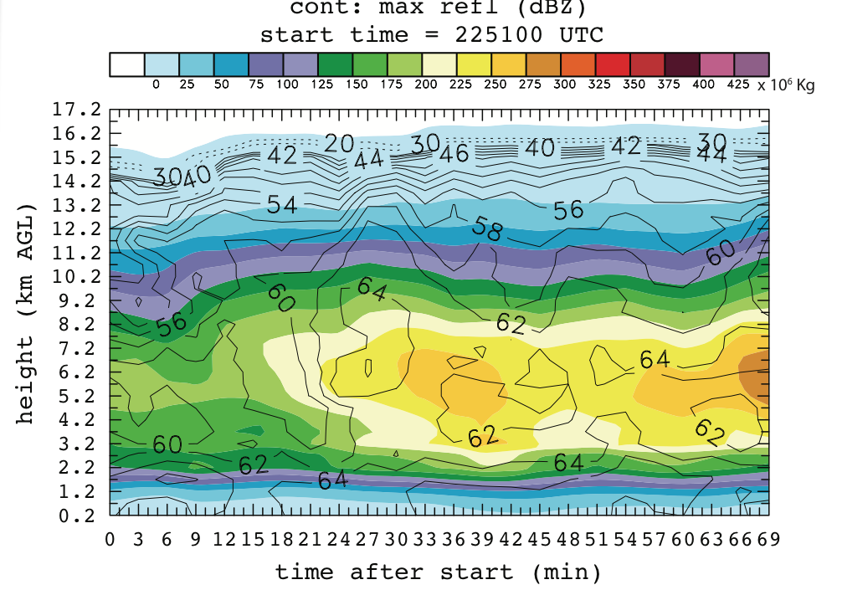
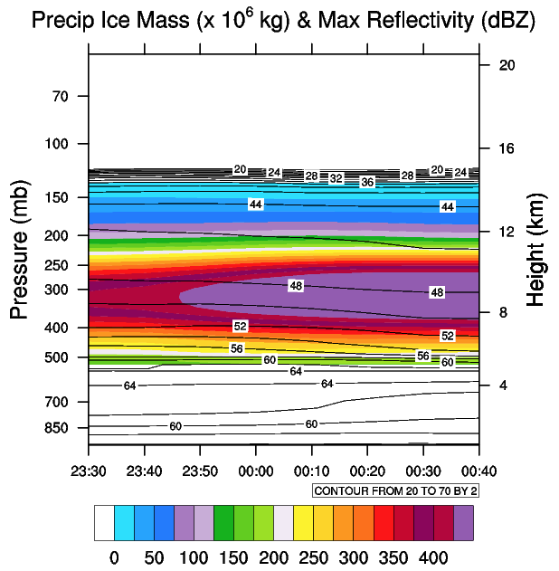
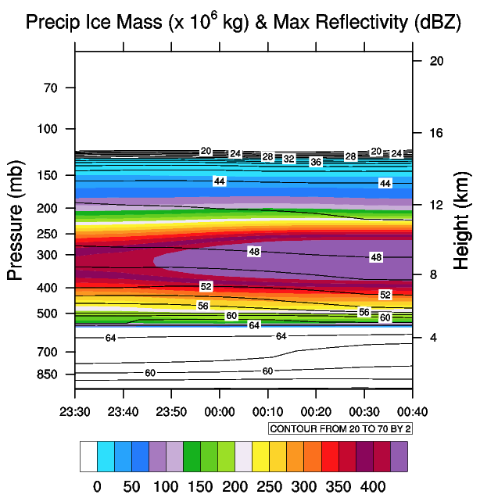
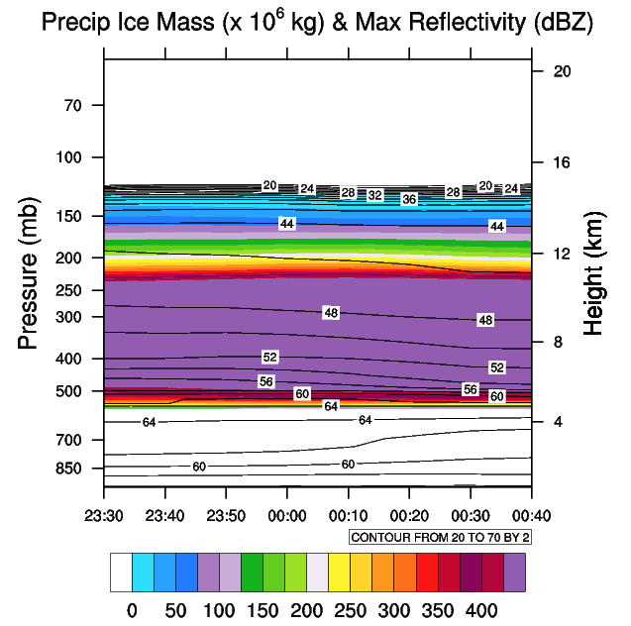
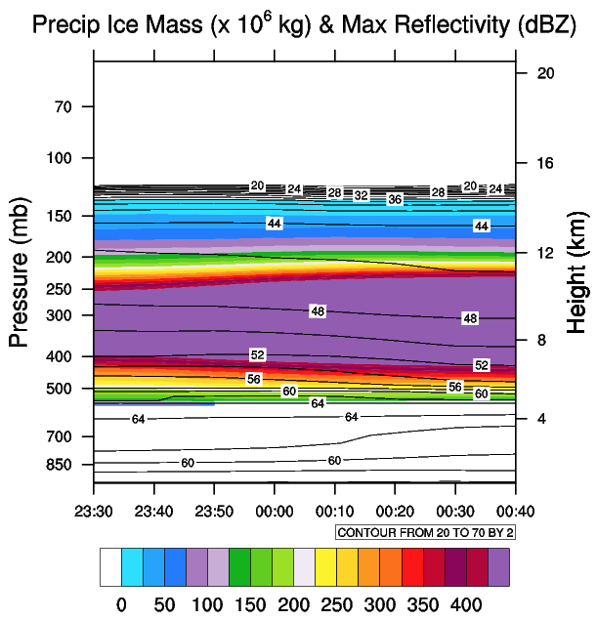
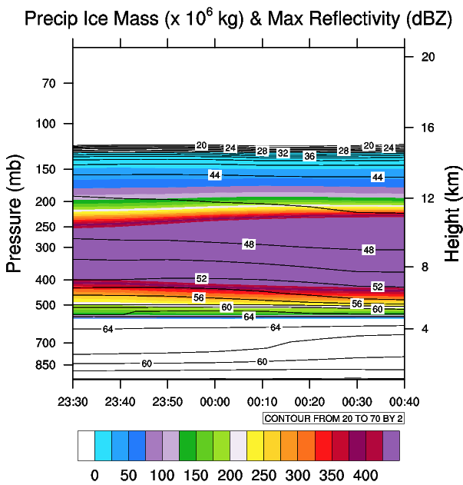
DLA
Max: 528 Min: 0.27
½ qg, 1 qs with “.and.”
Max: 528 Min: 0.01
½ qg, 1 qs with “.or.”
Max: 839 Min: 0.01
1 qg, 1 qs with “.and.”
Max: 858 Min: 0.54
½ qg, 2 qs with “.and.”
Max: 858 Min: 0.01
½ qg, 2 qs with “.or.”

Slide 20
Comparison with Smart-R reflectivity

Slide 21
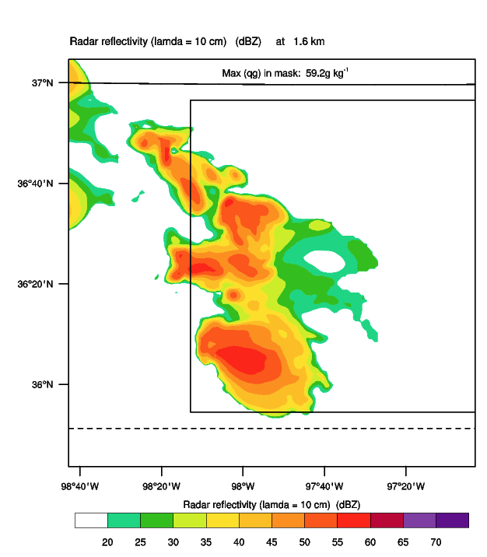
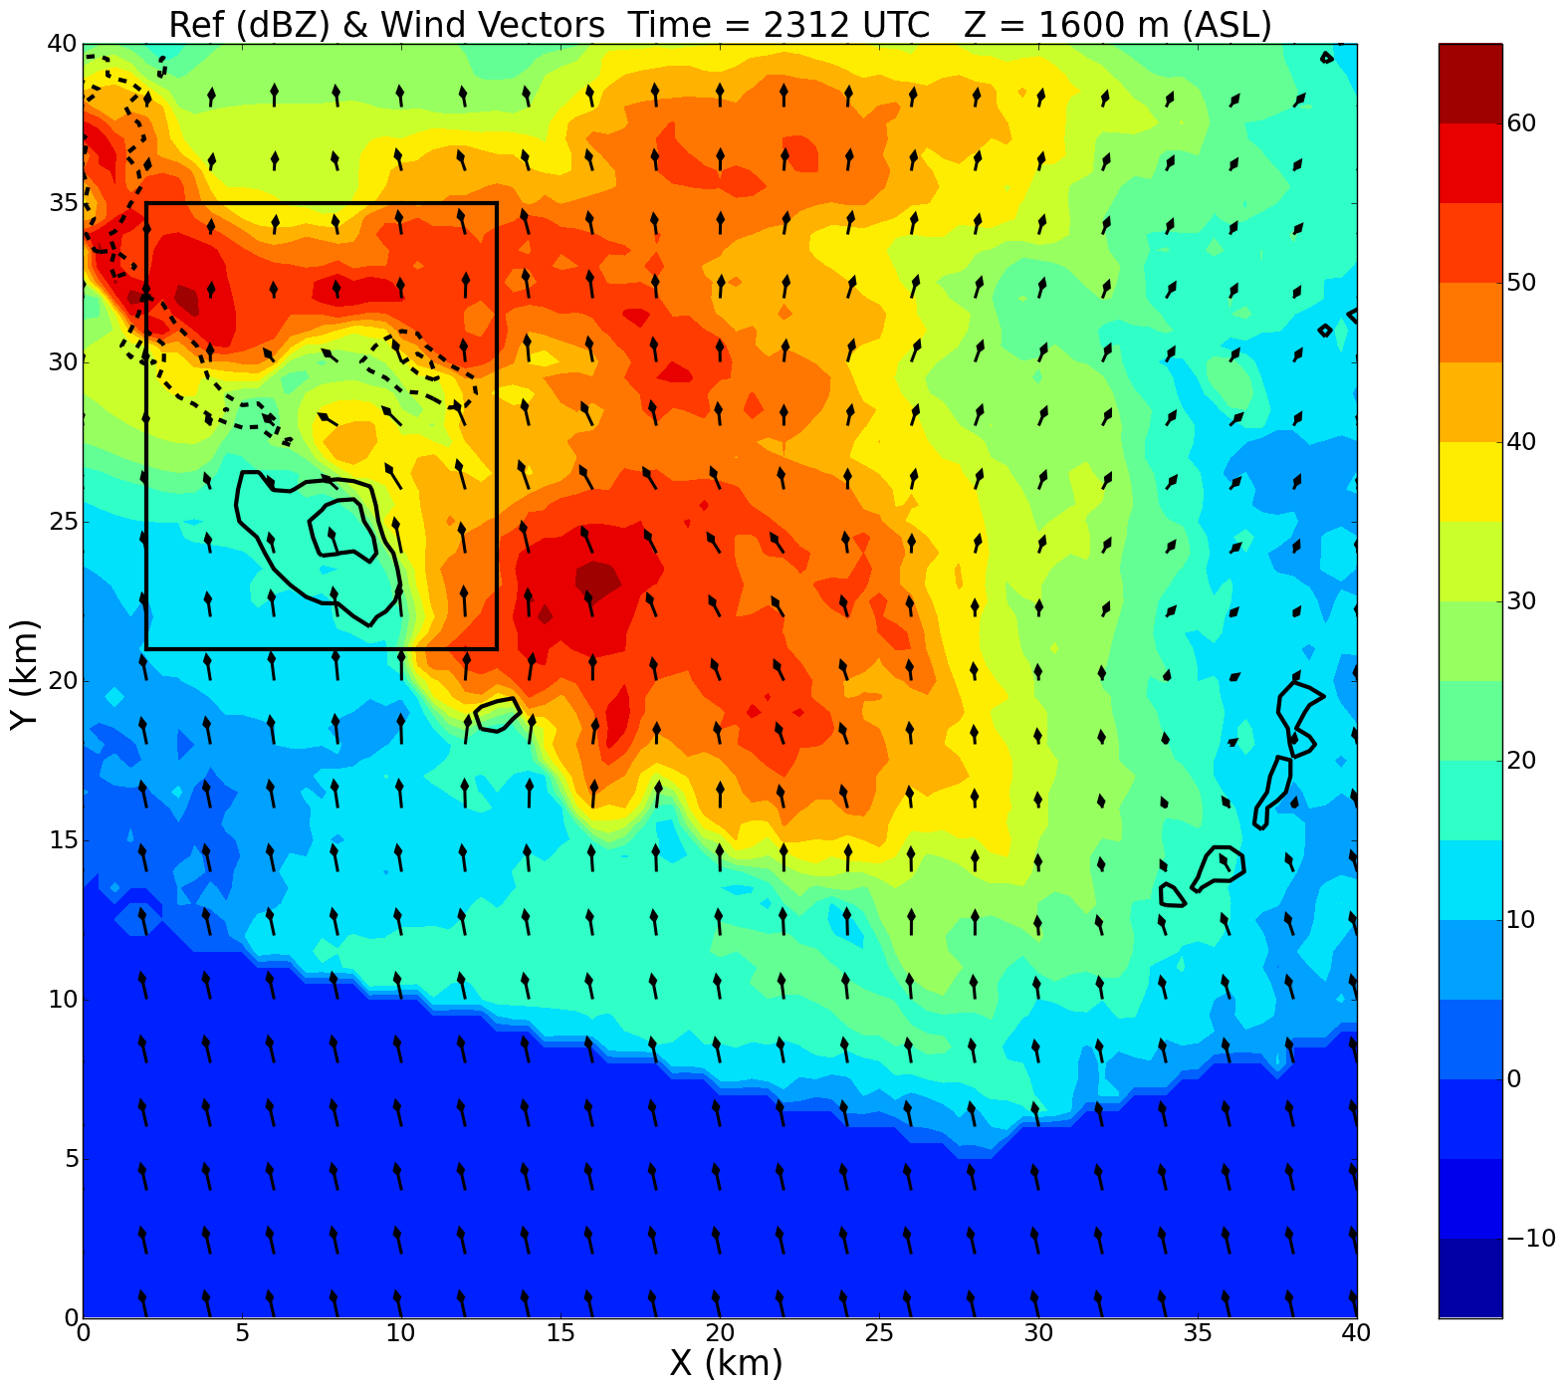
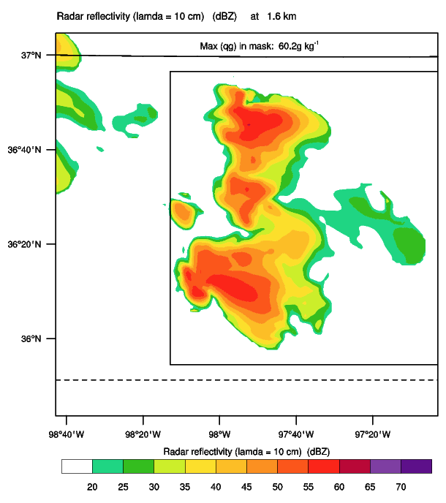
Reflectivity / Storm Rel. Winds / Vert. Vel. 1.6 km asl
I’m not sure what this box represents
SMART
WRF no LDA (exp327)
WRF LDA (exp318)
2312 UTC
2350 UTC
2350 UTC
10-min mask
Kingfisher storm
vert x-sec line
x/y axes are grid points with 500 m resolution
Origin of SMART plots:
(35.84343, -98.27846)
Observed max refl > 60 dBZ
WRF max refl in mask is 59.2 dBZ (no LDA) and 60.2 dBZ (with LDA)
Model-simulated refl represents obs well at 1.6 km
Biggerstaff

Slide 22
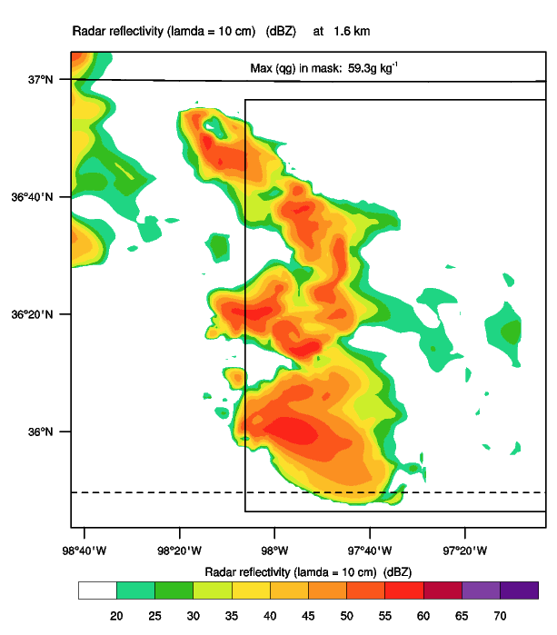
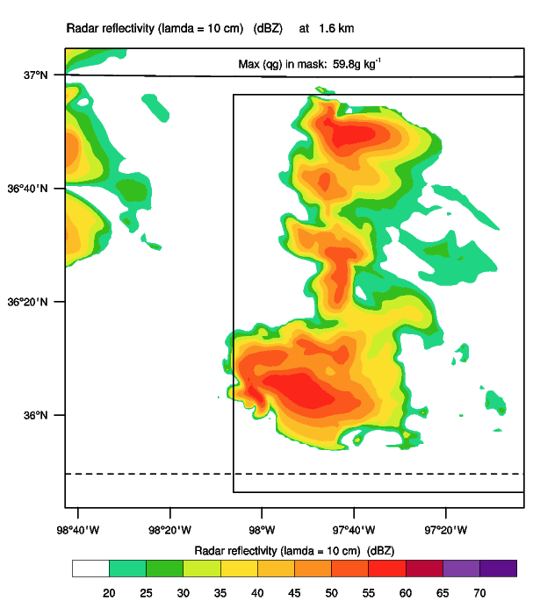
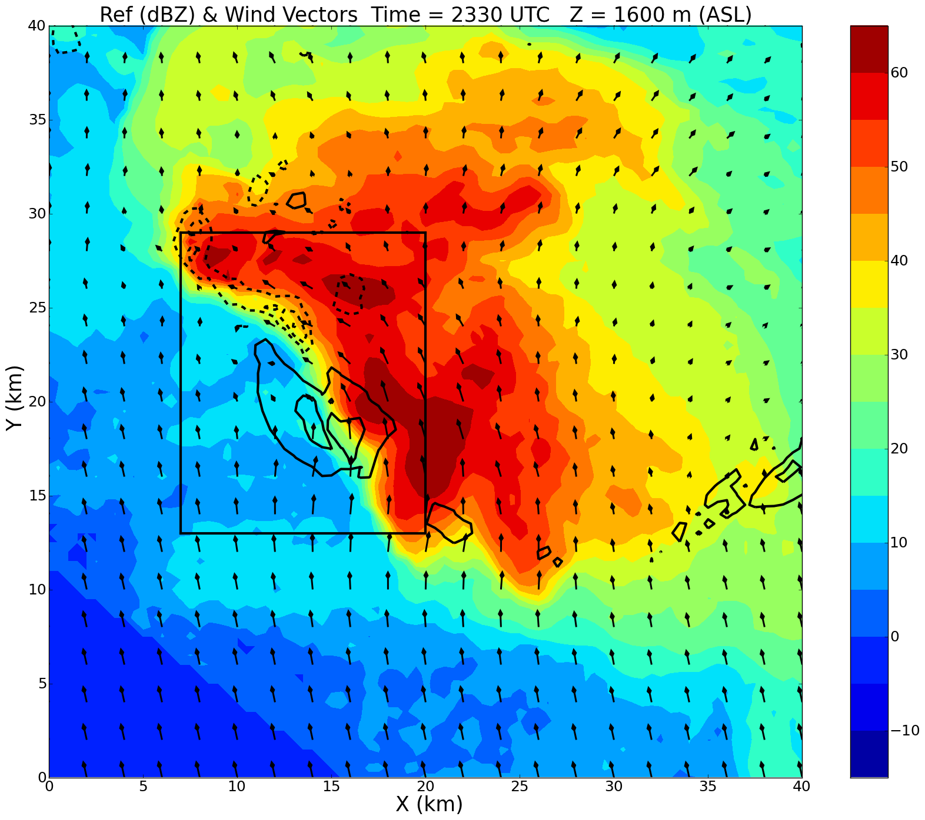
Reflectivity / Storm Rel. Winds / Vert. Vel. 1.6 km asl
I’m not sure what this box represents
SMART
WRF no LDA (exp327)
WRF LDA (exp318)
2330 UTC
0010 UTC
0010 UTC
10-min mask
vert x-sec line
x/y axes are grid points with 500 m resolution
Origin of SMART plots:
(35.84343, -98.27846)
Observed max refl > 60 dBZ
WRF max refl in mask is 59.3 dBZ (no LDA) and 59.8 dBZ (with LDA)
Model-simulated refl represents obs well at 1.6 km
Biggerstaff

Slide 23
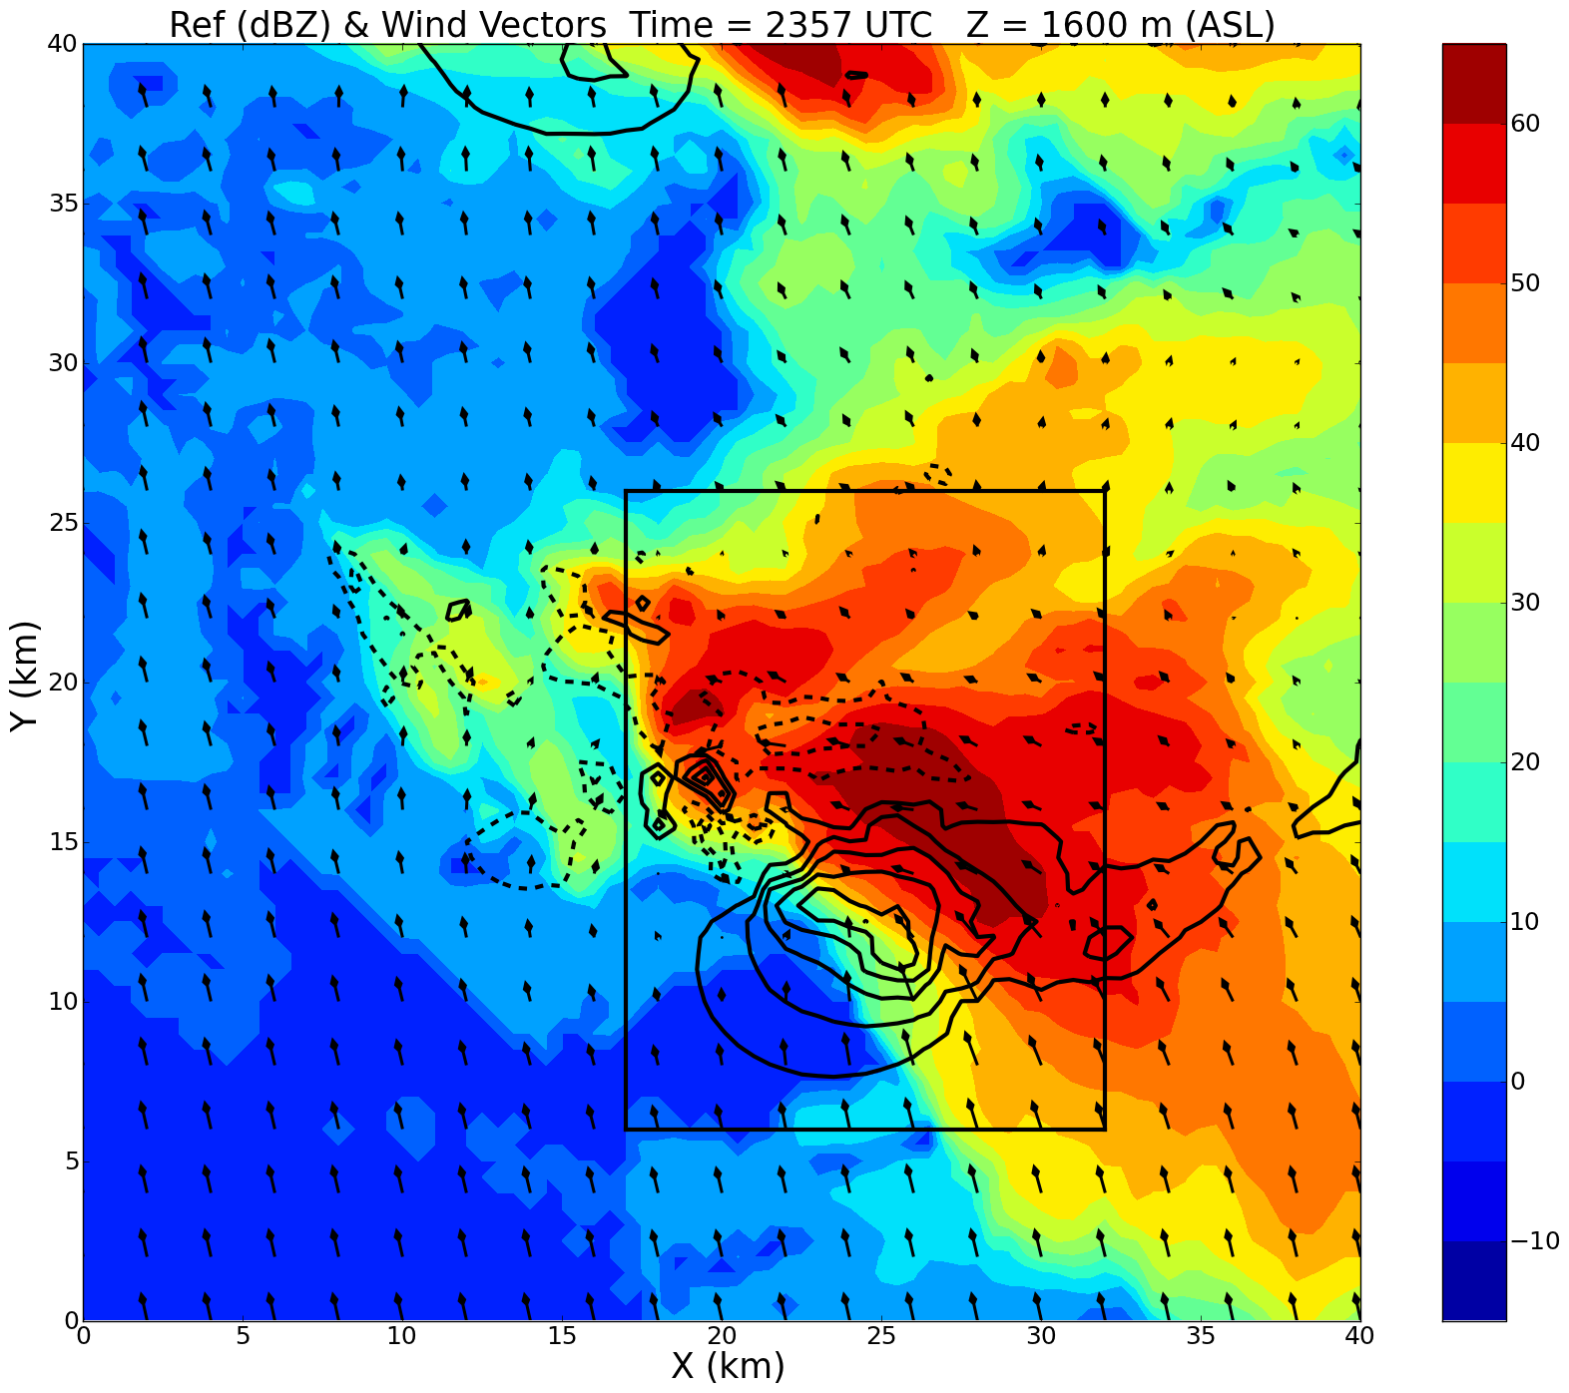
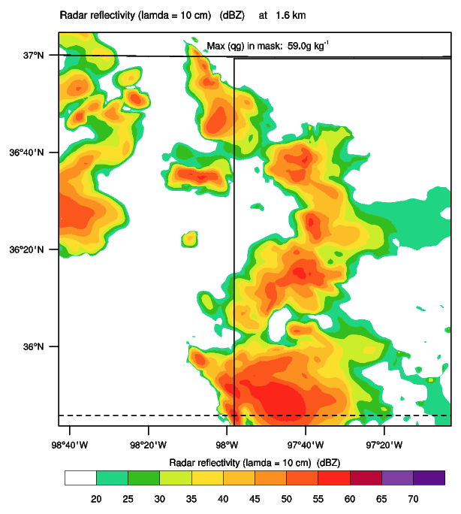
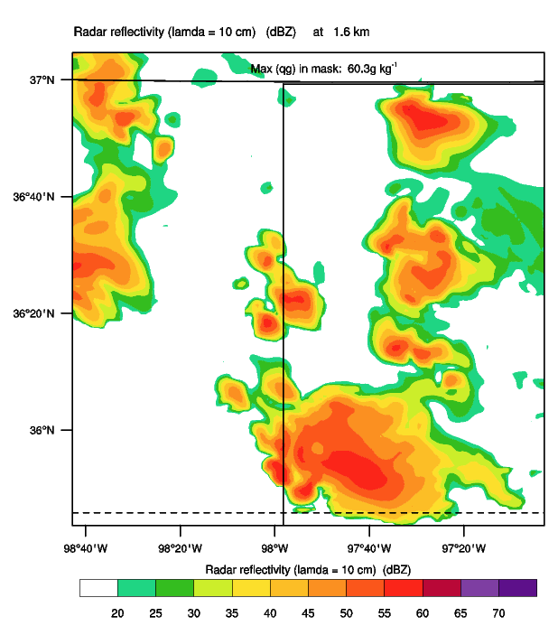
Reflectivity / Storm Rel. Winds / Vert. Vel. 1.6 km asl
I’m not sure what this box represents
SMART
WRF no LDA (exp327)
WRF LDA (exp318)
2357 UTC
0040 UTC
0040 UTC
10-min mask
vert x-sec line
x/y axes are grid points with 500 m resolution
Origin of SMART plots:
(35.84343, -98.27846)
Observed max refl > 60 dBZ
WRF max refl in mask is 59.0 dBZ (no LDA) and 60.3 dBZ (with LDA)
Model-simulated refl represents obs well at 1.6 km
Biggerstaff

Slide 24
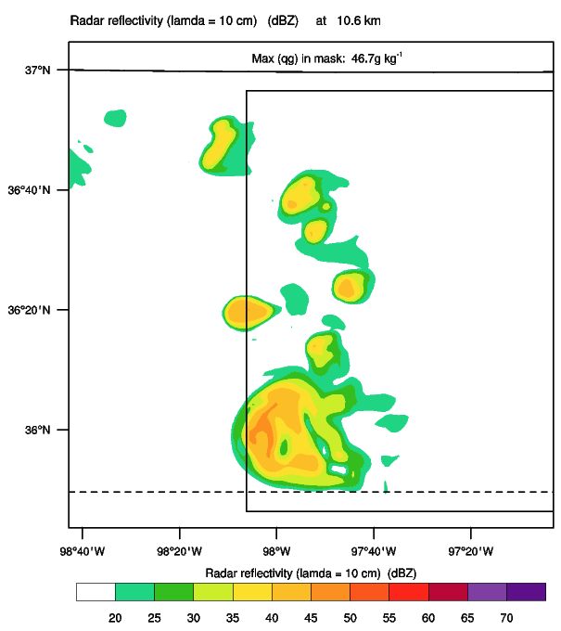
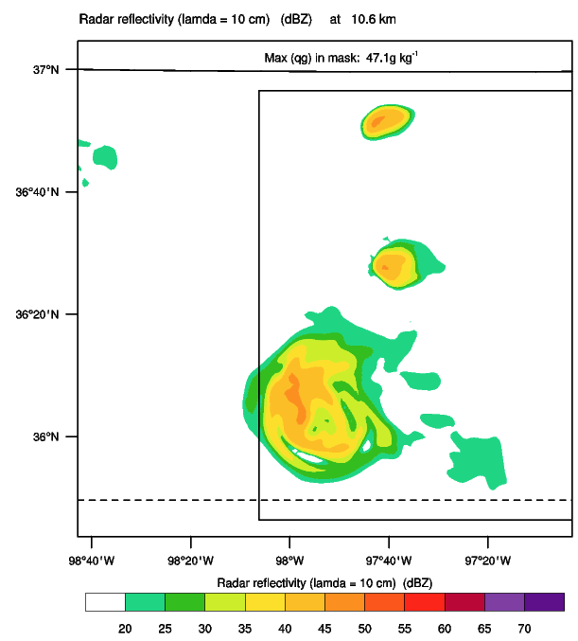
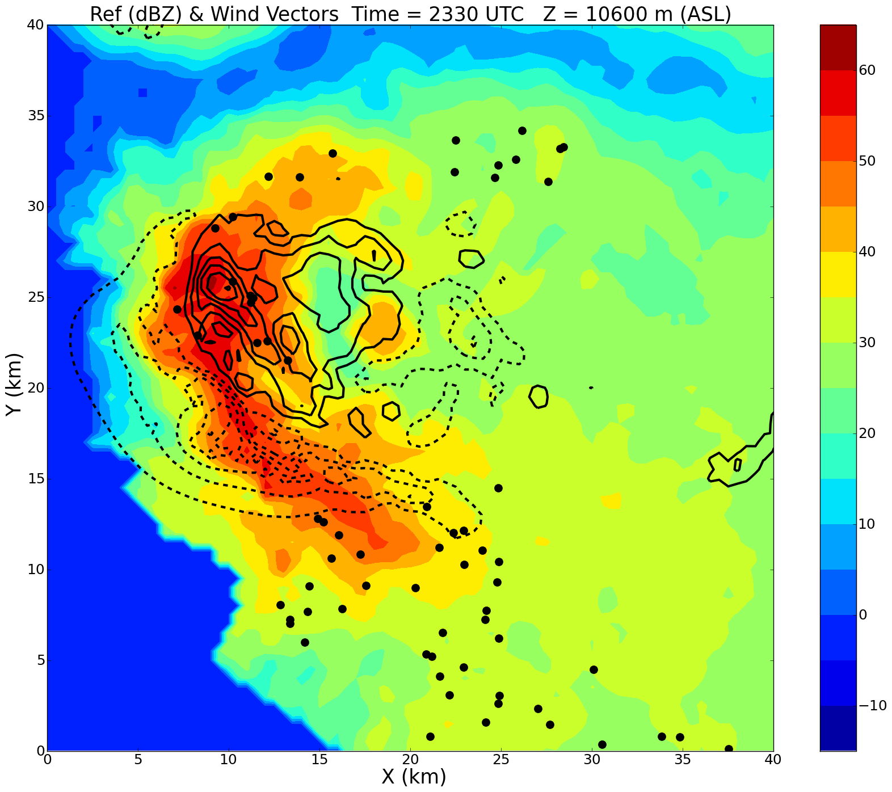
Reflectivity / Vert. Vel. 10.6 km asl
SMART
WRF no LDA (exp327)
WRF LDA (exp318)
2330 UTC
0010 UTC
0010 UTC
10-min mask
vert x-sec line
x/y axes are grid points with 500 m resolution
Origin of SMART plots:
(35.84343, -98.27846)
Observed max refl > 60 dBZ
WRF max refl in mask is 46.7 dBZ (no LDA) and 47.1 dBZ (with LDA)
Model-simulated refl within 25% of obs at 10.6 km
Biggerstaff

Slide 25
Reflectivity / Vert. Vel. 10.6 km asl
SMART
WRF no LDA (exp327)
WRF LDA (exp318)
2342 UTC
0020 UTC
0020 UTC
10-min mask
vert x-sec line
x/y axes are grid points with 500 m resolution
Origin of SMART plots:
(35.84343, -98.27846)
Observed max refl 55-60 dBZ
WRF max refl in mask is 47.0 dBZ (no LDA) and 46.7 dBZ (with LDA)
Model-simulated refl within 25% of obs at 10.6 km
Biggerstaff

Slide 26
Reflectivity / Vert. Vel. 10.6 km asl
SMART
WRF no LDA (exp327)
WRF LDA (exp318)
2357 UTC
0040 UTC
0040 UTC
10-min mask
vert x-sec line
x/y axes are grid points with 500 m resolution
Origin of SMART plots:
(35.84343, -98.27846)
Observed max refl > 60 dBZ
WRF max refl in mask is 46.7 dBZ (no LDA) and 45.6 dBZ (with LDA)
Model-simulated refl within 25% of obs at 10.6 km
Biggerstaff

Slide 27
WRF no LDA (exp327)
WRF LDA (exp318)
0000 UTC
0000 UTC
Observed max refl 65-70 dBZ
WRF max refl in mask is 49.5 dBZ (no LDA) and 49.4 dBZ (with LDA)
Model-simulated refl within ~25% of obs at 8.7 km
DiGangi, 2014

Slide 28
WRF no LDA (exp327)
WRF LDA (exp318)
0020 UTC
0020 UTC
Observed max refl 65-70 dBZ
WRF max refl in mask is 49.6 dBZ (no LDA) and 49.4 dBZ (with LDA)
Model-simulated refl within ~25% of obs at 8.2 km
DiGangi, 2014

Slide 29
WRF no LDA (exp327)
WRF LDA (exp318)
0040 UTC
0040 UTC
Observed max refl 65-70 dBZ
WRF max refl in mask is 51.7 dBZ (no LDA) and 51.5 dBZ (with LDA)
Model-simulated refl within 25% of obs at 7.2 km
00:00 UTC
DiGangi, 2014

Slide 30
DLA Rain Water Mixing Ratios
23:21Z:
Found throughout mixed phase region above ~4.7 km
Supercooled rain existed as high as ~7.2 km in main updraft
Max supercooled rain water observed at 4.7 km (5-6 g kg⁻¹)
23:39Z:
Existed at every level through 7.2 km
Max within updraft from 4.7-6.2 km with 4-5 g kg⁻¹
00:00Z:
Max of 5-6 g kg⁻¹ from 4.2-5.7 km
DiGangi, 2014

Slide 31
WRF no LDA (exp327) 23:40Z Max qr: 6.4 g kg⁻¹
WRF no LDA (exp327) 00:00Z Max qr: 7.2 g kg⁻¹
WRF no LDA (exp327) 00:40Z Max qr: 9.1 g kg⁻¹
WRF LDA (exp318) 23:40Z Max qr: 7.1 g kg⁻¹
WRF LDA (exp318) 00:00Z Max qr: 6.5 g kg⁻¹
WRF LDA (exp318) 00:40Z Max qr: 8.5 g kg⁻¹

Slide 32
WRF no LDA (exp327) 23:40Z Max qr: 9.4 g kg⁻¹
WRF no LDA (exp327) 00:00Z Max qr: 8.1 g kg⁻¹
WRF no LDA (exp327) 00:40Z Max qr: 8.1 g kg⁻¹
WRF LDA (exp318) 23:40Z Max qr: 5.7 g kg⁻¹
WRF LDA (exp318) 00:00Z Max qr: 6.2 g kg⁻¹
WRF LDA (exp318) 00:40Z Max qr: 7.2 g kg⁻¹

Slide 33
WRF no LDA (exp327) 23:40Z Max qr: 10.1 g kg⁻¹
WRF no LDA (exp327) 00:00Z Max qr: 8.0 g kg⁻¹
WRF no LDA (exp327) 00:40Z Max qr: 8.1 g kg⁻¹
WRF LDA (exp318) 23:40Z Max qr: 8.9 g kg⁻¹
WRF LDA (exp318) 00:00Z Max qr: 7.5 g kg⁻¹
WRF LDA (exp318) 00:40Z Max qr: 7.9 g kg⁻¹

Slide 34
DLA Cloud Water Mixing Ratios
23:21Z:
Found throughout mixed phase region above ~4.7 km
Supercooled cloud water found as high as ~11 km in main updraft
Max supercooled cloud water observed at 7.2 km (11-12g kg⁻¹)
23:39Z:
Existed at every level through 7.2 km
At 7.2 km, max values of 9-10 g kg⁻¹
At and above 6.2 km, a secondary max formed
00:00Z:
Max cloud water values of 10-11 g kg⁻¹ from 6.7-7.2 km
DiGangi, 2014

Slide 35
WRF no LDA (exp327) 23:40Z Max qc: 5.3 g kg⁻¹
WRF no LDA (exp327) 00:00Z Max qc: 5.6 g kg⁻¹
WRF no LDA (exp327) 00:40Z Max qc: 6.0 g kg⁻¹
WRF LDA (exp318) 23:40Z Max qc: 5.2 g kg⁻¹
WRF LDA (exp318) 00:00Z Max qc: 5.5 g kg⁻¹
WRF LDA (exp318) 00:40Z Max qc: 5.8 g kg⁻¹

Slide 36
WRF no LDA (exp327) 23:40Z Max qc: 8.8 g kg⁻¹
WRF no LDA (exp327) 00:00Z Max qc: 8.9 g kg⁻¹
WRF no LDA (exp327) 00:40Z Max qc: 8.7 g kg⁻¹
WRF LDA (exp318) 23:40Z Max qc: 8.9 g kg⁻¹
WRF LDA (exp318) 00:00Z Max qc: 9.1 g kg⁻¹
WRF LDA (exp318) 00:40Z Max qc: 9.0 g kg⁻¹

Slide 37
WRF no LDA (exp327) 23:40Z Max qc: 8.5 g kg⁻¹
WRF no LDA (exp327) 00:00Z Max qc: 9.3 g kg⁻¹
WRF no LDA (exp327) 00:40Z Max qc: 8.7 g kg⁻¹
WRF LDA (exp318) 23:40Z Max qc: 9.0 g kg⁻¹
WRF LDA (exp318) 00:00Z Max qc: 9.1 g kg⁻¹
WRF LDA (exp318) 00:40Z Max qc: 8.7 g kg⁻¹

Slide 38
DLA Snow/Ice Mixing Ratios
DiGangi, 2014
23:21Z:
Max values at 10.2 km were 6-7 g kg⁻¹
Values increase to 10 g kg⁻¹ from 11.2-12.2 km
From 11.7-13.7 km on the eastern edge of storm and anvil value were > 7 g kg⁻¹
Max of 8-9 g kg⁻¹ at 13.2 km
23:39Z:
Max values in main storm core were 8-9 g kg⁻¹ from 11.7-12.7 km
Max values in the entire domain were 9-10 g kg⁻¹ from 12.2-13.2 km
00:00Z:
Max values of 6-7 g kg⁻¹ at 11.2-11.7 km

Slide 39
WRF no LDA (exp327) 23:40Z Max qsi: 4.5 g kg⁻¹
WRF no LDA (exp327) 00:00Z Max qsi: 5.4 g kg⁻¹
WRF no LDA (exp327) 00:40Z Max qsi: 4.2 g kg⁻¹
WRF LDA (exp318) 23:40Z Max qsi: 4.7 g kg⁻¹
WRF LDA (exp318) 00:00Z Max qsi: 5.1 g kg⁻¹
WRF LDA (exp318) 00:40Z Max qsi: 4.5 g kg⁻¹

Slide 40
WRF no LDA (exp327) 23:40Z Max qsi: 3.7 g kg⁻¹
WRF no LDA (exp327) 00:00Z Max qsi: 5.9 g kg⁻¹
WRF no LDA (exp327) 00:40Z Max qsi: 5.5 g kg⁻¹
WRF LDA (exp318) 23:40Z Max qsi: 5.5 g kg⁻¹
WRF LDA (exp318) 00:00Z Max qsi: 4.6 g kg⁻¹
WRF LDA (exp318) 00:40Z Max qsi: 5.2 g kg⁻¹

Slide 41
WRF no LDA (exp327) 23:40Z Max qsi: 4.5 g kg⁻¹
WRF no LDA (exp327) 00:00Z Max qsi: 5.4 g kg⁻¹
WRF no LDA (exp327) 00:40Z Max qsi: 5.5 g kg⁻¹
WRF LDA (exp318) 23:40Z Max qsi: 4.3 g kg⁻¹
WRF LDA (exp318) 00:00Z Max qsi: 5.2 g kg⁻¹
WRF LDA (exp318) 00:40Z Max qsi: 4.9 g kg⁻¹

Slide 42
DLA Graupel Mixing Ratios
DiGangi, 2014
23:21Z:
Hail core indicated max values 8-9 g kg⁻¹ at 1.2 km, with additional high values at 4.4 km
At and above 7.2 km higher values appear with high flash density
Starting at 11.2 km most values above 1 g kg⁻¹
23:39Z:
Max in hail cores at 1.2 km was 10 g kg⁻¹, with a secondary core outside of hail core (6-7 g kg⁻¹) at same altitude
Max values above FL were at 8.2-8.7 km (9 g kg⁻¹)
00:00Z:
Exceeded 4 g kg⁻¹ at 4.2 km and increased with height above FL through 4.5 km
Max value 11-12 g kg⁻¹ at 7.2 km
Max value at 9.2-9.7 km was 10-11 g kg⁻¹

Slide 43
WRF no LDA (exp327) 23:40Z Max qg: 8.8 g kg⁻¹
WRF no LDA (exp327) 00:00Z Max qg: 9.1 g kg⁻¹
WRF no LDA (exp327) 00:40Z Max qg: 10 g kg⁻¹
WRF LDA (exp318) 23:40Z Max qg: 8.8 g kg⁻¹
WRF LDA (exp318) 00:00Z Max qg: 9.6 g kg⁻¹
WRF LDA (exp318) 00:40Z Max qg: 8.6 g kg⁻¹

Slide 44
WRF no LDA (exp327) 23:40Z Max qg: 12.7 g kg⁻¹
WRF no LDA (exp327) 00:00Z
Max qg: 14.2 g kg⁻¹
WRF no LDA (exp327) 00:40Z
Max qg: 13.4 g kg⁻¹
WRF LDA (exp318) 23:40Z Max qg: 13.7 g kg⁻¹
WRF LDA (exp318) 00:00Z Max qg: 12.9 g kg⁻¹
WRF LDA (exp318) 00:40Z Max qg: 12.7 g kg⁻¹
Values slightly different from slide 14 (exp306?)
Values slightly different from slide 14 (exp306?)

Slide 45
WRF no LDA (exp327) 23:40Z Max qg: 13.7 g kg⁻¹
WRF no LDA (exp327) 00:00Z Max qg: 11.5 g kg⁻¹
WRF no LDA (exp327) 00:40Z
Max qg: 11.6 g kg⁻¹
WRF LDA (exp318) 23:40Z Max qg: 11.7 g kg⁻¹
WRF LDA (exp318) 00:00Z Max qg: 11.7 g kg⁻¹
WRF LDA (exp318) 00:40Z Max qg: 13.1 g kg⁻¹

Slide 46
Conclusions
Rain water (WRF and DLA appear similar)
WRF without and with LDA slightly overestimates the DLA max values at 4.7km (5-6 g kg⁻¹) at 23:21Z
WRF with LDA does show values (3-5 g kg⁻¹) similar to the DLA (4-5 g kg⁻¹) from 4.7-6.2 km at 23:40Z model time
WRF with LDA does show values (5-7 g kg⁻¹) similar to the DLA (5-6 g kg⁻¹) around 4.7 km at 00:00Z model time and observations at 23:21Z and 00:00Z
Cloud water (WRF and DLA appear similar)
WRF without and with LDA underestimates the DLA max values at 7.2 km (11-12 g kg⁻¹) at 23:21Z and at 00:00Z
WRF without and with LDA generates max values near 9-10 g kg⁻¹ at 7.2 km, like DLA
Snow/Ice (WRF underestimates DLA)
WRF without and with LDA did not exceed 6 g kg⁻¹ at any of the altitudes over the time period analyzed
DLA exceeded 6 g kg⁻¹ starting at 23:21Z
Graupel (WRF and DLA appear similar below 10 km, but 1.5-2X greater above)
WRF without and with LDA generates values from 9-11 g kg⁻¹ around 8.2 km, like DLA
WRF without and with LDA underestimates (8-10 g kg⁻¹) the DLA max values at 7.2 km (11-12 g kg⁻¹)
WRF without and with LDA shows max values around 9.2 km from 9-11 g kg⁻¹, like the DLA
WRF without and with LDA indicates max values from 11-14 g kg⁻¹ above 9.2 km in the model vertical cross-sections compared to the DLA contour plots, which appear to show values around 7-8 g kg⁻¹ in the contours

