Slide 1





DISCOVER-AQ and FRAPPÉ Forecast Activities
Compiled from input from different groups

Slide 2
CDPHE
The Air Pollution Control Division (APCD) of the Colorado Department
of Public Health & Environment (CDPHE) Will Provide O3 Forecast Support
4 meteorologists at the APCD will continue to issue statewide and Front
Range forecasts for O3 and other pollutants 7 days a week.
These will include a 9 AM MDT update, a 24-36 hour forecast by 3 PM
MDT, and a multi-day outlook (crafted specifically for FRAPPE and
DISCOVER-AQ.)
Meteorologist will also issue advisories for blowing dust, wildland fire
smoke, stratospheric O3 intrusions, and any air quality event in Colorado.
Forecasts are based on several synoptic and mesoscale meteorological
models, a variety of satellite products, observations, in-house regression
tools, and more than 7 decades of combined staff Colorado air quality
forecasting experience. RAP HRRR best tool for 15-hour convection outlook.
Forecasts and advisories are currently disseminated on our web pages and
via listserves, AIRNow, local media, and hotlines. We can arrange for
project-specific methods of distribution. A large number of wildfires will absorb
much of our time.
Patrick Reddy/Gordon Pierce

Slide 3
DISCOVER-AQ Forecast Briefings
Meteorology
Forecast maps – NWS surface and NAM upper air; today and the next 3 days
NAM/MOS time series – Denver and Ft. Collins; today and next 3 days;
T, TD, WS, WD, RH, POP, Sky cover
BUFKIT – NAM – time series of cloud amount by altitude, precip, and PBLH
– next 3 days
PBLH from NOAA/ARL WRF-ARW
Wind fields at several sigma levels from NOAA/ARL WRF-ARW
Cloud forecast maps – NAM, GFS, Canadian, GEOS-5
NWS forecaster comments/advice
Fly/no-fly recommendations
Ken Pickering

Slide 4
DISCOVER-AQ Forecast Briefing
Air Quality
Air quality yesterday – surface station O₃ observations
Air quality forecast maps – NOAA/ARL CMAQ products – O₃, NO₂, HCHO
today and tomorrow
Ozone forecasts from State agency – today, tomorrow, beyond?
Air quality yesterday – surface station PM_{2.5} observations
AERONET and MODIS AOD – yesterday
Air quality forecast maps – NOAA/ARL CMAQ product – surface PM_{2.5}
Air quality forecast maps and time series – GEOS-5 aerosol extinction, AOD,
mass concentrations by aerosol type
PM_{2.5} forecasts from State agency – today, tomorrow, beyond?
Ken Pickering

Slide 5
Forecast Schedule
8 - 10 AM Review meteorological and air quality model products
10 - 11 AM Consult with NWS forecaster and CDPHE air quality forecaster
11 AM – 1 PM Prepare/finalize briefing
1 PM Conduct briefing
Ken Pickering

Slide 6

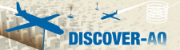

NAQFC-orecasting support: Initialized at 00 UTC with 60 hours forecast duration
WRF-ARW | Both North America (12 km) & CONUS (4 km)
Map projection & grid | Lambert Conformal & Arakawa C staggering
Vert. co-ordinate | 42 σ-p unevenly spaced levels
advection | RK3 (Skamarock and Weisman (2008))
SW & LW radiation | RRTMG (Iacono et al. 2008))
PBL Physics | Mellor-Yamada-Janjic (MYJ) level 2.5 closure
Surface layer scheme | Monin-Obukhov Similarity with viscous sub-layer
Land Surface Model | NCEP NOAH
Cloud Microphysics | Thompson et al. (2008)
Cloud convective mixing | Betts-Miller-Janjic Mass adjustment
AForecast: 12 km nested to 4 km
CMAQ4.7.1 | Both CONUS(12 km) & DISCOVER-AQ/FRAPPE (4 km)
Map projection & grid | Lambert Conformal & Arakawa C staggering
Vert. co-ordinate | 42 σ-p unevenly spaced levels
Gas chemistry | Cb05 with 156 reactions
Aerosol chemistry | Aero5 with updated evaporation enthalpy
Anthropogenic emission | 2005NEI as base year, mobile projected using AQS*, area and off-road used CSPR^, point source uses 2012 CEM data
 | WRAP oil and gas emissions data
Biogenic emission | BEIS-3.14
Lateral BC | RAQM (B. Pierce)
42 vertical layers
Air Resources Laboratory/NOAA: DISCOVER-AQ/FRAPPÉ preparation meeting, April 3 2014, Boulder
Ken Pickering
Notes:
^12 km domain is set a bit large to match National AQ Forecasting Capability for side-by-side verification.

Slide 7
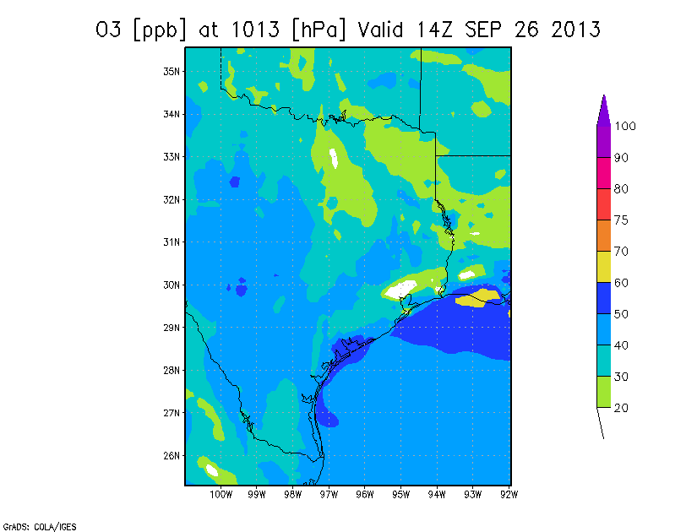
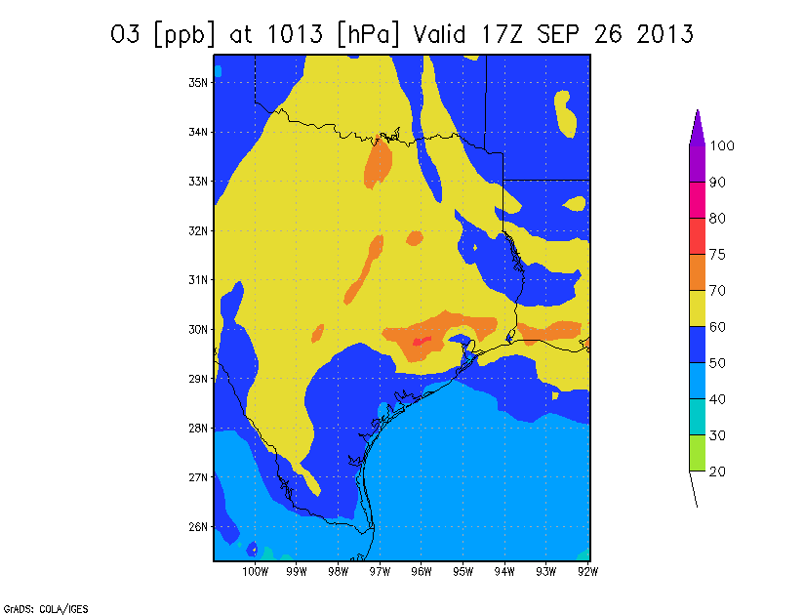
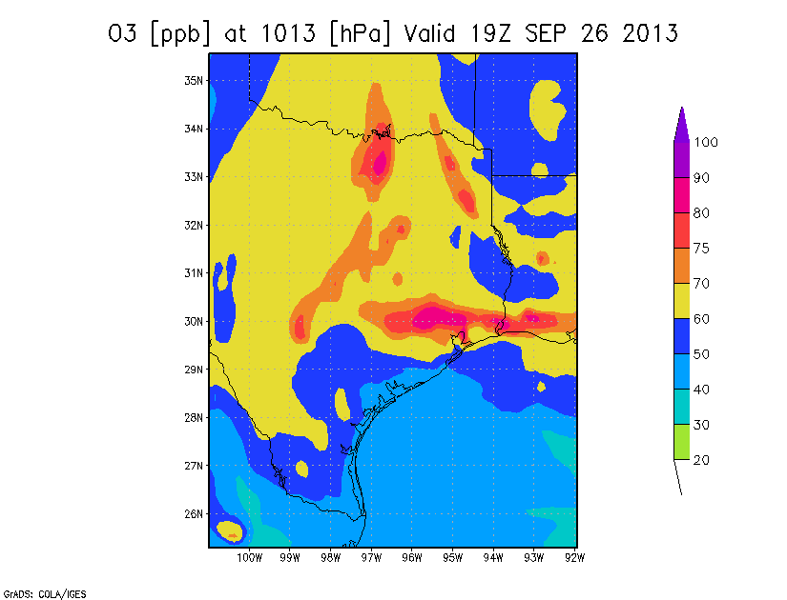
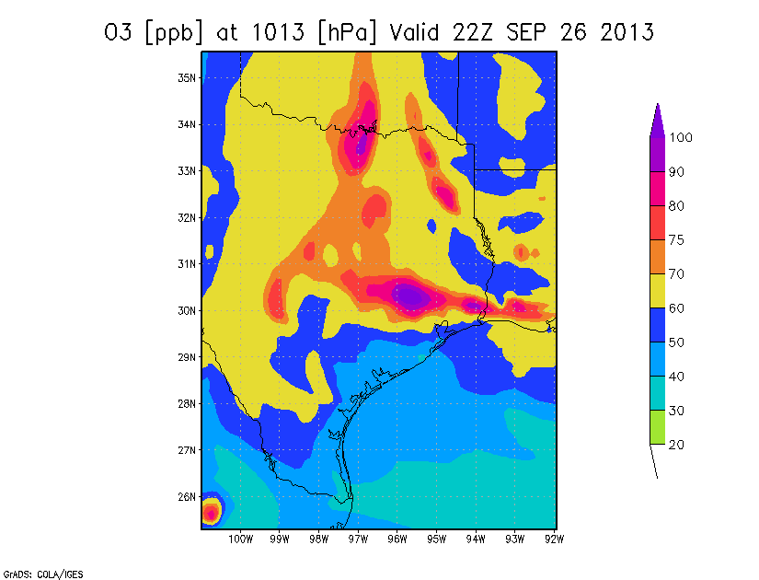
9 AM
12 PM
Forecast from
06Z SEP 25
2 PM
5 PM
Ken Pickering

Slide 8
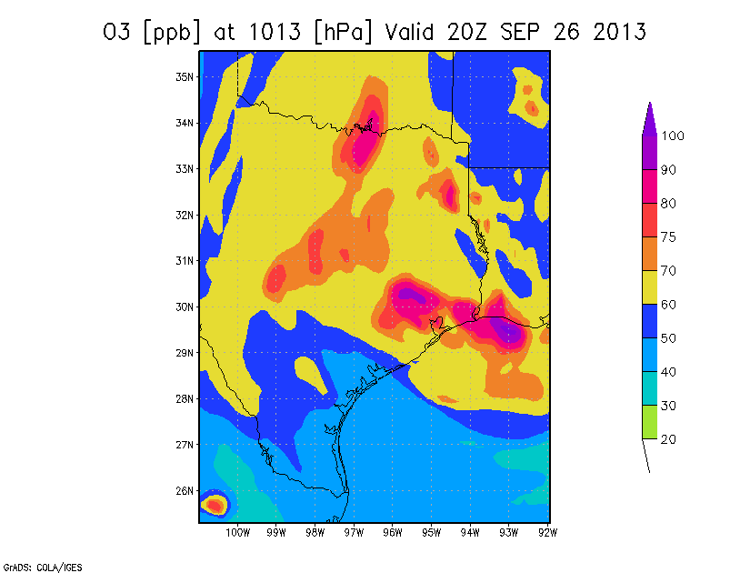
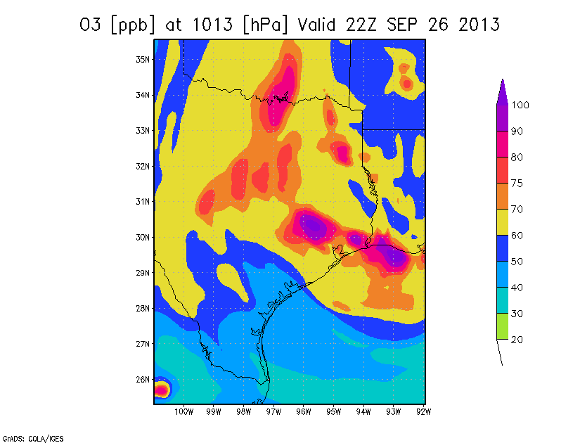
NOAA Experimental CMAQ
Forecast for Today from 06Z
(1 AM CDT)
5 PM
3 PM

Slide 9
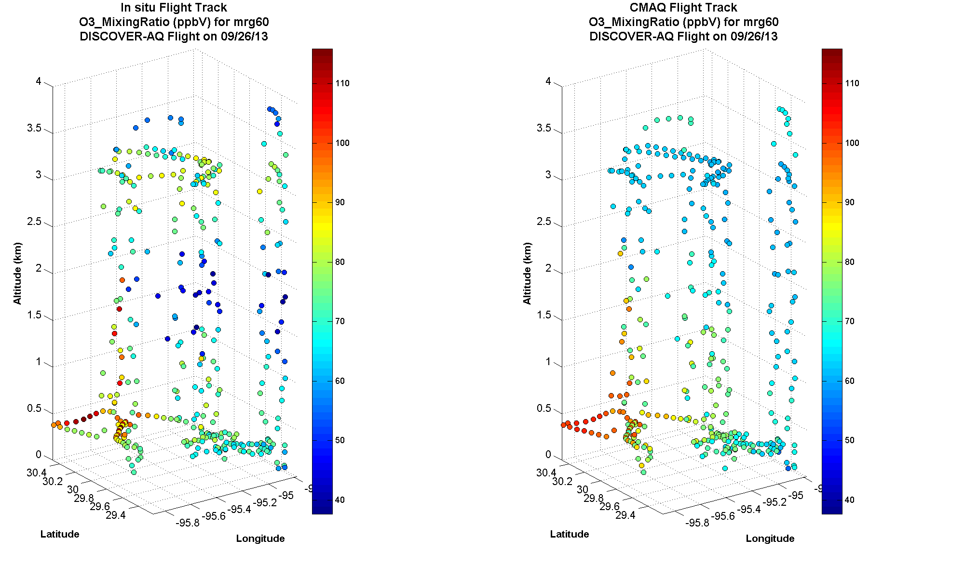
CMAQ missed
elevated O₃ layer
Conroe
profile well
forecast
O₃ maximum
to NNW of
Houston well
forecast
Conroe
Galveston
Ken Pickering

Slide 10

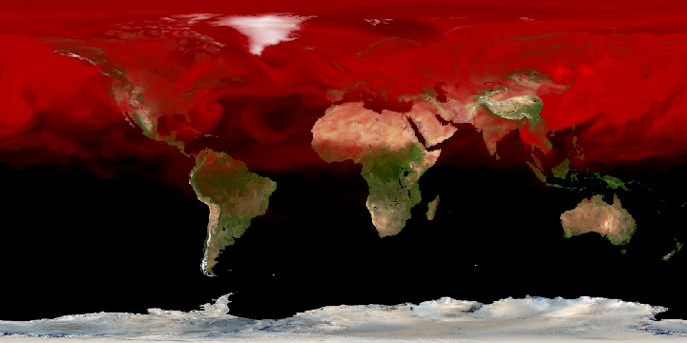
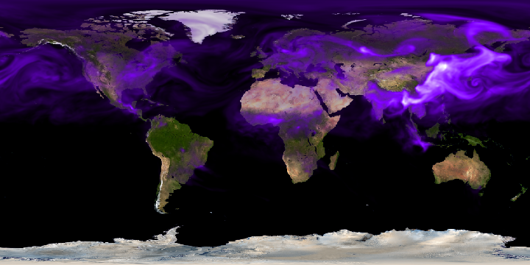
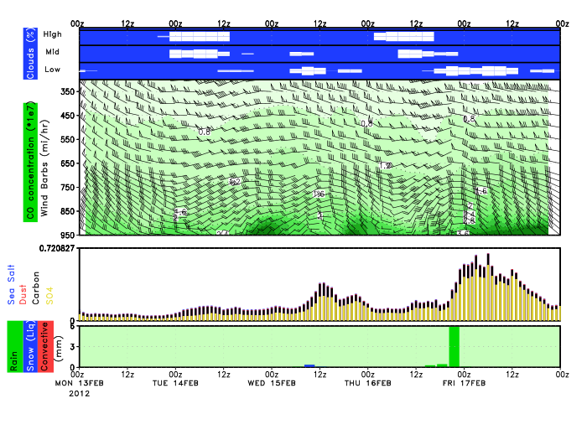
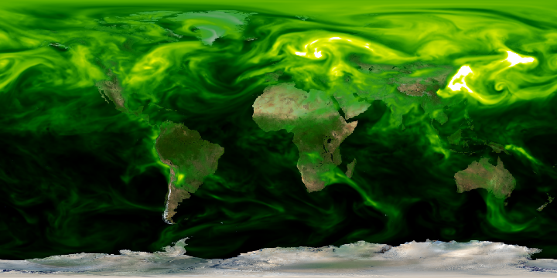
GEOS-5/GOCART Forecasts
Global 5-day chemical forecasts customized for each campaign
O3, aerosols, CO, CO₂, SO₂
Resolution: Nominally 25 km
Driven by real-time biomass emissions from MODIS
Assimilated aerosols interacts with circulation through radiation
CO
Smoke
SO₄
http://gmao.gsfc.nasa.gov/forecasts/
Ken Pickering

Slide 11
GEOS-5 Atmospheric Data Assimilation System
Feature | Description
Model | GEOS-5 Earth Modeling System, with GOCART coupled to radiation parameterization
Fire Emissions | QFED: Daily, NRT, MODIS FRP based
Met Data Assim | Full NWP observing system (uses GSI)
Aerosol Data Assimilation | Local Displacement Ensembles (LDE) MODIS reflectances (Aqua & Terra) AERONET Calibrated AOD’s (Neural Net) Stringent cloud screening
Forecasts | 5 day forecasts twice daily: 0Z an 12Z
Resolution | nominally 25 km, 72 layers, top ~85 km
Aerosol Species | Dust, sea-salt, sulfates, organic & black carbon
Carbon Species | CO₂, CO with several tagged tracers
Ken Pickering

Slide 12
QFED: Quick Fire
Emission Dataset
Near real time estimates based on MODIS Fire Radiative Power (AQUA/TERRA)
Current focus on MODIS
Through Joint Center for Sattelite Data Assimilation (JCSDA) collabotating with NOAA/STAR on the inclusion of data from
Geostationary
VIRS
Plume Rise model (Freitas et al. )
Driven by GEOS-5 meteorology
Under tuning/validation
QFED relies on LANCE MODIS Level 2 Fire Data
Ken Pickering

Slide 13
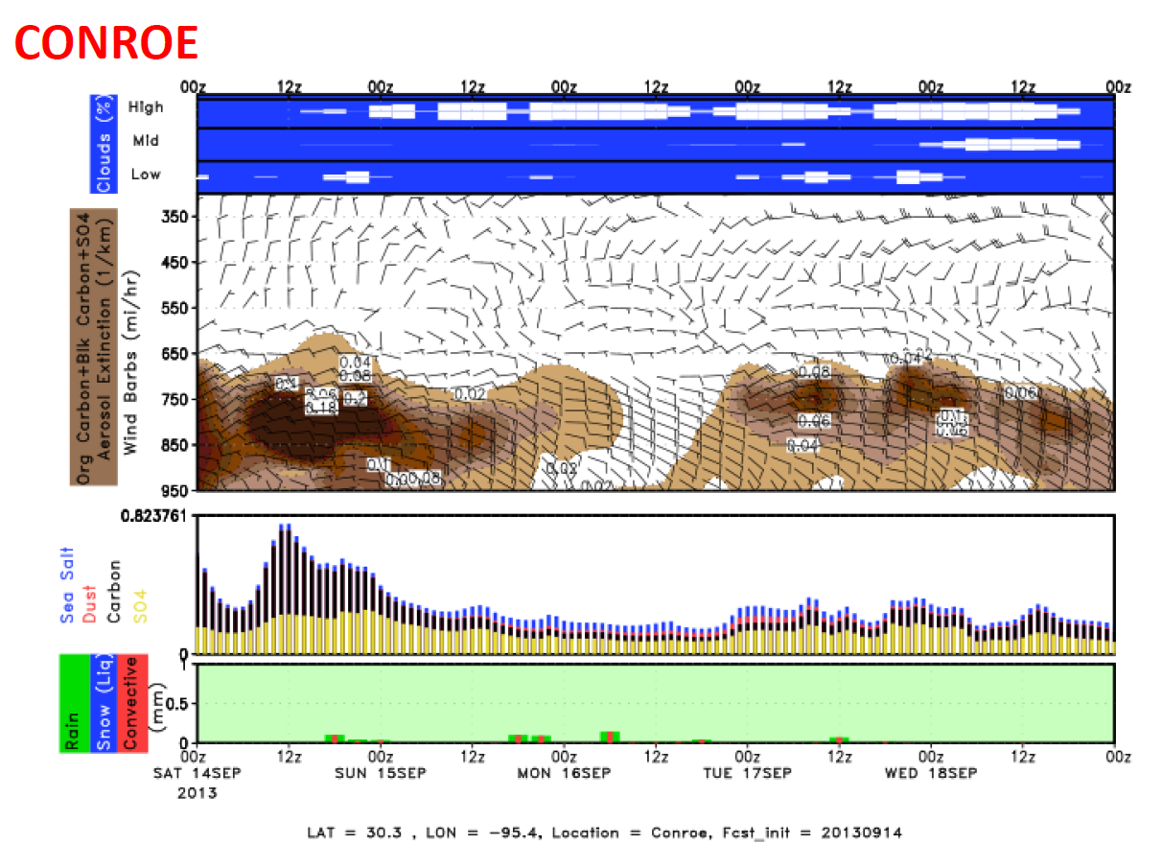
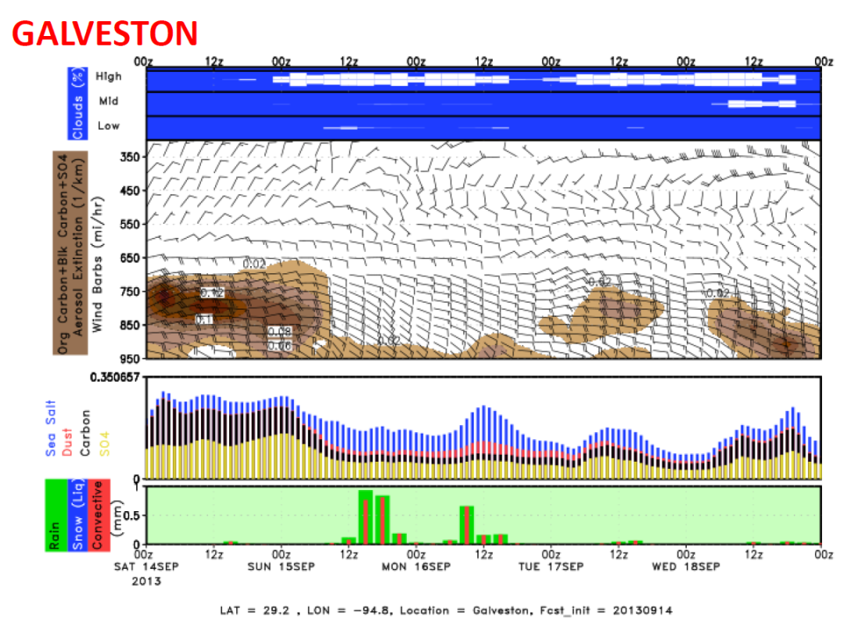
Cloud cover
Extinction
AOD
GEOS-5 aerosol
forecast from
00 UT 14 Sept.
GEOS-5 global model at
0.25 deg. resolution;
GOCART aerosols, CO, SO₂;
includes assimilation of
MODIS AOD
Run by Arlindo da Silva
at NASA/GSFC
Ken Pickering

Slide 14
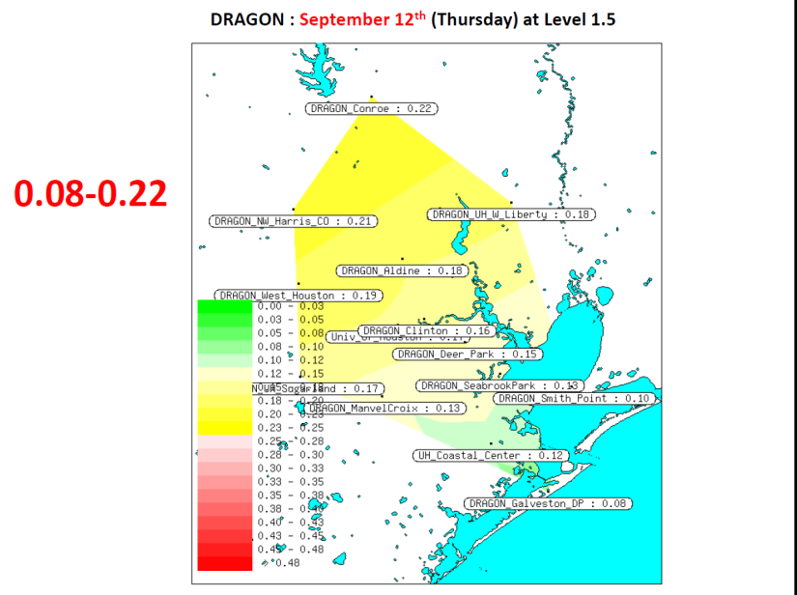
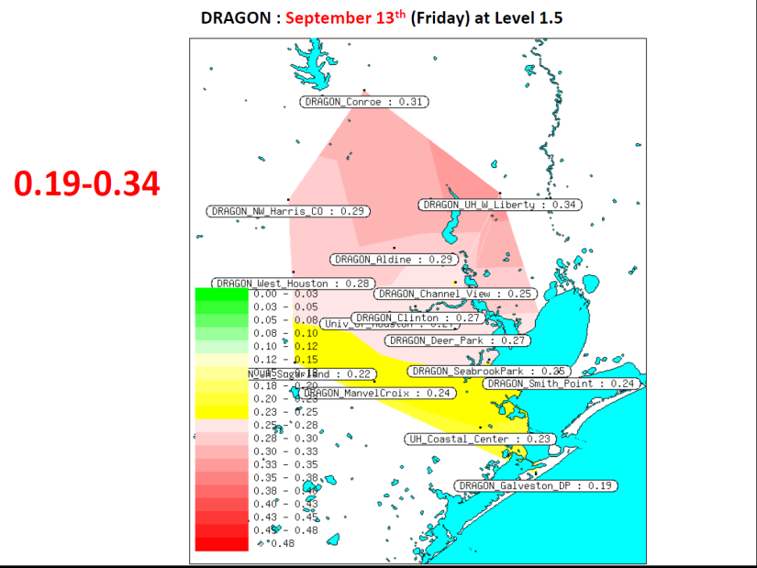
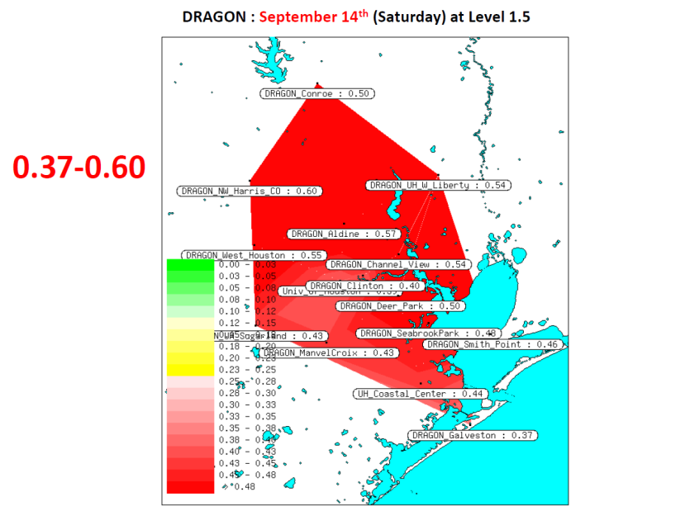
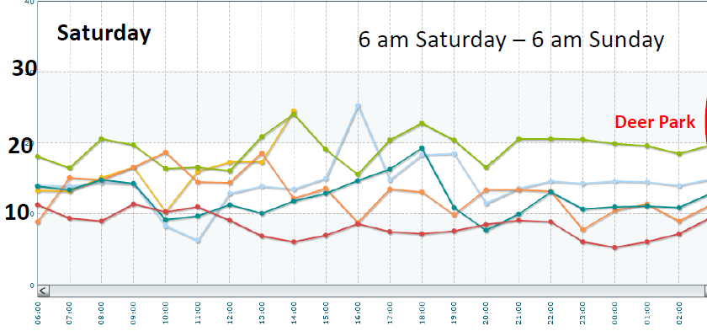
Houston Aerosol Episode of Sept. 14, 2013
High AOD associated with
agricultural fire plumes
from Mississippi Valley.
Back door cold front
pushed smoke over
Houston.
No real impact seen in
surface PM2.5.
Hourly
PM2.5
(µg/m³)
Ken Pickering

Slide 15
Post Mission Modeling
Simulations of DISCOVER-AQ/FRAPPE period with CMAQ and WRF-Chem:
36, 12, 4 km resolution domains (perhaps 1.3-km if necessary)
Use best available emission inventories
Evaluate WRF meteorology using:
Surface stations, sondes, tethered balloon, wind profilers,
aircraft
Evaluate chemistry and emissions through comparisons with
P-3B and C-130 in-situ data, surface in-situ data,
Pandora and AERONET remote sensing data
Evaluate model column vs. surface correlations against those from
observations
Evaluate spatial and temporal variability in model vs. that in
observations
Ken Pickering

Slide 16
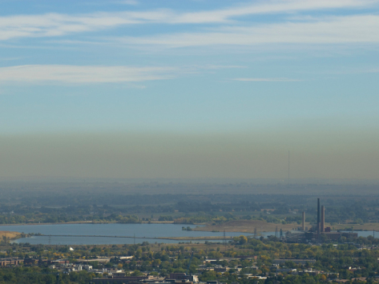
FRAPPÉ Forecast Briefings
Jointly with DISCOVER-AQ
Additional Met & Chemistry Products
Short-term forecasts for aircraft and mobile vans
Decisions on Flight Day and Flight Pattern for C-130
up to 3-5 days out
Special events (LRT, fires, ...), transport/flow patterns, emission flight conditions,....
Gabriele Pfister

Slide 17
FRAPPÉ Forecast Products
Satellite Products
FINN near-realtime fire emissions (based on MODIS fire counts) (NCAR/ACD)
MOPITT CO (within 1 day of overpass) (NCAR/ACD)
IASI CO (~ 4-day delay) (NCAR/ACD)
Met Forecasts
WRF with assimilation (NCAR-RAL)
3DVar (no radar DA, 3h UC/12h fcst/1km)
3DVar (with radar DA, 1h UC/12h fcst) 4DVar (with radar DA, 3h UC/12h fcst)
RTFDDA (with radar DA, 3h UC/24h fcst)
Chemical/Tracer Forecasts
MOZART-4 global, 5-day forecast (NCAR)
Full chemistry at 1.9°x2.5° (possibly assimilation of CO)
Tracer forecasts at 0.5°x0.5° (CO, isoprene-like, ....)
RAQMS (NOAA/NESDIS)
Global 1x1 degree on-line chemical and aerosol assimilation and forecasting system
Assimilation of MODIS AOD, MLS stratospheric O₃ profiles and OMI total O₃
WRF-Chem (NOAA/ESRL)
WRF-Chem on RAPid refresh (RAP) 13km domain; 48 hour forecast
WRF-Chem Tracers (NCAR/ACD) - added to RTFDDA
FLEXPART (NCAR/ACD): Forward trajectories for defined sources

Slide 18
Global Modeling, Fire Emissions and Satellite Support for FRAPPÉ
NCAR/ACD
Louisa Emmons, Christine Wiedinmyer, & MOPITT team

Slide 19
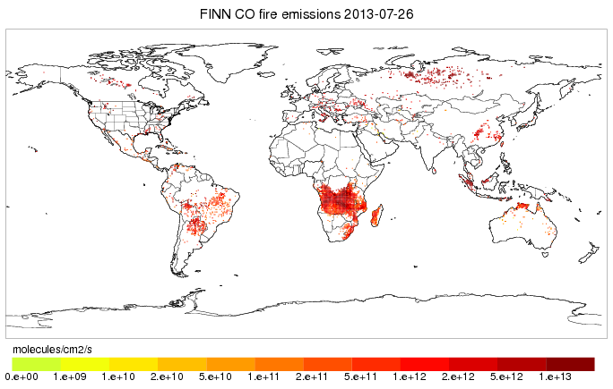
Fire Emissions
NCAR/ACD
Fire INventory from NCAR (FINN)
Daily fire emissions of trace gases and particles
FINN is run in real-time based on MODIS Rapid Response fire counts
http://www.acd.ucar.edu/acresp/forecast/fire-emissions.shtml
Plots and data files available for forecasts and hindcasts
Additional fire products will be compiled:
NASA QFED
NOAA HMS
…
Christine Wiedinmyer

Slide 20
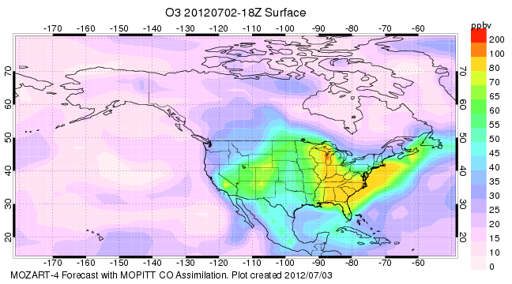
MOZART-4 driven by GEOS-5
NCAR/ACD
Full chemistry at 1.9°x2.5°
http://www.acd.ucar.edu/acresp/forecast/
5-day forecasts, hourly output, currently operational
Louisa Emmons

Slide 21
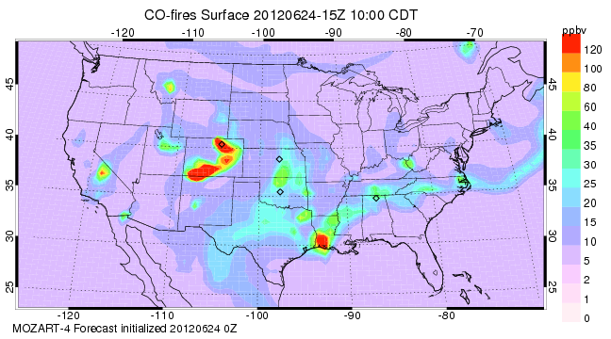
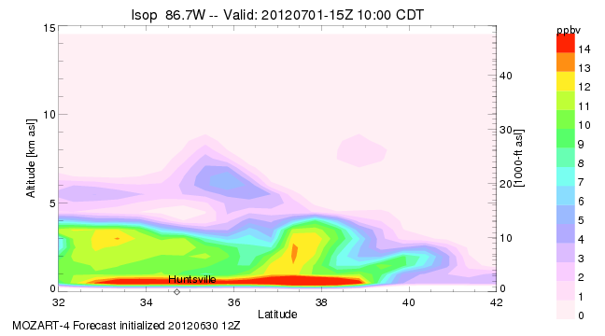
MOZART-4 Tracers
NCAR/ACD
Forecasts of tracers only at 0.5° horizontal resol.
Isoprene-like tracer based on MEGAN isoprene emissions
Anthropogenic NOx tracer from individual cities and/or regions
Fire CO tracer for various regions
Others?
Similar to forecasts for DC3 (http://www.acd.ucar.edu/acresp/dc3/), will be run specifically for FRAPPE
Louisa Emmons

Slide 22
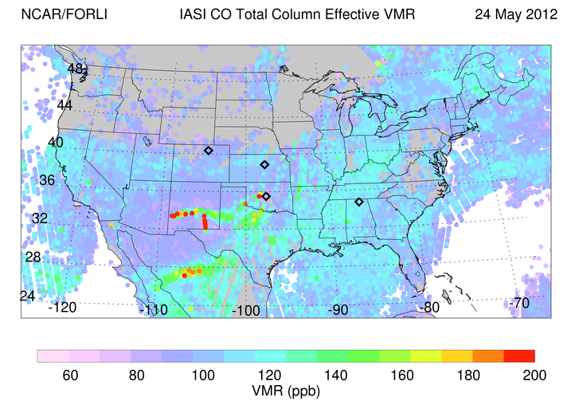
Chemistry Satellite Observations
NCAR/ACD
MOPITT CO – available within a day of overpass
IASI CO – about 4-day delay, global coverage 2x/day
Louisa Emmons

Slide 23
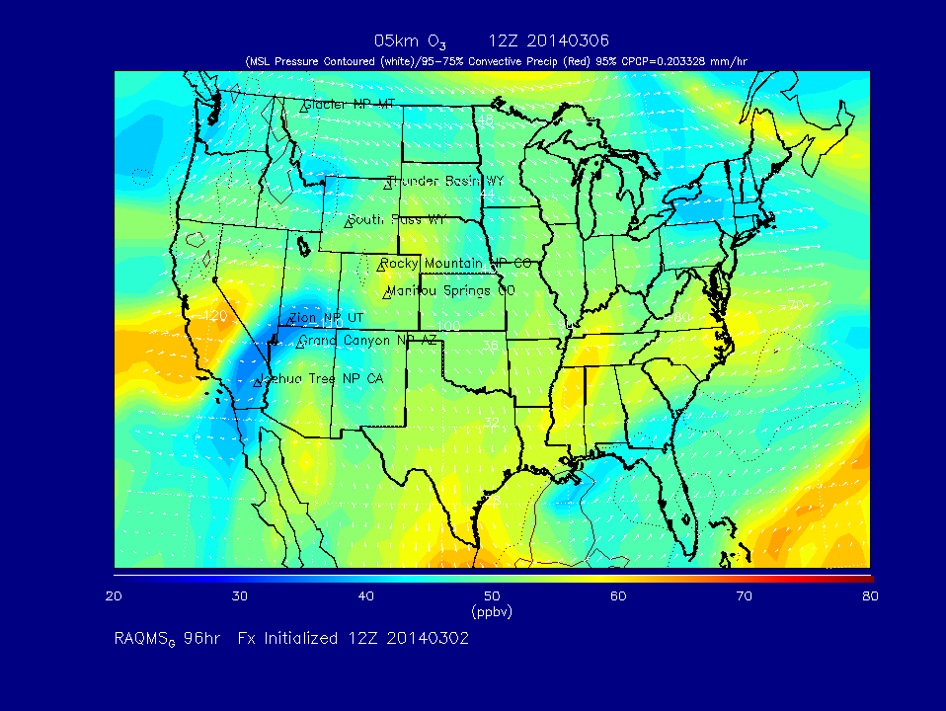
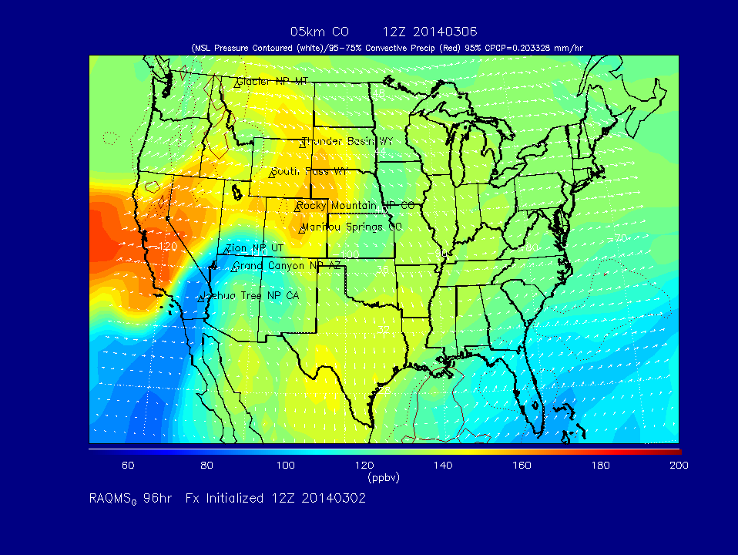
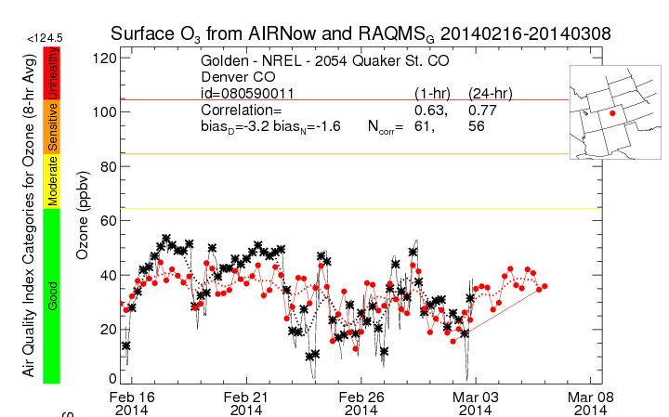
NOAA/NESDIS
Cooperative Institute for Meteorological Satellite Studies (CIMSS)
Real-time Air Quality Modeling System (RAQMS)
Global 1x1 degree on-line chemical and aerosol assimilation and forecasting system
Assimilation of MODIS aerosol optical depth, MLS stratospheric ozone profiles and OMI cloud cleared total column ozone
MODIS fire detection and Ecosystem/Severity dependent fire emissions
Real-time verification using US EPA AIRNow surface ozone and PM2.5 measurements
Currently used to initialize real-time 8km WRF-CHEM forecast (GOCART aerosol mechanism, http://raqms.ssec.wisc.edu/ ) and 13km RAP-chem forecast (RACM chemical and MOSAIC aerosol mechanisms, http://ruc.noaa.gov/wrf/WG11_RT/)
Brad Pierce

Slide 24
Forecasting weather and air quality with RAP-Chem
NOAA/ESRL
RAP-Chem = WRF-Chem on RAPid refresh (RAP) domain
Dx=13km, RAP is operational at NCEP with hourly forecast cycle (meteorology only)
Experimental RAP-Chem:
Includes gas-phase chemistry (O3), aerosols (modal approach), Secondary Organic Aerosols ( SOA, Volatility Basis Set approach)
Includes also wildfires, volcanic ash (if major eruption within North American Grid), dust, sea salt
Aerosol interaction with radiation (microphysics interactions may also be included)
Chemical boundary conditions from RAQMS or MACC – still to be decided
NEI 2011 emissions
Produce AQ forecasts and work towards improving weather forecasts
48-hr forecasts
Currently on display: O3 (various levels), Nox, CO, HCHO, PM25, OA, Precipitation. Three cross-sections. More possible.
Currently displayed on the WEB: full domain and zoomed in CONUS domain http://ruc.noaa.gov/wrf/WG11_RT/ ). More possible.
Georg Grell

Slide 25
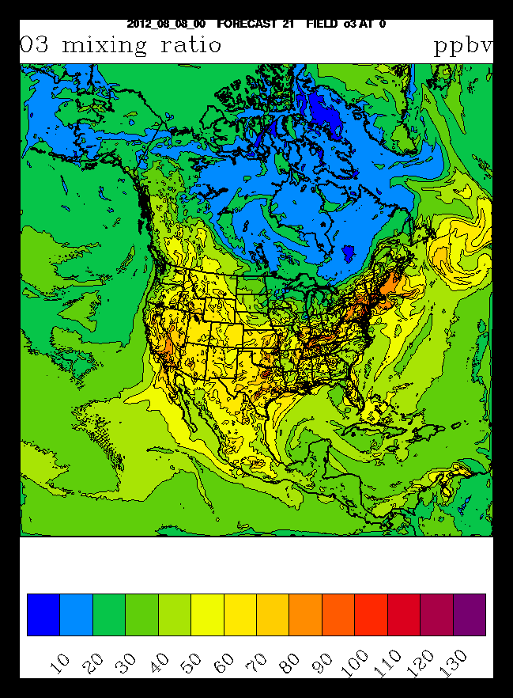
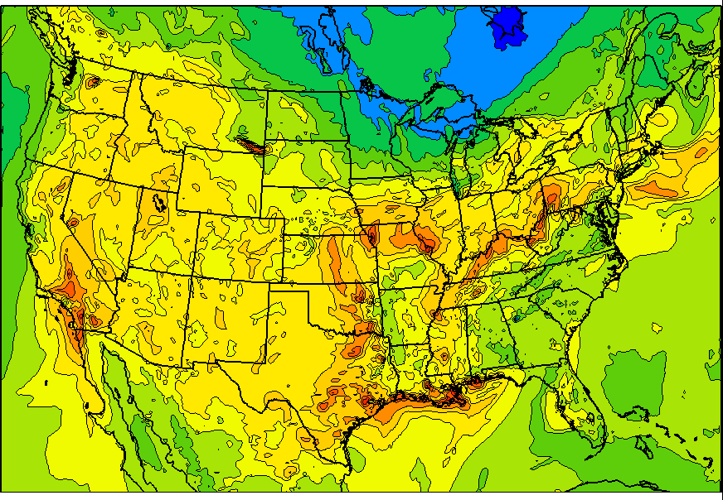
Basic domains, additional Colorado zoom would be possible
NOAA/ESRL
Full RAP domain
Example of CONUS zoomed domain
Ozone mixing ratio (ppbv)
Georg Grell

Slide 26
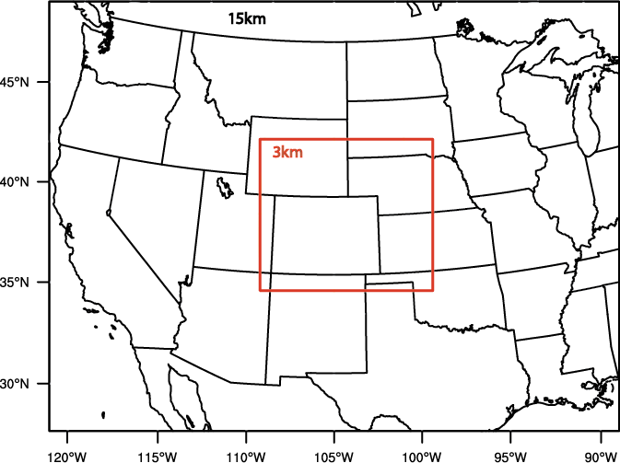
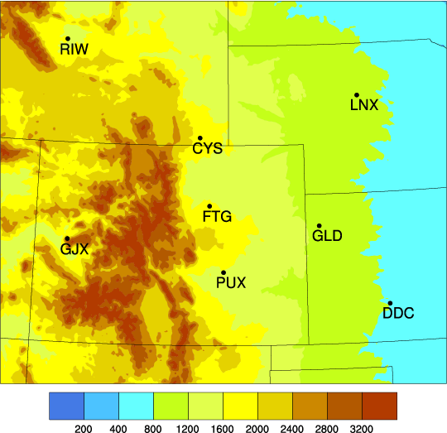
STEP - Short Term Explicit Prediction
Summary of DA/NWP systems
NCAR/RAL
Nested WRF domain
Outside systems:
NSSL (3DVar with radar DA, 1h UC*/12h fcst)
GSD/FAB (LAPS with radar DA, 1h UC/12h fcst)
UK MetOffice (UM-WRF, 6h UC/36h fcst)
Note:
- Each organization will run their own system
No extra resource required from NCAR
NCAR systems:
WRF 3DVar (no radar DA, 3h UC/12h fcst/1km)
WRF 3DVar (with radar DA, 1h UC/12h fcst)
WRF 4DVar (with radar DA, 3h UC/12h fcst)
RTFDDA (with radar DA, 3h UC/24h fcst)
* UC – Update Cycle
1km
CHILL
S-Pol
1km nowcast/hydro domain
Jenny Sun/David Gochis
3km radar DA domain

Slide 27
NCAR/RAL
Project Timeline
pre-operational
testing of each subsystem
Finalize domains
and configurations
of each subsystem
STEP hydromet
2014
(7 July – 15 August)
Integrated system testing
System
Installation
Feb Mar Apr May June July Aug
Yellowstone:
- Account
Dedicated cores
Disk space
Data transfer
Initial version of
web display
Finalize
web display
Data transfer and
Display of outside systems
Finish real-time
data flow for all obs.
Jenny Sun/David Gochis

Slide 28
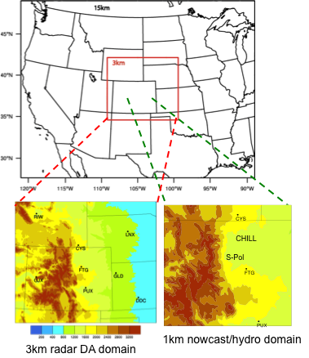
Anthropogenic tracer (NOx like) (area, non-road, point sources)
Mobile tracer (NOx like)
Oil & Gas tracer (ethane like)
Agricultural tracer (emission info needed)
NCAR/ACD
Suggested Tracers:
WRF-Chem Tracers
Add to 3km STEP Forecast
Inert with specified lifetime
Mary Barth/Gabriele Pfister

Slide 29
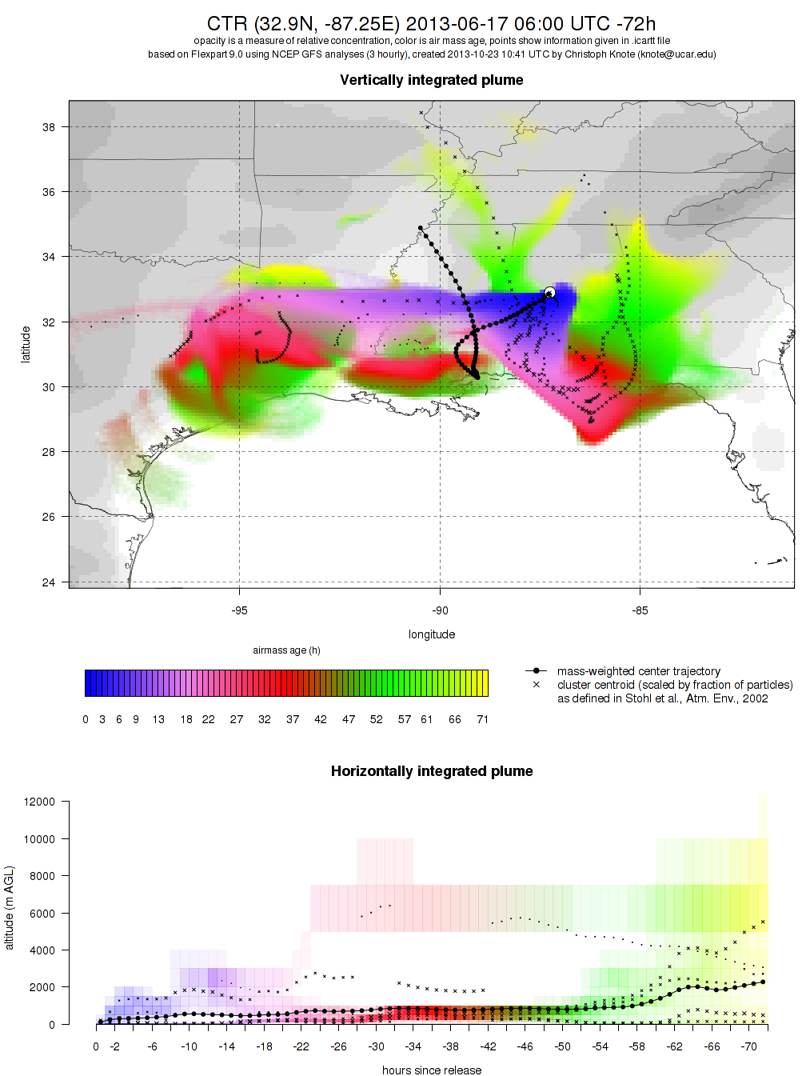
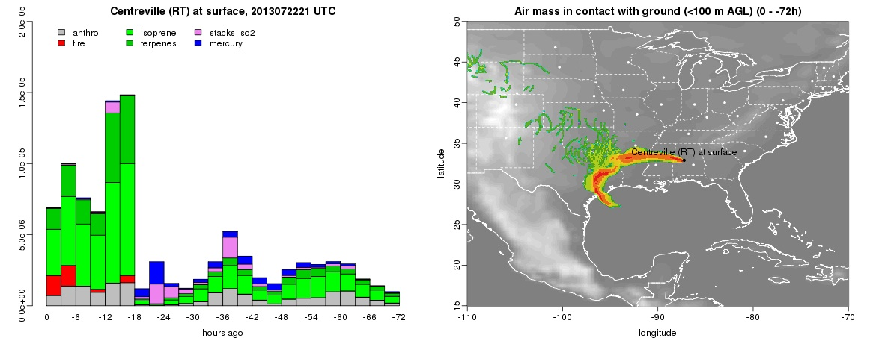
Lagrangian particle dispersion products with FLEXPART
NCAR/ACD
trajectories from ground stations / aircraft paths
forward and backward in time
based on GFS (global) and WRF (regional) model forecasts / analysis
can be convolved with emissions
deterministic trajectory trajectory clusters sensitivity maps
ICARTT/NetCDF/plots
airmass history and emissions loading
horizontal and vertical information
Christoph Knote/Rajesh Kumar

Slide 30
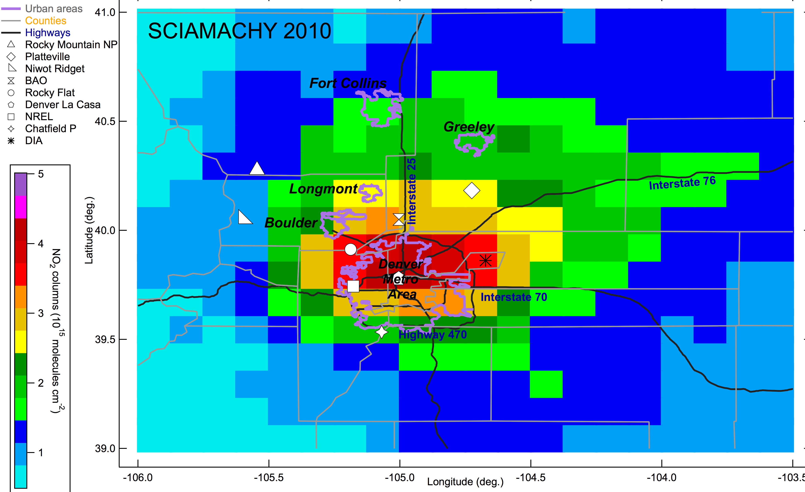
Satellite NO₂ Columns: May-Sep. 2010
Morning Orbit
NOAA
Si-Wan Kim, NOAA/ Andreas Richter, U. of Bremen

Slide 31
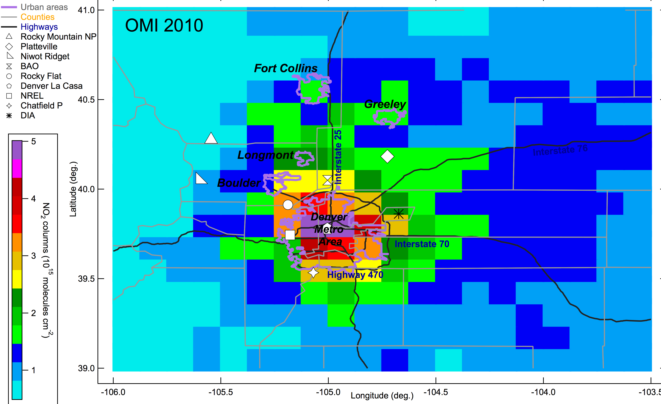
Satellite NO₂ Columns: May-Sep. 2010
Afternoon Orbit
NOAA
Si-Wan Kim, NOAA/ Andreas Richter, U. of Bremen

Slide 32
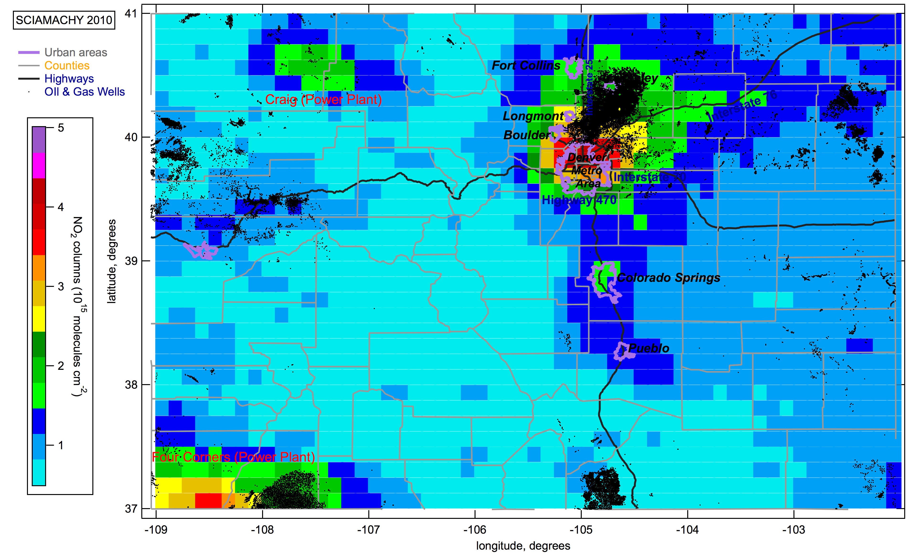
SCIAMACHY NO₂ Columns: May-Sep. 2010
Dots: Oil and Gas Wells
NOAA
Si-Wan Kim, Gabrielle Petron, Gregory Frost, NOAA

